Slide 1
The Parables of Jesus
Jesus Christ Course
Document # TX001251

Slide 2
The Parables of Jesus
The first ten slides will show an artistic depiction of Jesus’ parables.
Quietly study the image.
Use your memory or a Bible to determine what parable is being presented.
After some quiet reflection, name the parable.
As a class, recall as much of the parable as you can while still viewing the image.
What is the message of the parable? How does the artist portray the message of the parable?
What are the common elements between the images and the parables depicted?

Slide 3
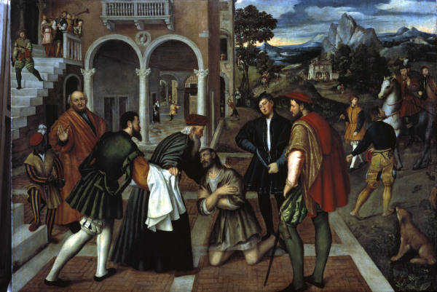
Image in public domain
Notes:
The Parable of the Prodigal Son
Luke 15:11–32

Slide 4
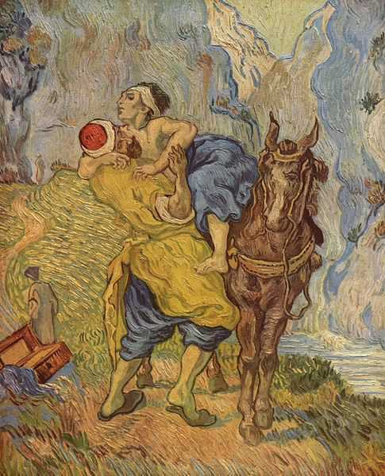
Image in public domain
Notes:
The Parable of the Good Samaritan
Luke 10:30–37

Slide 5
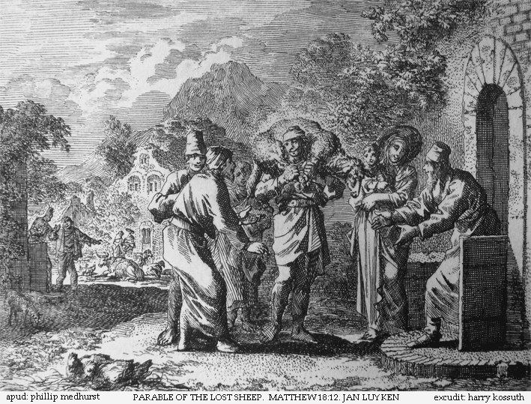
Image in public domain
Notes:
The Parable of the Lost Sheep
Matthew 18:12–14
Luke 15:3–7

Slide 6
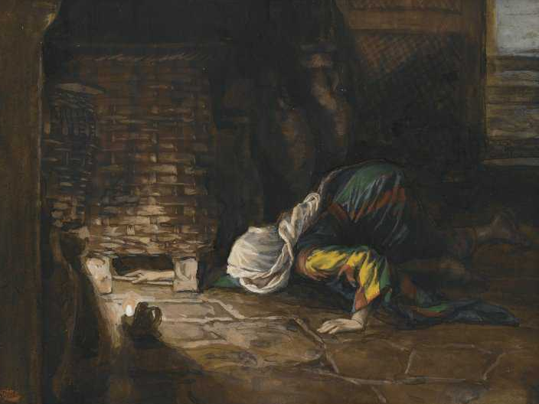
Image in public domain
Notes:
The Parable of the Lost Coin
Luke 15:8–10

Slide 7
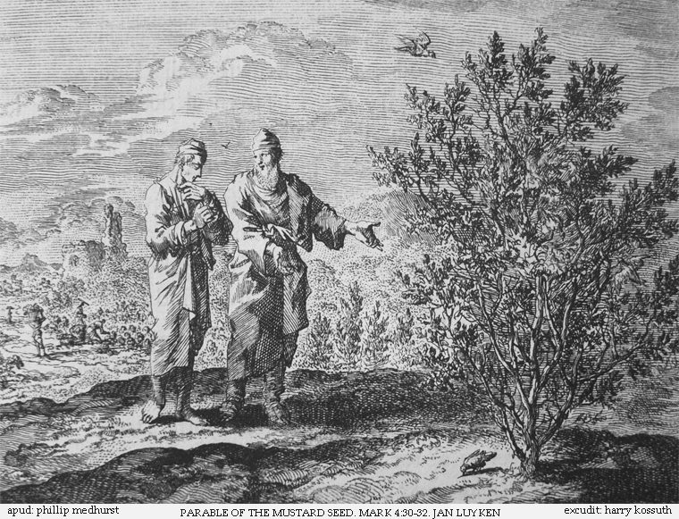
Image in public domain
Notes:
The Parable of the Mustard Seed
Matthew 13:31–32
Mark 4:30–32
Luke 13:18–19

Slide 8
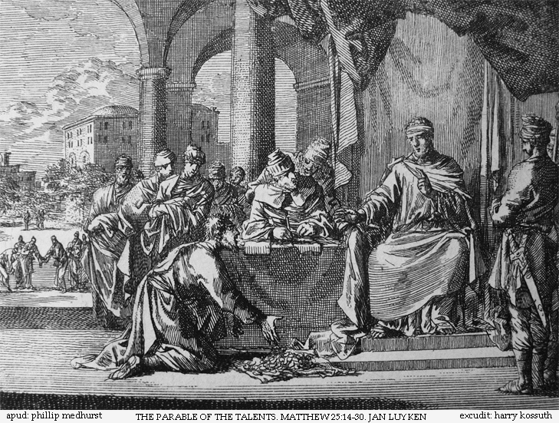
Image in public domain
Notes:
The Parable of the Talents
Matthew 25:14–30

Slide 9
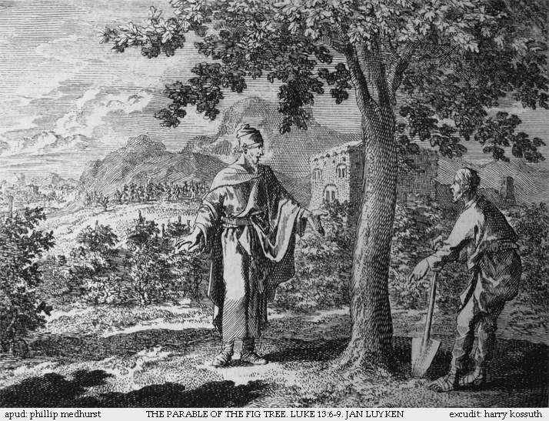
Image in public domain
Notes:
The Parable of the Fig Tree
Matthew 24:32–35
Mark 13:28–31
Luke 21:29–33

Slide 10
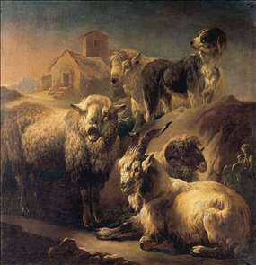
httpwww.free-stories.netimagessheepandgoatparable.jpg
Notes:
The Parable of the Sheep and the Goats
Matthew 25:31–46

Slide 11
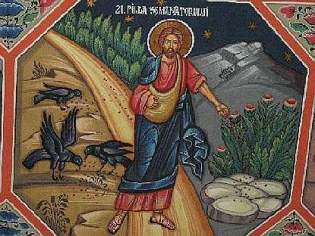
Image in public domain
Notes:
The Parable of the Sower
Matthew 13:3–8,18–23
Mark 4:3–9,14–20
Luke 8:5–8,11–15

Slide 12
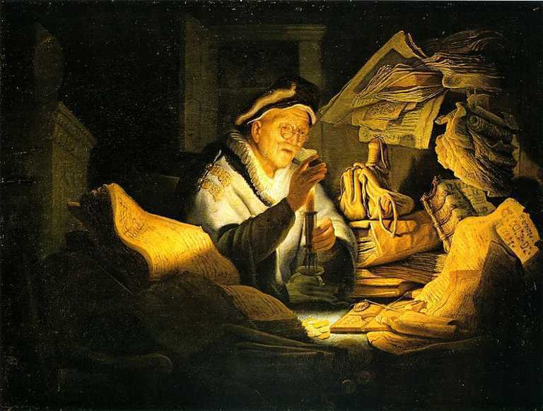
Image in public domain
Notes:
The Parable of the Rich Fool
Luke 12:16–21

Slide 13
Overview of Parables
A specific style of Jesus’ teaching
Narrative teaching, like storytelling: people are intended to hear the narrative and identify with the characters and the actions
Honored tradition among Judean people: parables passed on wisdom of the ancestors to the next generation
A well-crafted parable revealed injustice, led to repentance, and brought about change.

Slide 14
Definition of a Parable
A story that uses metaphors based on daily life to convey religious truths
Comes from the Greek word parabole, meaning “comparison”

Slide 15
Common or Core Elements of Parables
What are the common or core elements of Jesus’ parables?
Compare things.
Use elements from everyday life to relate to audience.
Contain a surprise twist to engage audience.
Describe God—God’s nature, qualities, or attributes.
Give examples of people’s relationships with one another.
Explain how God wants people to act, especially if they want to be a part of the Kingdom of Heaven.
Describe the Kingdom.

Slide 16
Importance of Parables
They describe God.
They describe God’s Kingdom.
They are an invitation to enter into the Kingdom of God.
They describe how God wants people to act, especially if they want to be a part of the Kingdom.
They are mirrors for people to see their behavior, especially what they need to change.
They are a concrete reality that confronts people with the choice to examine their priorities and make difficult choices.

Slide 17
The Parables of Jesus
Closing discussion:
What is your favorite or most memorable parable? Why?
What character in your favorite parable do you most relate to? Why?
Describe the overall message of the parable in your own words.
Notes:
Notes: If you do not have time or you wish to skip the closing discussion, consider using these questions as an exit handout for the students to complete before they leave class.

