Slide 1
Climate Change
Catholic Social Teaching
Document #: TX002033
Notes:
[Music: Introduction music such as “Peace Is Flowing like a River”]

Slide 2
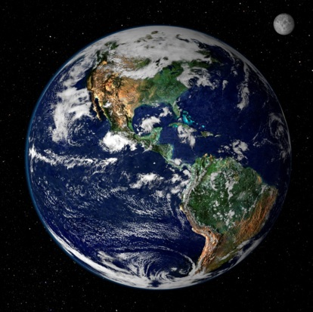
Climate Change
Climate change happens slowly and is not noticeable until after many decades.
Climate changes occur due to human activities and natural causes.

Slide 3
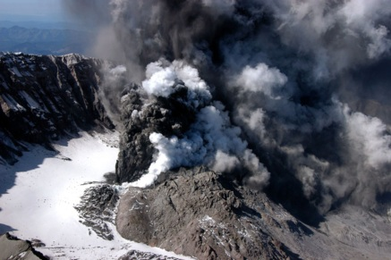
Natural Climate Change
Climate changes result from natural causes such as changes in ocean patterns, Earth’s orbit, volcanic eruptions, and the sun’s intensity.
Changes in Earth’s orbit affect the amount of sunlight absorption on Earth.
Differences in the sun’s intensity or the sun’s rays cause warmer weather with higher intensity or cooler temperatures with lower intensity, respectively.
Volcanic eruptions result in gas releases such as aerosol and carbon dioxide.

Slide 4
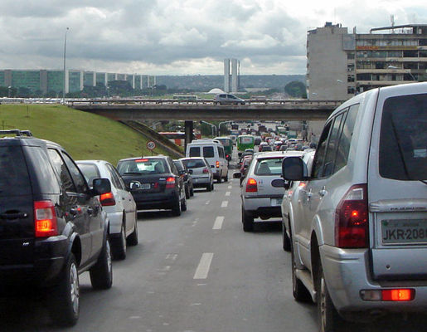
Human Activity and Climate Change
Human activities such as deforestation and the burning of fossil fuels change the atmosphere’s composition.
Human activities that release greenhouse gases lead to climate changes.
Human activity in the last century seems to have accelerated climate change.
Climate change caused by human activity is both a threat to creation and a symptom of damage to creation.

Slide 5
Effects of Climate Change
Climate change affects the environment and the ecosystem.
When the climate changes, farmers have a hard time adapting to the changes.
Changes in the weather can lead to droughts, changes in irrigation, water quality, and fish farming.

