Slide 1



Slide 2
Christian Morality
and Social Justice
Chapter A
The Bible: The Gospel of Matthew

Slide 3
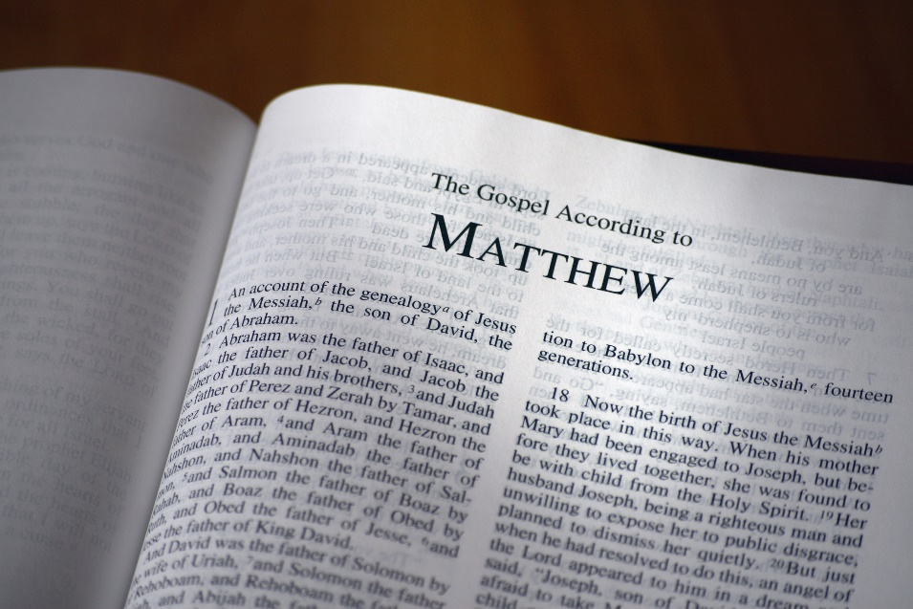
Chapter Summary The Bible: The Gospel of Matthew
In this chapter, you will discover the Gospel of Matthew. In this Gospel, the author links the Jewish Covenant and Law with the New Covenant and Law established by Jesus. In this Gospel, Jesus is the new Moses who proclaims God’s Law from the mountaintop (the Sermon on the Mount). The Gospel ends with the sending of Christ’s disciples, the foundation of the Church, to carry the Good News of salvation into the whole world.
© Vibelmages/www.shutterstock.com

Slide 4
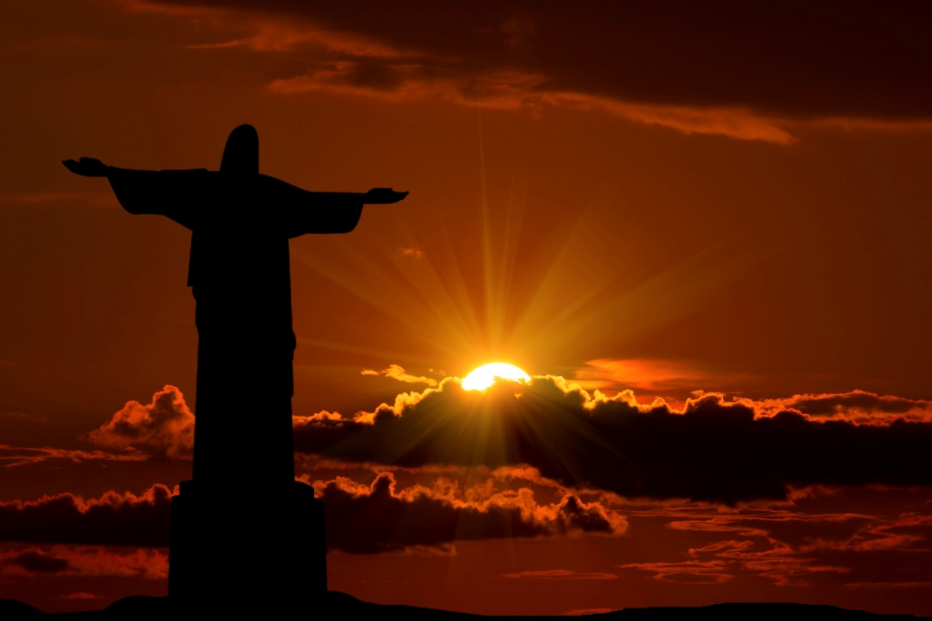
“Jesus, Messiah for the World” (Matthew 1:1–17, 2:1–12)
In Matthew’s Gospel, Jesus is the Messiah who springs from within God’s people (the ancestors of Christ) yet is destined to be the Savior of the whole world (symbolized by the Magi).
© artphotoclub/www.shutterstock.com

Slide 5

“Jesus, Messiah for the World” (Matthew 1:1–17, 2:1–12)
Activity: “The House of David”
If you use Breakthrough! The Bible for Young Catholics, read about the ancestor of Jesus assigned to your group, located in the color inserts:
Group 1: Abraham
Group 2: David
Group 3: Ruth
Group 4: Mary
Then answer these questions about the ancestor:
What was the title or position in life of this ancestor (king, widow, and so on)?
What did this person do that was noteworthy?
What do we know of this person’s character?
What good quality in this person reminds you of Jesus?
© GmbH/www.shutterstock.com

Slide 6
“Jesus, Messiah for the World” (Matthew 1:1–17, 2:1–12)
The Gospel of Matthew begins with the ancestors of Jesus, so that its Jewish Christian readers would know that Jesus was a descendant of their spiritual father, Abraham, and of the house and line of famous King David.

Slide 7
“Jesus, Messiah for the World” (Matthew 1:1–17, 2:1–12)
Jesus’ ancestors include both Jews and Gentiles. Ruth was a Gentile who married into a Jewish family.
The Wise Men, or Magi, teach us that the Messiah came not just to the Jews but also to the Gentiles. The Wise Men found God through their observations of the natural world.

Slide 8
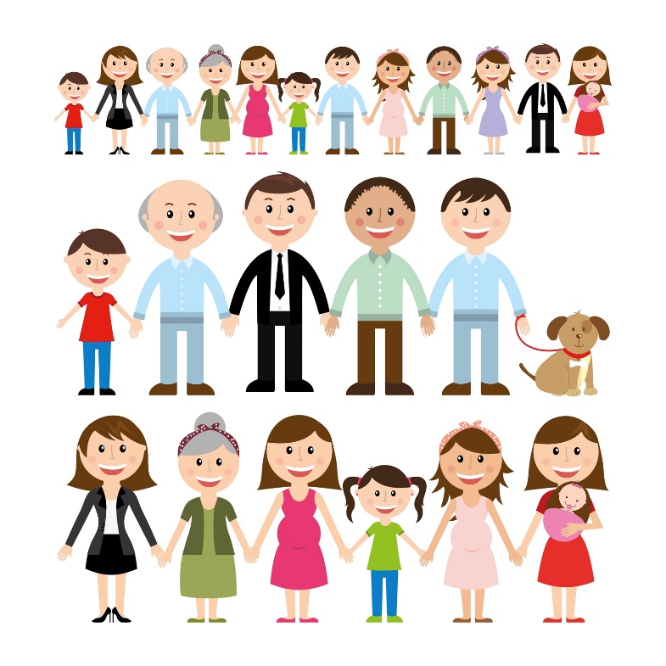
“Jesus, Messiah for the World” (Matthew 1:1–17, 2:1–12)
Practice It!
Journal or write one paragraph about why ancestors are important:
What do ancestors tell us?
What do Jesus’ ancestors tell us about Jesus?
How do they help us to understand Jesus better?
© johavel/www.istockphoto.com

Slide 9

“Jesus’ Teaching Meets Opposition” (Matthew 12:15–21,13:53–58,15:1–9)
Jesus’ teaching was opposed by the Jewish leaders.
© igor.stevanovic/www.shutterstock.com

Slide 10
“Jesus’ Teaching Meets Opposition” (Matthew 12:15–21, 13:53–58, 15:1–9)
Jesus was sent by the Father to reveal the truth. He is God’s Chosen Servant.
Jesus’ teaching was ignored and rejected by the leaders of the people.
In this Gospel, Jesus invites us to listen to his teaching and seek to follow it, so that our words and actions may always express the truth.

Slide 11

“Jesus’ Teaching Meets Opposition” (Matthew 12:15–21, 13:53–58, 15:1–9)
Activity
Silently read Matthew 15:1–9.
Then respond to the following statements on paper:
Name one rule in your family that you consider to be a very important rule to keep in your life.
Name one teaching of Jesus that you consider very important to follow.
What does this passage (Matthew 15:1–9) emphasize?
© carmen2011/www.shutterstock.com

Slide 12

“Jesus’ Teaching Meets Opposition” (Matthew 12:15–21,13:53–58,15:1–9)
Ten Commandment Challenge!
© KlaraDohnalova/www.shutterstock.com
How many of the Ten Commandments can you name? Pair up with the person next to you and compile a list. You have 5 minutes!

Slide 13
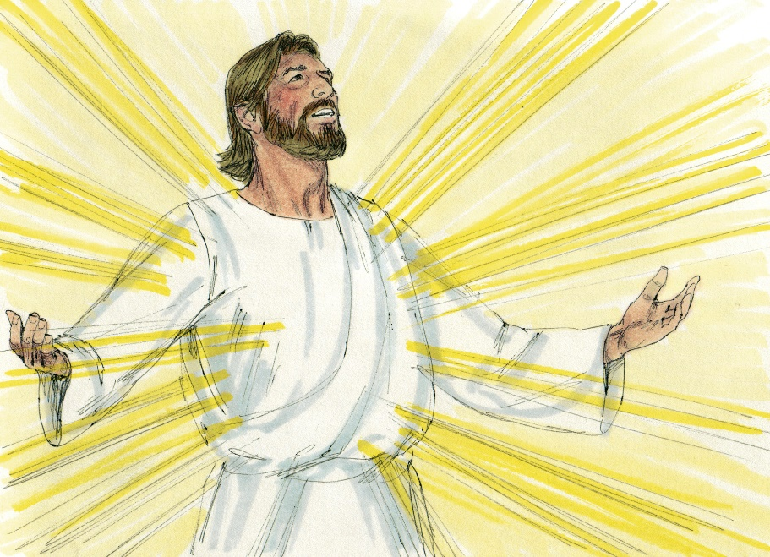
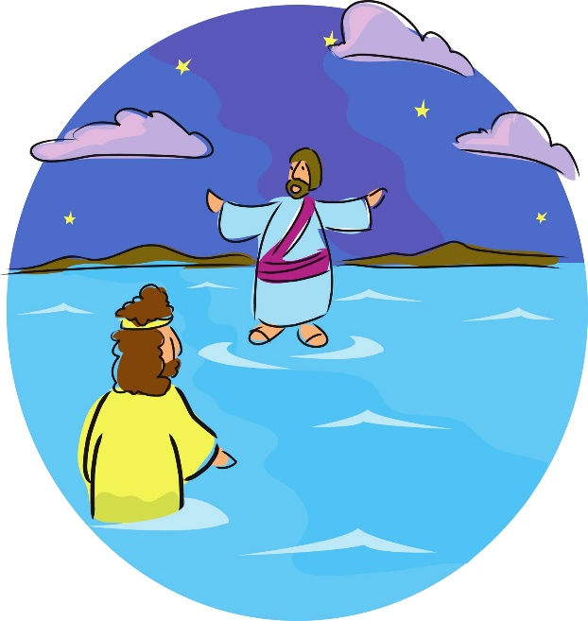
“Jesus, Human and Divine”
(Matthew 14:22–32, 17:1–9)
© BibleArtLibrary/www.istockphoto.com
© RobandJenniferChristianson/www.shutterstock.com
Jesus is shown to be both
human and divine, as witnessed by his Transfiguration
and his miracles.

Slide 14
“Jesus, Human and Divine”
(Matthew 14:22–32, 17:1–9)
Matthew’s Gospel begins with an account of the human origins of Jesus—his ancestry and his birth in Bethlehem.
This Gospel also contains two events showing the divine nature of Jesus: the Transfiguration of Jesus and Jesus’ walking on water.
Because Jesus is both human and divine, he understands our human situation and has the divine power to help us.

Slide 15
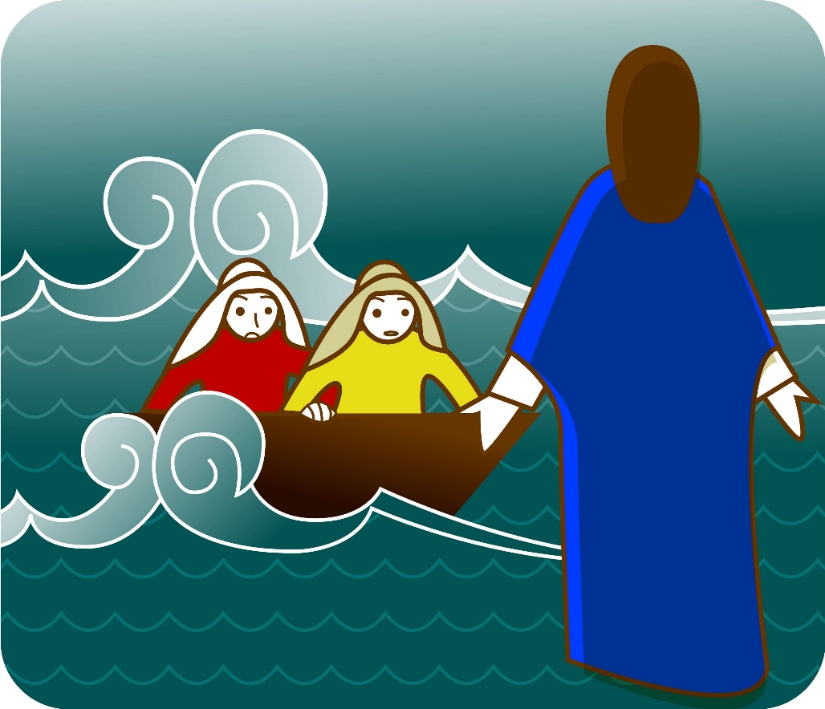
“Jesus, Human and Divine”
(Matthew 14:22–32 and 17:1–9)
Activity
1. You will be assigned the letter A or the letter B.
2. Here is what the letters mean:
Letter A: Peter’s Faith
Letter B: Peter’s Doubt
3. Read Matthew 14:22–32.
4. Gather into two groups
(As and Bs).
© wizdata1/www.shutterstock.com

Slide 16

“Jesus, Human and Divine”
(Matthew 14:22–32, 17:1–9)
Letter A:
Make a list that answers the question, After reading about Peter’s faith, what comparisons can we make to our own faith in Jesus?
Letter B:
Make a list that answers the question, After reading about Peter’s doubt, what can we do if we start doubting?
© simmosimosa/www.istockphoto.com
One person from each group should share the list their group made.

Slide 17
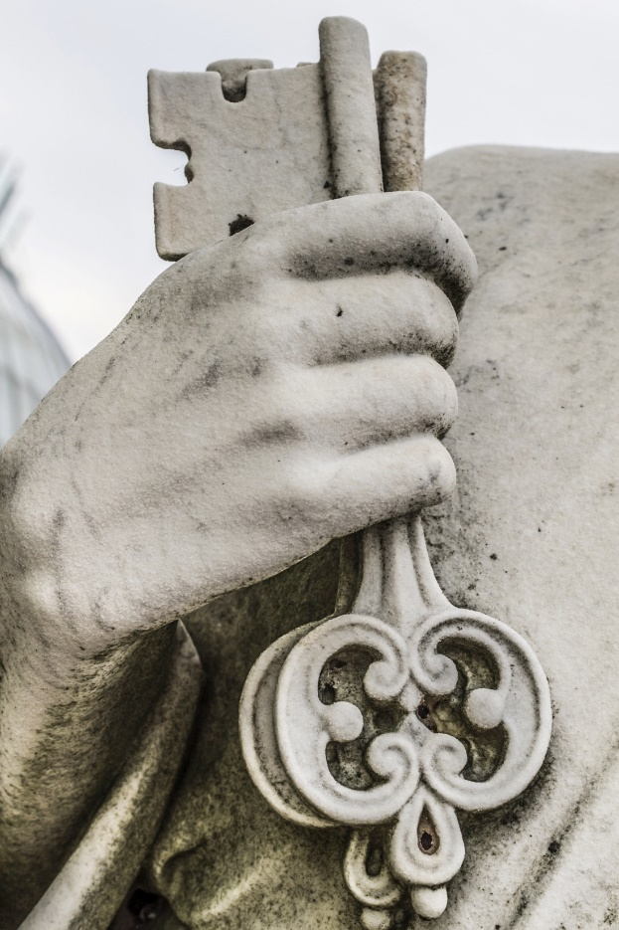
“Jesus Sends Us Out to the World”
(Matthew 16:13–19, 28:16–20)
Jesus declares that Peter is the foundation of the Church,
and sends us, his Church, into the world with a message of love and salvation.
© BildagenturZoonarGmbH/www.shutterstock.com

Slide 18
“Jesus, Human and Divine”
(Matthew 14:22–32, 17:1–9)
Because Peter was given insight into who Jesus is, Jesus gave him the mission of being the “rock,” or foundation, of the Church.
Jesus also gave Peter (formerly known as Simon) his name, which means “rock.” Peter and his successors would be the foundation of the Church. Peter was the first leader of the Church, the first Pope. All the popes who came after him have the responsibility of leading and guiding the Church.

Slide 19
“Jesus, Human and Divine”
(Matthew 14:22–32, 17:1–9)
After his Resurrection, Jesus gave the mission of evangelization to the entire Church. The Church is to go out to all peoples to teach the message of Jesus and to baptize new believers. We are part of this mission!

Slide 20
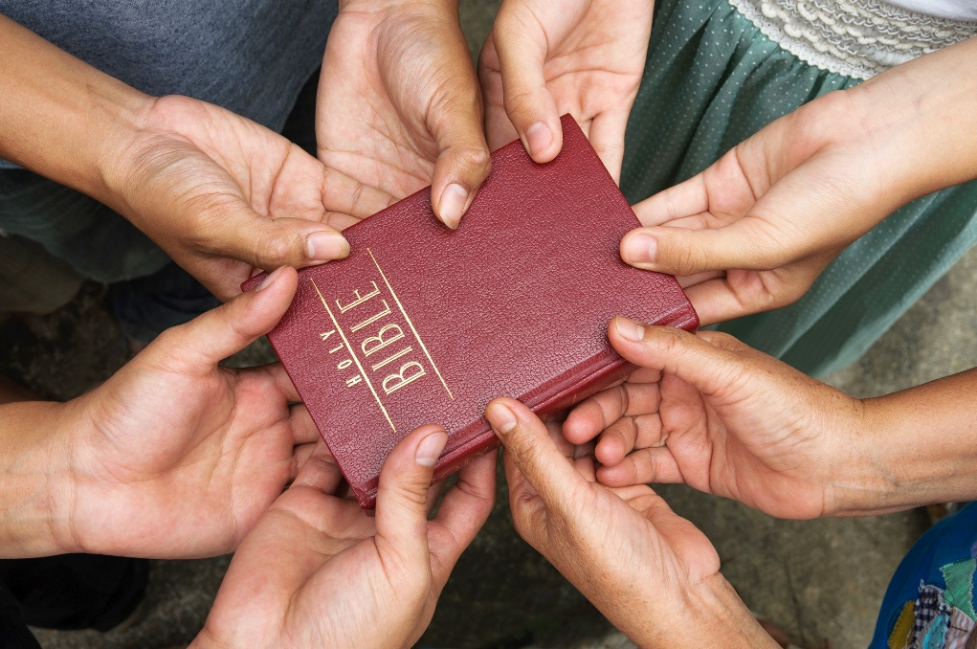
“Jesus, Human and Divine”
(Matthew 14:22–32, 17:1–9)
Evangelize: to bring the Gospel to others
Activity:
Put “children of the world” into a search engine and search for images.
Make a few presentation slides with the images you find.
Include the following:
a picture and how you feel we can evangelize to the children
a final slide that shares ideas of how to evangelize in our world today
© somchairakin/www.shutterstock.com

