Slide 1
Document #: TX005847

Slide 2
The Prophets, Jesus Christ, and the Holy Spirit
Chapter F
The Bible: The Gospel of Mark

Slide 3
Chapter Summary
This chapter will explore the life and teachings of Jesus according to the Gospel of Mark.
Mark focuses on the public ministry of Jesus.
The Gospel begins with the baptism of Jesus, after which Jesus almost immediately calls disciples to himself and begins to teach and heal. Jesus teaches about the Kingdom of God, revealing his true self and his mission.
Ultimately, Jesus is misunderstood, betrayed, mocked, and crucified, yet he imparts renewed hope through the Resurrection.

Slide 4
Off and Running (Mark, chapter 1)
Name a musician, band, actor, or sports figure who became an “overnight sensation.”
What happened to make the person so famous?
What is the latest video to go “viral”? What makes this video so interesting?
© PopTika/Shutterstock.com

Slide 5
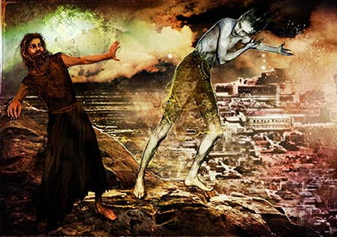
Jesus’ Ministry
Mark presents Jesus as an “overnight sensation.”
Jesus was baptized by John the Baptist and began his public ministry soon after.
After being tempted by Satan, Jesus called fishermen Simon, Andrew, James, and John to follow him and be his disciples.
Jesus healed many who were sick with all kinds of diseases and drove out many demons.
© Odessa Sawyer / Saint Mary's Press

Slide 6
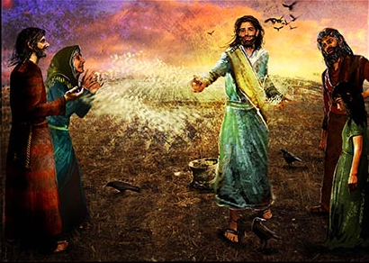
Jesus Teaches about the Kingdom (Mark 4:1–34)
Jesus taught his disciples the Parable of the Sower and its meaning.
Jesus explained the importance of parables as a teaching method.
Jesus taught his disciples that Kingdom of God is mysterious. It starts very small but will grow very large.
© Odessa Sawyer / Saint Mary's Press

Slide 7
Share It!
What’s the largest plant you or your family have ever grown?
Have you ever planted grass, or another plant in a milk carton?
How did it feel to watch it grow?
What does a plant really need to grow well?
© Sofiaworld/Shutterstock.com

Slide 8
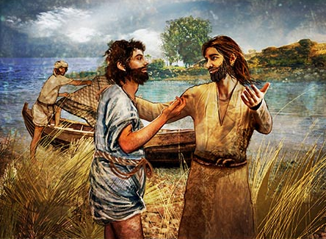
Who Do You Say I Am? (Mark 8:27–38)
Peter boldly proclaimed that Jesus is the Messiah.
Even though he was right, Jesus told Peter he still didn’t completely under- stand what it means to be the Messiah.
© Odessa Sawyer / Saint Mary's Press

Slide 9
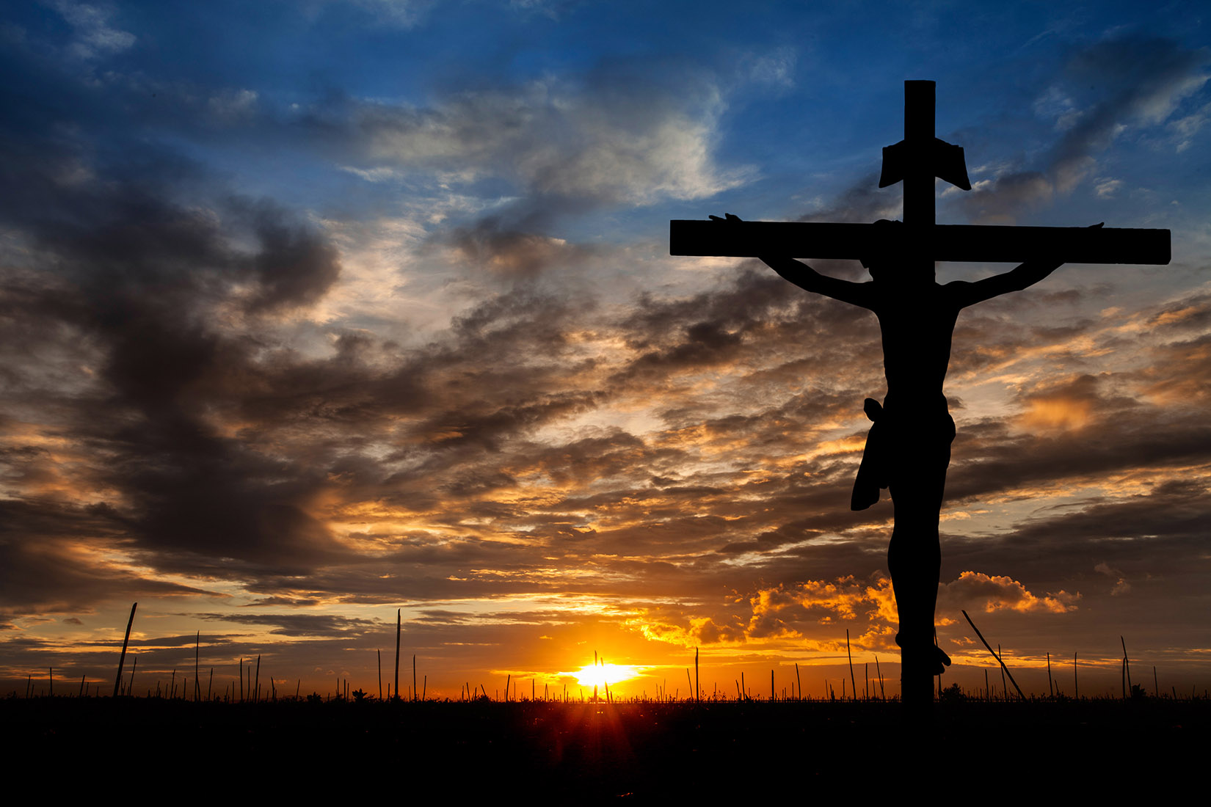
Think About It!
Jesus tells his disciples that he must suffer and die and that discipleship will be difficult.
In today’s world is it still difficult to be a follower of Jesus? Why or why not?
© Golfmhee/Shutterstock.com

Slide 10
Journal It!
Imagine Jesus facing you and asking, “Who am I in your life? What questions do you have for me?”
Write down what you would say to him in response.
© Golfmhee/Shutterstock.com

Slide 11
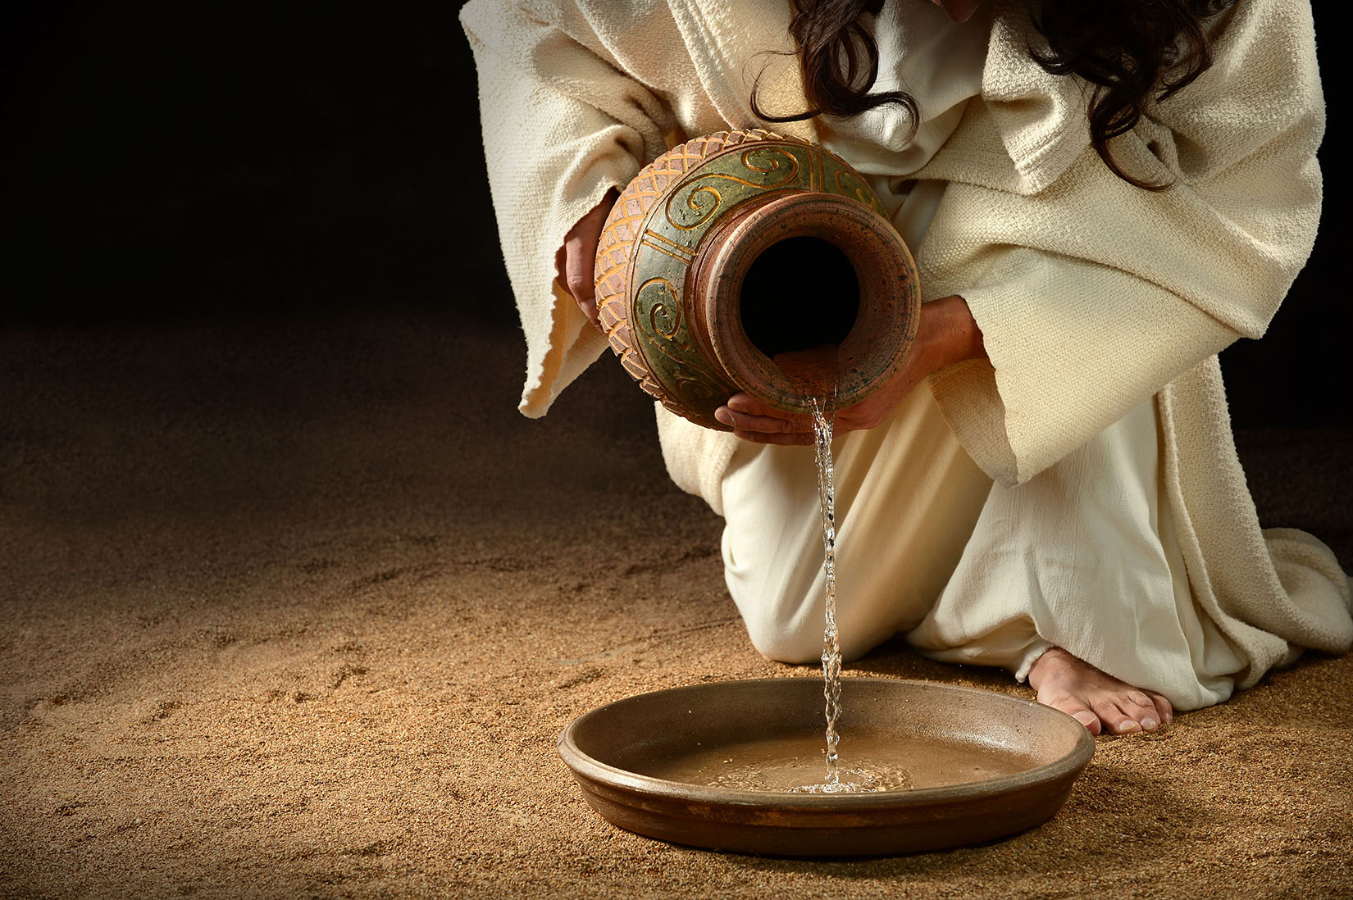
Imperfect Disciples (Mark 9:33–37, 10:35–45)
The disciples of Jesus did not always understand Jesus or his teachings.
The disciples sometimes fought over status and wanted places of privilege.
Jesus reminded his disciples that, just as he had come to serve others, they were called to do the same.
© Gino Santa Maria / Shutterstock.com

Slide 12
Share It!
What are some ways that you can follow Jesus’ example to love and serve others?
© Monkey Business Images / Shutterstock.com

