Slide 1
Chapter 14: Islam
World Religions: A Voyage of Discovery
DOC ID #: TX003951

Slide 2
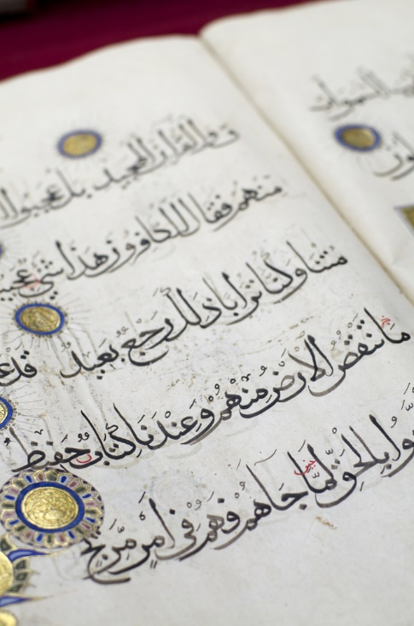
The Qur’an
It is believed to have been verbally revealed to Muhammad.
Speaking in the first person, it sets forth God’s will for humanity.
It is the world’s most read and most memorized book.
© prostok / www.shutterstock.com
Notes:
Notes: The Qur’an is about two-thirds as long as the New Testament. It is generally thought to be poetically brilliant and pleasing to the ear; it is oftentimes recited and not just read. The Qur’an also is commonly produced, as shown on this slide, in impressive Arabic script, sometimes with decorative features. (See the next slide, on calligraphy.)

Slide 3
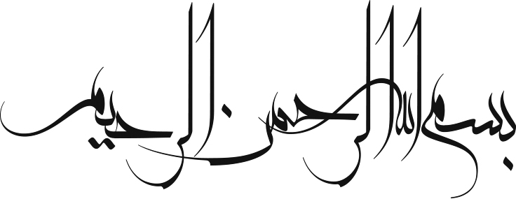
Celebrating Allah with Calligraphy
The Arabic phrase Bismillah means “in the name of God.”
Out of respect for the extreme sacredness of Allah, Muslims do not create artistic depictions.
Calligraphy and other art forms are utilized instead to celebrate the divine.
© emran / www.shutterstock.com
Notes:
Notes: There is no better way for the students to acquire understanding of Islamic theology than reading from the Qur’an, just a little bit of which will make clear the great emphasis on the dual character of God as on one hand merciful, and on the other hand the unwavering judge who will determine every individual’s fate on the Day of Doom (or Day of Judgment). Along with strict monotheism, Islam also holds to belief in angels and demons, or jinn. The angel Gabriel, Jibril in Arabic, pronounced to Muhammad that he had been called by God to be a prophet. Muslims believe that there have been a great many prophets, including the biblical figures Noah, Abraham, Moses, and Jesus.

Slide 4
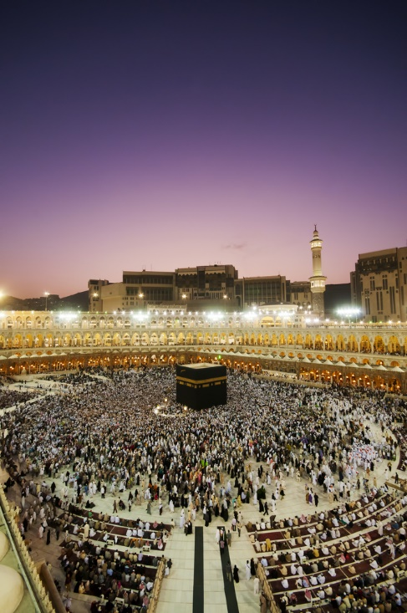
Umma: The Muslim Community
Unity is shown through circumambulation of the Ka‘ba during the hajj.
Other events also unite Muslims and nurture community, such as praying on five specific occasions each day, and for men, gathering at a mosque on Fridays to pray together.
© AHMAD FAIZAL YAHYA / www.shutterstock.com
Notes:
Notes: (There is more on the hajj accompanying slide 9.) One of the features about the hajj that is commonly cited by those who have made the pilgrimage is the sense of unity and lack of economic, social, ethnic, or other forms of stratification, brought about in part by the wearing (by men) of the ihram, two simple pieces of white cloth. Ihram is also a state of being, devoid of any signifiers of stratification.

Slide 5
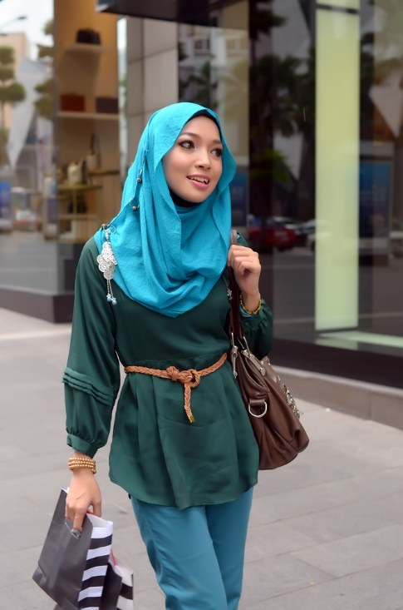
Wearing the Veil
Muslim women typically are veiled when doing activities like shopping.
Wearing of the veil, called hijab in Arabic, is based in part on the Qur’an.
The interpretations of those teachings can vary widely.
© dboystudio / www.shutterstock.com
Notes:
Notes: Some Islamic cultures or regimes, for example, the Taliban in Afghanistan, impose extremely strict regulations on women and how they dress. In other places, the rules are far more liberal. Verses in the Qur’an that refer to modest dress for women include 24:30–31 and, especially, 33:53,59.

Slide 6
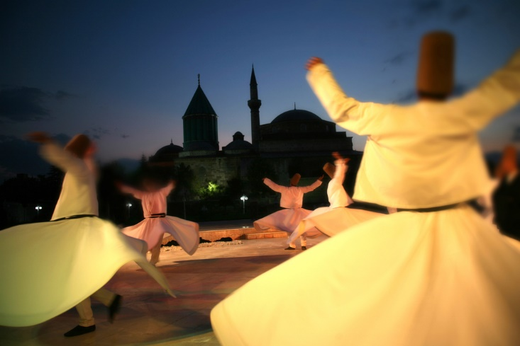
Sufism: The “Whirling Dervishes”
Sufism employs various techniques to enhance spiritual awareness.
One category is dhikr, “recollection” of God, to the point that the Sufi loses awareness of himself.
The dancing performed by the Mevlevi Order, also known as the whirling dervishes, is a form of dhikr.
© mehmetcan / www.shutterstock.com
Notes:
Notes: A resource in video format that nicely captures Sufism and includes consideration of the Mevlevi Order is Huston Smith’s Islamic Mysticism: The Sufi Way, (30 minutes, 1999), an excerpt from which is included in the Wisdom of Faith: Islam PBS interview with Bill Moyers. Much more could be incorporated into a class session that reveals some more about Sufism, ranging from historical analysis to more consideration of cultural forms, such as the poems of Rumi or Rabi’a.

Slide 7
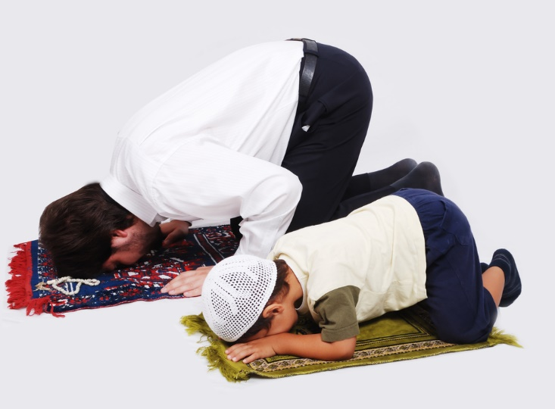
Salat: Prayer
Prayer is one of the Five Pillars of Islam and the most important daily ritual activity.
Muslims pray five times per day at specific times.
On Fridays men gather together at a mosque for prayer led by an imam.
© Zurijeta / www.shutterstock.com
Notes:
Notes: Muslims always pray in the direction of Mecca and typically use prayer mats to help maintain purity. The call to prayer (adhan) by the muezzin is one of the most recognizable and memorable aspects of Islam culture; it might be worthwhile to play a recording. The cycles of movements and recitation of prayer are called raka. The specification of five as the required number of times to pray per day is not in the Qur’an (although prayers are mentioned on occasion), but is related in the hadith literature’s account of Muhammad’s miraculous night journey to heaven (called the miraj; see slide 12 for more information on this). Muhammad is said first to have been told by God that everyone is to pray fifty times per day. Per the advice of Moses, Muhammad went back to God, who eventually agreed on the lower number of five, stating that each round of prayer would count for ten.

Slide 8
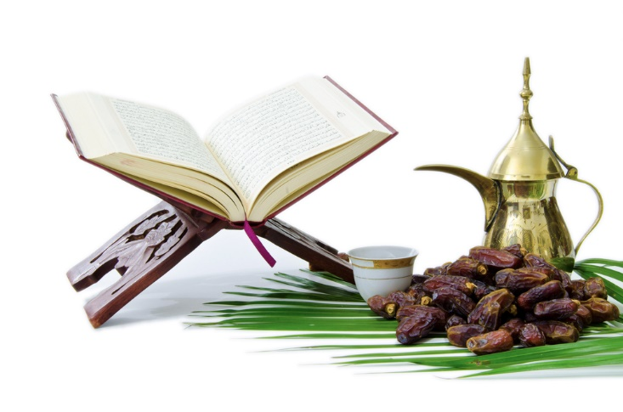
Ramadan: Fasting and Special Meals
Sawm, fasting during the month of Ramadan, is one of the Five Pillars.
From dawn to sundown, adult Muslims are to refrain from eating and drinking.
At the evening breaking of the fast, dates are often eaten first.
© Rahhal / www.shutterstock.com
Notes:
Notes: Those unable to perform sawm are free from these obligations. The preference for dates relates to Muhammad’s practice of eating dates when breaking the fast. Ramadan occurs during the ninth month of the Islamic lunar calendar (and therefore shifts through the year according to the solar-based calendar). The end of Ramadan is celebrated by the important holiday Id al-Fitr, the Feast of Fast-Breaking.

Slide 9
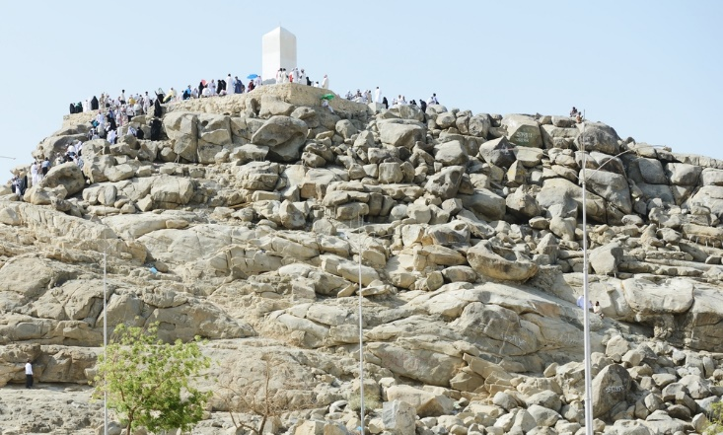
Muslims on the Hajj
The hajj, pilgrimage to Mecca during Ramadan, is to be undertaken by every Muslim who is physically and financially able.
During the hajj, specific rituals are performed.
One such ritual is journeying to the plain of Arafat.
© Zurijeta / www.shutterstock.com
Notes:
Notes: The rituals of the hajj involve locations of historical importance. The journey to the plain of Arafat, pictured on this slide, commemorates the faith of Abraham, who, according to Islam, at this site was ready to sacrifice his son Ishmael. (Jews and Christians, per the Book of Genesis, consider this son to have been Isaac.) The hajj takes place during the last month of the Islamic lunar calendar.

Slide 10
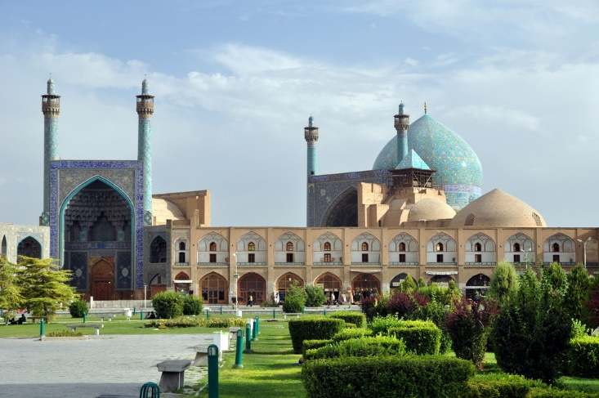
Shah Mosque, Isfahan, Iran
Any place designated for prayer is a mosque (masjid in Arabic).
Many mosques are quite simple in design; others are architecturally and artistically extraordinary.
The Shah Mosque in Isfahan was built in the seventeenth century.
© Matej Hudovernik / www.shutterstock.com
Notes:
Notes: (The following slide presents Sultan Ahmed Mosque, another extraordinary example.) The Shah Mosque was built during the period of the Safavid empire (1501–1722). All mosques provide a space for prayer, and most provide facilities for ritual purification through ablution of the face, hands, and feet (shoes are not worn inside of a mosque). Most mosques also contain a mihrab, a niche positioned to indicate the direction toward Mecca, which is the direction Muslims face when praying.

Slide 11
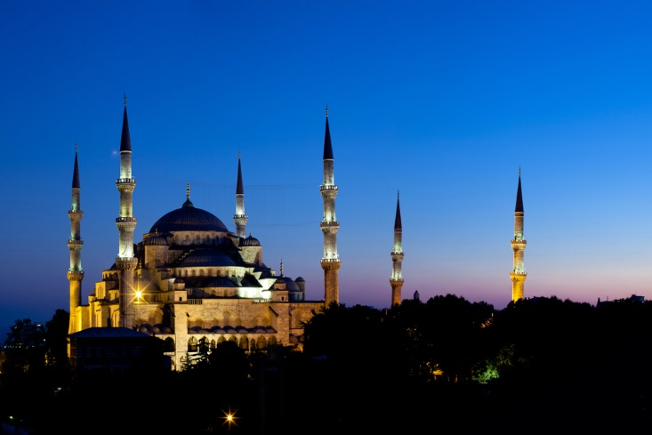
Sultan Ahmed Mosque, Istanbul
This mosque is also known as the Blue Mosque because of its interior decoration.
It is one of the most impressive architectural achievements of the Ottoman empire (1281–1924).
© VanHart / www.shutterstock.com
Notes:
Notes: Istanbul, before it was conquered by the Ottoman empire in 1453 and became its capital city, had been known as Constantinople, named for the Roman emperor Constantine the Great, who reigned from 306 to 337. Along with this mosque, Istanbul is home to the Hagia Sophia, built during the reign of Byzantine emperor Justinian, who reigned from 527 to 565. The Hagia Sophia is considered to be perhaps the greatest Byzantine architectural achievement. When Constantinople fell, the icons adorning the interior of Hagia Sophia were whitewashed and the building was converted into a mosque. Today it maintains museum status.

Slide 12
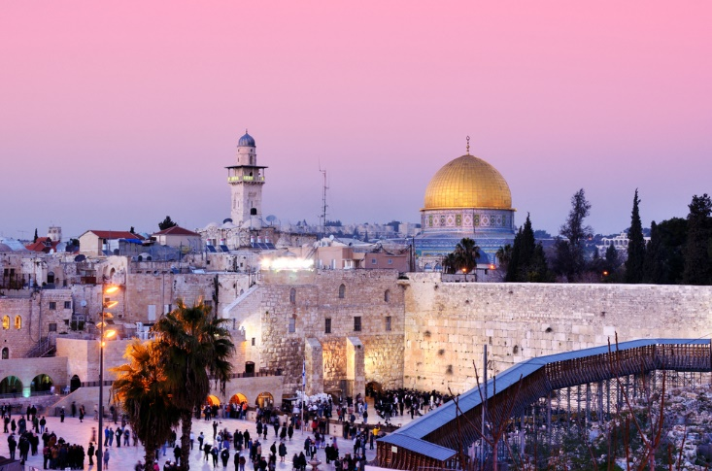
Dome of the Rock, Jerusalem
The Qur’an and other sources tell of a miraculous night journey undertaken by Muhammad.
The Dome of the Rock was constructed in 691 to commemorate this event.
It is on the Temple Mount, the former site of the Jerusalem Temple.
© SeanPavonePhoto / www.shutterstock.com
Notes:
Notes: Muhammad, at the beckoning of the angel Gabriel, was transported from Mecca to Jerusalem and from there up through the various levels of Heaven, eventually encountering God. The Arabic name for Muhammad’s ascension to Heaven is miraj. It is an especially significant event for Sufis, who consider Muhammad because of this experience to have been endowed with special spiritual knowledge. The Qur’an (17:1) mentions the miraj, but much more elaborate accounts are set forth in the hadith literature (whence the story about God agreeing to limit the number of daily prayers to five, noted on slide 7). The presence of the Dome on the Rock and its specific location on the Temple Mount are significant factors with regard to political controversy concerning the city of Jerusalem.

Slide 13
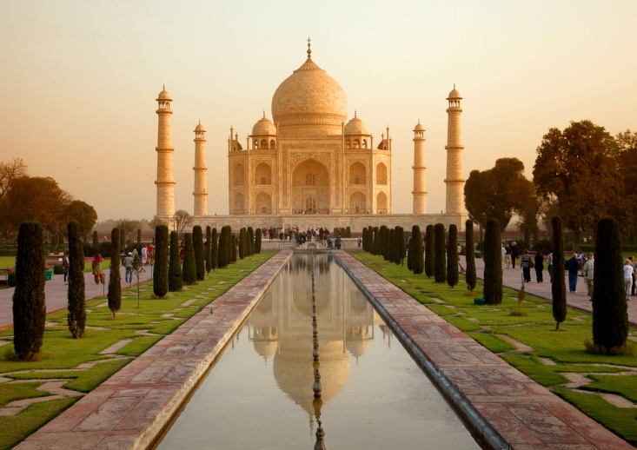
Taj Mahal, Agra, India
The most recognizable example of Islamic architecture worldwide is not a mosque, but a mausoleum.
It was built by the Mogul ruler Shah Jahan, who reigned from 1628 to 1658, in memory of his beloved wife Mumtaz Mahal.
© Rechitan Sorin / www.shutterstock.com
Notes:
Notes: The Taj Mahal is a masterpiece of Mogul architecture and is generally considered to be one of the world’s most beautiful buildings, drawing throngs of visitors year round. Mumtaz Mahal died in 1632 when giving birth to the couple’s fourteenth child. In addition to the Taj Mahal, the reign of Shah Jahan saw the production of the Shah Jahan on the Peacock Throne (c. 1635, attributed to Govardhan), an exquisitely crafted opaque watercolor painting. The Peacock Throne itself, which took seven years to complete, contained lavish jewels and became legendary even during the emperor’s reign. In general, the reign of Shah Jahan was the apex of Mogul greatness, a time of peace, prosperity, and spectacular architectural and artistic achievements such as these.

