Slide 1
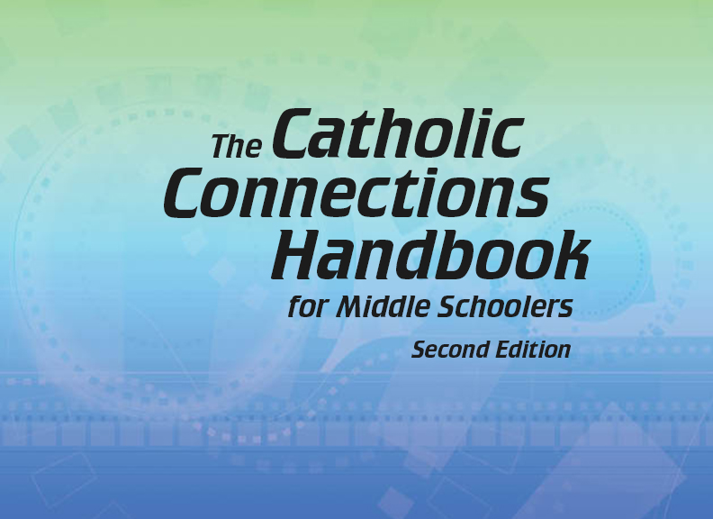

Document #: TX005840

Slide 2
Prayer and
Church History
Chapter G
The Church in the Middle Ages

Slide 3
Chapter Summary
In this era, the Church expanded from the role of religious leader to a role as a political power.
Church unity was shattered by the Schism, or split, between the Eastern and Western Christian Churches in 1054.
The Crusades and the Inquisitions brought conflict and tragedy into the life of the Church.
Yet faith grew through the efforts of monasteries and new religious orders.

Slide 4
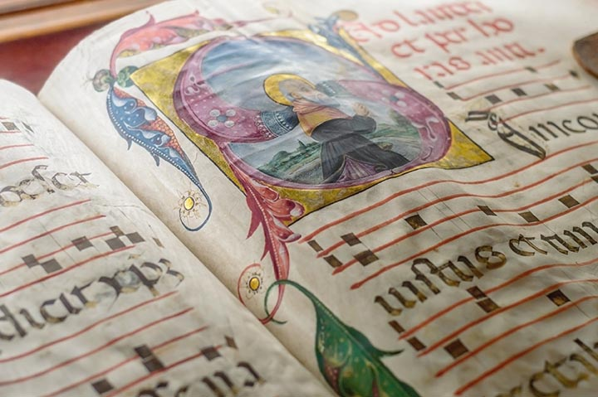
Introduction,
“Mayhem and Monks”, and “Emperor Charlemagne”
(Church History, pages 40–45)
The Middle Ages ushered
in an era of monasticism
and the rise of
Charlemagne.
(This is a choir book used by monks in the Middle Ages to sing the Liturgy of the Hours.)
© Thoom/Shutterstock.com

Slide 5
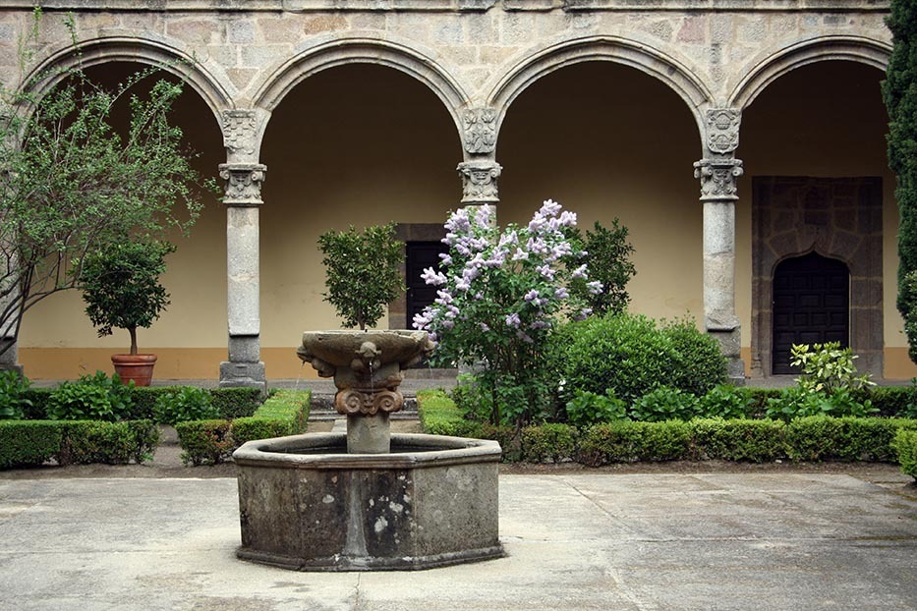
Mayhem and Monks
The Middle Ages is also
called “the medieval period.”
This era was marked by
a growth in monasticism,
that is, a life of prayer
and work in monasteries.
Monks (men) and nuns
(women) are sometimes
called monastics.
© Lenteja/Shutterstock.com

Slide 6
Search It!
Monks and nuns still exist today. There may be a monastery near you. Gather in a small group and find a Catholic monastery online.
Look at the chart on page 43. How does your chosen monastery fulfill these four functions today? Share your findings with your group.

Slide 7
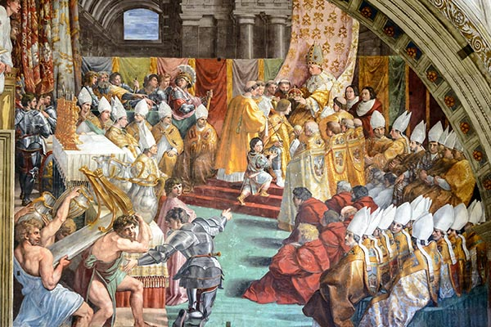
Emperor Charlemagne
After his father’s death,
Charlemagne became
King of the Franks.
The Church became
dependent upon
Charlemagne’s power,
and Charlemagne was
crowned the Holy
Roman Emperor.
© Viacheslav Lopatin / Shutterstock.com

Slide 8
The Holy Roman Empire
Charlemagne’s empire lasted until the death of his great-grandson in 888 A.D. It was re-established one hundred years later by Otto the Great, the German king.
For 600 years, the Pope crowned the Holy Roman Emperor. This shows the unity of Christianity and politics during the Middle Ages.

Slide 9
Think About It!
The Constitution of the United States provides for freedom of religion and the separation of church and state.
Gather in groups and discuss:
1) What are the consequences of freedom of religion and church-state separation for Catholic schools?
2) For state-supported (public) schools?
3) Why is both freedom and separation good for the United States?

Slide 10
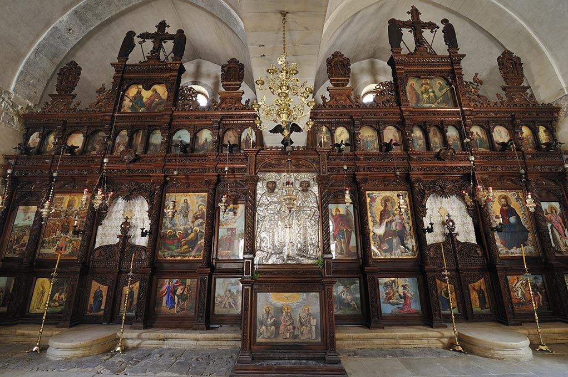
“The Church Divides”
(Church History, pages 46–48)
The many differences
between the Eastern
and Western Church
ultimately led to the
Great Schism of 1054.
(This is an icon screen in an Eastern Orthodox church. The altar is behind the screen, with a middle double door and a door on either side. The area behind the screen represents Heaven. During the Liturgy, the middle doors are opened so that important actions, like the consecration, can be seen. During Easter and Easter Week, all the doors are opened!)
© T photography / Shutterstock.com

Slide 11
Writing an Icon
In icon painting, the icon is said to be “written.” The icon is not signed in order to guard the icon writer’s humility.
Before working, the icon writer prays.
Find an icon or holy picture you like. Spend a few moments in prayer, then try to reproduce it on paper as best you can. Drawing this way is an act of love and worship.

Slide 12
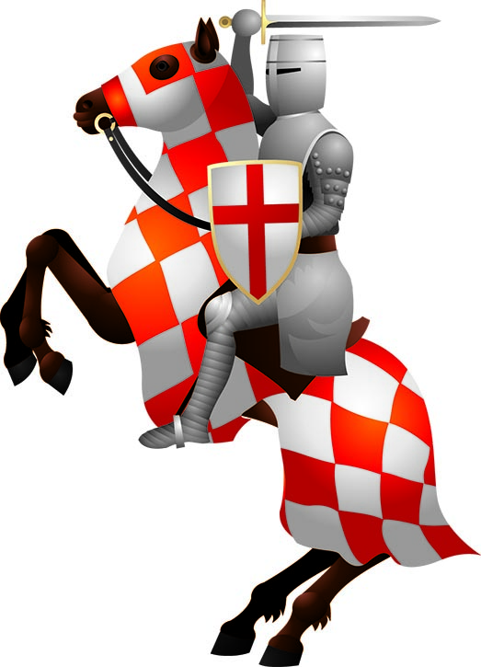
“The Crusades” and
“The Inquisitions”
(Church History, pages 49–54)
Internal and external threats
to Christianity led to the
Crusades (holy wars to protect
Christians and holy places) and
the Inquisitions (investigations
into people and situations
challenging Christian beliefs).
© elmm/Shutterstock.com

Slide 13
The Crusades
The Crusades were organized to take back the Holy Land from the Muslims.
The Crusaders recovered Jerusalem but, in the process, massacred both Jews and Muslims.
Jerusalem later fell to the Muslims again, but Christians were allowed access to Jerusalem for trade and for religious pilgrimages.

Slide 14

The Fourth Crusade
The Fourth Crusade was called to re-capture Jerusalem. On the way, the crusaders stopped at Constantinople. The crusaders attacked citizens and looted their churches. Pope Innocent III condemned their actions, but the damage was done.
In 2001, Pope John Paul II
asked forgiveness of the
Orthodox Church for the
sacking of Constantinople
in 1204. The Greek Archbishop
offered the Pope a silver olive branch as a sign of peace.
© volkova natalia / Shutterstock.com

Slide 15
Catholic and
Orthodox Relations
Gather in groups of two or three. Choose an Orthodox church near you, or find one online. Draft a letter to the priest of this church. Include the following points:
Explain that you have been studying Church History, and have studied the sacking of Constantinople in 1204 by Western Christians.
Explain that you have also learned of Pope John Paul II’s apology to the Orthodox Church (in 2001), and that you would like to add your voices to that apology.
Choose the best parts of each draft and mail one letter. In this way you will be making a gesture of peace at your local level! We cannot change history, but we can improve our own times.

Slide 16
“The Inquisitions”
(Church History, pages 52–54)
There were two inquisitions: the Medieval Inquisition and the Spanish Inquisition.
The goal of the Medieval Inquisition was to root out heresy.
The goal of the Spanish Inquisition was to solidify the authority of the king and queen.

Slide 17
“Falsehood Has No Rights”
For many centuries, the Church agreed with this statement.
This changed at Vatican Council II, when the Church formally proclaimed that all people have a right to choose their religion, even if their beliefs do not reflect the full truth of the Catholic faith (Declaration on Religious Liberty).

Slide 18
Share It!
Gather in small groups. Make a list of ways you can share your faith with others.
Include actions as well as words.
Include the “how” (for example, joyfully and respectfully)
as well as the “what.” (See Declaration on Religious Liberty, 14.)

Slide 19
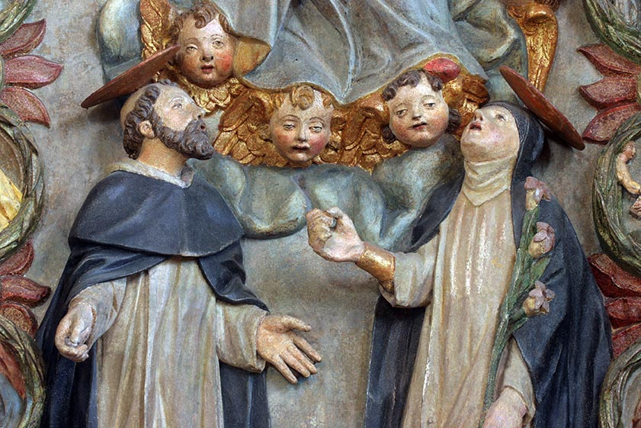
“Witnesses to Faith”
(Church History, pages 54–60)
Great witnesses of faith, such as Saint Dominic and Saint Catherine of Siena, inspired the Church’s growth and the faithfulness of her people.
(The above is a sculpture of Saint Dominic and Saint Catherine of Siena.)
© Zvonimir Atletic / Shutterstock.com

Slide 20
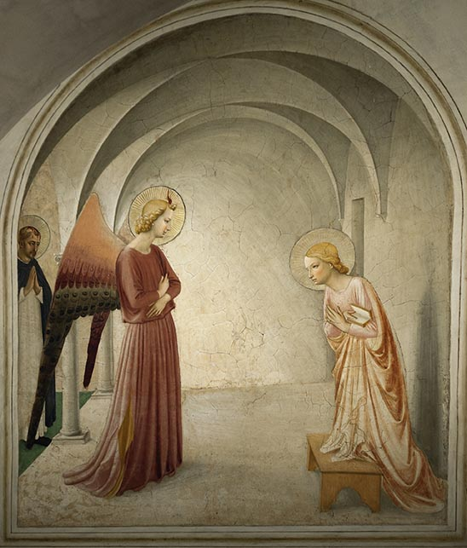
Witness to Faith Presentation
Choose one of the saints listed here. Prepare a costume and give a short presentation, in costume, on your chosen saint.
Pope Saint Gregory VII
Saint Joan of Arc
Saint Dominic
Saint Thomas Becket
Saint Catherine of Siena
Saint Bonaventure
Saint Francis of Assisi
Saint Albertus Magnus
Saint Clare of Assisi
Fra Angelico
Saint Thomas
Aquinas
Saint Benedict
of Nursia
Saint Roch
Saint Rosalia
Saint Yves
Saint Bede
Saint Bernard of Clairvaux
Saint Scholastica
Saint John of Nepomuk
(This art piece is by Fra Angelico, a Franciscan friar and artist.)
© Tramont_ana/Shutterstock.com

