Slide 1
Chapter 9: Zen Buddhism
World Religions: A Voyage of Discovery
DOC ID #: TX003946

Slide 2
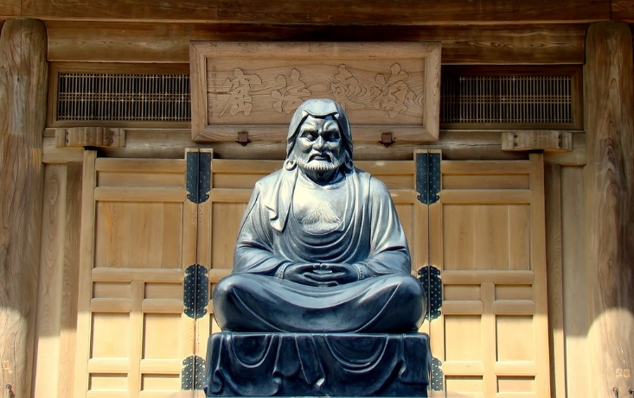
Bodhidharma
Bodhidharma is credited with bringing Zen Buddhism from India to China early in the sixth century AD.
The Chinese term is Ch’an, which like the Japanese Zen, means “meditation.”
This form of Buddhism eventually became established in Japan.
© Paolo Gianti / www.shutterstock.com
Notes:
Notes: The statue shown on this slide is in Kencho-ji, a Rinzai temple in Kamakura, Japan. Historical information regarding Bodhidharma is limited, and there are divergent accounts of his origins. One account says he came from Persia, another from south India. He famously is believed to have sat in meditation facing a wall in a cave for nine years, thereby sufficiently impressing the monks at Shaolin Monastery to be allowed admittance.

Slide 3
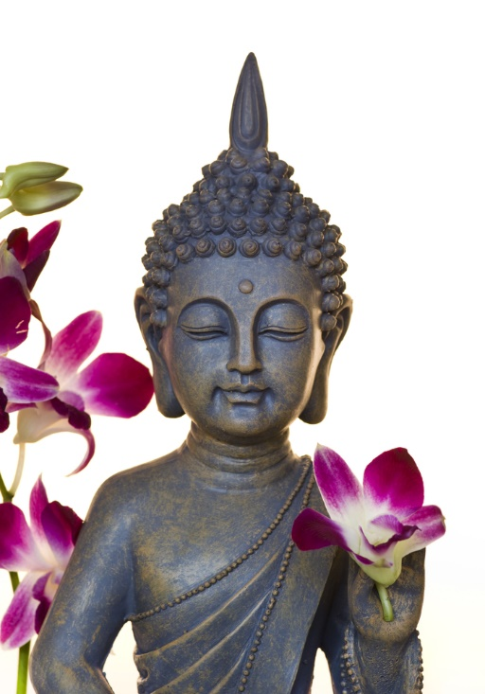
Buddha with Orchid Flower
Zen Buddhism traces its origins back to a sermon delivered by the Buddha.
During the sermon, the Buddha held up and admired a flower.
Only one of his disciples, Mahakasyapa, smiled, indicating that he understood.
© Andrea Haase / www.shutterstock.com
Notes:
Notes: In more technical language, Mahakasyapa received the dharma transmission. According to the Zen tradition, he was the first to do so, thus becoming the rightful successor to the Buddha. This means of transmission exemplifies the potency of direct experience as opposed to dependence on words—a main emphasis of Zen.

Slide 4
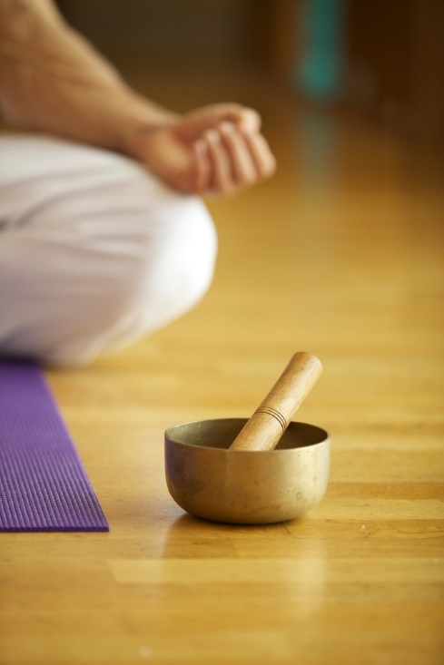
Zazen
Zazen, seated meditation, is the featured practice of Zen Buddhism.
Singing bowls and decorative stones.
“Don’t just do something, sit there!”
© Shoot Out Loud / www.shutterstock.com
Notes:
Notes: The practitioner shown on this slide is equipped with a singing bowl, used to commence a period of meditation. Practitioners can also have a suizeki, a decorative stone reminiscent of the Zen garden and landscaping. Singing bowls and decorative stones are sometimes used to enhance zazen. “Don’t just do something, sit there!” is a popular modern Zen saying. It probably always proves difficult to convey the relevance of a practice like meditation simply by talking about it or assigning the right readings, or by observing someone else engaged in it. If appropriate, ask the students to meditate for just a few minutes and then to report on their experiences.

Slide 5

Enso
The enso, Japanese for “circle,” is an important symbol for Zen.
The enso represents enlightenment.
The enso is a very common subject of Japanese painting.
© MoinMoin / www.shutterstock.com
Notes:
Notes: Sometimes the circle is enclosed, perhaps indicating the artist’s sense of wholeness or completion; other times it is left open, perhaps a sign of the inevitable imperfection of life. The method by which the enso is painted relates closely to Zen practice, as it requires spontaneity and directness. Because the enso is a symbol of enlightenment, this would be a good occasion to discuss satori.

Slide 6
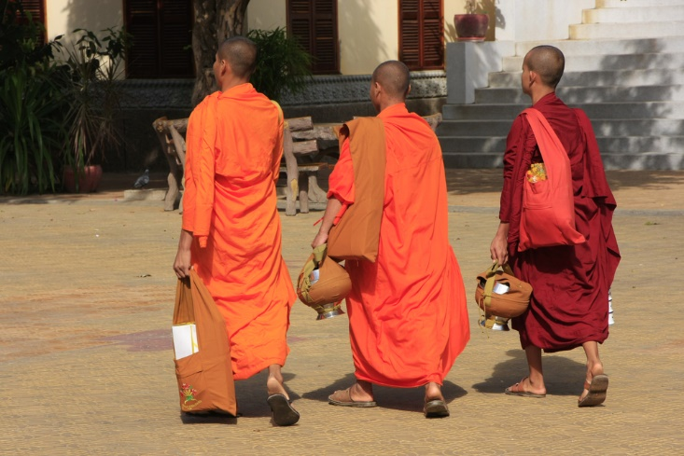
Monks Walking to a Meditation Hall
The meditation hall, or zendo, is an important space in any monastery.
A day in the meditation hall begins before dawn with a simple meal and the reciting of prayers.
Several hours are devoted to zazen.
v Donya Nedomam / www.shutterstock.com
Notes:
Notes: The hours of zazen are sometimes punctuated by walking meditation. A pillow and mat are normally used to help maintain comfort and proper posture. Cities in North America quite commonly have Zen organizations that welcome the public to participate in zazen, or at least to visit the site. The San Francisco Zen Center, for example, maintains impressive sites in the city, at the Zen Mountain Center in Carmel Valley, and at its organic farm north of the city. It also provides an informative website: http://www.sfzc.org/.

Slide 7
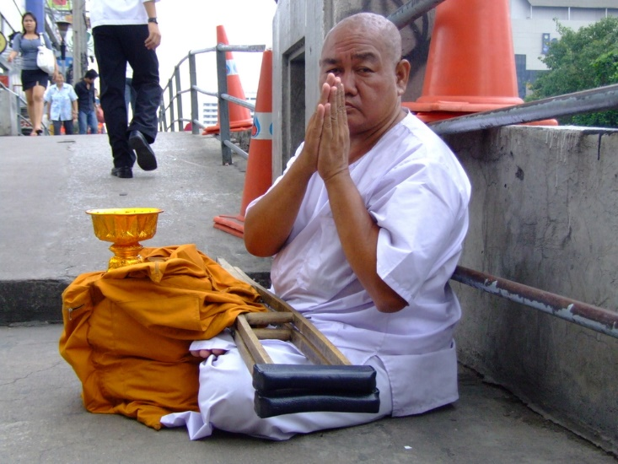
Zen Monk
Monks and nuns typically depend on the laity for gifts of food.
In this regard and others, the practice of Zen in Asia tends to be more traditional than the practice of Zen in North America.
© Charlie Edward / www.shutterstock.com
Notes:
Notes: The monk shown on this slide sits and waits for donations. One of the notable differences between Zen as traditionally practiced in Japan and its other ancestral homelands—China, Korea, and Vietnam— and Zen in North America is the intense and (for most) demanding relation of disciple to master. This is famously epitomized by the so-called “encouragement stick” wielded by the master in the zendo.

Slide 8
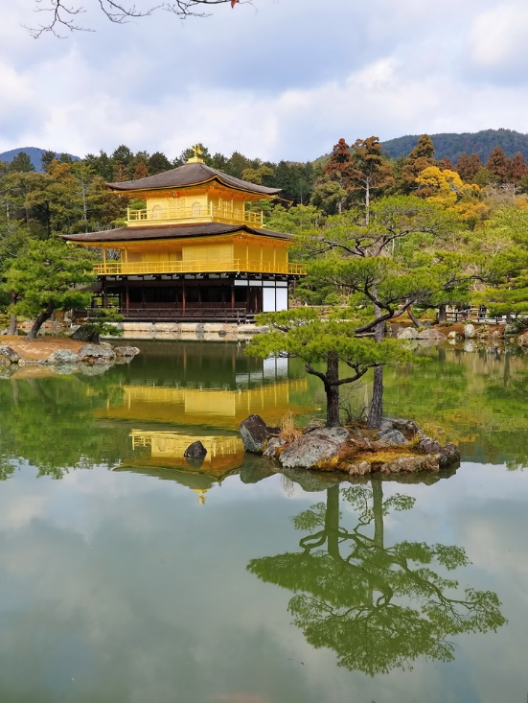
Zen Temple
The Temple of the Golden Pavilion in Kyoto is among the most popularly visited places in Japan.
The temple is covered in gold leaf.
The building complex and gardens are designed to integrate the outside with the inside.
© Jordan Tan / www.shutterstock.com
Notes:
Notes: The Temple of the Golden Pavilion (Kinkau-Ji in Japanese) is renowned for its architecture and landscaping, all of it reflecting the Zen cultural heritage. The history of the temple dates back to 1397, although all parts have been rebuilt at some point over the centuries, the most recent being the pavilion, which was rebuilt in 1955 after having been destroyed by a fire. This fire provides the basis for a novel published in 1956 by Yukio Mishima, The Temple of the Golden Pavilion (New York: Vintage/Ebury, 2001).

Slide 9
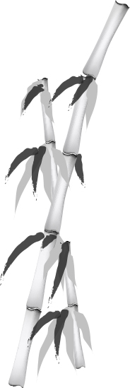
Sumie
Sumie is a type of brush painting common throughout East Asia.
The ink is always applied with a brush, ideally with a single stroke.
© pananba / www.shutterstock.com
Notes:
Notes: (The painting included in the slide set on Taoism is a Chinese example of brush painting.) Along with incorporating Taoist themes of tranquility and harmony with nature, sumie (or sumi-e) features the Zen idea of direct and spontaneous experience by emphasizing single brushstrokes. The Sumi-e Society of America, Inc., founded in 1963, provides information on exhibits and publications: http://www.sumiesociety.org/frame.htm.

Slide 10
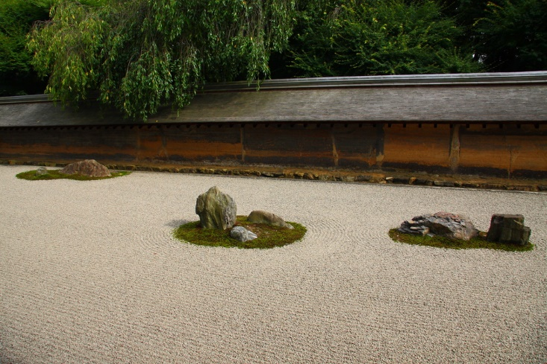
Zen Gardens
Zen gardens incorporate beautiful elements of nature.
They capture the Zen ideals of simplicity and spontaneity.
Historically, the development of the Zen garden correlated with that of sumie landscape painting.
© Sergii Rudiuk / www.shutterstock.com
Notes:
Notes: The Zen rock garden shown on this slide is located in a temple in Kyoto, Japan. Like almost every cultural aspect associated with Zen, the garden is an aid to meditation, presenting a direct depiction of the essence of nature rather than (from a Zen perspective) getting bogged down in details. Zen gardens have existed for over a thousand years.

Slide 11
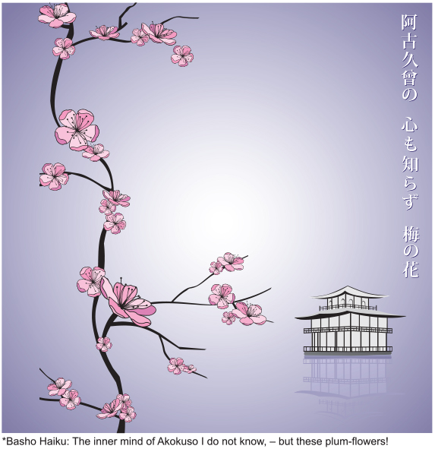
Haiku
Haiku exemplifies Zen ideals through succinct and straightforward expression.
This poem by Matsuo Basho in Japanese reads “akokuso no / kokoro shirazu / ume no hana.”
Like all haikus, the poem conforms to a specific 5/7/5 structure.
© vberla / www.shutterstock.com
Notes:
Notes: Haiku is a traditional Japanese poetic form characterized by a specific, concise structure (although the structure is not necessarily based on syllables, as commonly understood in English forms of haiku). According to translator Robert Aitken in his book The River of Heaven: The Haiku of Basho, Buson, Issa, and Shiki (Berkeley, CA: Counterpoint Press, 2011), Basho, a great master of haiku, was inspired to compose this haiku when thinking of a longer poem by Tsurayuki (883 to 946), whose childhood name was Akokuso. That poem makes “more sense” conventionally speaking, as Basho depended not on the poet’s perspective but on his own: the immediate experience of the smell of blossoms.

