Slide 1
Effects of Grace
The Paschal Mystery
Unit 1, Chapter 1
Document #: TX005792

Slide 2
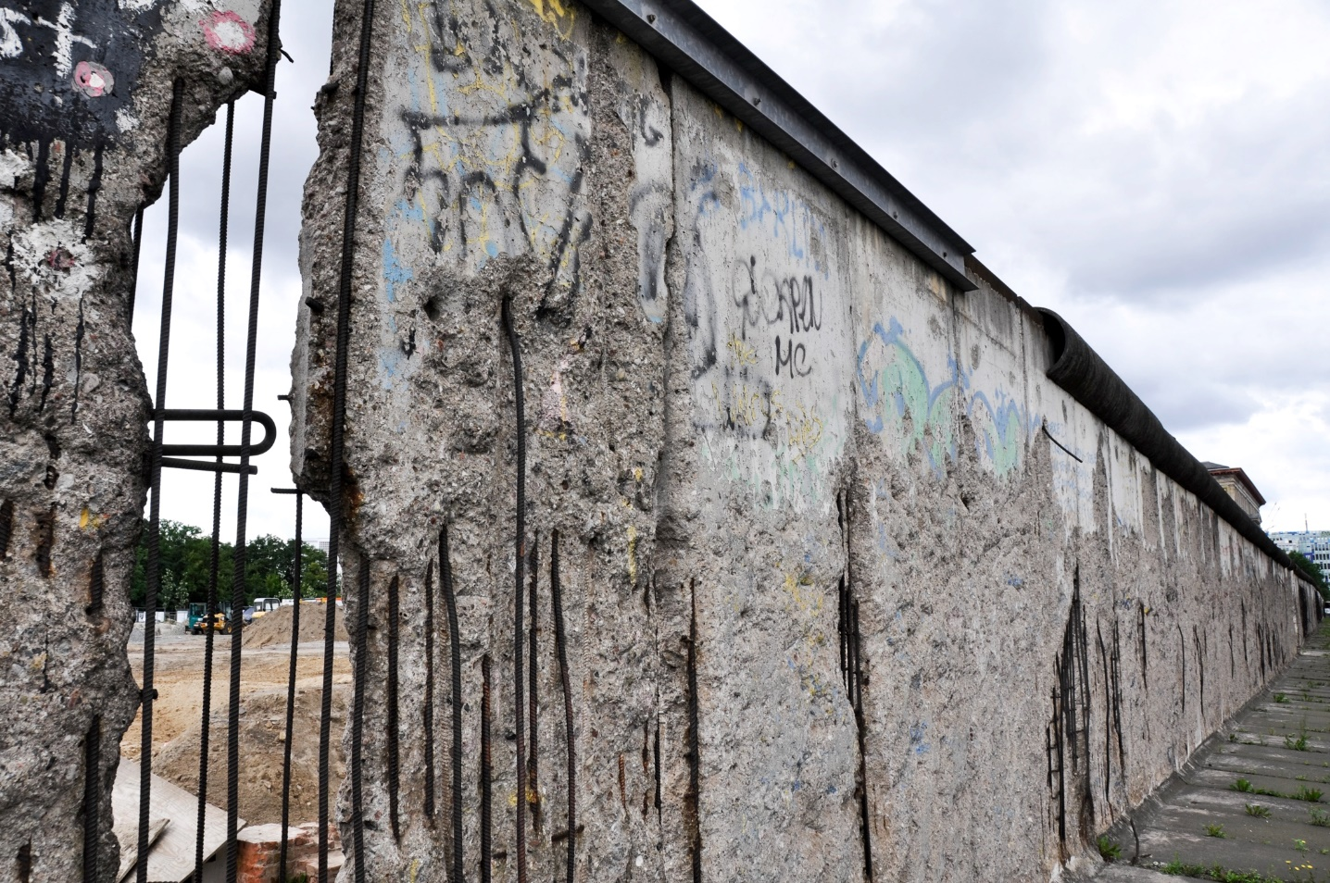
The lasting effects of Original Sin are real. Original Sin has shattered our harmony with God, with others, and with the world we live in.
© Alberto Loyo / Shutterstock.com

Slide 3
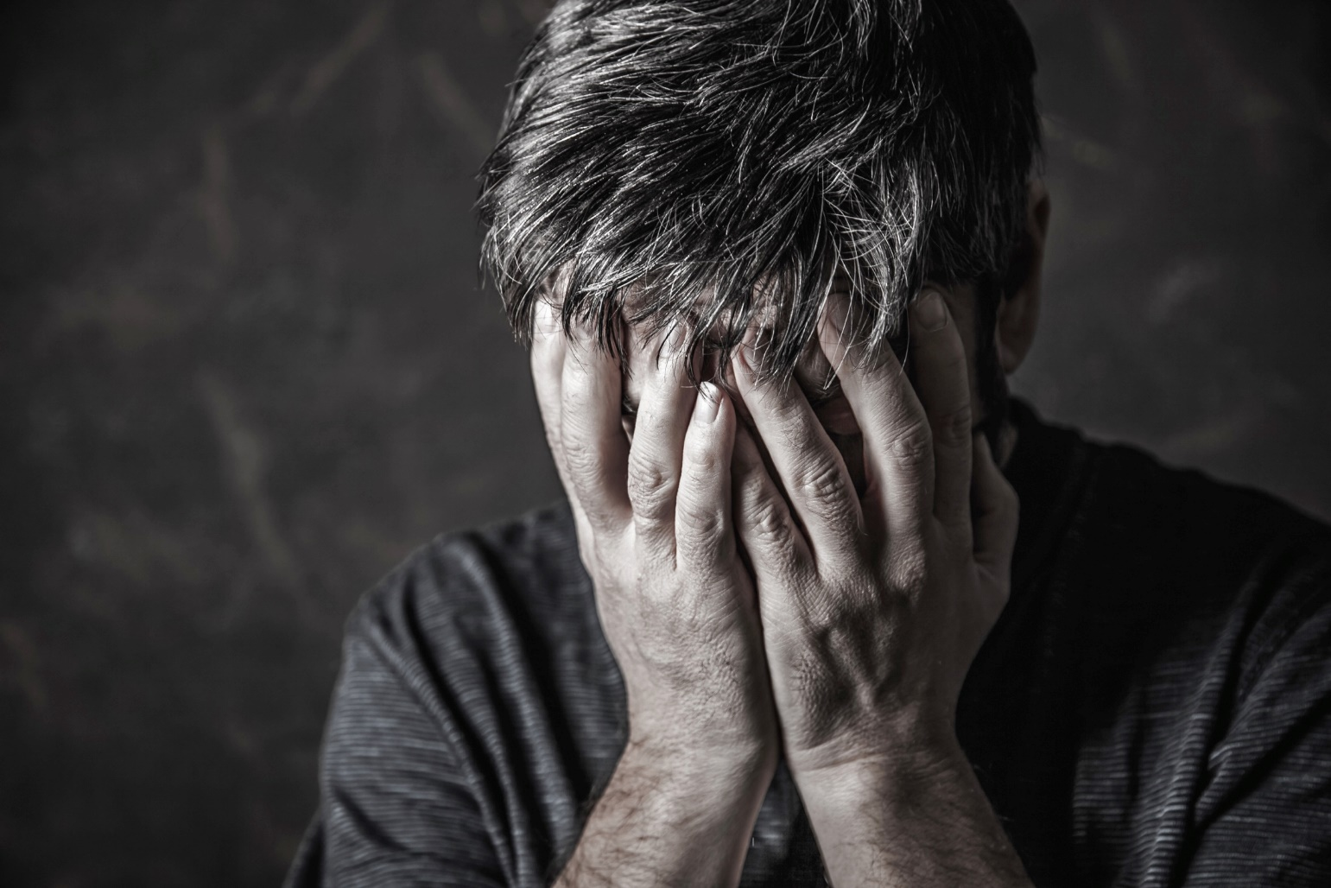
Original Sin has affected how we feel about ourselves.
© Anelina / Shutterstock.com

Slide 4

Even so, God’s grace is much stronger than humanity’s sinfulness.
© Gustavo Frazao / Shutterstock.com

Slide 5

Humanity Was Created in God’s Image
able to enter into communion with others
united with others as caretakers of the earth
capable of self-knowledge
© matsuregional.com

Slide 6
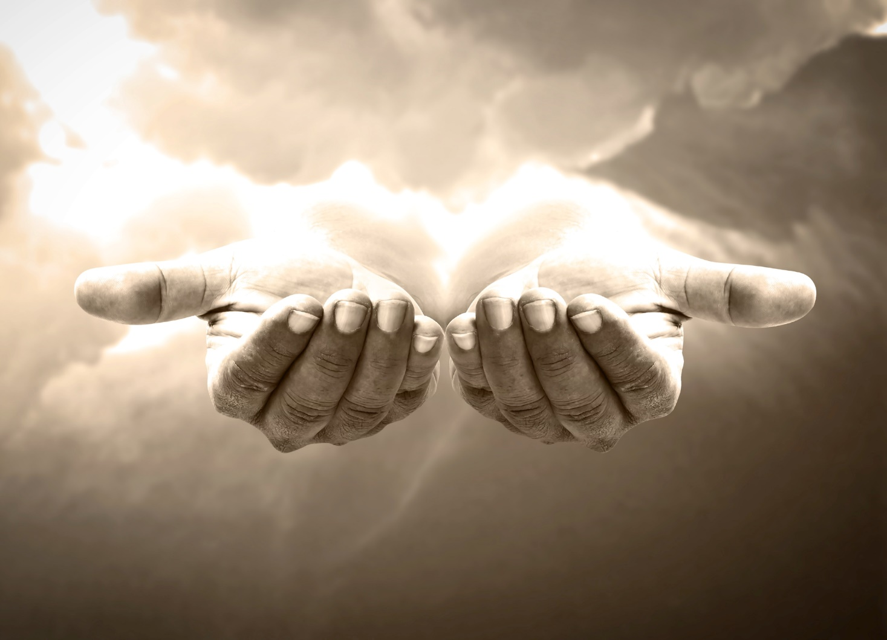
God’s grace can restore that original holiness and righteousness.
© CHOATphotographer / Shutterstock.com

Slide 7
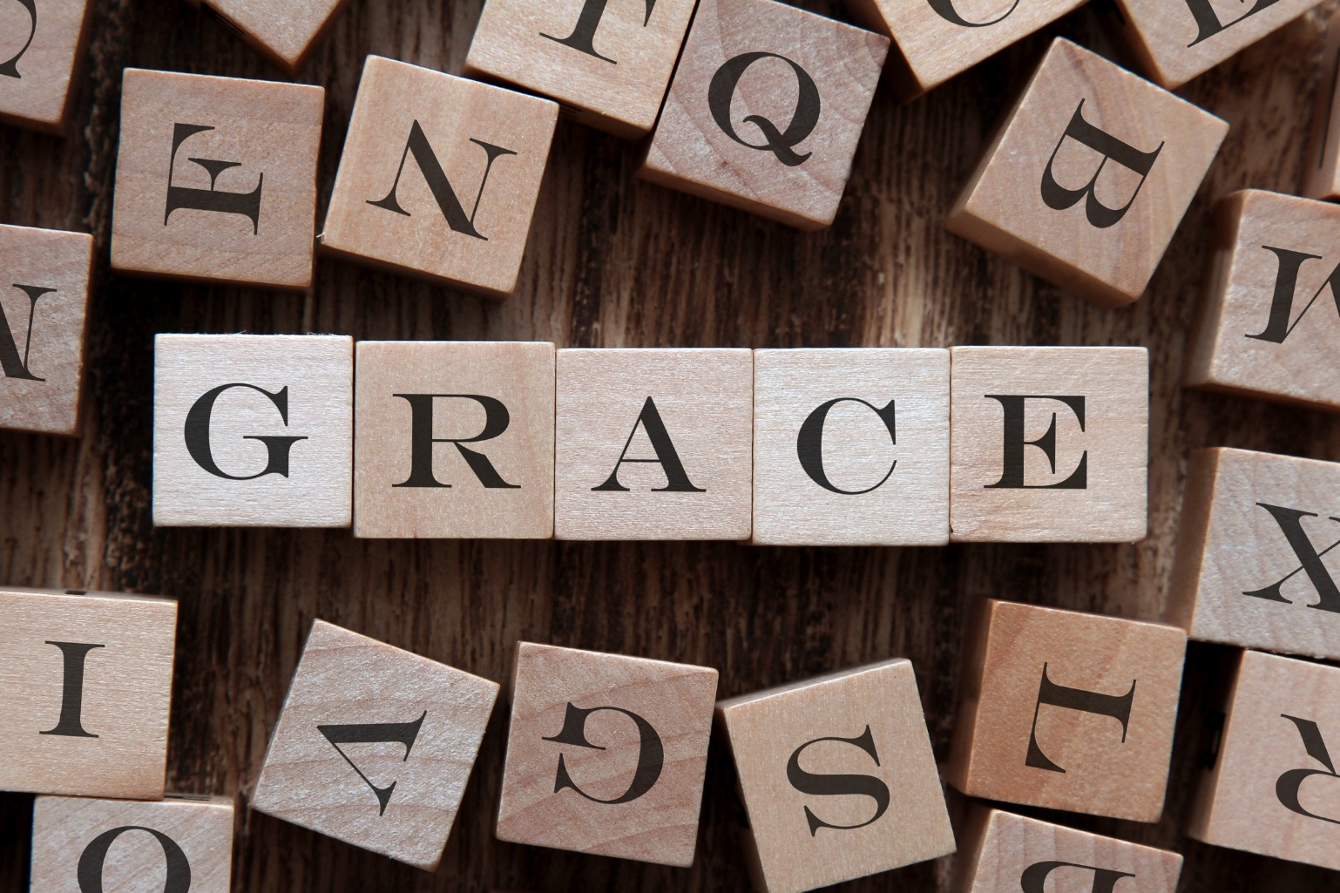
What Is Grace?
© schatzy / Shutterstock.com

Slide 8
What Is Grace? (cont’d.)
Grace is participation in the life of God.
Grace is God’s own life infused into our human souls.
Grace is the help we need to respond to God’s call to be his adopted sons and daughters.

Slide 9
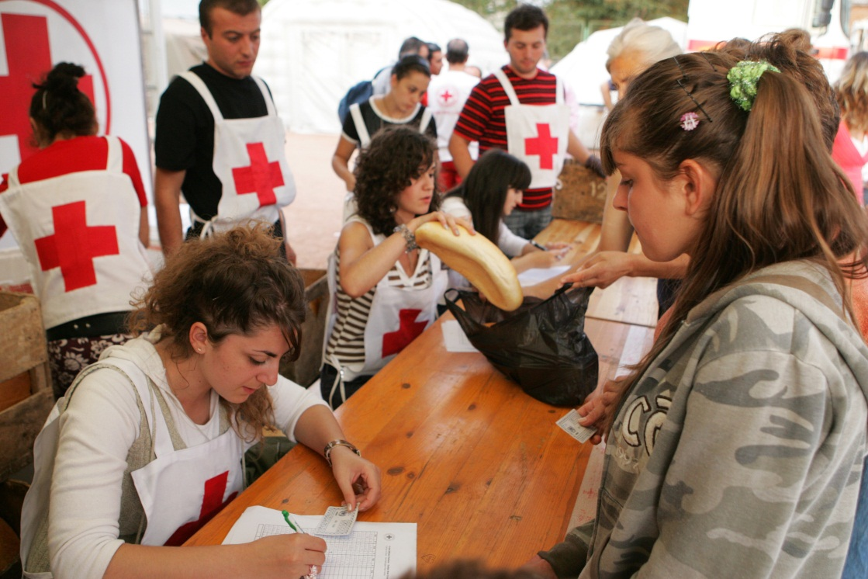
The Effects of Grace
Grace allows us to love with Christ’s love.
© kojoku / Shutterstock.com

Slide 10
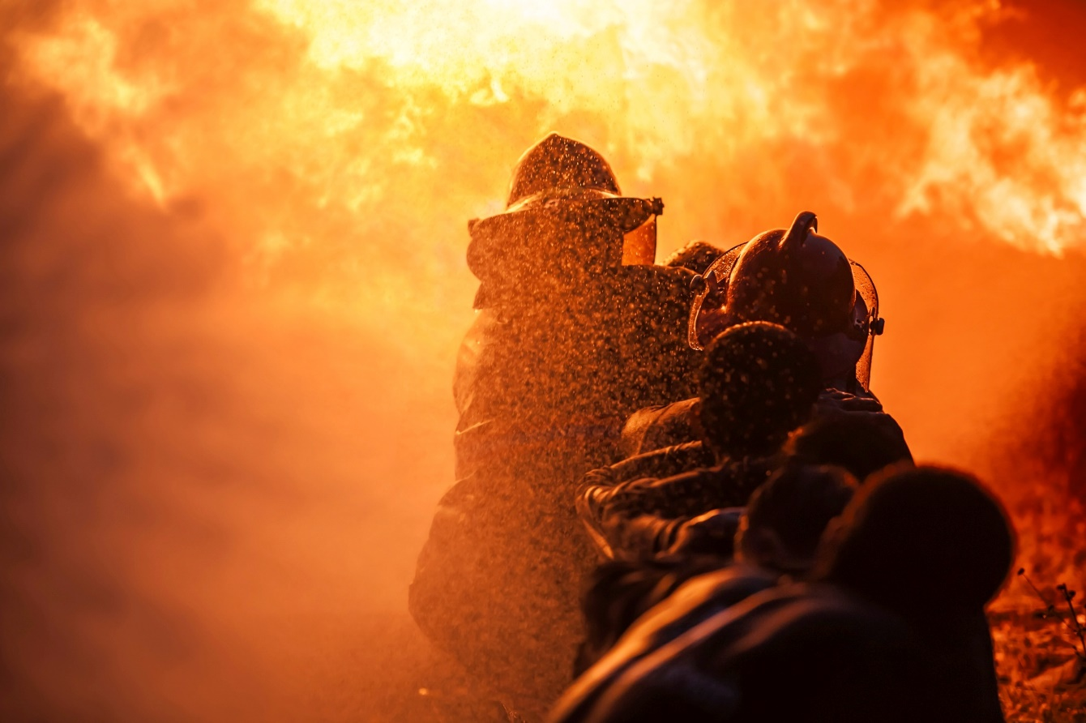
Grace perfects the virtues and good qualities we develop in life.
© sandyman / Shutterstock.com

Slide 11
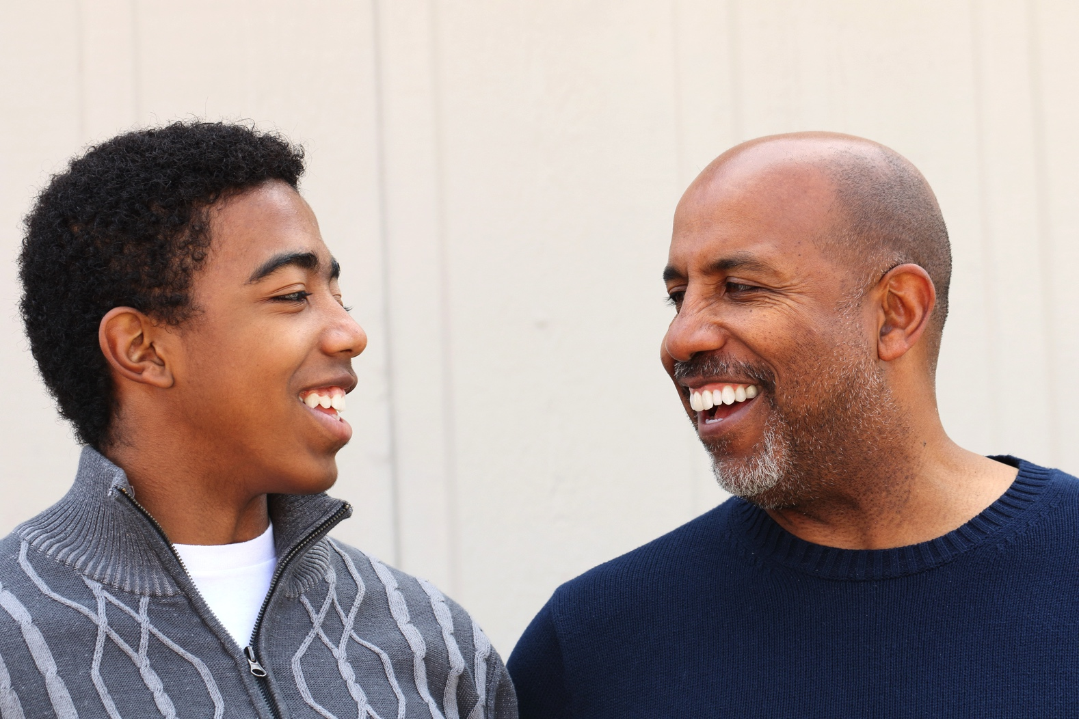
Grace offers us a parent-child relationship with God.
© pixelheadphoto / Shutterstock.com

Slide 12

Grace makes us holy, healing our souls of sin.
© grace21 / iStock

Slide 13
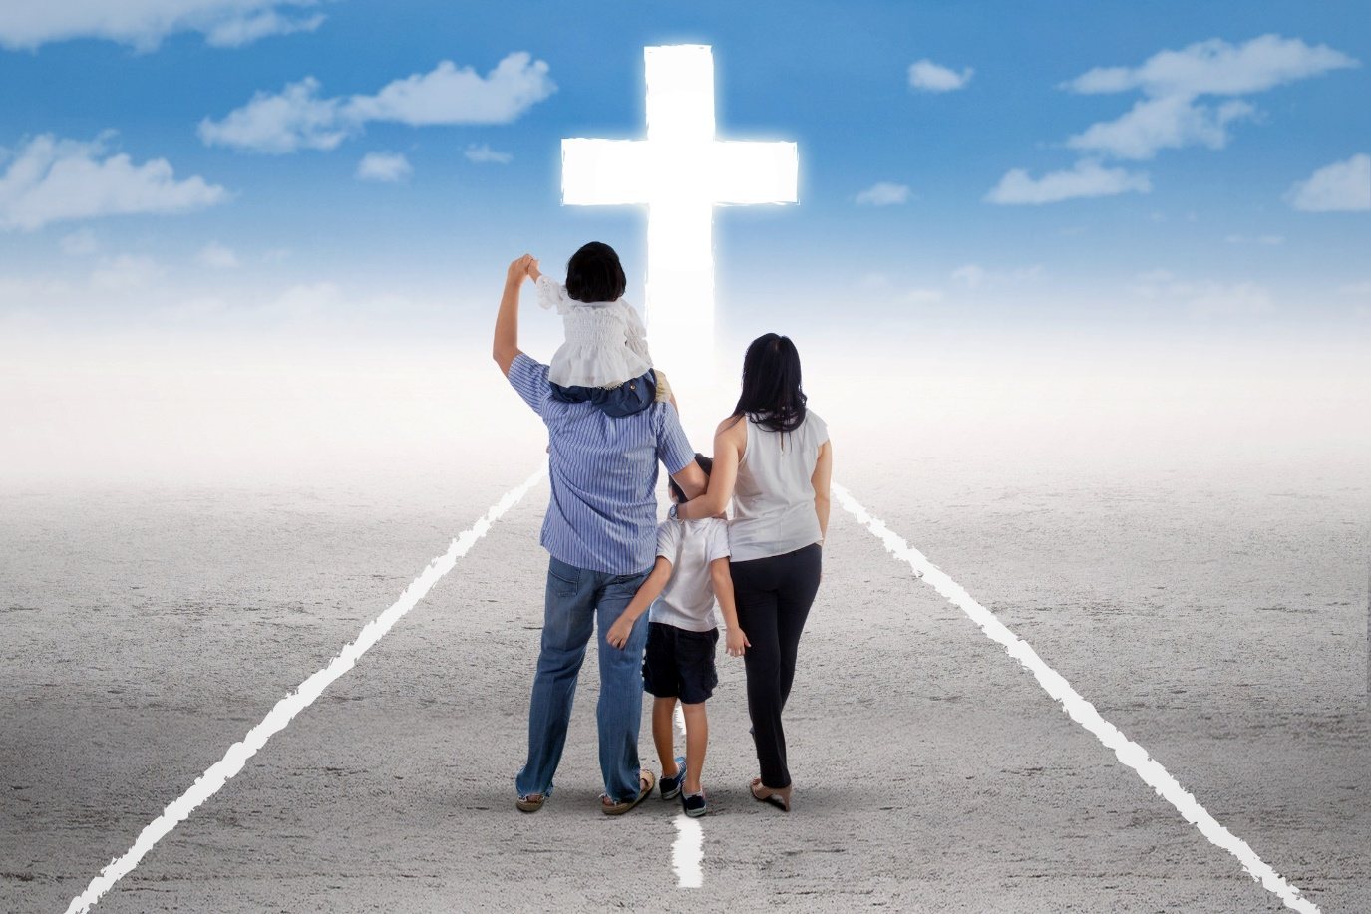
Grace allows us to respond to God’s call to enter into eternal life.
© Creativa Images / Shutterstock.com

