Slide 1
The Church and Salvation
The Church
Unit 4, Chapter 12
Document #: TX005562
© 2016 Saint Mary’s Press
Living in Christ Series

Slide 2

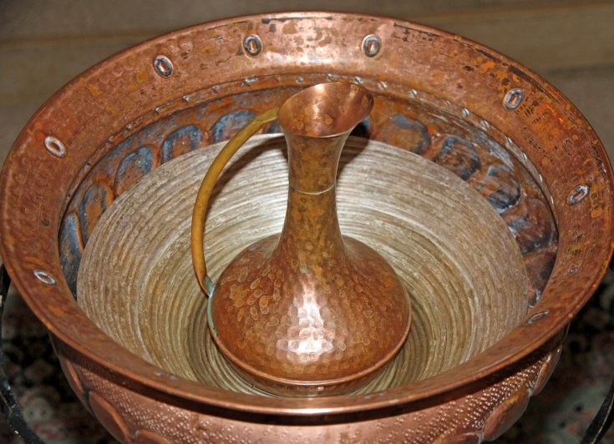
The Fullness of Salvation
Is it true that most people will go to Heaven, regardless of their religion?
God loves all people,
and his will is for
everyone to be saved.
Jesus Christ is the one
true path to salvation.
© ChiccoDodiFC / Shutterstock.com
© 2016 Saint Mary’s Press
Living in Christ Series
Notes:
Notes: Remind the students that Christ established the Church as the means of salvation. (Later slides address salvation for those who do not know the Gospel.)

Slide 3
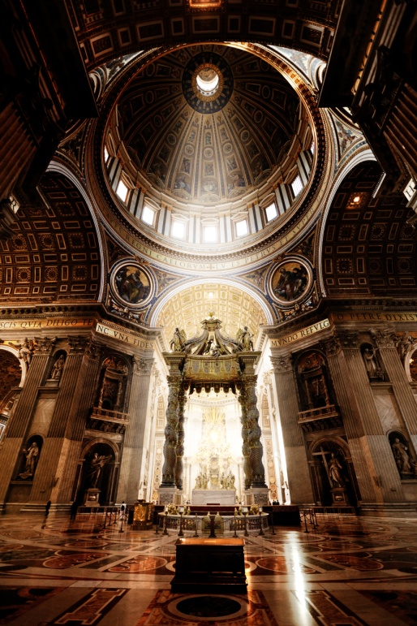
The Fullness of the Church of Christ
The Catholic Church is the only Church with the fullness of the four Marks of the Church:
It is One, Holy, Catholic, and Apostolic.
It alone has retained the fullness of the means of salvation.
© Iakov Kalinin / Shutterstock.com
© 2016 Saint Mary’s Press
Living in Christ Series
Notes:
Notes: Ask volunteers to summarize each of the four Marks of the Church. (See the introduction to unit 2 of the student book.) The means of salvation (Revelation, Sacraments, and ordained ministry) are explained in the following slides.

Slide 4
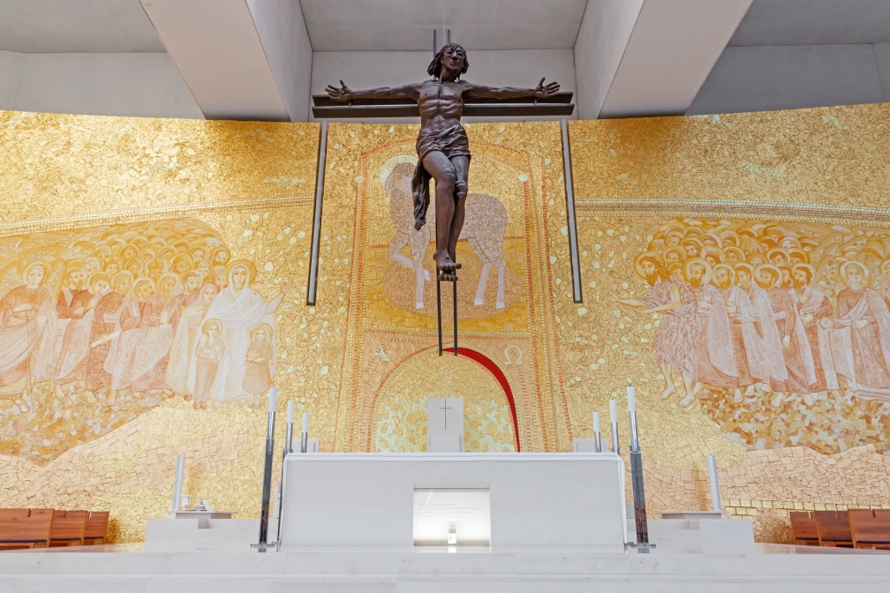
The Church Is Necessary for Salvation
Christ is the one path to salvation, and he is present to us in the Church.
Salvation comes from Christ, our Head, through the Church, which is his Body.
© 2016 Saint Mary’s Press
Living in Christ Series
© StockPhotosArt / Shutterstock.com
Notes:
Notes: Ask volunteers to read John 14:6, Mark 16:16, and John 3:5. (Later slides address salvation for those outside the Church.)

Slide 5
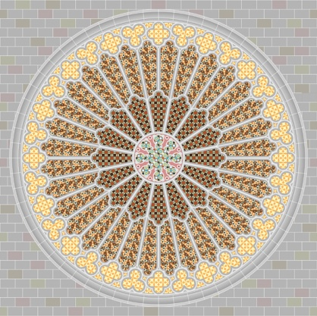
The Church Is a Sacrament
A sacrament is a visible sign of God’s invisible grace.
The Church is the sacrament
of salvation . . .
both a sign and an
instrument of the saving
union between God and
humans.
© kornilov007 / Shutterstock.com
© 2016 Saint Mary’s Press
Living in Christ Series
Notes:
Notes: Discuss what it means to say that the Church is a sign of salvation and the instrument of salvation, as in article 50 of the student book.

Slide 6

Salvation for Those outside the Church
Is it true that only Catholics can be saved?
The answer is no.
© 2016 Saint Mary’s Press
Living in Christ Series
© Ints Vikmanis / Shutterstock.com
Notes:
Notes: With the students, brainstorm some Church doctrines or beliefs that might contribute to this answer.

Slide 7
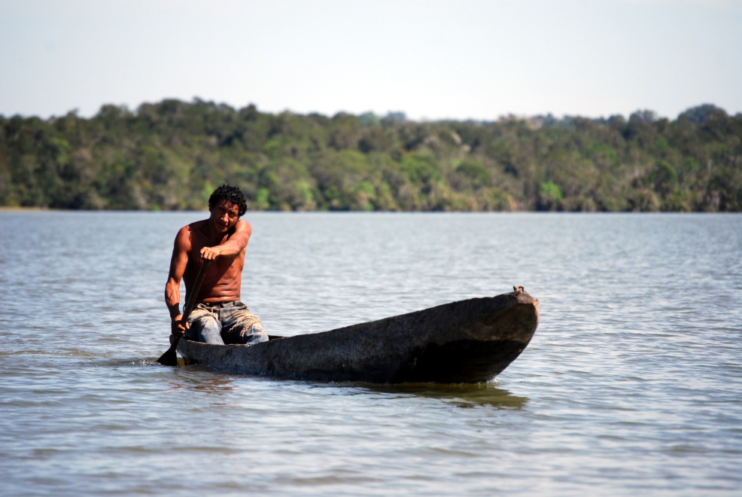
Salvation Is Offered to All People
Through the ages,
millions of people
never had the
chance to join the
Church.
If the Church is
necessary for
salvation, how
could such people be saved?
Salvation is available to them through God’s grace.
© Frontpage / Shutterstock.com
© 2016 Saint Mary’s Press
Living in Christ Series
Notes:
Notes: Discuss what is necessary for salvation for those who do not know the Gospel, as in the section “Salvation Is Offered to All People” in article 51 of the student book: “They nevertheless sincerely seek God and, moved by his grace, try to do his will as they know it in their conscience.”

Slide 8
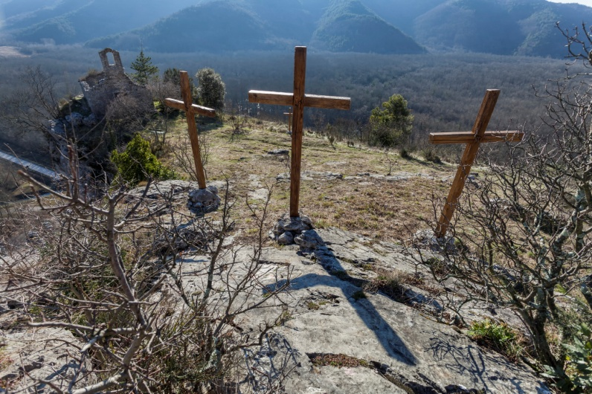
Saving Grace
Grace is available outside the visible boundaries of the Church.
It still comes from
Christ, as a result
of his sacrifice.
It is communicated
by the Holy Spirit.
© tingra / iStock
© 2016 Saint Mary’s Press
Living in Christ Series
Notes:
Notes: Point out that the Holy Spirit works through non-Catholic churches to offer salvation to their members. Direct the students to read the sidebar in article 52 of the student book, “Why Are You Catholic?” Discuss the importance of being able to answer this question.

Slide 9

The Church’s Mission
The Church still has the sacred duty to preach the Gospel to all people.
The mission regarding non-Catholic Christians should lead us to Christian unity.
The mission regarding non-Christians involves respectful dialogue.
© 2016 Saint Mary’s Press
Living in Christ Series
© Anelina / Shutterstock.com
Notes:
Notes: Review the missionary mandate given by Jesus to his followers, as in Matthew 28:19, and what it might mean for young Catholics today.

Slide 10

Who Needs Religion?
People sometimes say they have a right
to worship God in their own way.
How does God wish to be worshipped?
God wishes to be
worshipped by
people joined
together in
communities, not
just by isolated
individuals.
© LoloStock / Shutterstock.com
© 2016 Saint Mary’s Press
Living in Christ Series
Notes:
Notes: Discuss some ways of worshipping God that the students may wish to incorporate into their spiritual practice, along with communal worship at church.

Slide 11
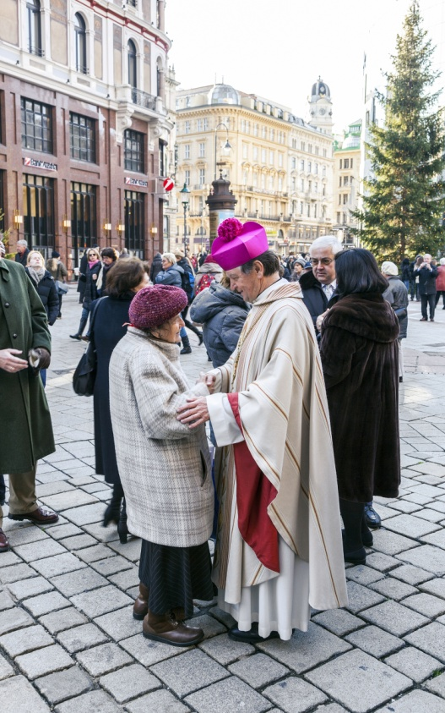
Our Social Nature
We are created to live in community, not in isolation.
We depend completely on Christ’s free gift of grace for our salvation.
Christ distributes this gift through the community of the Church.
© Jorg Hackemann / Shutterstock.com
© 2016 Saint Mary’s Press
Living in Christ Series
Notes:
Notes: Direct the students to read the second sidebar in article 52 of the student book, “Communal Worship in the Book of Revelation.” On the board, list all of the beings who are mentioned as part of the community joined together in worship.

Slide 12
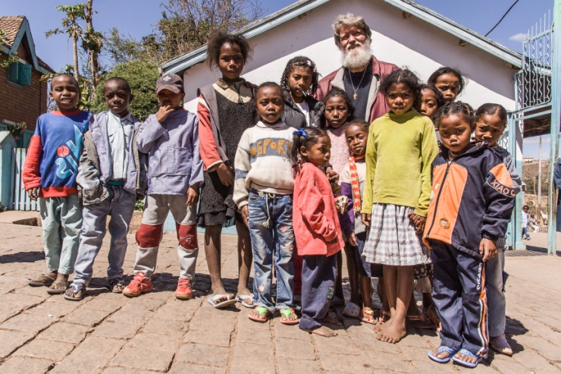
Communal Worship
When we participate in the Mass, we are part of a community on many levels:
the liturgical assembly
the local church or
diocese
the People of God
throughout the world
the worshippers in
Heaven
©Pierre-Yves Babelon / Shutterstock.com
© 2016 Saint Mary’s Press
Living in Christ Series
Notes:
Notes: Point out that in the Eucharistic Liturgy, we are united with all of these communities, and with Christ himself.

Slide 13
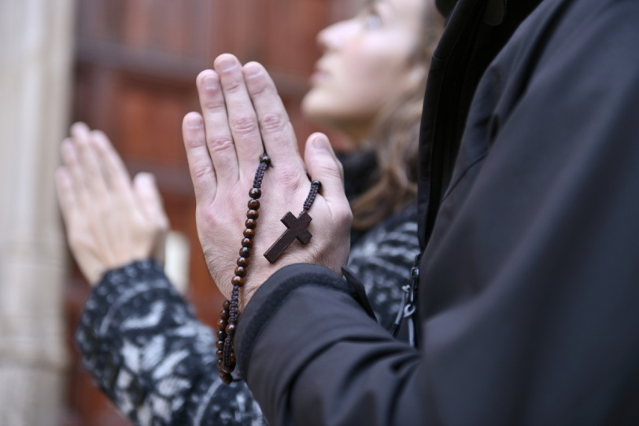
Individual Worship
We also worship God through our individual devotions.
Our personal worship
should both draw us to
communal prayer . . .
and complement the
communal worship
of the Church.
© mangostock / Shutterstock.com
© 2016 Saint Mary’s Press
Living in Christ Series
Notes:
Notes: Explain that the goal of God’s plan for us is communion with God and unity with all people. Ask how some of the individual spiritual practices help to unite us with God, and with those joined together in worship, as listed on the board.

