Slide 1
The Church Is Apostolic
The Church
Unit 2, Chapter 7
Document #: TX005557
© 2016 Saint Mary’s Press
Living in Christ Series

Slide 2
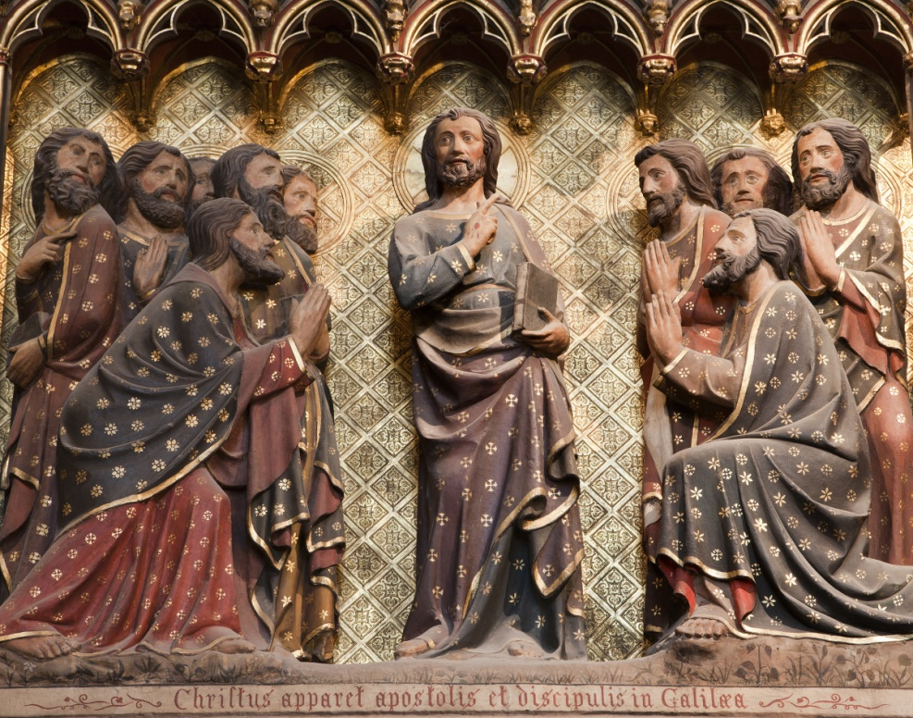
The Church Is Apostolic in Three Ways
She was and is built on the foundation of the Apostles.
The Church preserves and hands on the teaching of the Apostles.
The Church continues to be led by the Apostles through their successors.
© Renata Sedmakova / Shutterstock.com
© 2016 Saint Mary’s Press
Living in Christ Series
Notes:
Notes: Discuss the question in article 28 of the student book, “How does it help you to know that the Church’s teaching has been handed down in a direct line from the Apostles?”

Slide 3
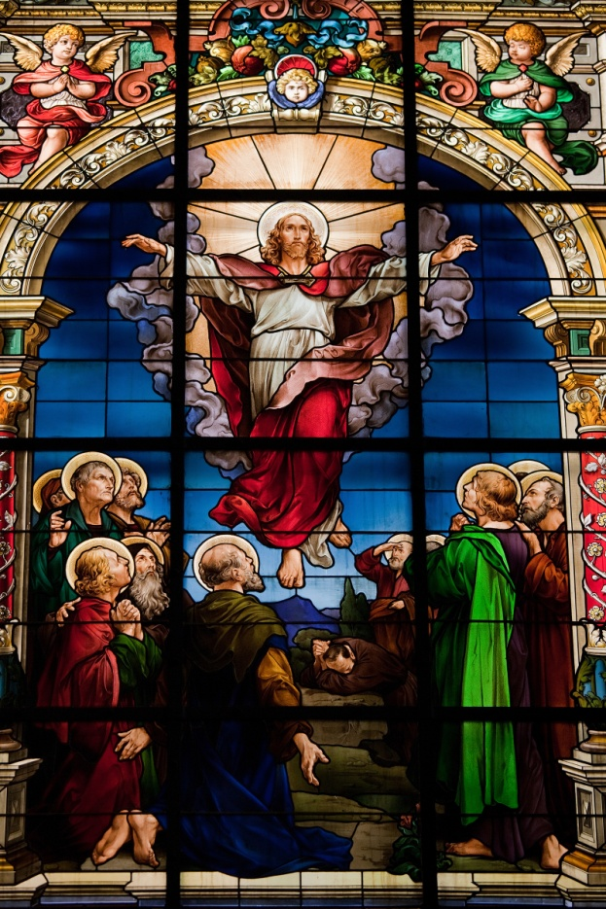
The Apostles Continued Jesus’ Mission
The Greek word apostolos literally means “one who is sent.”
Jesus sent his Apostles just as the Father sent him.
The Apostles relied on the power Jesus gave them.
© jorisvo / Shutterstock.com
© 2016 Saint Mary’s Press
Living in Christ Series
Notes:
Notes: If the students have Bibles, ask volunteers to read aloud the passages cited in the bullet points in article 29 of the student book: Matthew 10:7, Mark 6:13, Acts 9:36–42, and John 20:22–23. Discuss the authority given to the Apostles.

Slide 4
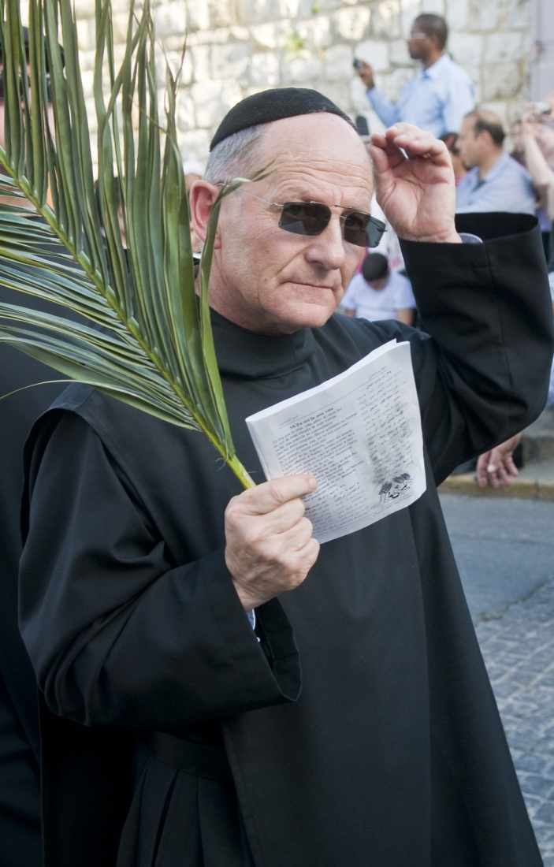
Appointing Successors
The teachings of Jesus have been transmitted from generation to generation.
This transmission of the truths Jesus Christ taught is known as Sacred Tradition.
The Apostles chose successors, who were given the title bishop.
© Kobby Dagan / Shutterstock.com
© 2016 Saint Mary’s Press
Living in Christ Series
Notes:
Notes: Explain that the process of passing on authority in the Church is called Apostolic Succession. Note that these successors are given authority to teach and interpret Sacred Scripture and Tradition.

Slide 5
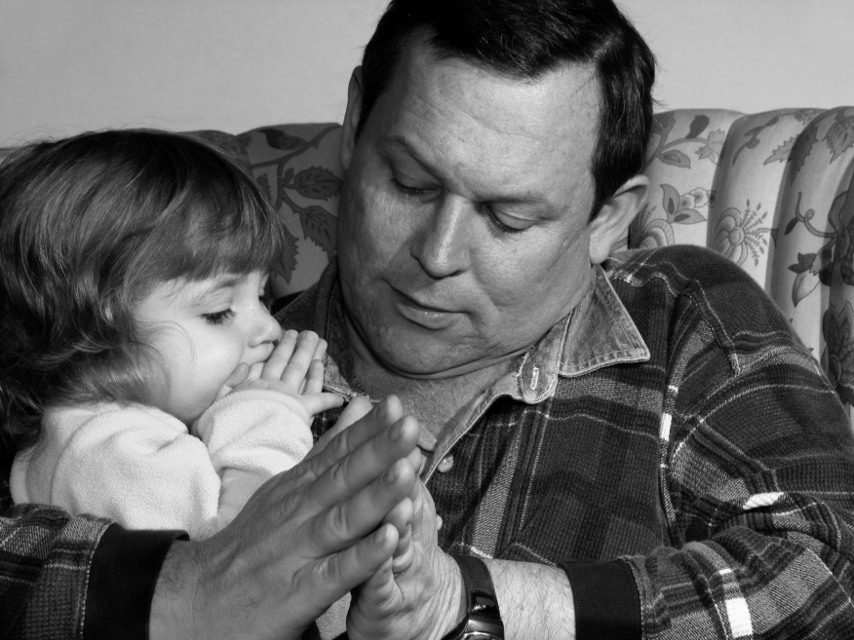
The Faith of the Church
Though faith or believing is a personal act, its source is the Church, who teaches us.
The faith of the Church precedes, supports, and nourishes the faith of individuals.
© AnitaPatterson / iStock
© 2016 Saint Mary’s Press
Living in Christ Series
Notes:
Notes: Explore how the Church has preceded the faith of the students. How has she supported their faith? nourished it? Consider sharing your own experience.

Slide 6
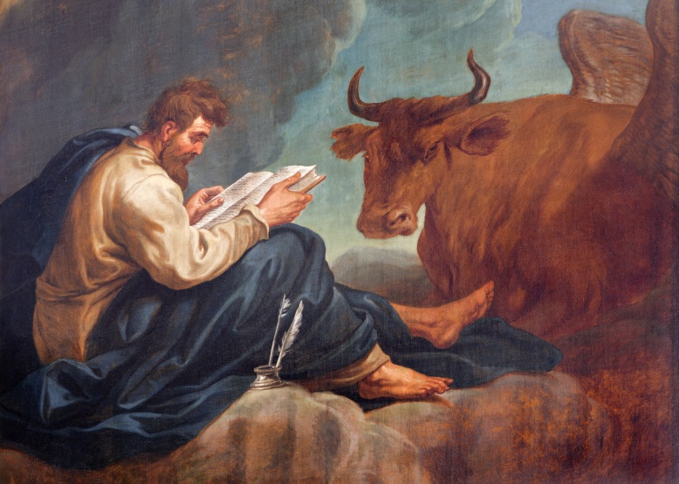
Passing Down the Apostolic Tradition
At first, the Apostles handed on the faith to the earliest Christians by preaching.
Later, the Apostles or their associates wrote the texts of the New Testament.
All of Sacred Scripture is inspired by the Holy Spirit.
© Renata Sedmakova / Shutterstock.com
© 2016 Saint Mary’s Press
Living in Christ Series
Notes:
Notes: Explore the significance of the last point for our willingness to trust the veracity of Scripture and Tradition.

Slide 7
Continuing to Hand It On
Why doesn’t the Church use the Bible alone as the source of authority?
Scripture and Tradition have one common source: God’s Revelation in Jesus.
Together, they make up a unified whole, never contradicting each other.
© StockPhotosArt / Shutterstock.com
© 2016 Saint Mary’s Press
Living in Christ Series
Notes:
Notes: Explain that the Magisterium interprets the Word of God and applies it to new questions. Illustrate the reliance on Scripture and Tradition by sharing some of the footnotes from a recent Church document.

Slide 8
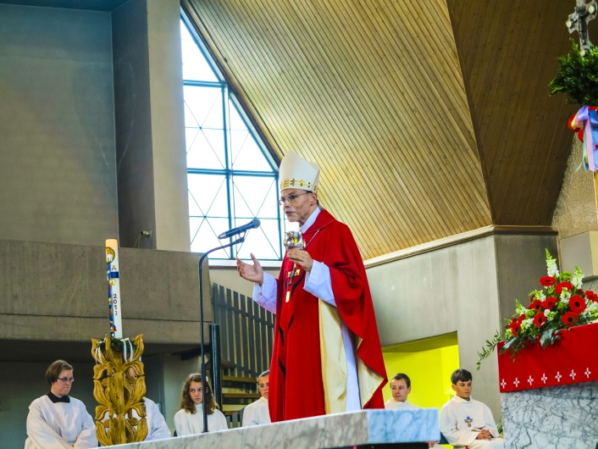
The Apostles and the Bishops
Jesus’ Apostles passed on the gift of the Holy Spirit to their successors.
They did this through the laying on of hands.
Bishops receive the fullness of the Sacrament of Holy Orders.
© 2016 Saint Mary’s Press
Living in Christ Series
© Jorg Hackemann / Shutterstock.com
Notes:
Notes: Ask a volunteer to name the adjective that means “of or relating to a bishop.” (episcopal) Explain that episcopal consecration confers the office of sanctifying, teaching, and ruling on the bishop, conveying power from Christ to the man being consecrated as bishop.

Slide 9
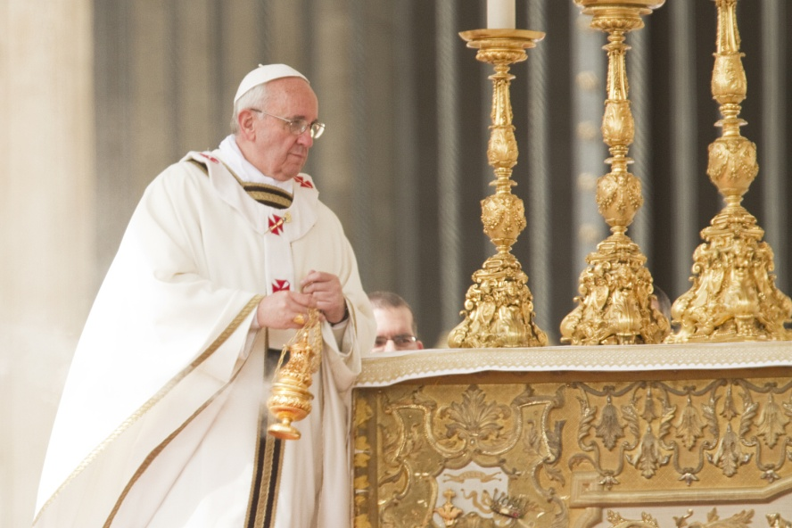
Peter and the Pope
Peter’s role as head of the Apostles continues in the role of the Pope as head of the College of Bishops.
Despite Peter’s human failings, Jesus chose him to be the solid rock of the Church.
The Pope is the Bishop of Rome.
© Philip Chidell / Shutterstock.com
© 2016 Saint Mary’s Press
Living in Christ Series
Notes:
Notes: Ask what failings the second bullet point refers to. (See article 31 of the student book.) Ask the questions that conclude article 31, “Do you think someone with human failings and flaws can be a good leader? Why or why not?”

Slide 10
We Are Sent to Spread the Good News
Every member of the Church has a vocation to the apostolate.
The whole Church is apostolic, sent out into the world to spread the Good News.
Anyone who engages in the apostolate must be in union with Christ.
© William Perugini / Shutterstock.com
© 2016 Saint Mary’s Press
Living in Christ Series
Notes:
Notes: Direct the students to read the definitions of apostolate and laity in article 32 of the student book. Discuss the statement in article 32 that participating in the celebration of the Eucharist is the soul of the apostolate.

Slide 11
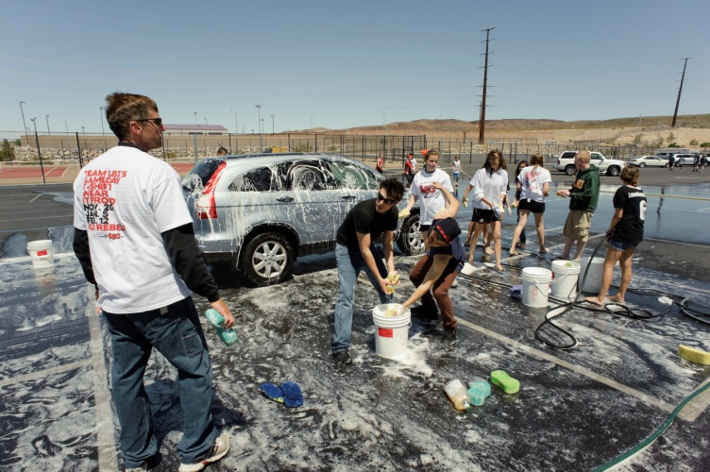
What Does a Lay Apostolate Look Like?
What is the difference between a career understood as an apostolate . . .
and one that is not?
Your life as a student can be an apostolate if you choose to make it so.
© rappensuncle / iStock
© 2016 Saint Mary’s Press
Living in Christ Series
Notes:
Notes: After the second bullet point, discuss the question as in article 32 of the student book. After the last bullet point, discuss what the apostolate could look like for teens.

