Slide 1
Respecting Material Goods
The Catholic Faith Handbook for Youth, Third Edition
Chapter 30
Document #: TX003161
Notes:
Use this presentation to introduce or review the material about sharing the earth’s resources on pages 333–334 of the student handbook.

Slide 2
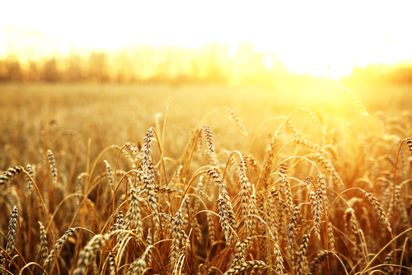
The Earth’s Goods Are for All
Material goods and the Seventh and Tenth Commandments
God created enough resources to go around.
God intended that the world’s resources benefit all creation.
We should not claim so much that others have little access to the goods they need to survive.
Copyright: manhattan8888 / www.shutterstock.com
Notes:
Provide a few current statistics, from a source such as the Web sites of Catholic Relief Services or Share the World’s Resources, about the distribution of world resources.

Slide 3
The Importance of Sharing
640 million children worldwide have no adequate shelter (1 in 3).
400 million have no access to safe water (1 in 5).
270 million have no access to health services (1 in 7).
Copyright: 3445128471 / www.shutterstock.com /
Notes:
Consider dramatizing the enormity of these figures. Before showing the first statistic, have the students count off and ask every third student to stand. Show the statistic on shelter. Ask for reactions to this information.

Slide 4
Love of neighbor requires that the goods of the earth be available to everyone.
Copyright: Pavelk / www.shutterstock.com
Notes:
Discuss the meaning of stewardship, the management of resources entrusted to our care. Remind the students that in Genesis, God gives humans the responsibility for the earth. Ask the students what stewardship might require, as opposed to ownership.

Slide 5
The people in the richest countries of the world have the means to share resources more effectively.
Copyright: Gordon Bell / www.shutterstock.com
Notes:
Ask the students about their own experiences helping those who lack basic services through school, parish, or other organizations, or through their own or their family’s efforts.

Slide 6
A Twofold Response
Charity: almsgiving to help ease poverty
Social action: efforts to change public policies that contribute to poverty
Copyright: niderlander / www.shutterstock.com
Notes:
Note that the second strategy takes longer but gets at the root of the problem. Provide examples of activities such as letter-writing, educating others, and supporting candidates.

Slide 7
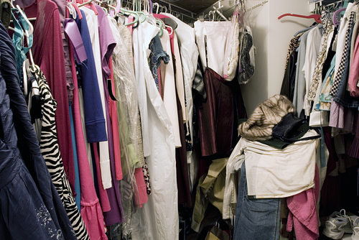
What Have I Bought?
How many things that you buy do you really need for basic survival?
How much influence did advertising or media images have on your purchasing decisions?
Would you consider buying less and donating more?
Copyright: Alon Brik / www.shutterstock.com
Notes:
Familiarize the students with the practice of tithing, that is, giving a fixed percentage of one’s income to charitable causes. Ask their views on this approach, and encourage them to consider it.

Slide 8
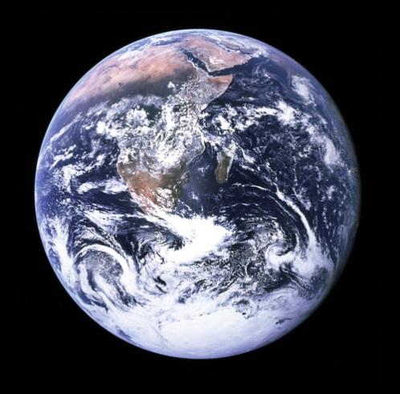
A Moral Duty for the Care of Creation
Creation can thrive if we get our priorities in order.
God entrusted human beings to manage the resources of the universe.
Our moral duty extends beyond today and tomorrow.
Copyright: Yuri Arcurs / www.shutterstock.com
Notes:
(Statistics on slide 3 are from “Global Issues: Social, Political, Economic and Environmental Issues That Affect Us All,” at www.globalissues.org/article/26/poverty-facts-and-stats.)

