Slide 1
The Book of Revelation:
Message to a Persecuted Community
The New Testament
Document #: TX002311

Slide 2
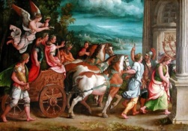
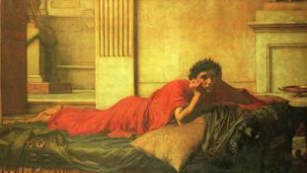
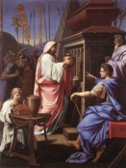
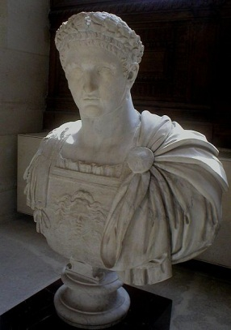
Why were the early Christians persecuted?
The Roman Empire practiced an imperial cult religion, in which the emperor was worshipped as a deity. Christians refused to participate in this cult.
Although Judaism was treated with relative tolerance by Rome, by the late first century, it was clear that Christianity was separating from Judaism and developing into a new religion. Therefore, Christians could no longer benefit from the relative freedom granted to Jews.
The Romans, with their great reverence for ancient traditions, tended to view any new religious movements with suspicion. This suspicion was compounded by the misinformation that circulated about Christians, including, for example, that they engaged in cannibalism by eating the body and drinking the blood of their founder.

Slide 3
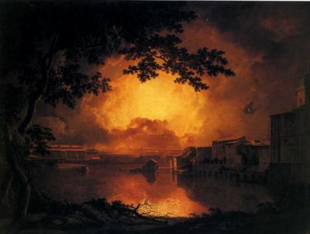
Why were the early Christians persecuted? (continued)
Christians were sometimes scapegoated as being responsible for disasters, such as the fire that destroyed the city of Rome in AD 64. This, then, was used to justify their persecution.
Remember that Jesus himself had been executed under Roman authority. Therefore, the Romans would, at best, treat his followers with extreme caution; at worst, they would subject them to a similar fate.

Slide 4
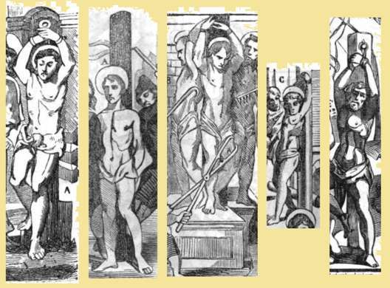
How were the early Christians persecuted?
Christians were persecuted in various ways, including
• heavy fines
• job loss
• exile from the Empire
• physical torture
• death (martyrdom)
Notes:
Notes: Regarding the latter two bullets, the Roman historian Tacitus (who lived from approximately AD 56 to 117) recounts in his writings gruesome practices such as feeding Christians to wild animals, crucifying them, and using their burning bodies as torches to illuminate the night.

Slide 5
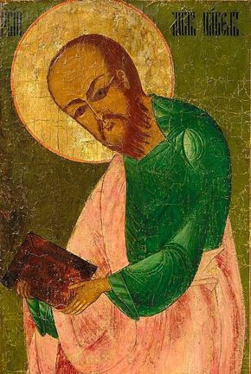
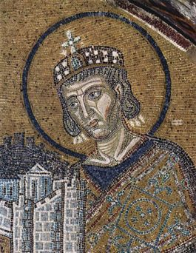
When were the early Christians persecuted?
Persecution of Christians began in the New Testament period, as recounted in the Acts of the Apostles. Saul, who became the Apostle Paul, “was trying to destroy the church; entering house after house and dragging out men and women, he handed them over to imprisonment” (Acts 8:3).
Persecutions continued sporadically, with varying degrees of intensity, until the Emperor Constantine issued the Edict of Milan—a declaration of religious toleration—in 313 and converted to Christianity himself.

Slide 6
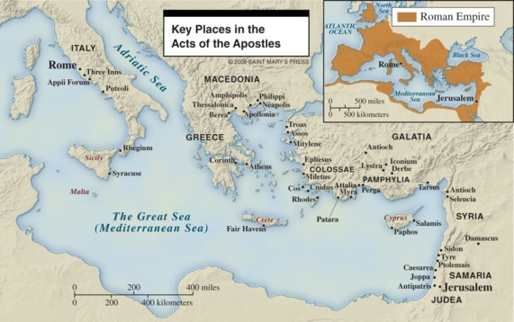
Where were the early Christians persecuted?
Christians were persecuted in many of the major cities of the empire, including Rome, Carthage, Corinth, Lyon, and Alexandria.
Note that many persecutions were local, not empire-wide. In fact, the first empire-wide persecution of the Christian laity did not occur until the mid-third century, during the reign of the Emperor Decius.

Slide 7

What is notable about the persecution under Domitian?
Domitian reigned as Emperor from 81 to 96.
The persecution during his reign is considered to have been the second major wave of persecution, following that which occurred under the Emperor Nero, around 64.
Domitian has been described as a tyrant who ruthlessly persecuted not only Christians but also his political enemies. He even ordered the execution of some of his own family members.
Biblical scholars believe that the Book of Revelation was written during the reign of Domitian. Awareness of this persecution can help us to understand why the Book of Revelation was written in symbolic language, a type of code: it was a message to a persecuted community that only they—and not their oppressors—could understand.

