Slide 1
Traditional and Contemporary Images of the Church
The Church: Foundations and Mission
Unit 3, Chapter 8
Document #: TX006512

Slide 2
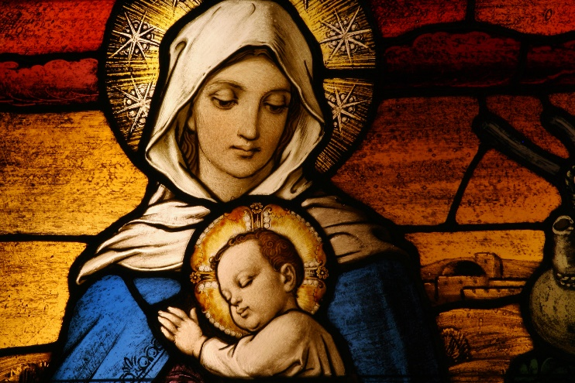
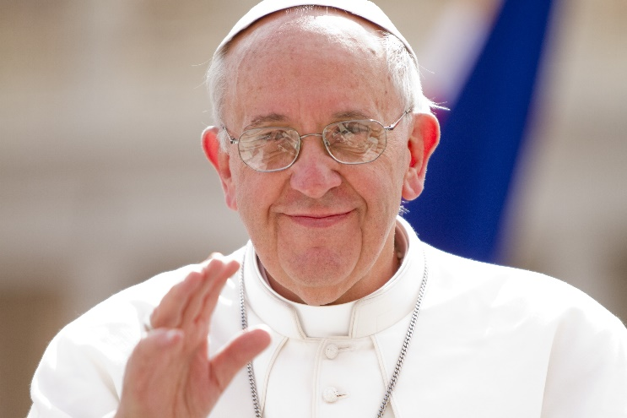
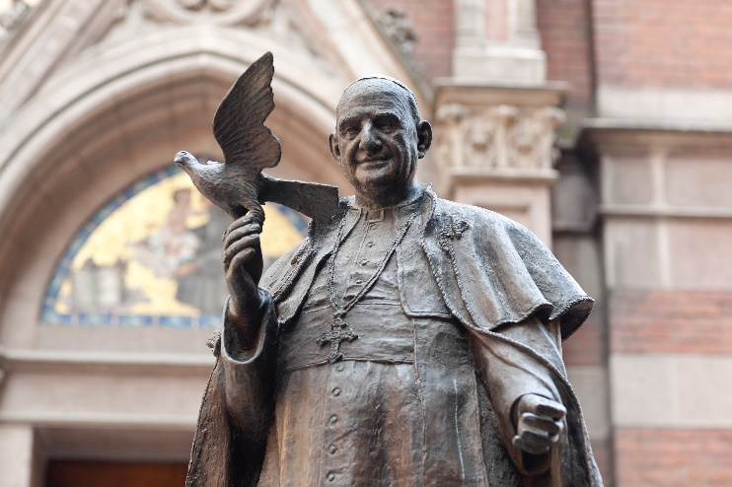
How do different images of the Church help us to understand what the Church really is?
Notes:
© CURAphotography / Shutterstock.com - © volkankovancisoy / istockphoto.com - © Philip Chidell / Shutterstock.com

Slide 3
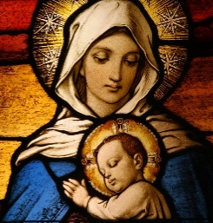
Images of the Church
In this chapter, we look at images of the Church that come from sources outside Scripture:
images from the life of Mary
images from the documents of Vatican Council II
images from Pope Francis
Notes:
© CURAphotography / Shutterstock.com - © volkankovancisoy / istockphoto.com - © Philip Chidell / Shutterstock.com
Notes: As you transition to this new chapter, you may wish to remind the students that the previous chapter (chapter 7) examined images of the Church from Scripture. As indicated on this slide, chapter 8 will look at images of the Church from three other sources. However, many of these “other sources” reflect scriptural images, either directly or indirectly. As you move through the slides, invite the students to identify these scriptural connections.

Slide 4
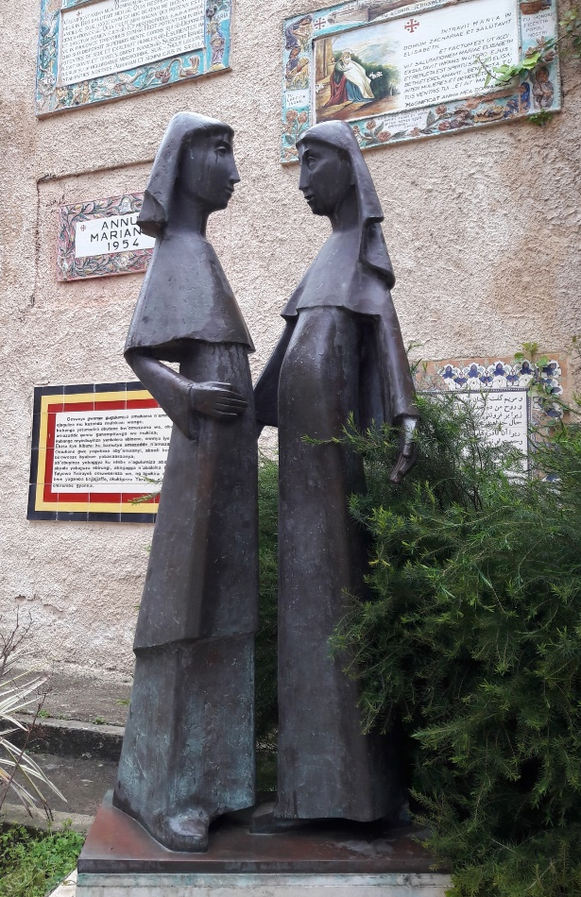
Images from the Life of Mary: The Magnificat
Mary proclaims the Magnificat while visiting her cousin Elizabeth (see Luke 1:46–55).
It is Mary’s prayer, a song of praise.
Mary prays it after discovering she is pregnant, and she goes to share the news with Elizabeth.
The prayer reflects Old Testament themes of God’s love, mercy, and justice.
Notes:
© naturesharing / Shutterstock.com
Notes: If the students recall the Old Testament story of Hannah, Samuel’s mother, you might mention that the Magnificat bears a striking resemblance to Hannah’s song of praise (see 1 Samuel 2:1–10). Both women are pregnant in unusual, miraculous circumstances: Mary is a virgin, and Hannah was thought to be barren (unable to conceive a child).

Slide 5
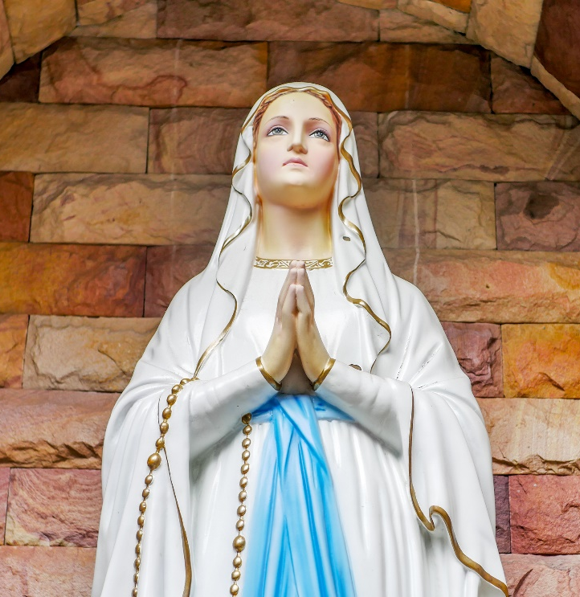
The Magnificat and the Church
The themes in the Magnificat provide us with insights about the mission of the Church.
The Church is called to praise God always.
The Church is called to serve the world, especially those who are in great need.
The Church will endure forever, until the Reign of God is fully realized.
Notes:
© macpanama / Shutterstock.com
Notes: The imagery in the Magnificat is striking, beautiful, and powerful. Time permitting, consider reading it aloud or using it as a prayer to begin or end this class session.

Slide 6
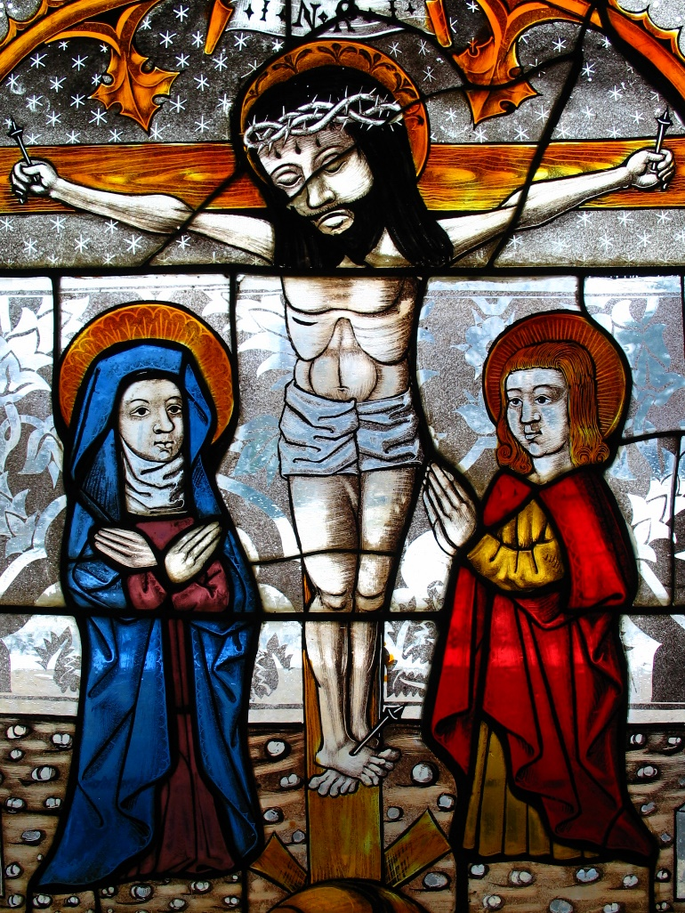
Images from the Life of Mary: The Foot of the Cross
As Jesus is dying on the cross, his final words to Mary and John also provide insight about the nature of the Church.
Jesus entrusts Mary and the Beloved Disciple (who represents the Church) to one another.
Pope Francis established a new feast day to honor Mary as the Mother of the Church.
Notes:
© hfng / istockphoto.com

Slide 7
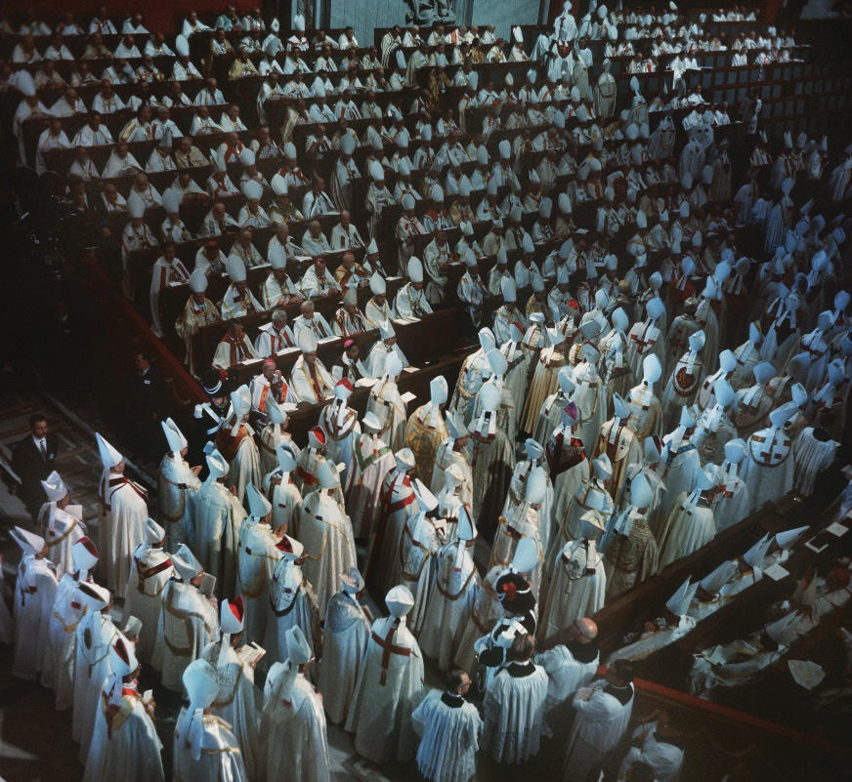
Vatican Council II Image: The People of God
The Church is the entire worldwide community of baptized disciples.
The Church is all of us, not just those who hold a particular title, office, or leadership role.
Notes:
© dpa picture alliance archive / Alamy Stock Photo
Notes: Help the students to understand that although Vatican Council II (1962–1965) brought renewed emphasis to the image of the Church as the People of God, the image itself was not a new idea. Vatican II simply helped us to rediscover and reclaim the ancient, scripturally based idea that we all become part of the Church through Baptism. All baptized people have a unique Christian dignity, equality, and freedom.

Slide 8
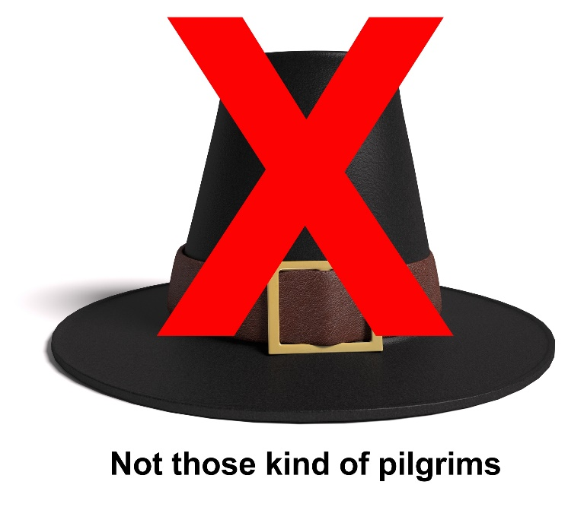
Vatican Council II Image: A Pilgrim People
We are on a spiritual pilgrimage (journey) toward the Kingdom of God and a heavenly home.
Are we there yet?
Yes: Christ has already established the Kingdom of God.
No: The Kingdom of God is not yet fully realized.
Notes:
© WesAbrams / istockphoto.com

Slide 9
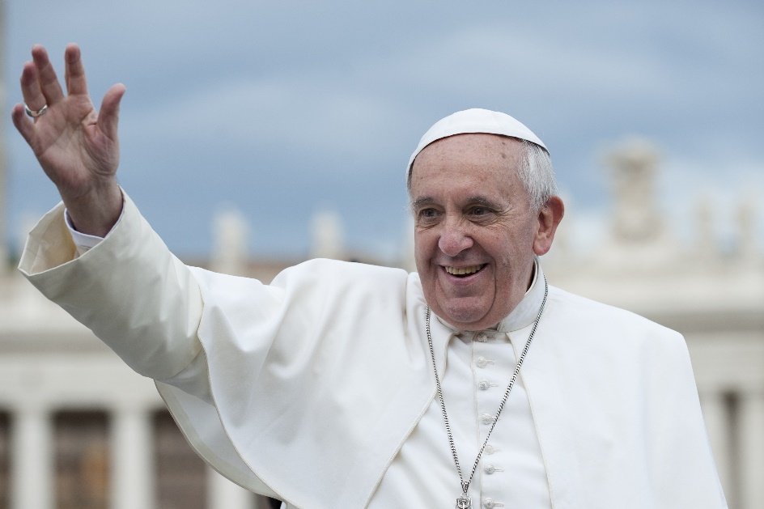
Images from Pope Francis
Pope Francis has been very creative in describing the Church. For example, he has used the metaphor of the Church as a field hospital:
focusing our mission on people who are hurting
tending spiritual and emotional wounds
reaching out with care and compassion
Notes:
© neneo / Shutterstock.com
Notes: Pope Francis’s creative use of this image draws our attention to the Church’s mission of service and healing. All of us can share in this mission in both big and small ways.

Slide 10
Images from Pope Francis
Pope Francis has used other creative images, such as:
The Church should have the “odor of the sheep”:
be with people, up close and personal, rather than keeping our distance
The Church should be “out on the streets”:
bravely going wherever the need is greatest
Notes:
© Africa Studio / Shutterstock.com

Slide 11
Discuss
Break into small groups and brainstorm some ways you can step out of your comfort zone and make sacrifices for the sake of the Gospel.
Notes:
Notes: Help the students to understand that these images, like all the images discussed in this chapter, are metaphors. Pope Francis is not suggesting that we should find smelly people we can help so that we can smell like them. Nor is he suggesting that we take actions that are unnecessarily risky, foolish, or dangerous. But he is inviting us to step out of our comfort zones and to make sacrifices for the sake of the Gospel. The “Make It So” feature that appears on page 187 of the student book lists several suggestions for how students could respond to Pope Francis’s invitation. You might read this feature aloud and invite students to brainstorm other ideas.

