Slide 1
We Are Children of God
Jesus Christ: God’s Love Made Visible, Second Edition
Unit 4, Chapter 11
Document#: TX004817

Slide 2

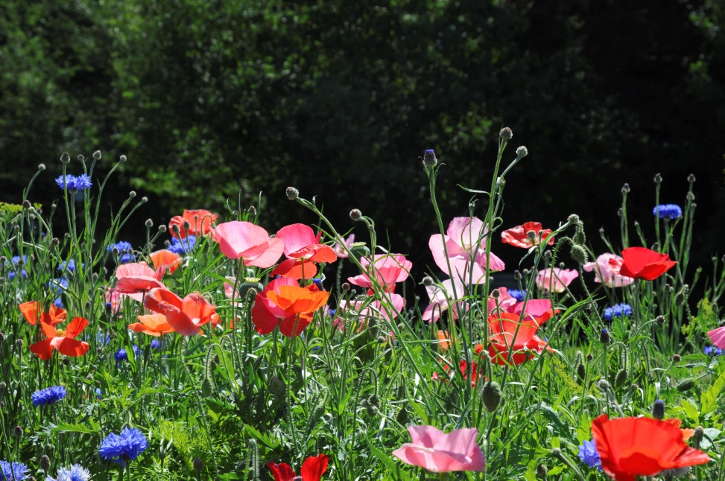
God Desires Our Happiness
God created us to be deeply happy during our time on earth and in Heaven.
Our desire for happiness comes from God.
Only God can truly fulfill that desire.
© nsca / iStockphoto.com
Notes:
Discuss the messages that our consumer culture promotes about happiness. Ask volunteers to identify experiences of deep happiness that have no connection to materialistic values. Look for links to God’s presence in those experiences.
This slide corresponds to content in article 50, “God Desires Our Happiness,” in the student book.

Slide 3

Original Happiness Lost, Restored
At first, humankind lived in harmony with God, with one another, and with nature.
We need God to restore to us the happiness
of living as he desires.
God the Father sent
Jesus to save us
through the Paschal
Mystery.
© diephosi / iStockphoto.com
Notes:
Ask what happened that caused humanity to lose its original justice and holiness (the Fall). Review the effects of Original Sin.
This slide corresponds to content in article 50, “God Desires Our Happiness,” in the student book.

Slide 4
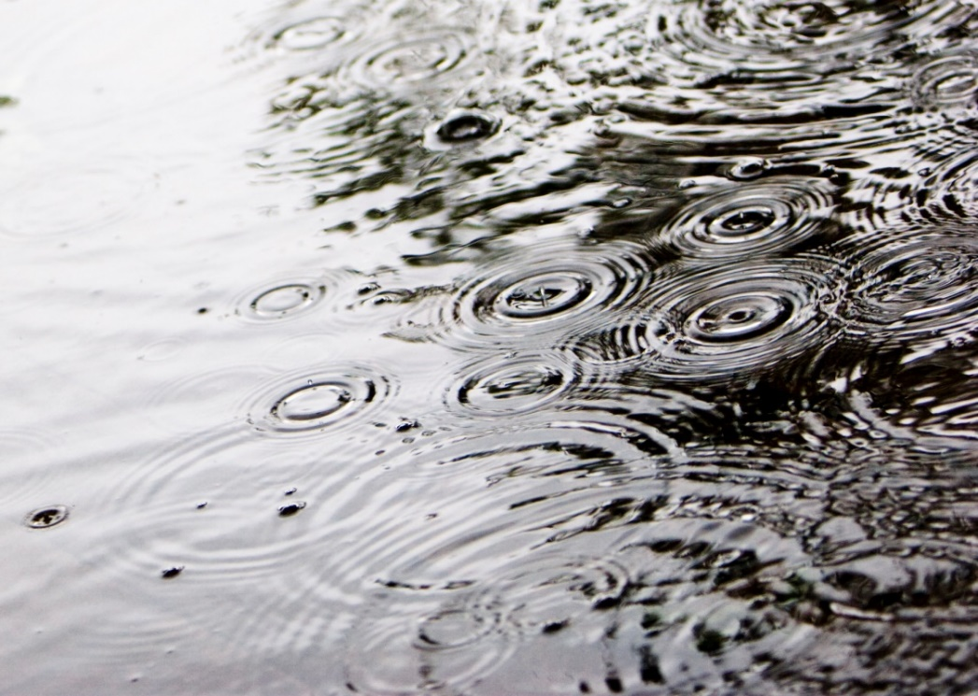
True Joy
Believing in the saving work of Jesus does not guarantee happiness every day.
Faith in Jesus offers us a foundation for a life that is full of deep and abiding joy.
True joy is the mark of the authentic Christian.
© Steve Froebe / iStockphoto.com
Notes:
Discuss the joy that results from living as God wills. Ask for examples from everyday life (the joy of serving, forgiving, and so on).
This slide corresponds to content in article 50, “God Desires Our Happiness,” in the student book.

Slide 5
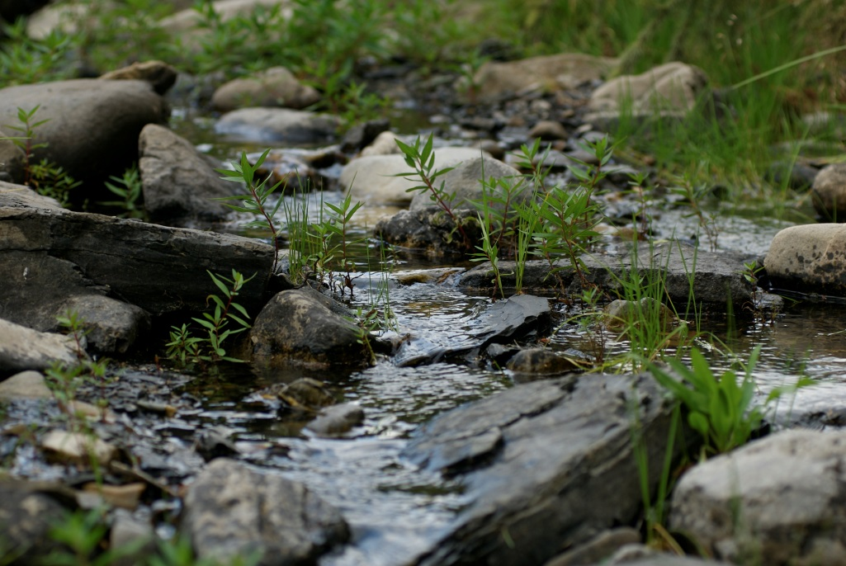
The Beatitudes and Happiness
The Beatitudes: Jesus identifies those who are blessed.
He presents us with a vision of the happiness God desires for us.
We find joy when we show mercy, fight for righteousness, and make peace.
© flyexpert / iStockphoto.com
Notes:
Direct the students to read the Live It! sidebar in article 52 in the student book. Challenge the students to follow through on this exercise.
This slide corresponds to content in article 50, “God Desires Our Happiness,” in the student book.

Slide 6
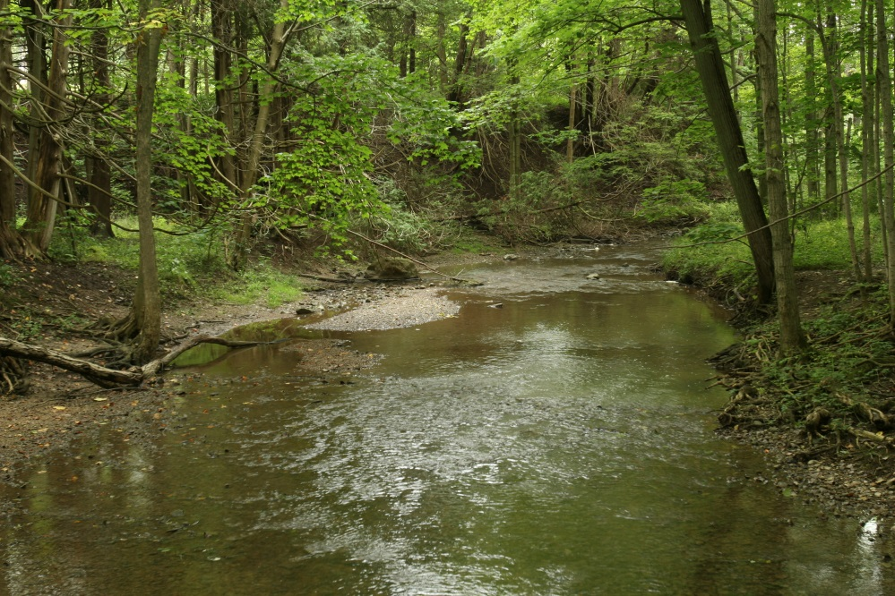
Baptism: Becoming God’s Adopted Children
Through the Sacrament of Baptism, we enter into a new relationship with God.
Baptism transforms the newly baptized person into a Temple of the Holy Spirit.
It unites the person with Christ and his divine nature.
© strathroy / iStockphoto.com
Notes:
Explain the practice of adult Baptism, referring to the Did You Know? sidebar in article 51 in the student book. Discuss the students’ experience of Baptism in their parishes.
This slide corresponds to content in article 51, “Baptism: Becoming God’s Adopted Children,” in the student book.

Slide 7
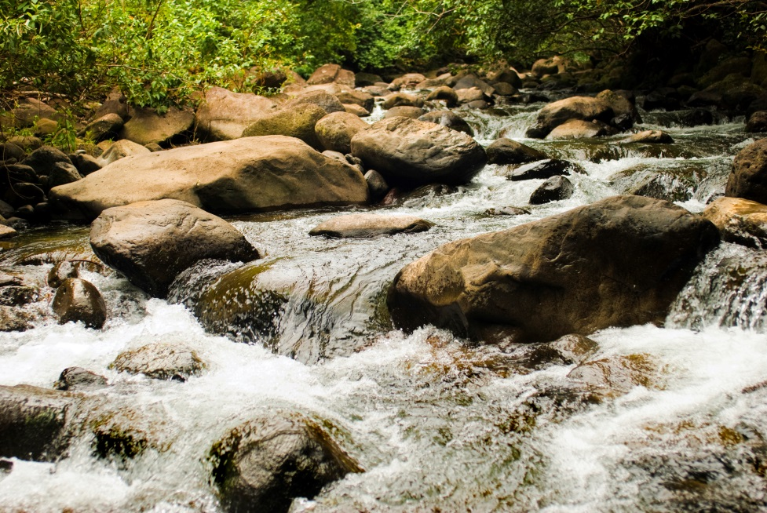
God’s Children and Heirs
The baptized person is a freely adopted son or daughter of God.
Baptism gives us a new relationship with other fellow believers in Christ.
It creates profound equality among believers.
© gregobagel / iStockphoto.com
Notes:
Read aloud Galatians 3:26–28, quoted at the end of the section “God’s Children and Heirs” in the student book. Brainstorm terms that Saint Paul might use if he were speaking of today’s Christian community (rich or poor, liberal or conservative, and so on).
This slide corresponds to content in article 51, “Baptism: Becoming God’s Adopted Children,” in the student book.

Slide 8
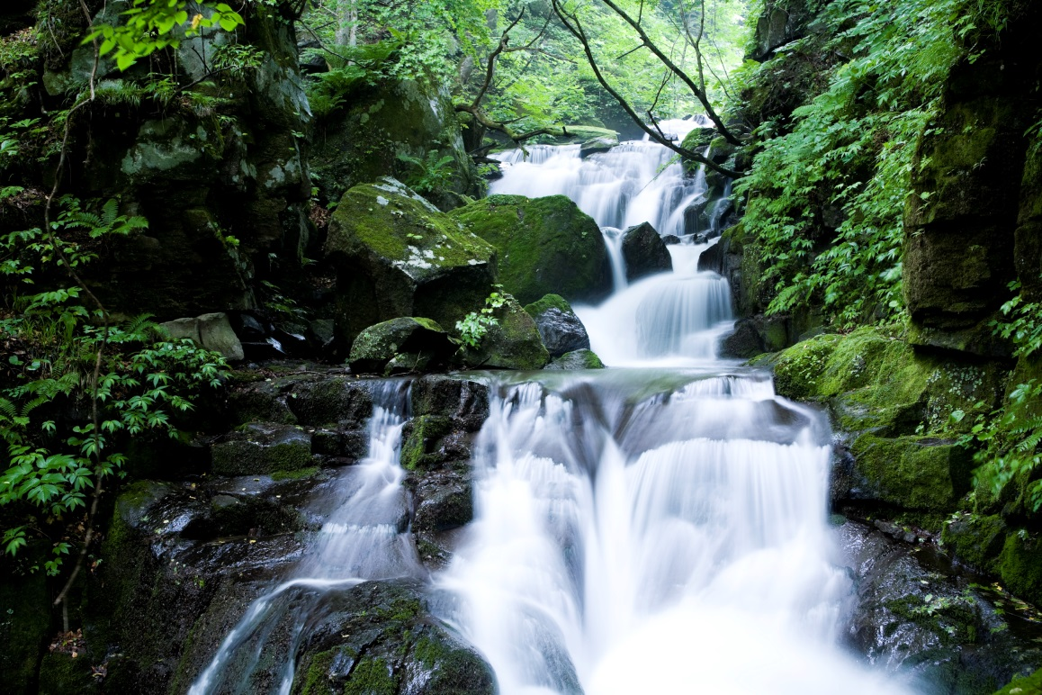
Grace
Grace is a freely offered gift of God, not something that we have to earn.
The grace we receive in Baptism allows us to share in the closeness of the Trinity.
Grace enables us to live in a way that is worthy of his adopted children.
© ooyoo / iStockphoto.com
Notes:
Ask the question at the end of the section “The Role of Grace” in the student book: “Why do you think God freely offers us grace?”
This slide corresponds to content in article 51, “Baptism: Becoming God’s Adopted Children,” in the student book.

Slide 9
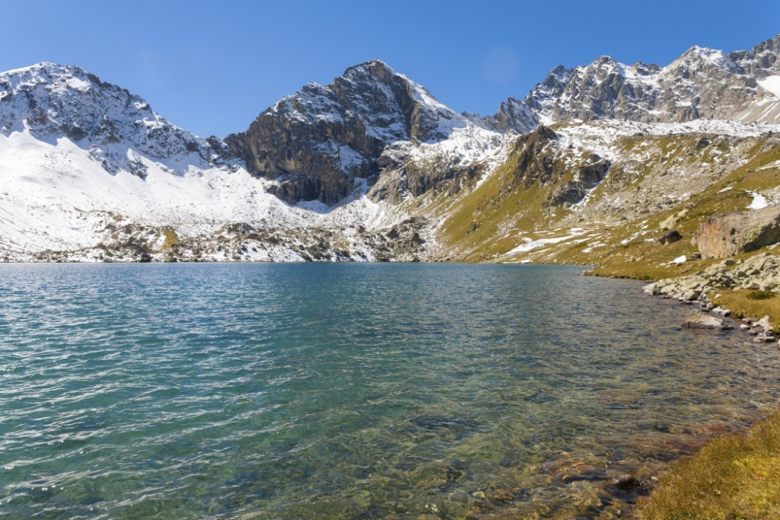
Eternal Life: Our Ultimate Destiny
As God’s children, we are destined to live forever in the presence of God.
Nothing can take the
place of God in our lives.
© Ekaterina_Marory / iStockphoto.com
Notes:
Ask the second question that concludes the final section in article 52 in the student book: “How can you put God first in your life?”
This slide corresponds to content in article 52, “Eternal Life: Our Ultimate Destiny,” in the student book.

Slide 10
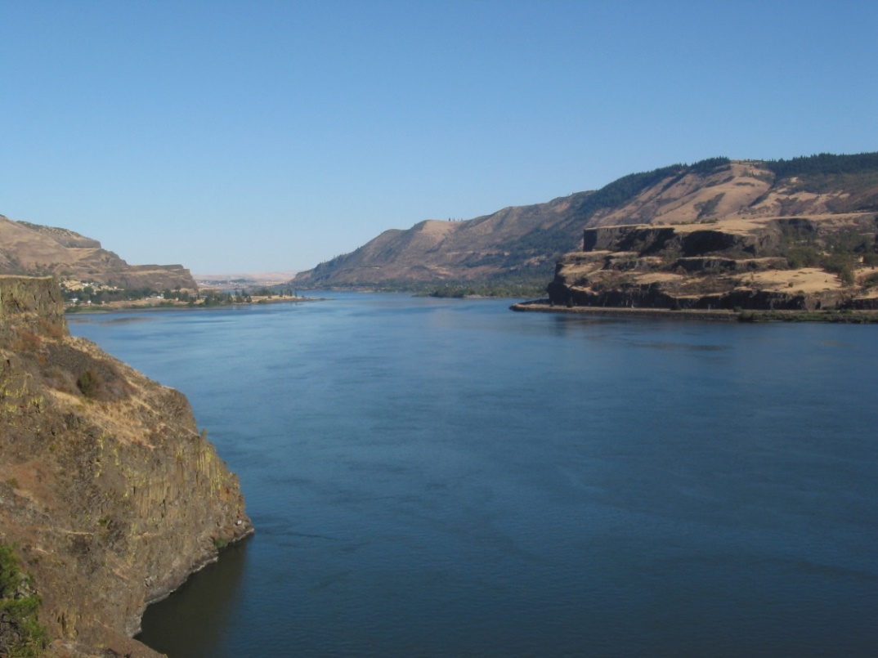
Sharing in Jesus’ Resurrection
We have been baptized into Christ’s body.
Like him, we will be raised to immortality.
We will live forever with God, sharing in the life
of the Blessed Trinity.
© chamey / iStockphoto.com
Notes:
Read aloud Romans 6:3–5, quoted in the section “Sharing in Jesus’ Resurrection” in the student book. Explain that baptismal immersion is like passing through death; a new white garment symbolizes a new life.
This slide corresponds to content in article 52, “Eternal Life: Our Ultimate Destiny,” in the student book.

Slide 11
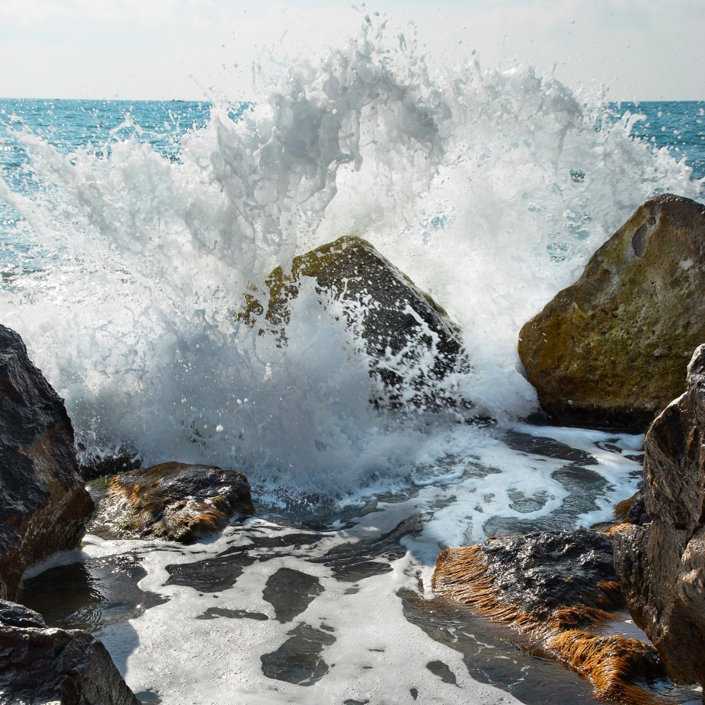
Heaven
Heaven is a mystery that surpasses our human comprehension.
It is perfect communion with God and with all those united in Christ.
© Dovapi / iStockphoto.com
Notes:
Direct students to read the scriptural images of Heaven listed in the paragraph that begins “What is Heaven like?” in the section “Heaven” in the student book. Discuss what each image conveys about Heaven.
This slide corresponds to content in article 52, “Eternal Life: Our Ultimate Destiny,” in the student book.

Slide 12

The Catholic Funeral
The symbols of the funeral liturgy strengthen our belief that the baptized are destined to share in eternal life with God.
Many elements of the funeral liturgy connect with the liturgy of Baptism.
© nsca / iStockphoto.com
Notes:
Ask volunteers to read aloud the bulleted points on the Catholic funeral liturgy in the section “Preparing for Eternal Life with God: The Catholic Funeral Liturgy” in the student book. Discuss how these symbols and rituals relate to the baptismal liturgy.
This slide corresponds to content in article 52, “Eternal Life: Our Ultimate Destiny,” in the student book.

