Slide 1
Life Issues: War
The Catholic Faith Handbook for Youth, Third Edition
Chapter 28
Document #: TX003159
Notes:
Use this presentation to introduce or review the just-war theory.

Slide 2
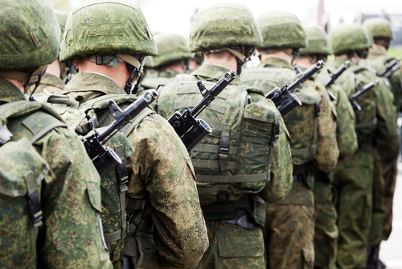
Is War Morally Permissible?
Love is incompatible with violence.
All citizens and governments must do everything they can to avoid war.
We have the right to stop an individual, or a nation, from inflicting harm.
Copyright: Ilya Andriyanov / www.shutterstock.com
Notes:
After showing the last statement, ask the students what other methods governments can use to resolve conflicts.

Slide 3
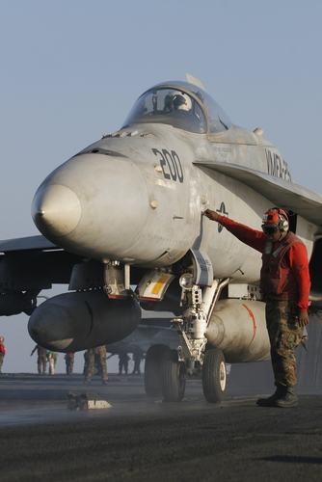
Just-War Theory
The principles of legitimate self-defense are just as applicable for nations as they are for individuals.
The Church has developed criteria that must be met for a war to be morally permissible.
Copyright: Jason and Bonnie Grower / www.shutterstock.com
Notes:
Tell the students that the Church bases its modern just-war theory on the thirteenth-century writings of Saint Thomas Aquinas.

Slide 4
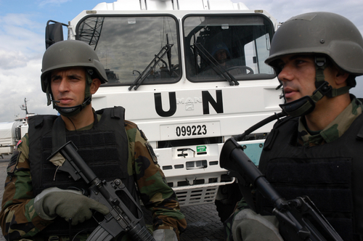
Just Cause
Nations may wage war to correct a grave, public evil.
An example: a nation can intervene to prevent genocide.
Copyright: homeros / www.shutterstock.com
Notes:
Check the Web sites of “World without Genocide” or “Genocide Watch” to learn about current cases. Inform the students that genocide is a common feature of modern warfare, particularly in Africa and Asia.

Slide 5
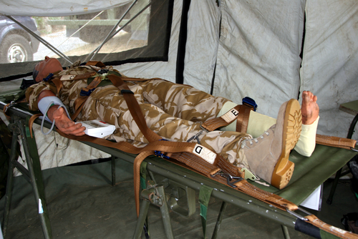
Comparative Justice
The good achieved through war must far outweigh the loss of life and disruption it causes.
QUESTION: In your view, what kind of good would outweigh the suffering caused by war?
Copyright: Timothy Large / www.shutterstock.com
Notes:
Encourage the students to give serious thought to this question. Remind them that as voters they will someday have input on issues of war and peace, and can voice their opinions even before they reach voting age.

Slide 6
Legitimate Authority
Only duly constituted public authorities may wage war.
A private army may not conduct its own war.
Copyright: Konstantin L / www.shutterstock.com
Notes:
If a student asks about rebellion against an oppressive government, explain that people may defend themselves against a regime that threatens their survival.

Slide 7
Right Intention
Nations must use war only for a truly just cause and solely for that purpose.
Nations may not wage war out of ethnic hatred or revenge, or for material gain.
Copyright: blinkblink / www.shutterstock.com
Notes:
Note that in order to support a war, citizens must be well informed about the reasons for it and the long-term goal.

Slide 8
Probability of Success
War may not be used in a futile cause or in a case where disproportionate measures are required to achieve success.
Nations may not cause grave destruction for a lost cause.
Copyright: TsuneoMP / www.shutterstock.com

Slide 9
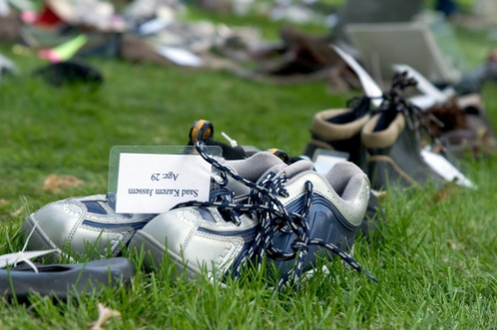
Proportionality
The overall destruction expected must be outweighed by the good to be achieved.
Loss of civilian life must be avoided at all costs.
Copyright: Karla Caspari / www.shutterstock.com
Notes:
Explain that modern methods of warfare make this last condition very difficult to meet. The Church allows that a war that harms civilians can still be a just war as long as that harm isn’t intentional.

Slide 10
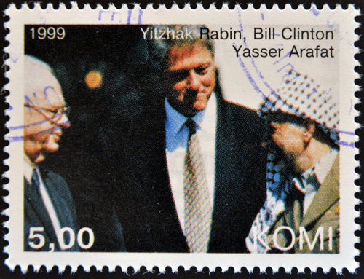
Last Resort
Copyright: Neftali / www.shutterstock.com
Nations may wage war only after exhausting all peaceful alternatives.
QUESTION: How do the principles of a just war relate to the conflict resolution principles we use in daily life?
Notes:
Encourage the students to look at each principle to see whether it could apply to an individual.

