Slide 1
Chapter 4: Buddhism
World Religions: A Voyage of Discovery
DOC ID #: TX003941

Slide 2
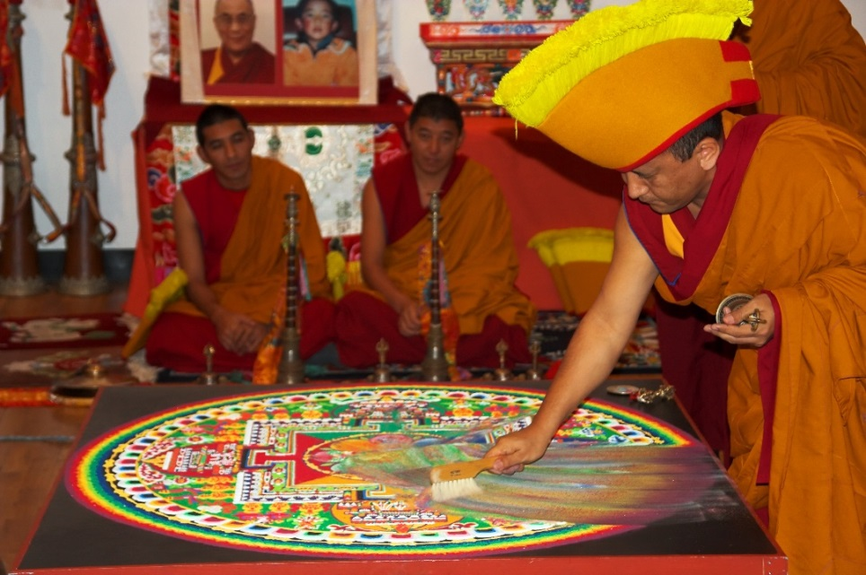
Impermanence
This is one of the Three Marks of Existence.
Tibetan Buddhists spend several days constructing intricate sand mandalas.
Shortly after completion, the mandala is quickly destroyed, symbolizing the impermanence of existence.
© Artur Bogacki / www.shutterstock.com
Notes:
Notes: (As stated in the student book glossary, mandalas are patterned icons that promote enlightenment through visual stimulation.) The photo of the Dalai Lama, the saffron robes of the monks, and the distinctive yellow hat all indicate that these are Tibetan Buddhists, and in fact members of the Gelug or Yellow Hat Sect. The ritual of creating and deconstructing sand mandalas is itself a Tibetan Buddhist practice, now commonly performed by Tibetan monks visiting the places in North America.

Slide 3
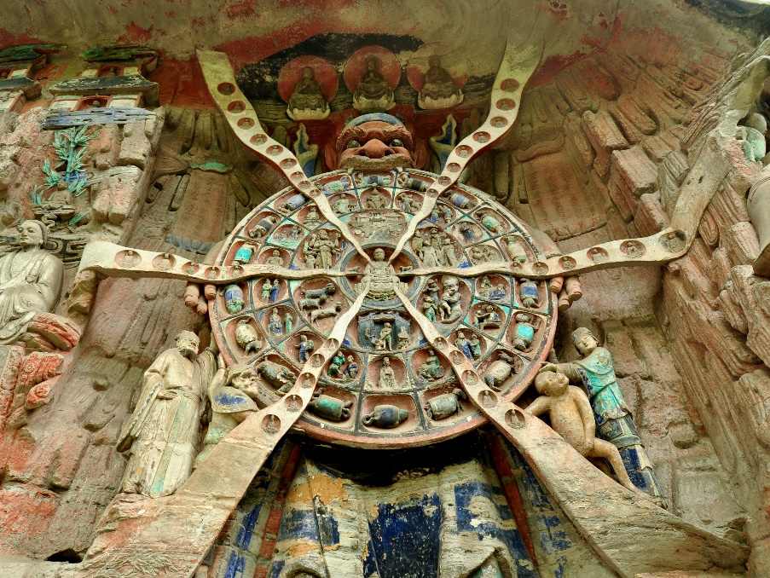
Buddhist Wheel of Life
The Wheel of Life represents samsara.
It is portrayed in art as a reminder of essential teachings.
The six realms of rebirth are depicted in the second wheel.
The twelve links of “codependent origination” are depicted in the third wheel.
© jejim / www.shutterstock.com
Notes:
Notes: The sculpture shown on this slide is in Dazu, China. Much could be offered here in order to explain the details of the six realms of rebirth and “codependent origination” (in Sanskrit, pratītyasamutpāda; in Pali, paticcasamuppāda)—also known as dependent origination, dependent co-arising, and various other terms. Although consideration of codependent origination is beyond the scope of the student book’s introductory study of the Buddhist tradition, this doctrine is highly significant, especially as a subject upon which Buddhist practitioners are to meditate. The Wheel of Life is also depicted in the tangka on slide 8.

Slide 4
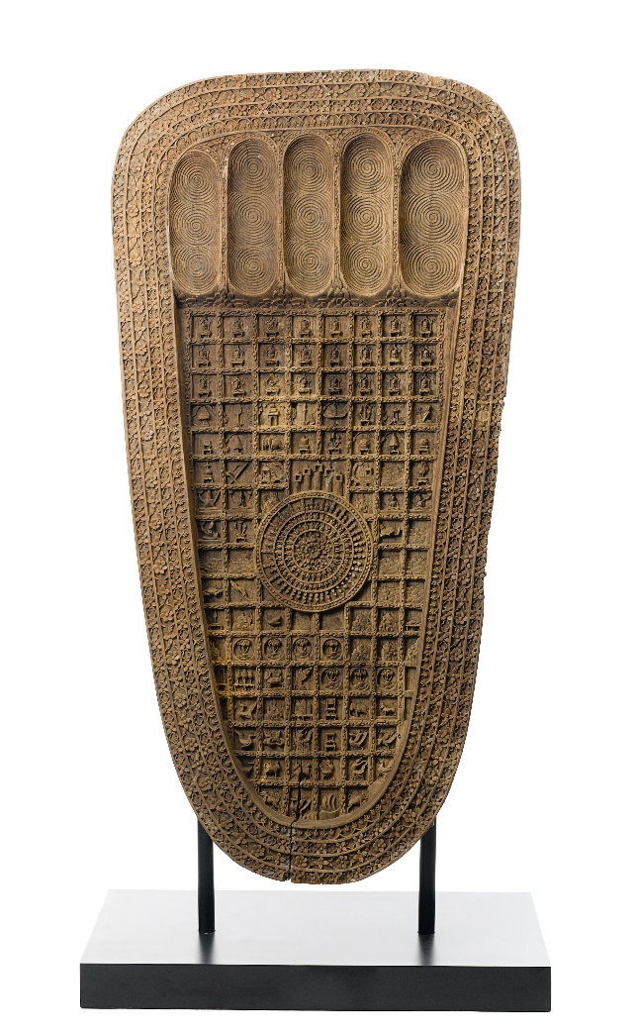
Buddha’s Footprint
The Buddha’s footprint is among the tradition’s earliest visual symbols.
It signifies the Buddha’s passing into nirvana.
Sometimes the footprints are in rock on the ground, as if left by the Buddha.
Others have been made as wooden carvings.
© Venus Angel / www.shutterstock.com
Notes:
Notes: The footprints often contain symbols and writing; this one contains both. Some of the “natural” footprints in the ground are venerated as relics, traditionally believed to be places where the Buddha actually stood.

Slide 5
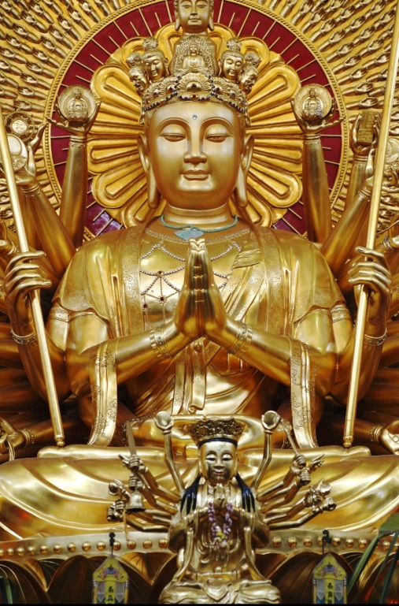
Avalokiteshvara
The multi-armed Avalokiteshvara is the bodhisattva of compassion.
In China, Avalokiteshvara is identified in female form as Kuan Yin.
Avalokiteshvara is known in the Tibetan language as Chenrezig.
The Dalai Lama is believed to be the incarnation of Chenrezig.
© Gwoeii / www.shutterstock.com
Notes:
Notes: The importance of Avalokiteshvara in various cultures, including China’s Kuan Yin, makes this bodhisattva an especially inviting subject for concentrated study. The variety of artistic manifestations is similarly inviting for further exploration. This example is from the Po Ling Temple in Kuala Lumpur, Malaysia.

Slide 6
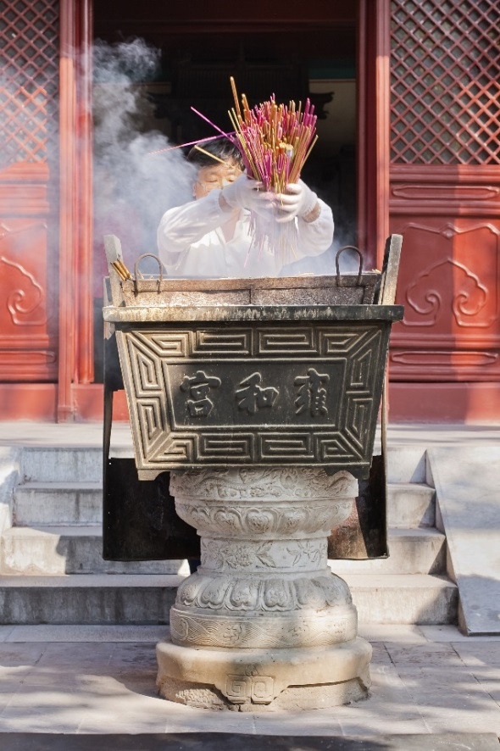
Offering of Incense
Buddhists commonly make offerings of burning incense, lit candles, or flowers.
This ritual act cultivates mindfulness and virtue.
It is believed to reduce suffering and to lead to good rebirth.
© TonyV3112 / www.shutterstock.com
Notes:
Notes: This altar is situated at Lama Temple, in Beijing, China. The symbolic significance of offerings can be quite intricate; for example, the scent of burning incense is associated with moral purity. Any Buddhist practitioner—not just priests, monks, or nuns—is free to make such an offering, and scenes like this one are very common at Buddhist temples.

Slide 7
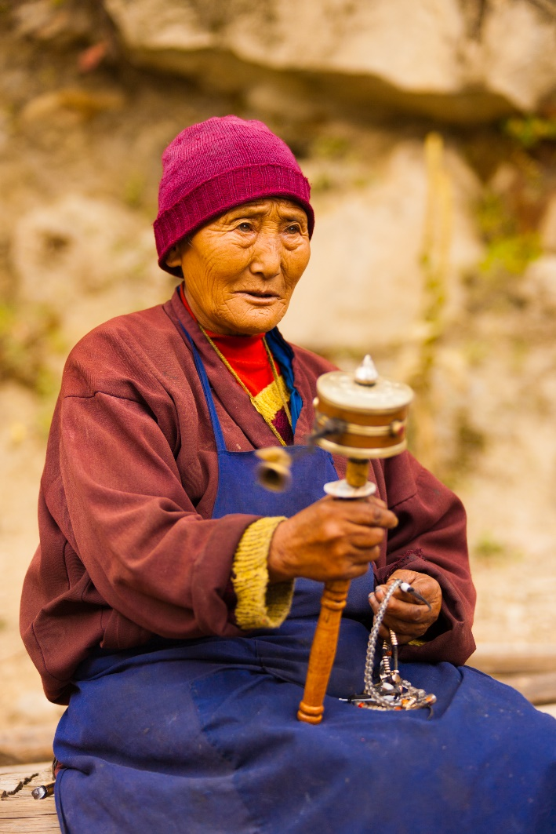
Tibetan Prayer Wheel
The wheel is a common Buddhist symbol.
Tibetan Buddhists commonly use prayer wheels, adorning them with essential teachings in the form of prayers.
Spinning the wheel is believed to have the same effect as speaking the prayers.
© Pius Lee / www.shutterstock.com
Notes:
Notes: The symbolism of the wheel is featured in the Wheel of Life. The mantra Om, mani padme hum is often written on prayer wheels. The wheel symbolism relates to dharma, based in part on the traditional manner of referencing the Buddha’s process of teaching: “turning the wheel of dharma.” This turning is divided into three phases, traditionally believed to have been set forth on three occasions, the first being the Buddha’s famous sermon at the Deer Park near Varanasi where he taught the Four Noble Truths.

Slide 8
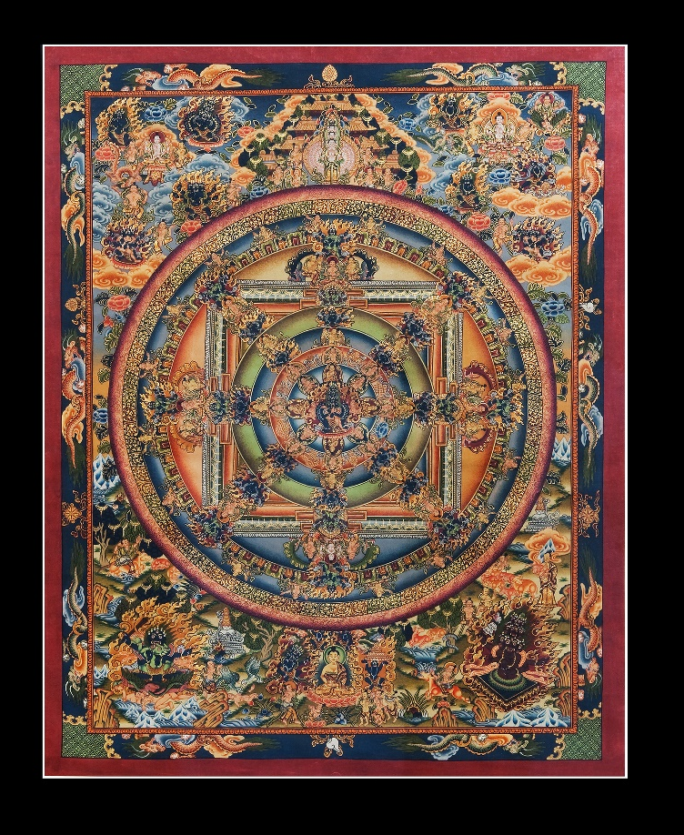
Mandala
The tangka is a painting on cloth with embroidery.
Tangkas are used in Tibetan Buddhism and often portray mandalas.
The Wheel of Life features twelve links of “codependent origination.”
© Zzvet / www.shutterstock.com
Notes:
Notes: Usually tangkas (also spelled as thangka or tanka) are painted on silk. Typically they feature mandalas, the patterned icons that are also portrayed by Tibetan Buddhists in sand (as shown on slide 2; the Wheel of Life is shown on slide 3). The mandala shown on this slide is clearly set forth in a fourfold scheme (with accompanying schemes of six, eight, and twelve), representative of the cosmos. Like most every Tibetan tangka, this one includes depictions of various Buddhas and bodhisattvas. This slide might provide an opportunity to ask the students to consider how such a patterned icon could aid in meditation.

Slide 9
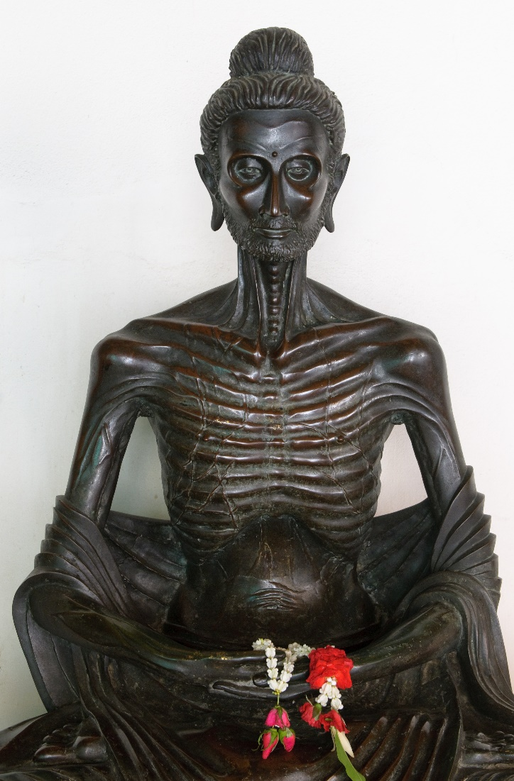
Emaciated Buddha
Prior to his enlightenment, Gautama practiced extreme asceticism.
Gautama chose instead the Middle Way of moderation.
Buddhist monks and nuns commonly avoid consuming food after noon.
© javarman / www.shutterstock.com
Notes:
Notes: The sculpture shown on this slide is from Bangkok, Thailand. This slide and the following four illustrate five common ways of depicting the Buddha: emaciated, sitting (touching the ground), standing, laughing (although this is not Gautama the Buddha), and reclining. Having discovered that extreme asceticism did not lead to enlightenment, Gautama chose instead the Middle Way. The students will likely find it surprising to learn that the Middle Way is to avoid consuming food after noon.

Slide 10
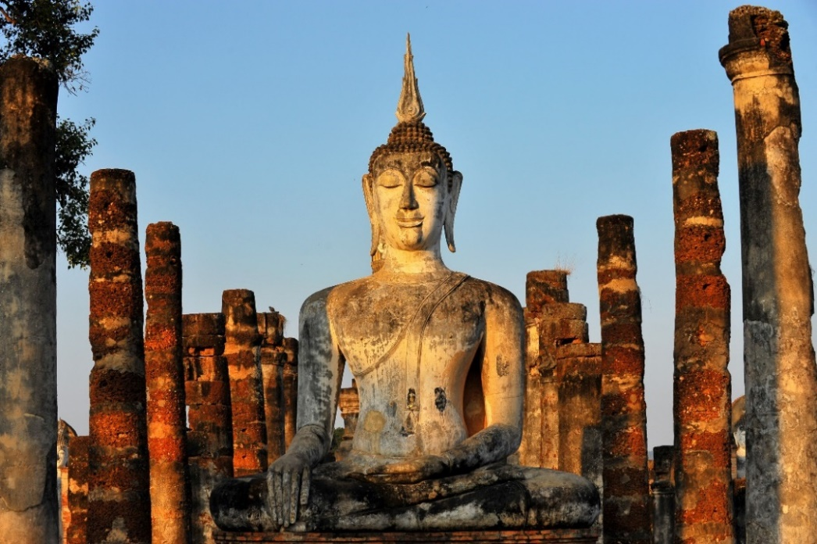
Earth-Touching Buddha
Gautama sat in meditation, which led to his enlightenment.
He touched the ground in response to a challenge by Mara.
By touching the ground, the Buddha called Earth to witness his triumph.
© think4photop / www.shutterstock.com
Notes:
Notes: The stone sculpture shown on this slide is located in Wat Mahathat Temple, in Thailand. This common way of depicting the Buddha is also known as “Buddha defying Mara.” Mara is the demonic being who tried to tempt Gautama to abandon his quest. The ground is said to have shaken in response, confirming Gautama’s triumph. More detail on the events of the night of enlightenment could be provided, perhaps by sharing with the students ancient accounts from Buddhist scriptures.

Slide 11
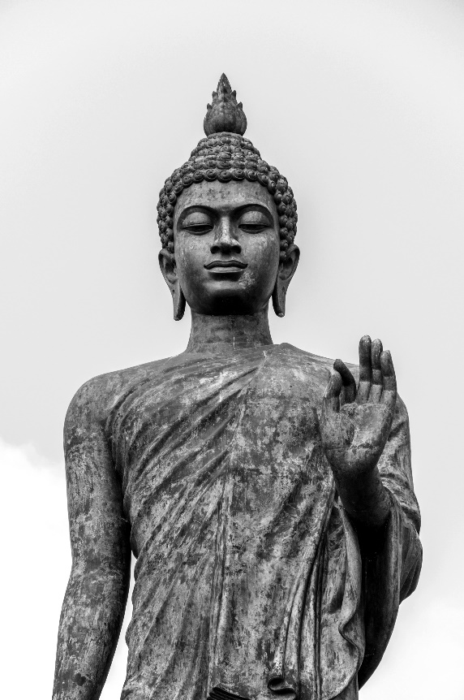
Standing Buddha
Standing Buddha sculptures feature a variety of symbolic gestures and events.
The index finger joining the thumb symbolizes intellectual discourse.
At 52 feet high, this is the world’s tallest Buddha statue.
© wasanajai / www.shutterstock.com
Notes:
Notes: The Buddha’s various hand gestures as portrayed in sculptures and paintings are categorized and assigned specific meanings. The statue shown on this slide is located in the Phutthamonthon (or Buddha Monthon), a Buddhist park in the province of Nakhom Pathom, Thailand. Other colossal sculptures include one at Bodh Gaya, India, the location of the Buddha’s enlightenment underneath the Bo tree. More information could be provided to the students regarding the important function of hand gestures, or mudras. A Google search will provide access to sites with charts and explanations.

Slide 12
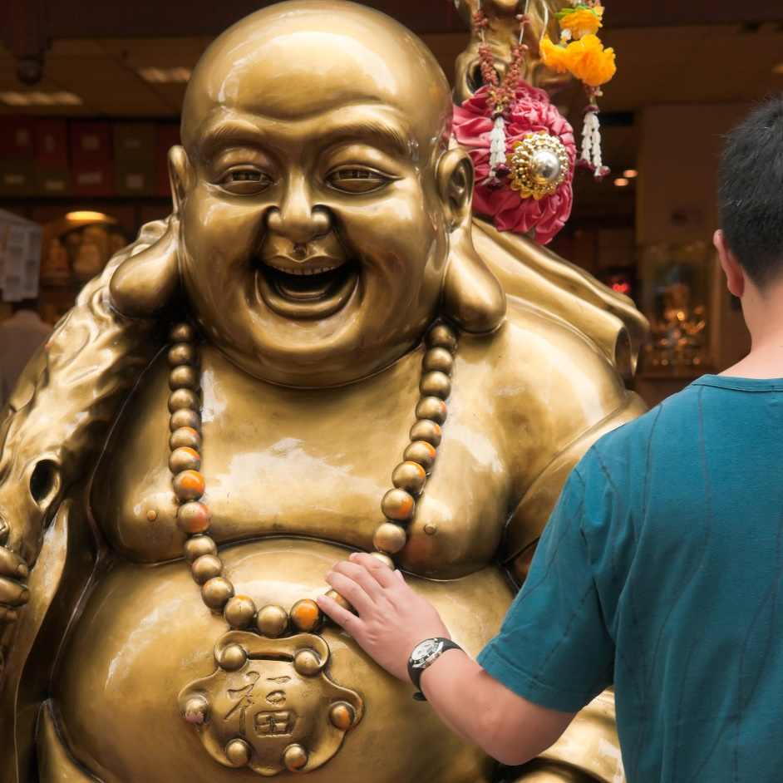
Laughing Buddha
The laughing Buddha is associated with prosperity and good luck.
This is especially popular in China.
Rubbing the belly of the laughing Buddha is said to bring good luck.
© Lawrence Wee / www.shutterstock.com
Notes:
Notes: (Budai [Chinese] is known in Japan as Hotei). Based on a Ch’an (Zen) monk who lived in the tenth century, this is not actually Gautama Buddha but rather a celestial Buddha named Budai, often thought to be an earthly incarnation of the future Buddha Maitreya. Along with providing opportunity for contrasting images of Buddhas, this slide—especially the second bullet point—can be the basis for a more in-depth discussion of the great variety of Buddhas and bodhisattvas.

Slide 13
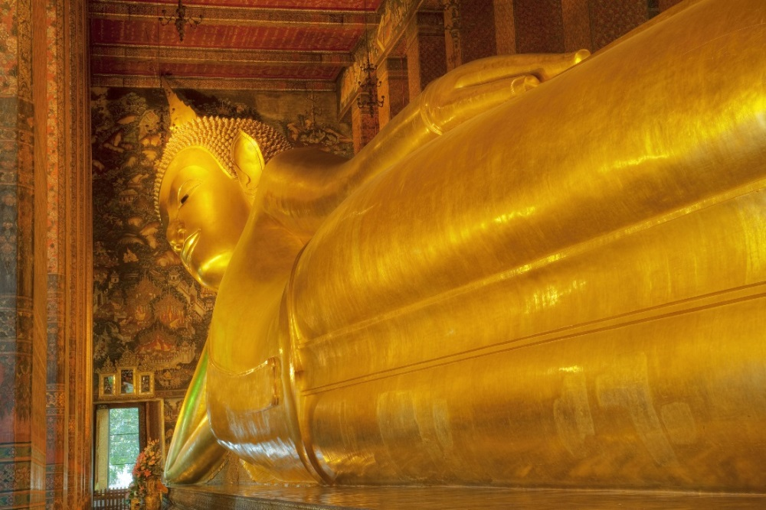
Reclining Buddha
The reclining Buddha sculptures depict his passing away into nirvana.
This event, the parinirvana, is commonly depicted in art.
The sculpture is about 50 feet high and 140 feet long.
© David Davis / www.shutterstock.com
Notes:
Notes: The famous sculpture shown on this slide is in Wat Pho (Temple of the Reclining Buddha), in Bangkok, Thailand. The soles of the feet contain engravings of the 108 auspicious signs associated with the Buddha.

