Slide 1
The Miracles of Jesus
Document #: TX004712
Notes:
Notes: This PowerPoint is designed for teachers who would like to provide more in-depth information regarding miracles in the synoptic Gospels. It should be used in conjunction with learning experience 6.

Slide 2
Miracle Defined
The word that is translated into English as “miracle” is the Greek word dynameis.
A more literal translation is “act of power.”
© soliman design / Shutterstock.com
Notes:
Notes: This translation helps us understand that Jesus demonstrates his own power in the miracles and allows people to experience God’s power through him.

Slide 3
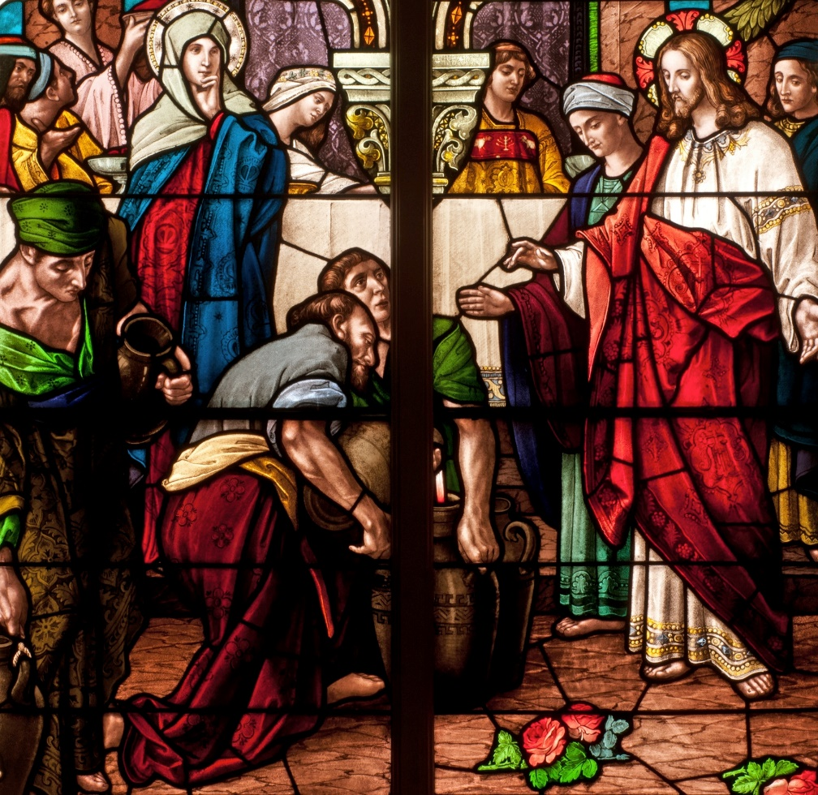
Types of Miracles Found in the Synoptic Gospels
Healing Miracles
Exorcisms
Nature Miracles
Restoration of Life
© Nancy Bauer / Shutterstock.com
Notes:
Notes: The synoptic Gospels provide us with four different kinds of miracles. In learning experience 6, students will have to read a miracle story and identify what type of miracle is found in the story.

Slide 4
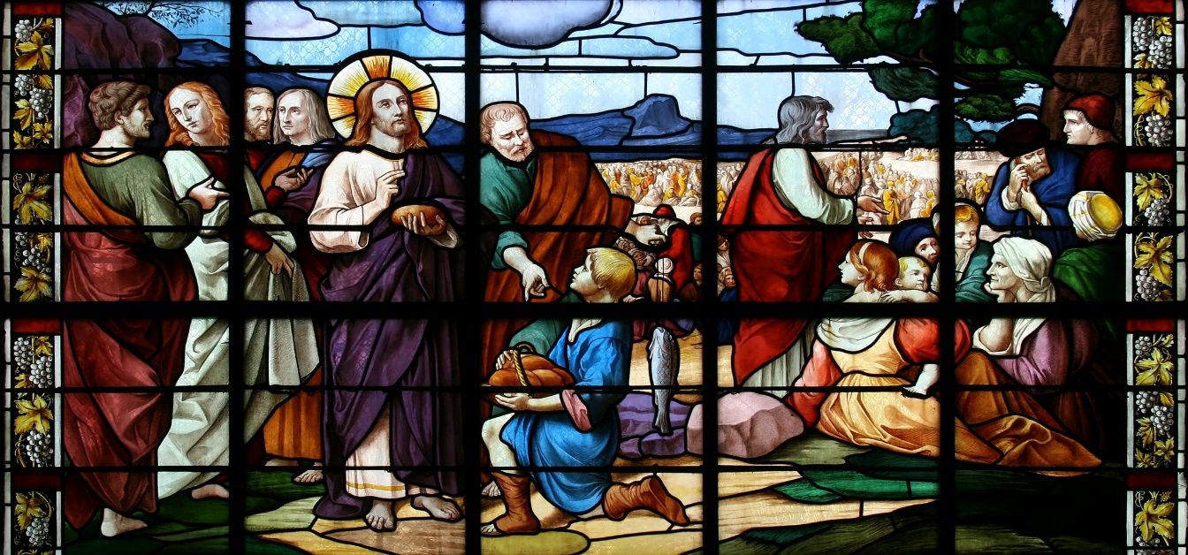
The Reign of God
The miracles are a significant way in which Jesus proclaims the Reign of God.
Through miracles, Jesus demonstrates that the Reign of God has both already begun and is not yet fully realized.
© Tiberiu Stan / Shutterstock.com

Slide 5
The Gospel of Mark
Jesus often instructs those whom he has helped or healed not to speak of the miracle to others.
Biblical scholars call this the “messianic secret.”
© iStock.com/fizia
Notes:
Notes: The healing of the leper at the beginning of Mark’s Gospel illustrates this point.

Slide 6
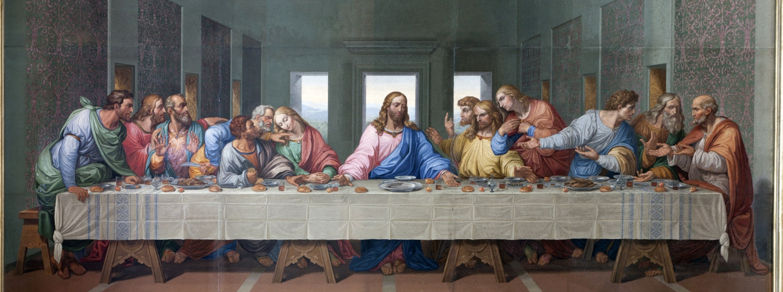
The Gospel of Matthew
Jesus reinforces his teaching about the coming of God’s Kingdom and its salvific act by performing miracles.
Jesus commissions the Apostles to preach the Kingdom with authority and to follow his example.
© Renata Sedmakova / Shutterstock.com
Notes:
Notes: You may wish to have the students locate and read Matthew 10:7‒8.

Slide 7
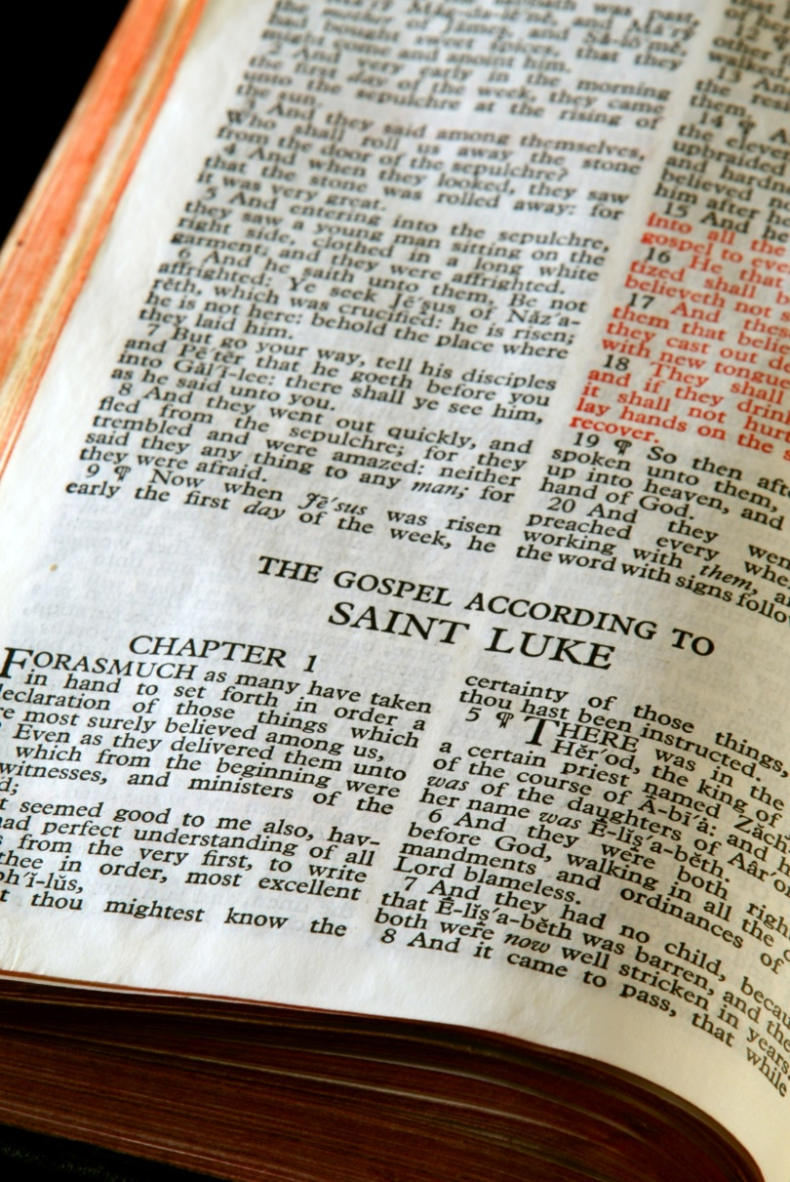
The Gospel of Luke
Jesus consistently teaches that everyone is included and invited to the Reign of God.
Jesus’ miracles often demonstrate this point as he reaches out to sinners and outcasts.
© Stephen Orsillo / Shutterstock.com
Notes:
Notes: The healing of the ten lepers is unique to the Gospel of Luke and illustrates these points well.

Slide 8
For Reflection
Which of Jesus’ miracles do you recall?
What miracle of Jesus most speaks to you?
In what way does that miracle speak to an “act of power” or God’s power acting through Jesus?
How do the miracles of Jesus strengthen your belief in him?
© Tad Denson / Shutterstock.com
Notes:
Notes: You may choose to have students share their responses in pairs, small groups, or with the whole class.

