Slide 1
The Holy Spirit and the Church
The Church
Unit 1, Chapter 2
Document #: TX005552
© 2016 Saint Mary’s Press
Living in Christ Series

Slide 2

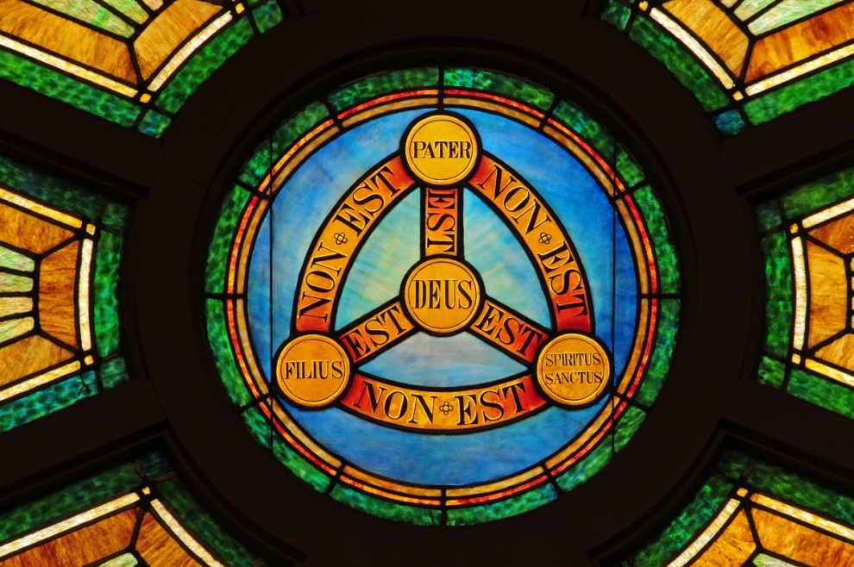
Introducing the Holy Spirit
The Third Divine Person of the Trinity first appears in the Book of Genesis.
In the Old Testament, we see the Holy Spirit participating in the
work of salvation.
The Holy Spirit was
fully revealed at
Pentecost.
© Nancy Bauer / Shutterstock.com
© 2016 Saint Mary’s Press
Living in Christ Series
Notes:
Notes: Review the definition of Trinity, as in article 4 of the student book.

Slide 3
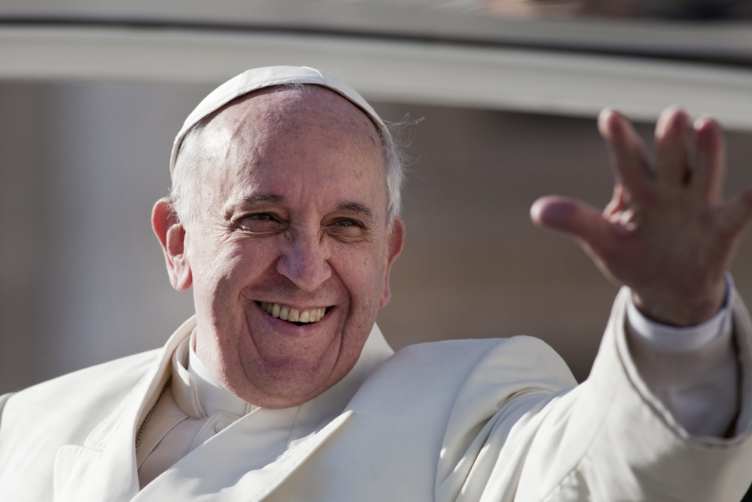
The Holy Spirit’s Mission
The Holy Spirit has revealed the mission of Christ, which is continued by the Church.
The Holy Spirit inspired the Apostles and other disciples to share the Good News.
© giulio napolitano / Shutterstock.com
© 2016 Saint Mary’s Press
Living in Christ Series
Notes:
Notes: Point out that the mission of the Church includes sharing the Good News, and following Jesus in his example of poverty, obedience, service, and self-sacrifice. Ask the question that concludes article 4 of the student book, “Where do you see the Holy Spirit at work in the Church?”

Slide 4

Pentecost: The Church Revealed to the World
Fifty days after Passover, Jesus’ followers gathered in Jerusalem.
The Apostles were filled with the Holy Spirit
They could speak so that they could be understood by all who heard them.
© Darren Baker / Shutterstock.com
© 2016 Saint Mary’s Press
Living in Christ Series
Notes:
Notes: Read aloud the account of Pentecost in Acts 2:1–13. Explain that the Holy Spirit is poured out on all who are baptized, not only on those original followers. Referring to the sidebar in article 4 of the student book, “Being Open to the Spirit,” discuss how the Holy Spirit works in us.

Slide 5

The Age of the Church
Pentecost marked
the beginning of the
Church’s mission
on earth.
Christ was no longer
present on earth in
the same way as
before.
By sending us his
Holy Spirit, Christ now acts in the world through his Church.
© Irina Fischer / Shutterstock.com
© 2016 Saint Mary’s Press
Living in Christ Series
Notes:
Notes: Explain the analogy of the birth of a child to that of the Church, as at the beginning of article 6 of the student book.

Slide 6

The Holy Spirit’s Work
The Holy Spirit builds, animates, and sanctifies the Church.
These elements of the Spirit’s mission are evidence of the Holy Spirit’s energy.
© 2016 Saint Mary’s Press
Living in Christ Series
© Vlasta Handlir / Shutterstock.com
Notes:
Notes: Ask for definitions of the terms in the first bullet point, as in article 7 of the student book. These elements of the Church’s works are discussed in the next slides.

Slide 7

The Spirit Builds the Church
The Holy Spirit builds individuals’ faith lives . . .
builds community . . .
and builds the Church by calling new members.
© 2016 Saint Mary’s Press
Living in Christ Series
© Irisska / Shutterstock.com
Notes:
Notes: Ask the students to identify the result of the Apostles’ preaching on Pentecost (three thousand people were baptized). Discuss modern-day examples of this element of the Spirit’s work, asking for examples of leaders or events that the Spirit uses to build the Church.

Slide 8

The Spirit Animates the Church
The tongues of fire at Pentecost symbolize transforming energy.
Followers who had
been huddling
behind closed
doors . . .
were converted into
bold missionaries
who began to
proclaim their faith.
© Pavel L Photo and Video / Shutterstock.com
© 2016 Saint Mary’s Press
Living in Christ Series
Notes:
Notes: Using the example of the dramatic transformation of Jesus’ followers, discuss the ability of the Holy Spirit to inspire us and give us courage. Ask for examples of holy men and women who seemed to be on fire with the love of God.

Slide 9
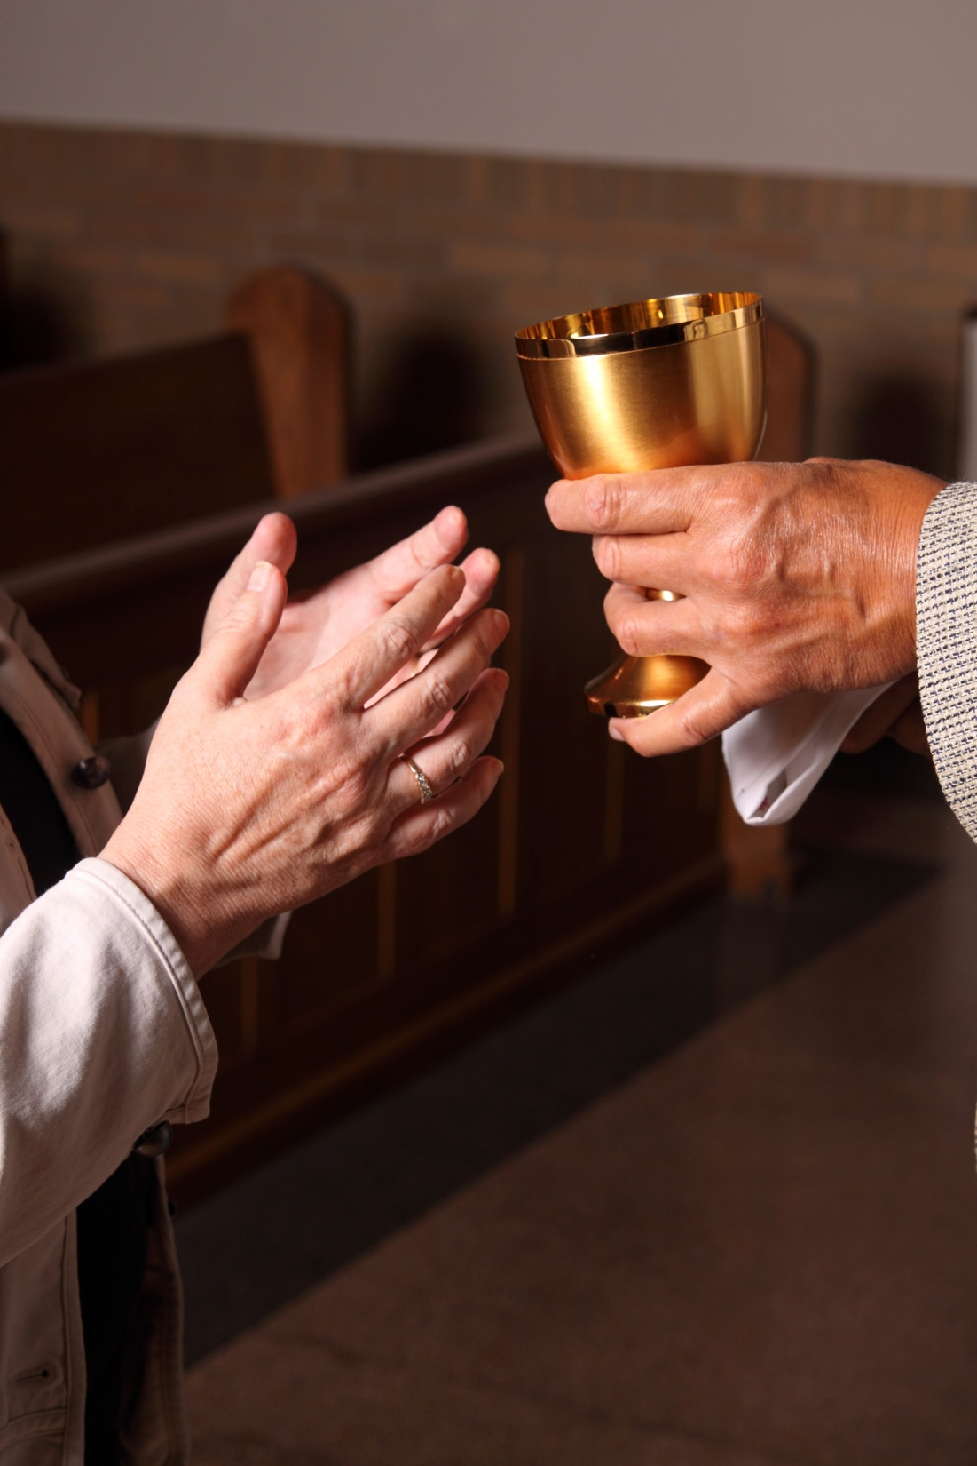
The Spirit Sanctifies the Church
The Holy Spirit works to increase the holiness of the Church and her members:
through the Sacraments
through the virtue by which we live a moral life
by the many gifts the Holy Spirit gives to each person
© princessdlaf / iStock
© 2016 Saint Mary’s Press
Living in Christ Series
Notes:
Notes: Note that as members of the Body of Christ, we are not alone as we try to be good and holy people: we have the grace offered by the Holy Spirit supporting us. Ask for ways that we can access that grace (Sacraments, community, prayer).

Slide 10

Life According to the Holy Spirit
When we ignore the Holy Spirit, we focus on the gratification of our own needs.
When we live in the
Holy Spirit, we focus
on the well-being of
others.
The Holy Spirit allows
us to deepen our
relationship with God.
© Lisa F Young / Shutterstock.com
© 2016 Saint Mary’s Press
Living in Christ Series
Notes:
Notes: Review the fruits of the Spirit found in Galatians 5:22–23, as quoted in article 9 of the student book. Ask for examples of how these qualities would help us to focus on the well-being of others during an ordinary school day.

Slide 11
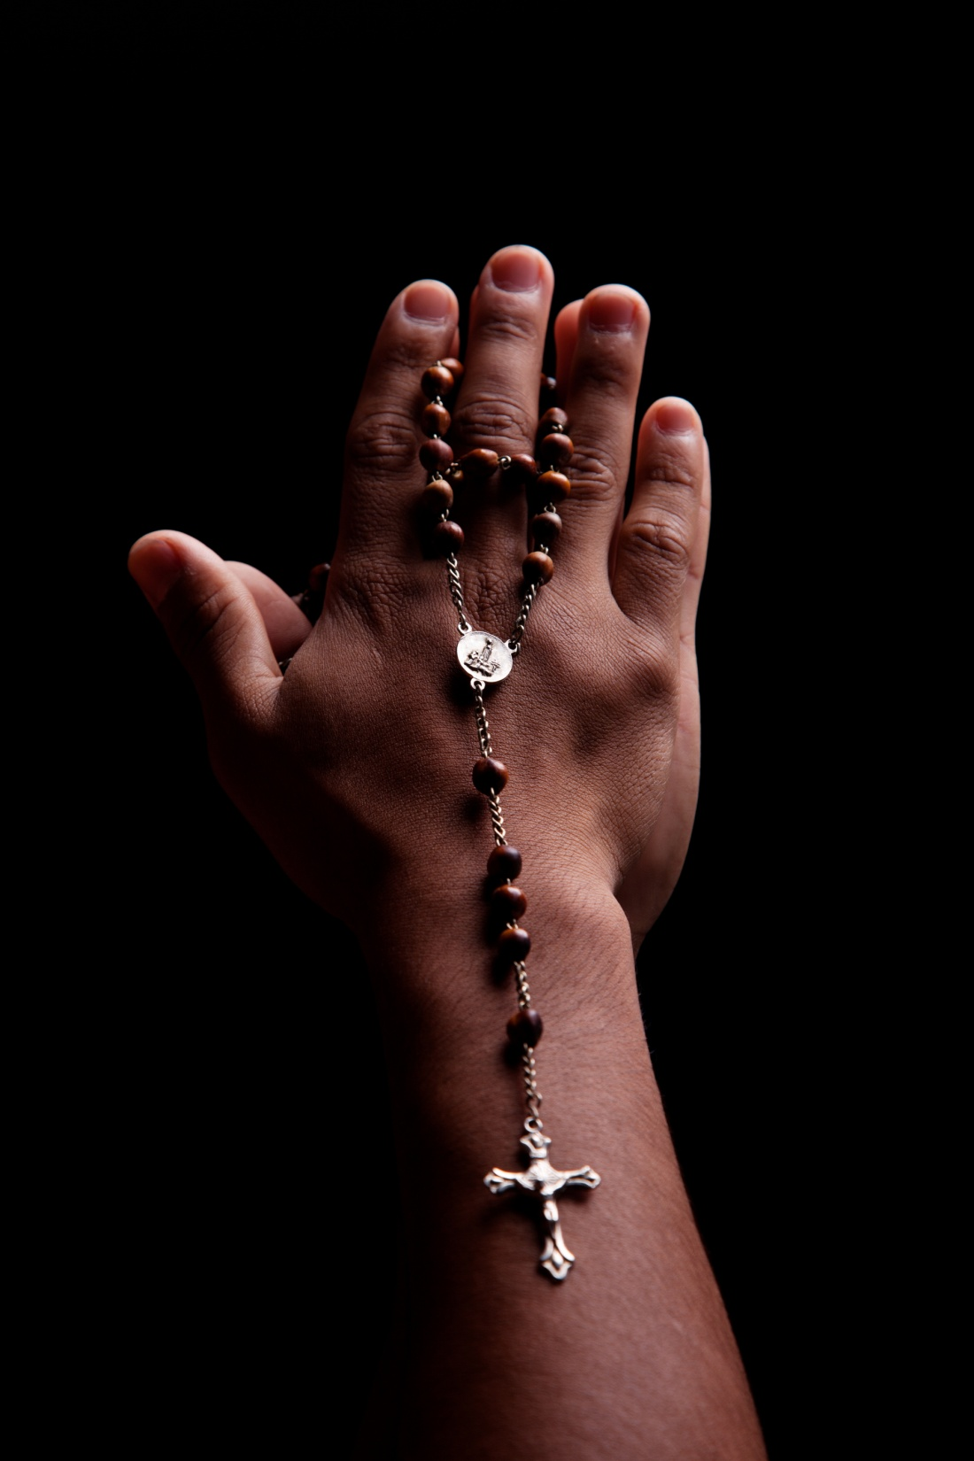
The Teaching of the Holy Spirit
The Holy Spirit helps us to understand the truths of faith.
The Holy Spirit teaches us to pray.
© AlexandreNunes / Shutterstock.com
© 2016 Saint Mary’s Press
Living in Christ Series
Notes:
Notes: Explain that the Spirit teaches the community to pray through Sacred Tradition, and also inspires us to pray in our own words. Discuss our need to rely on the Spirit when we have no words for prayer, as in times of confusion or suffering.

Slide 12

Charisms
The gifts of the Holy
Spirit are for the
benefit of the Church
and the world.
Ordinary charisms
are seen when we
use our gifts and talents to help others.
Extraordinary charisms involve spiritual gifts beyond normal human abilities.
© Jenny Sturm / Shutterstock.com
© 2016 Saint Mary’s Press
Living in Christ Series
Notes:
Notes: With the students, brainstorm ordinary charisms seen within your school community. If your school is associated with a religious order, discuss how the charism of the founder is seen in the school’s mission or character.

Slide 13
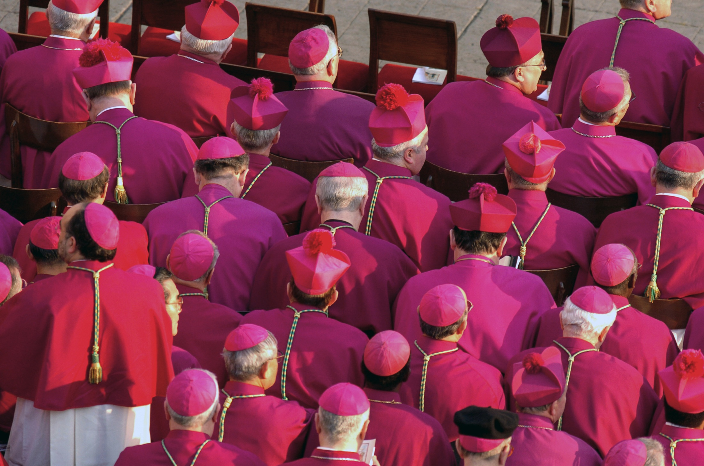
Charisms of Leadership
The Holy Spirit offers gifts that enable leaders to provide benefits to the whole Church.
Members of religious
orders often try to
pursue the charism
of their founder.
The Pope and the
bishops in union
with him have the
charism of infallibility.
© Paolo Bona / Shutterstock.com
© 2016 Saint Mary’s Press
Living in Christ Series
Notes:
Notes: Explain the doctrine of infallibility, as found in article 10 of the student book.

Slide 14
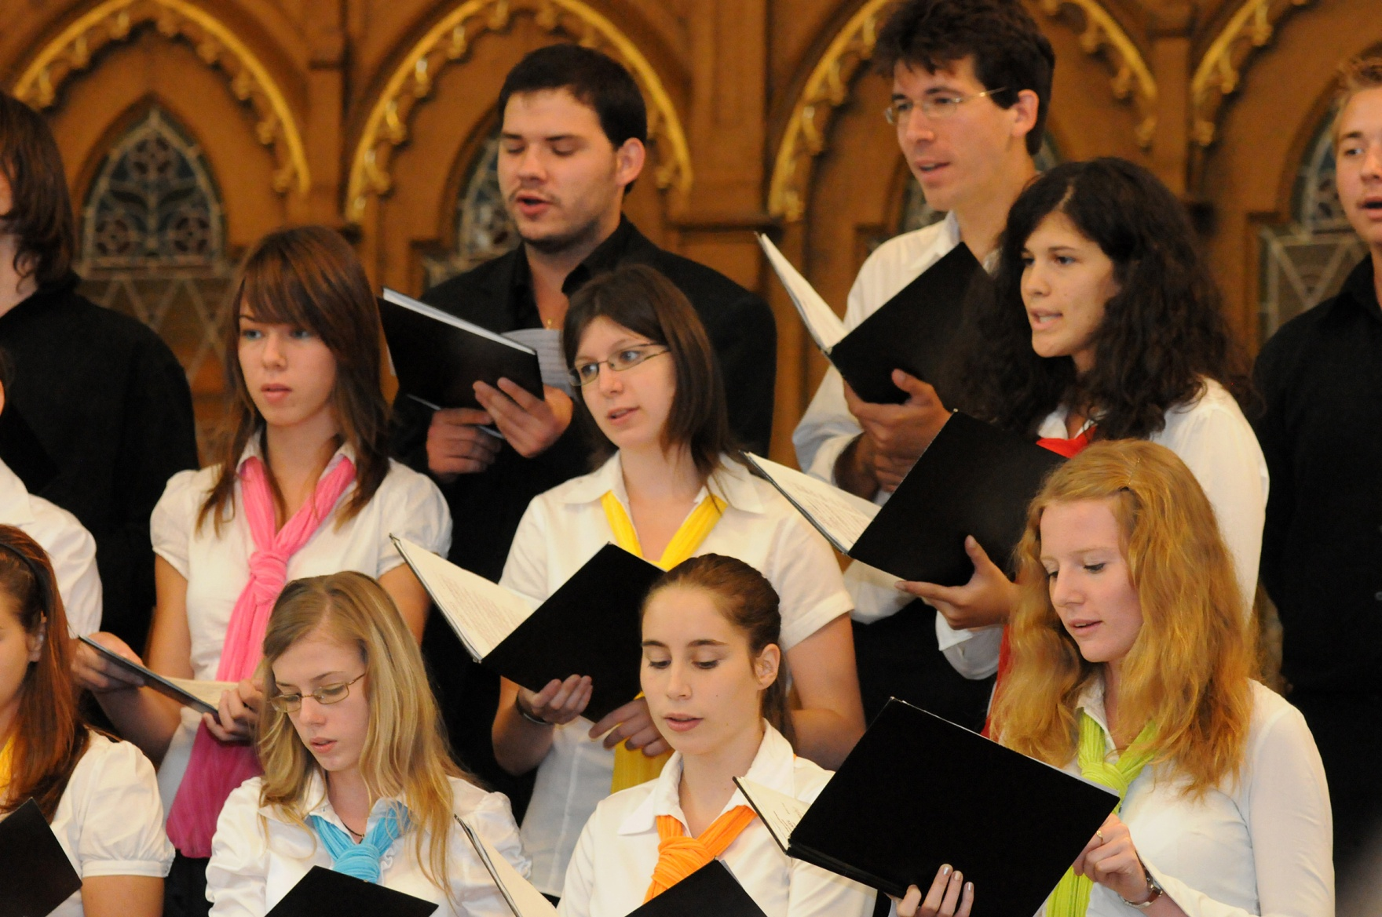
The Church Needs All Charisms
The Holy Spirit gives gifts to every member of the Church.
Each person can help to build up the Church.
© muzsy / Shutterstock.com
© 2016 Saint Mary’s Press
Living in Christ Series
Notes:
Notes: Read aloud the sidebar in article 10 of the student book, “A Challenge from Pope Benedict XVI to Youth.” Ask for examples of how young people can make a difference through the power of the Holy Spirit.

