Slide 1
Faith
The Catholic Faith Handbook for Youth, Third Edition
Chapter 4
Document #: TX003135
Notes:
Use this presentation to introduce or review the key points in chapter 4 of the student handbook.

Slide 2
Faith as Love and Trust
Faith, love, and trust are closely related.
If a person trusts us, it is easier to believe that he or she really loves us.
If we trust in another person, it becomes easier to love him or her without holding back.
Copyright: Supri Suharjoto / www.shutterstock.com
Notes:
Discuss the similarities and differences between trusting a loved one and trusting God. (We trust that a loved one wants what’s best for us. However, we know that others may fail us and that their wisdom may be imperfect, while God alone is entirely trustworthy.)

Slide 3
Responding to God’s Invitation
We were created with free will.
God’s Revelation of himself, particularly in the person of Jesus Christ, is his loving invitation to us to be in a relationship.
We can respond with love, trust, faith, and our will.
Copyright: Yuri Arcurs / www.shutterstock.com
Notes:
Ask the students to give examples of what it could mean to respond to God’s invitation to be in relationship through love, trust, faith, and our will.

Slide 4
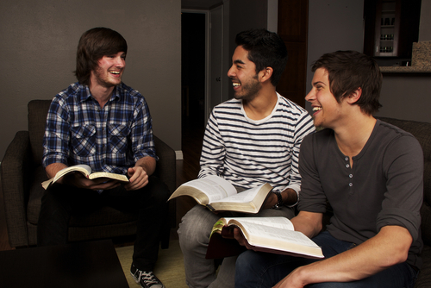
Faith: Personal and Communal
Faith is a personal act: we each choose to believe or not to believe.
Faith is a communal act: others pass on God’s Revelation to us, and others support our faith.
Scripture and Tradition teach that God wants us to be part of a church, a community of believers.
Copyright: JHershPhoto / www.shutterstock.com
Notes:
Discuss with the students the five points on page 49 of the student handbook, which show that God wants us to be part of his Church.

Slide 5
Faith: A Summary
Copyright: William Perugini / www.shutterstock.com
Our response to God’s loving invitation to believe in him
Giving ourselves completely—heart, mind, and will—to a loving relationship with God
Believing in and being a part of the Church, the Body of Christ, on earth

Slide 6
Characteristics of Faith
Faith is a grace, a supernatural gift of God.
The Holy Spirit helps us to recognize God’s invitation to a relationship with him.
Copyright: mangostock / www.shutterstock.com
Notes:
Comment with a more complete explanation, as needed, on the points on pages 50–51 of the student handbook. The next two slides cover those points as well.

Slide 7
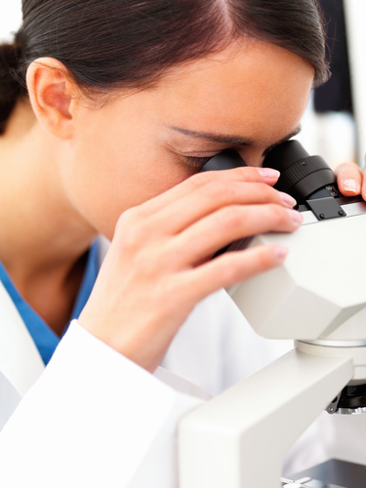
Characteristics of Faith
Faith is certain.
Faith seeks understanding.
Faith is not opposed to science.
Copyright: Yuri Arcurs / www.shutterstock.com
Notes:
Explain these points from page 51 of the student handbook.

Slide 8
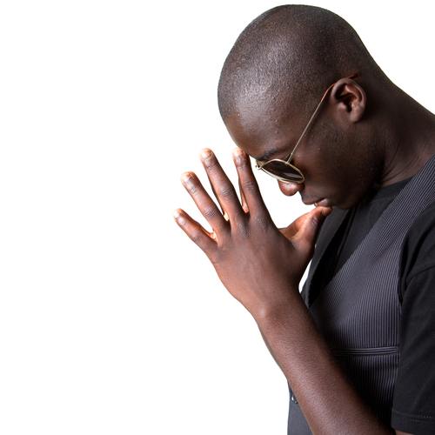
Characteristics of Faith
Faith is necessary for salvation.
Grace enables faith.
Faith is the beginning of eternal life.
Copyright: Martin Allinger / www.shutterstock.com
Notes:
Explain these points from page 51 of the student handbook.

Slide 9
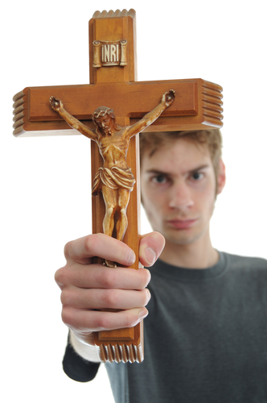
Proclaiming Our Faith
One of the first Christian creeds, found in the Bible, focuses on the death and Resurrection of Jesus.
Christians have been proclaiming the Apostles’ Creed since the Church’s earliest days in Rome.
Everywhere in the world, Catholics recite the Nicene Creed every Sunday at Mass.
Copyright: Vlue / www.shutterstock.com
Notes:
Provide a definition for the term creed: a brief summary of the things you believe, or a statement of faith.

Slide 10
An Early Creed
For I handed on to you as of first importance what I in turn had received: that Christ died for our sins in accordance with the scriptures, and that he was buried, and that he was raised on the third day in accordance with the scriptures, and that he appeared to Cephas, then to the twelve
(1 Corinthians 15:3–5).
Copyright: ULKASTUDIO / w/ww.shutterstock.com
Notes:
(The scriptural quotation is from the New Revised Standard Version of the Bible, Catholic Edition. Copyright © 1993 and 1989 by the Division of Christian Education of the National Council of the Churches of Christ in the United States of America. All rights reserved.)

