Slide 1
Luke’s Christology and the Reign of God
The New Testament
Document #: TX002252
Notes:
Notes: The author of the Gospel of Luke is a Gentile Christian who begins the Gospel with a literary prologue that imitates Hellenistic Greek writers. The author addresses “Theophilus” (literally “friend of God” or “lover of God”), who symbolically represents people of faith.

Slide 2
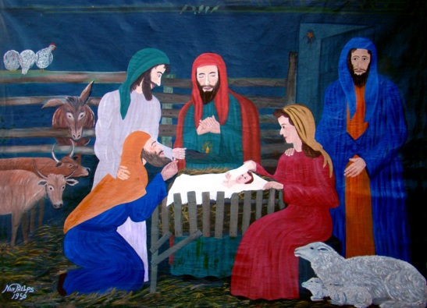
Luke’s Infancy Narrative (Luke 1:5—2:52)
Notes:
Notes: Luke’s infancy narrative begins with the announcement of the birth of John (the Baptist) to Zechariah. Though his wife, Elizabeth, is barren and advanced in years, she will give birth to John, much like other great women of the Old Testament: Sarah (see Genesis 15:3, 16:1); Rebekah (see Genesis 25:21); Rachel (see Genesis 29:31, 30:1); the mother of Samson (see Judges 13:2–3); and Hannah (see 1 Samuel 1:2).

Slide 3
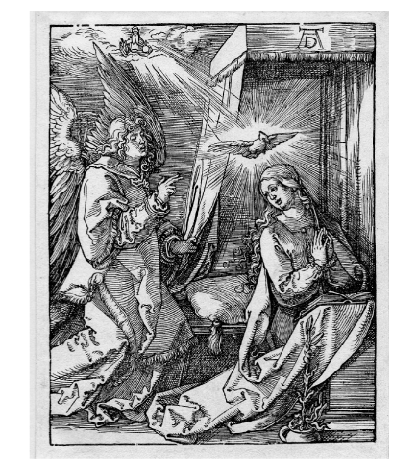
The Annunciation
Notes:
Notes: The Annunciation of Jesus’ birth to Mary parallels that of the annunciation of John’s birth to Zechariah: the angel Gabriel appears, each is troubled by this vision, the angel allays his or her fears, the announcement is made, the parent objects, and a sign is given as confirmation of what has been said. The difference, though, is that the author of Luke portrays Mary as one who believes (Luke 1:45), while Zechariah does not believe (Luke 1:20). After Mary receives the news, and after Zechariah confirms John’s name, each sings God’s praises in what is known as a canticle. These hymns of praise are traditional Jewish Christian hymns based on the Old Testament. In fact, the Canticle of Mary (known as the Magnificat) is similar to that of Hannah (see 1 Samuel 2:1–10). In both canticles, God is praised and blessed for extending mercy and forgiveness to all people.

Slide 4
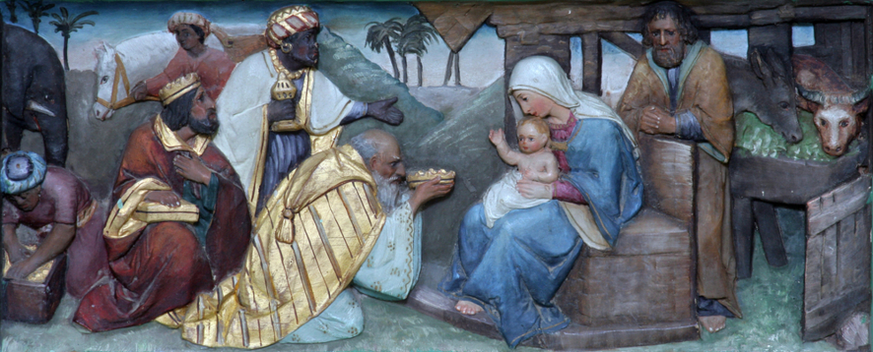
The Birth of Jesus
© Zvonimir Atletic/shutterstock.com
Notes:
Notes: As in Matthew’s Gospel, the author of Luke emphasizes that Jesus is of the house and family of David. Joseph takes Mary to the town of Bethlehem because of a government enrollment of citizens, both Roman and non-Roman. While there, she gives birth to Jesus. The author of Luke puts forth a unique Christology in this way (see following slides).

Slide 5
Mary gave birth to her firstborn son (Luke 2:7a).
Luke establishes that Jesus is the firstborn of all creation. In other words, he is divine.

Slide 6
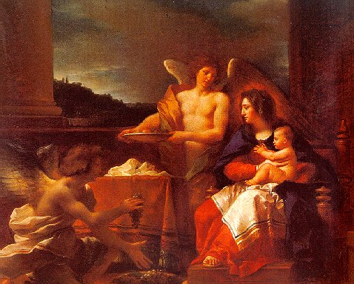
She wrapped him in swaddling clothes (Luke 2:7b) . . .
This reference to the birth of King Solomon (see Wisdom 7:4–5) reminds us that Jesus is fully human, like any other infant.

Slide 7
. . . and laid him in a manger (Luke 2:7b), . . .
Jesus is placed in a feeding trough for animals. In this way, we are reminded that Jesus is the Bread of Life.

Slide 8
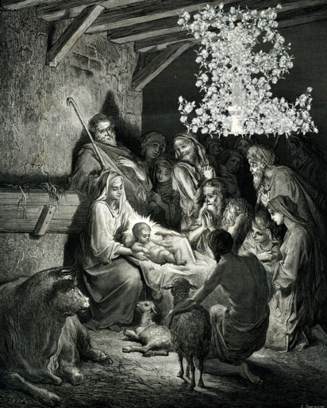
. . . because there was no room for them in the inn (Luke2:7d).
This reminder of Jesus’ lowly birth is also an allusion to his dwelling with and among the people (from Jeremiah 14:8).
© MarkauMark/shutterstock.com

Slide 9
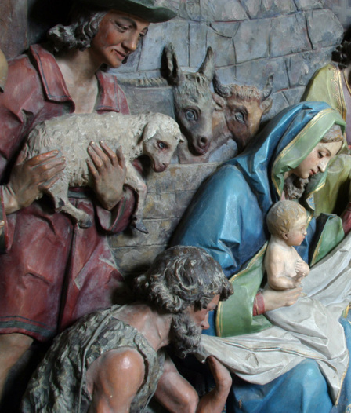
The Significance of the Shepherds
© Zvonimir Atletic/shutterstock.com
Notes:
Notes: The shepherds play a significant role in communicating the Christology of the Gospel of Luke, as well as Luke’s vision of the Reign of God: that God honors the poor and lowly. The angel Gabriel announces the birth of the Messiah to the poor and lowly—the shepherds in the fields. In this proclamation, the angel Gabriel says that this is “good news of great joy that will be for all the people” (Luke 2:10b). Again, the author of Luke portrays Jesus as a universal Savior, extending God’s love and mercy to all people.

Slide 10
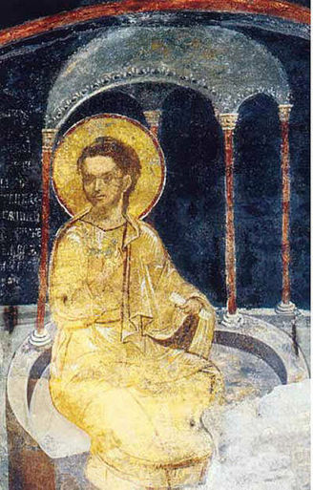
The Presentation in the Temple and Jesus in the Temple
Notes:
Notes: Two unique aspects of Luke’s infancy narrative include the presentation of Jesus in the Temple and the finding of the boy Jesus in the Temple. Luke portrays Mary and Joseph as abiding by the Law of Moses, which required purification after childbirth, as well as the consecration of the firstborn son. In this text Luke introduces Simeon, who blesses Joseph, Mary, and Jesus. At the same time, a prophetess by the name of Anna praises God and speaks well of Jesus. The author of Luke continues the theme of including parallel stories of both men and women. The story of Jesus in the Temple as a young boy is unique to Luke’s Gospel and serves a few purposes: it reminds us that Jesus is an observant Jew; that Jesus, who is divine, is doing his “Father’s work”; and that his divine Sonship usurps family ties. At the same time, this story concludes the infancy narrative in the same way it began: in the Temple in Jerusalem.

