Slide 1
Introduction to Prayer
The Catholic Faith Handbook for Youth, Third Edition
Chapter 33
Document #: TX003164
Notes:
Use this presentation to introduce the topic of prayer. It provides a basic definition and a starting point for a discussion of prayer, and concludes with a question for journaling.

Slide 2
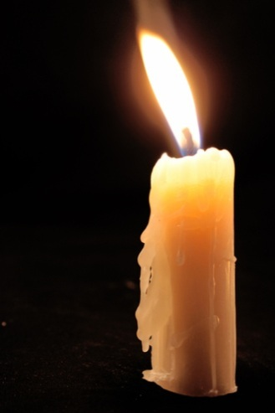
QUESTION: What is prayer?
ANSWER: Raising our minds and hearts to God.
Copyright: Alexandra Lande / www.shutterstock.com
Notes:
Before showing the definition of prayer on this slide, ask the students to write their own definition of prayer in their notebooks. Discuss similarities and differences between their definition and this one from an early Church father, Saint John Damascene.

Slide 3
When We Pray
We may get a flash of insight.
Our attitudes may gradually change as God forms our intellect.
We can be healed by God’s love and become more loving in our relationships.
Copyright: Repina Valeriya / www.shutterstock.com
Notes:
Share a personal example of how your own thinking changed as a result of prayer, or share an experience you’ve heard or read about.

Slide 4
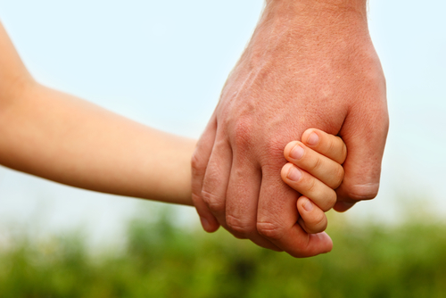
Prayer
It is not about using the right words or techniques.
It is about being a person who wants a relationship with God.
Everyone is called to prayer.
Copyright: vita khorzhevska / www.shutterstock.com
Notes:
Explain that God created us to be in communion with him, and created us in such a way that we need that communion and are able to experience it.

Slide 5
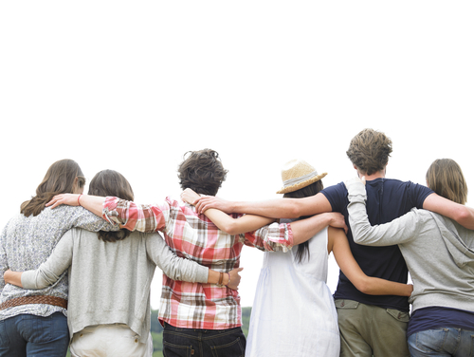
Friendship with God
Many of the qualities that enhance our friendship with others contribute to our friendship with God.
Copyright: Morgan DDL / www.shutterstock.com
Notes:
Call the students’ attention to the list of ways to develop good friendships on page 362 of the student handbook. Ask them to comment on how these features of friendship come into play in our relationship with God.

Slide 6
When you think about prayer as a relationship with God, which areas do you think need attention in your life?
Copyright: Brooke Becker / www.shutterstock.com
Notes:
Invite the students to journal on this question, and to share as they are willing with the larger class.

Slide 7
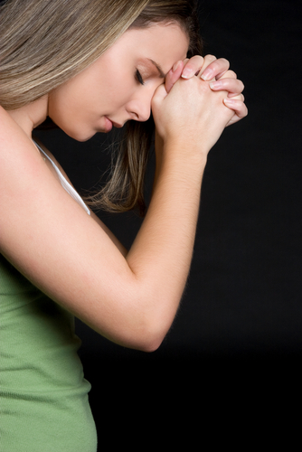
Guides for Prayer
Prayer in the Old Testament
The prayer of Jesus as model
The prayer of Mary
Saints and prayer traditions
Our families
Priests, deacons, religious, catechists, prayer groups, spiritual directors
Copyright: Jason Stitt / www.shutterstock.com

Slide 8
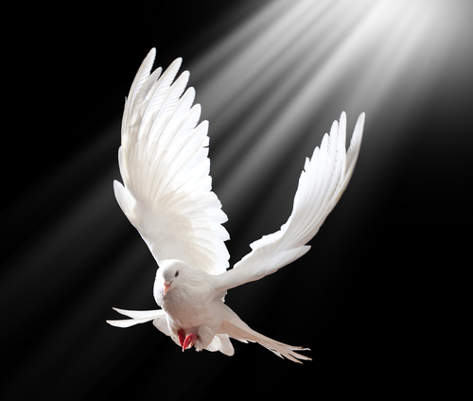
God’s Grace
Copyright: Tischenko Irina / www.shutterstock.com
No sin can ever separate us from God’s love and forgiveness.
The Holy Spirit communicates God’s grace to us.
Grace is the help God gives us to respond to our vocation to be his adopted sons and daughters.
Notes:
Explain that we receive grace through our Baptism, and in all of the other Sacraments.

Slide 9
Experiencing God’s Grace
Stop to give praise for all creation.
Be more aware of God’s presence in your daily life.
Pray, worship, and participate in the Sacraments.
Conversion: our lifelong journey with and to God
Copyright: PHOTOCREO Michal Bednarek / www.shutterstock.com

