Slide 1
What Is Faith?
Jesus Christ Course
Document # TX001270

Slide 2
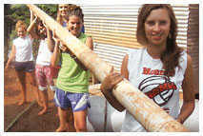
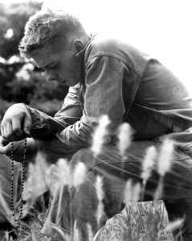
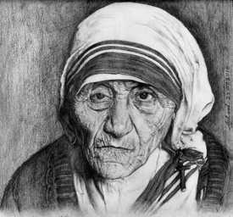
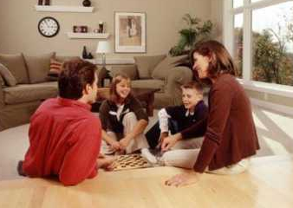
What Is Faith?
Describe how these images represent faith.
© camptocampus.com
Image in public domain
Image in public domain
© wowlao.blogspot
Notes:
Notes: While showing these images, lead a class discussion on the different ways people express faith.

Slide 3
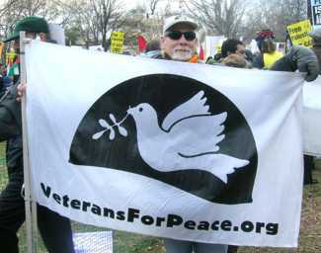
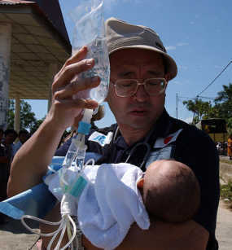
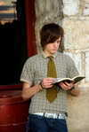
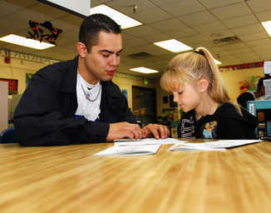
What Is Faith?
Describe how these images represent faith.
Image in public domain
Image in public domain
© revelation320.typepad
Image in public domain
Notes:
Notes: While showing these images, lead a discussion on the different ways people express faith.

Slide 4
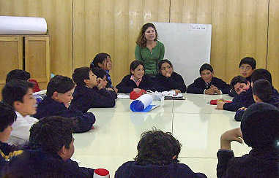
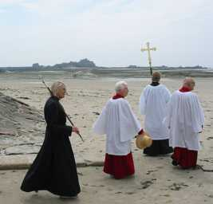
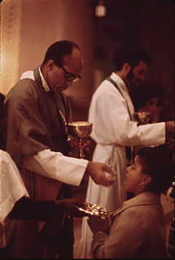
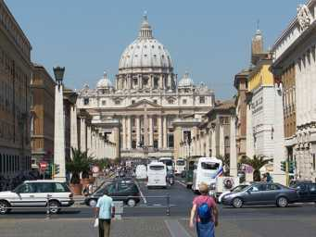
What Is Faith?
Describe how these images represent faith.
Image in public domain
Image in public domain
Image in public domain
Image in public domain
Notes:
Notes: While showing these images, lead a discussion on the different ways people express faith.

Slide 5
Faith
Word from the Latin fides, meaning “trust” or “belief”
A specific act or human response to Revelation
An internal surrender of our whole self to God (recall the Greatest Commandments)
A God-given theological virtue or habit of belief
Something that must be practiced—with practice comes wisdom
Notes:
Notes: After reviewing these characteristics of faith, go back to the previous slides. Ask the students to describe how these characteristics were present in the images in the previous slides. Discuss how these characteristics are present in the students’ own faith lives.

Slide 6
Faith
Building blocks of Christian life
A journey—with some high points and some low points
Something you can feel strongly one day and not the next
A daily response—through daily habits or expressions of faith, it grows
A grace that opens life to possible realities beyond the present experience
Notes:
Notes: After reviewing these characteristics of faith, go back to the previous slides. Ask the students to describe how these characteristics were present in the images in the previous slides. Discuss how these characteristics are present in the students’ own faith lives.

Slide 7
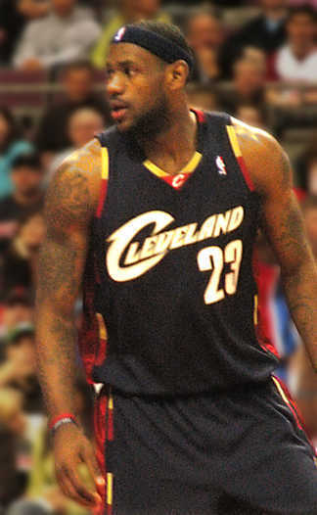
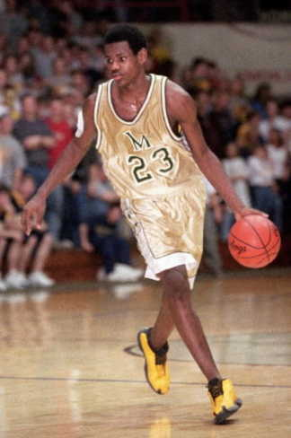
Consider these two images of NBA player
LeBron James
© http://media.cleveland
Image in public domain
Notes:
Notes: Propose this analogy: developing faith is like developing an athletic talent. It takes time, practice, focus, attention, and hard work.
Some questions to start:
What did LeBron James have to do to get to where he is today, playing in the NBA?
Does LeBron James have perfect games every time he plays?
Conclude by saying something along these lines:
Faith is like developing an athletic talent. If a person wants to have a strong, well-developed faith life, it requires practice, focus, and attention. Through a strongly developed faith life, and the connection with God, one becomes strong enough to keep going through the difficult times.

Slide 8
Expressions of Faith
Faith is expressed in many kinds of beliefs and practices:
prayer: communal and individual
Sacraments
service
charity
justice
Notes:
Notes: Solicit examples of each. Have some examples ready that the students may not name or may not be familiar with.

Slide 9
What Are the Connections?
Faith
Religion
Belief

Slide 10
Religion
Comes from the Latin religio, meaning “respect for the sacred” or “reverence for the gods.”
Refers to the set of practices and beliefs followed by those who believe in and worship God.

Slide 11
Belief
Comes from German, meaning what is “dear” or “esteemed.”
Refers to a mental act or state of mind placing trust or confidence in a person or doctrine.

Slide 12
Faith | Religion | Belief
Latin fides, meaning “trust” or “belief” | Latin religio, meaning “respect for the sacred” or “reverence for the gods” | Germanic origin, meaning what is “dear” or “esteemed”
A specific act or human response to Revelation An internal surrender of our whole self to God (recall the Greatest Commandments) God-given theological virtue or habit of belief | Set of practices and beliefs followed by those who believe in and worship God | A mental act or state of mind placing trust or confidence in a person or doctrine

Slide 13
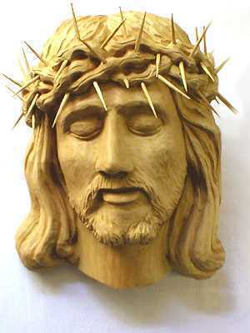
God’s Revelation
In faith we accept God’s Revelation. We express that faith in our religious beliefs and practices.
Image in public domain

Slide 14
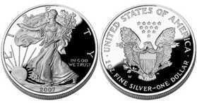
Faith and Religion
Two sides of the same coin
Cannot have one without the other
Faith without religion = fades away
Religious practices without faith = “going through the motions”
Faith requires willingness.
Mary said, “Behold, I am the handmaid of the Lord.
May it be done to me according to your word.”
(Luke 1:38)
© boostsilver.com
Notes:
Notes: Allow time for the last two points to sink in. Consider asking for examples of people who represent these last two points and the consequences of each type of faith.

Slide 15
Faith requires willingness but
it does not have to be perfect.

Slide 16
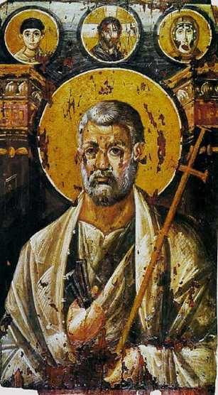
The Scriptures and Faith
“Simon Peter said in reply, ‘You are the Messiah, the Son of the living God’” (Matthew 16:16).
“[Peter] said to him, ‘Lord, I am prepared to go to prison and to die with you.’ But he replied, ‘I tell you, Peter, before the cock crows this day, you will deny three times that you know me’” (Luke 22:33–34).
“And so I say to you, you are Peter, and upon this rock I will build my church” (Matthew 16:18).
Image in public domain
Notes:
Notes: Emphasize that Jesus chose Peter because of his strong willingness yet his imperfect faith. Help the students to understand that our faith does not need to be perfect—what is important is that we try.

Slide 17
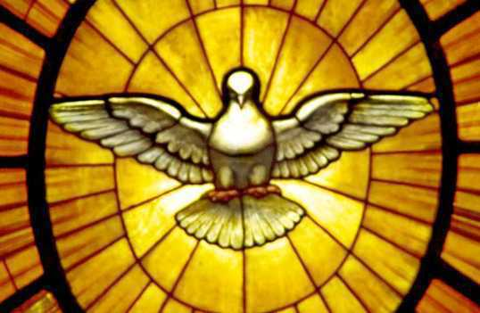
The Catechism and Faith
The Catechism of the Catholic Church says, “Faith is a supernatural gift from God. In order to believe, man needs the interior helps of the Holy Spirit” (179).
Image in public domain

Slide 18
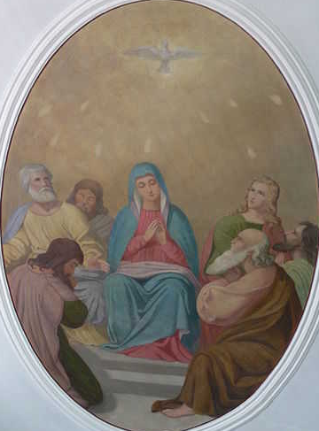
The Holy Spirit
Peter, Mary, and all the faithful allow God’s Holy Spirit to work in their lives:
“When the time for Pentecost was fulfilled, they were all in one place together. And suddenly there came from the sky a noise like a strong driving wind, and it filled the entire house in which they were. Then there appeared to them tongues as of fire, which parted and came to rest on each one of them. And they were all filled with the holy Spirit and began to speak in different tongues, as the Spirit enabled them to proclaim” (Acts of the Apostles 2:1–4).
Image in public domain
Notes:
Notes: Encourage the students to share examples of other people’s faith-filled response to the Holy Spirit. These can be examples from the Scriptures, the saints, or people they know.

Slide 19
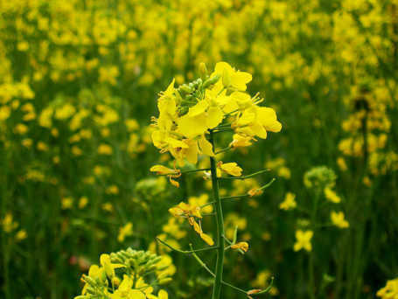
The Mustard Seed
“And the apostles said to the Lord, ‘Increase our faith.’ The Lord replied, ‘If you have faith the size of a mustard seed, you would say to [this] mulberry tree, ‘Be uprooted and planted in the sea,’ and it would obey you’” (Luke 17:5–6).
Image in public domain
Notes:
Notes: You may want to review the importance and the main points of Jesus’ Parable of the Mustard Seed.

Slide 20
Strengthening Faith
Ways to strengthen faith:
prayer: communal and individual
liturgy
Sacraments
service
charity
justice
Notes:
Notes: Refer back to the athletic analogy of how you strengthen your body for a sport. Ask the students to share examples. Be sure to mention the following if they are not named: eat right, sleep enough, weight train, cross-train, etc. Explain that without cross-training you can overuse muscles and make yourself more prone to injury because the supporting muscles are not strong enough.
Explain that faith can be like that. It’s important to “cross-train” in faith to be in peak condition. Ask the students to discuss how to strengthen faith by soliciting specific examples for each bullet point above.

Slide 21
Continuous Cycle
Practice faith
Increase faith
Practice faith in new and different ways
Increase faith
Faith is a continuous cycle. The more you practice your faith, the stronger it will grow. The firm foundation of faith will sustain you even in difficult times.
“Everyone who listens to these words of mine and acts on them will be like a wise man who built his house on rock. The rain fell, the floods came, and the winds blew and buffeted the house. But it did not collapse; it had been set solidly on rock”
(Matthew 7:24–25).

Slide 22
How will you build your foundation
?
Notes:
(The Scripture quotations in this presentation are from the New American Bible with Revised New Testament and Revised Psalms. Copyright © 1991, 1986, and 1970 by the Confraternity of Christian Doctrine, Washington, D.C. Used by the permission of the copyright owner. All Rights Reserved. No part of the New American Bible may be reproduced in any form without permission in writing from the copyright owner.
The quotation from the Catechism of the Catholic Church in this presentation is from the English translation of the Catechism of the Catholic Church for use in the United States of America, second edition, number 179. Copyright © 1994 by the United States Catholic Conference, Inc.—Libreria Editrice Vaticana. English translation of the Catechism of the Catholic Church: Modifications from the Editio Typica © 1997, by the United States Catholic Conference, Inc.—Libreria Editrice Vaticana.)

