Slide 1
Sacred Scripture and Sacred Tradition
Jesus Christ: God’s Love Made Visible, Second Edition Unit 2, Chapter 4
Document#: TX004809

Slide 2
The Old Testament
The Old Testament is the story of God’s relationship with the ancient Israelites.
It is a collection of sacred, inspired writings.
It recounts the gradual process of God’s self-disclosure to humanity.
© Ken Schulze / Shutterstock.com
Notes:
Direct the students to read the Did You Know? sidebar in article 16 of the student book. Use the Old Testament reading from the previous or upcoming Sunday to discuss the questions in the last paragraph of the sidebar.
This slide corresponds to content in article 16, “God’s Revelation through Sacred Scripture: The Old Testament,” in the student book.

Slide 3
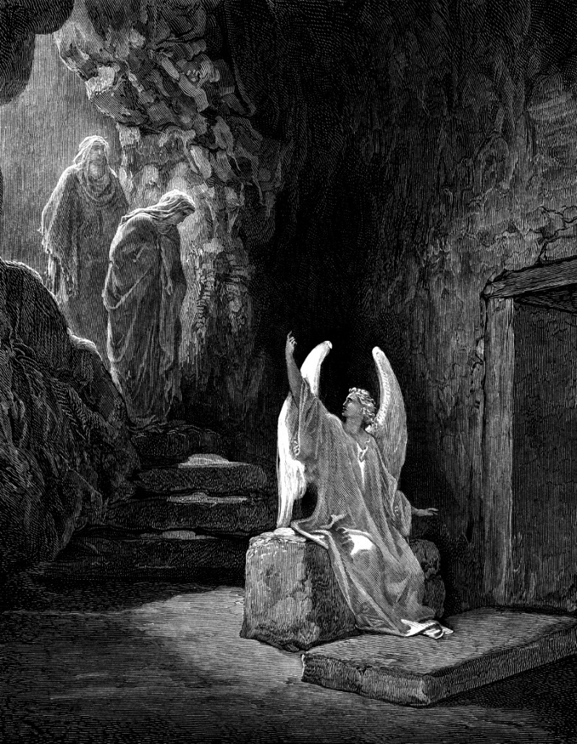
An Ancient Sign of God’s Love
Christians read the Old Testament in full awareness of Jesus as the Crucified and Risen Christ.
God’s relationship with the Israelites, ancestors of today’s Jews, endures forever.
The Old Testament will always be a way for Jews and Christians to encounter God.
© ivan-96 / iStockphoto.com
Notes:
Point out that the Old Testament contains inspired books that are also Scripture for the Jewish people. If any students have attended a synagogue service, ask about the reverence for the Torah scrolls. (They are kept in a tabernacle, covered with richly embroidered cloth, reverenced in a procession, and touched only by a pointer when read.)
This slide corresponds to content in article 16, “God’s Revelation through Sacred Scripture: The Old Testament,” in the student book.

Slide 4
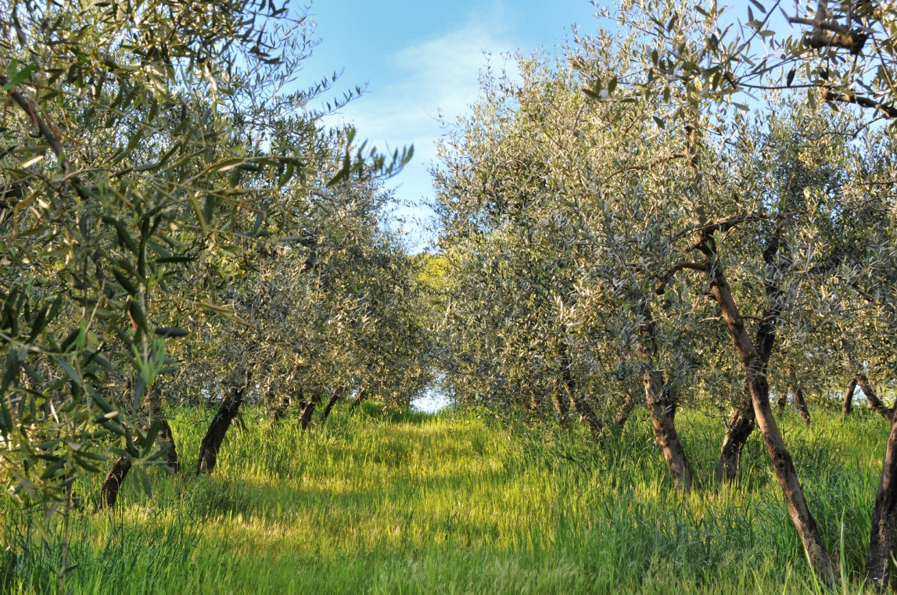
The Jewish Roots of Christianity
Saint Paul used the image of a tree for Judaism and Christianity.
Judaism is the tree; Christian communities are grafted branches.
A grafted branch could not survive without the original tree’s root.
© GraconDesign / iStockphoto.com
Notes:
Ensure that the students understand what grafting is. Note the education in Judaism that Jesus would have received. Ask how significant that training would have been for his teaching and ministry.
This slide corresponds to content in article 16, “God’s Revelation through Sacred Scripture: The Old Testament,” in the student book.

Slide 5
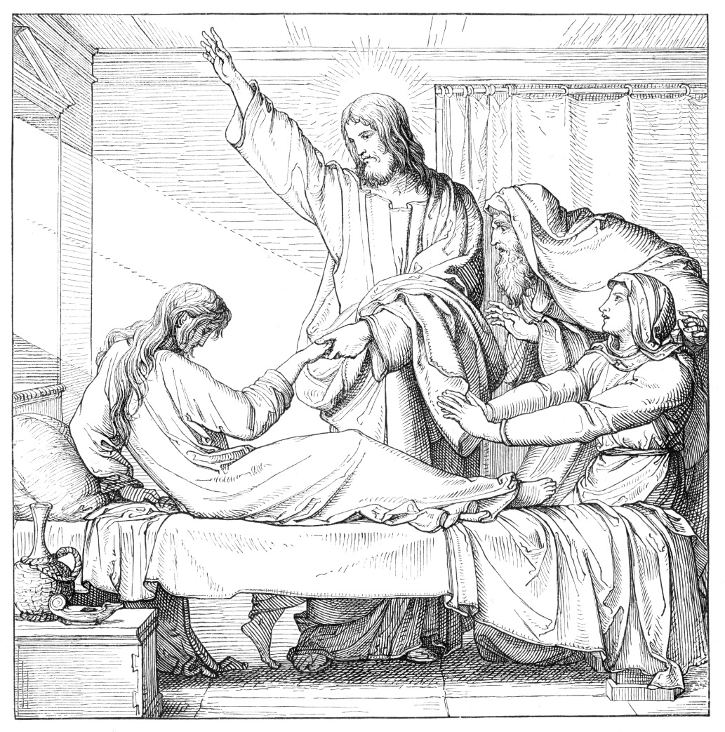
The New Testament
The Old Testament spans many hundreds of years.
The New Testament covers a much shorter period of time.
The books of the New Testament focus on the saving life and work of Jesus.
© Grafissimo / iStockphoto.com
Notes:
Ask the students how the books of the New Testament are used in liturgy (the second reading is usually taken from an Epistle; a reading from a Gospel is proclaimed at every Mass).
This slide corresponds to content in article 17, “God’s Revelation through Sacred Scripture: The New Testament,” in the student book.

Slide 6
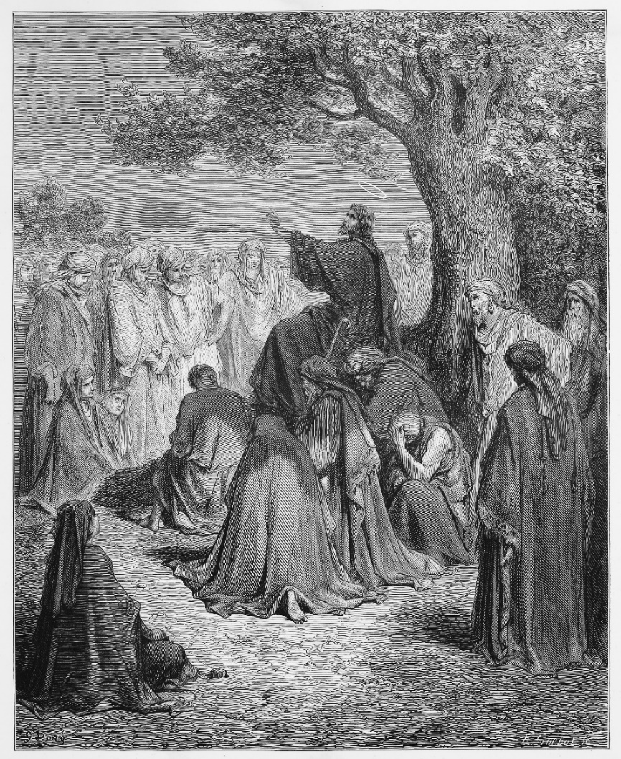
The Life and Teachings of Jesus
The New Testament is rooted in the historical life and teachings of Jesus.
It is not a complete, biographical account of the life of Christ.
It does faithfully transmit the life and teachings of Jesus.
© Nicku / Shutterstock.com
Notes:
Explain that almost all scholars of ancient history agree that Jesus was a historical person. Point out that there are even a few non-Christian first-century histories that mention him.
This slide corresponds to content in article 17, “God’s Revelation through Sacred Scripture: The New Testament,” in the student book.

Slide 7
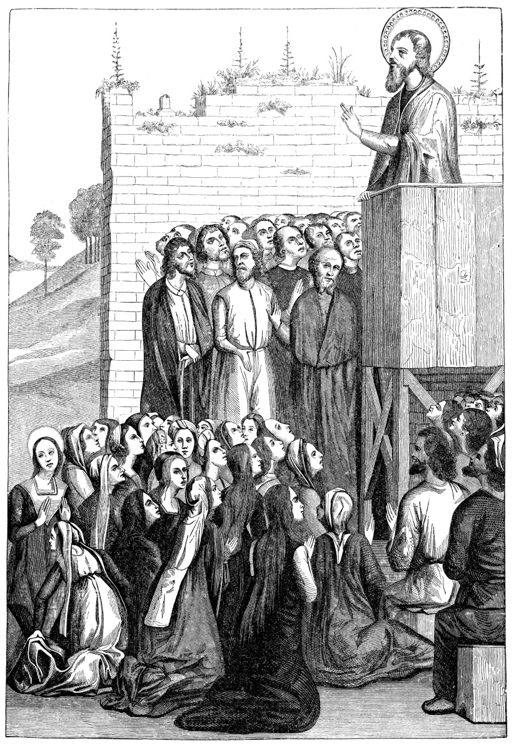
Oral Tradition
No part of the New Testament was written while Jesus was alive.
Little was written about Jesus for the first twenty years after the Resurrection.
Instead, his disciples proclaimed the Gospel by word of mouth.
© duncan1890 / iStockphoto.com
Notes:
Ask the students to share a family story—of their own or of another person—that benefited from hindsight, as the meaning of the event became clear.
This slide corresponds to content in article 17, “God’s Revelation through Sacred Scripture: The New Testament,” in the student book.

Slide 8
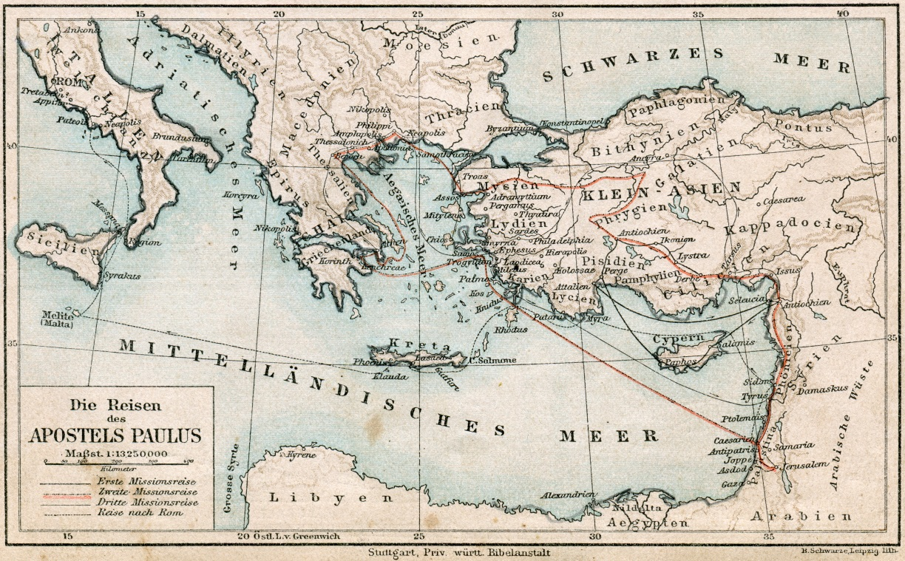
The Epistles
These letters are the earliest writings in the New Testament.
Saint Paul wrote the first New Testament letters around the year AD 51.
He traveled to many cities in the regions we now know as the Middle East and Europe.
Bocman1973 / Shutterstock.com
Notes:
Explain Saint Paul’s process of missionary work and letter writing, described in article 17 in the student book.
This slide corresponds to content in article 17, “God’s Revelation through Sacred Scripture: The New Testament,” in the student book.

Slide 9
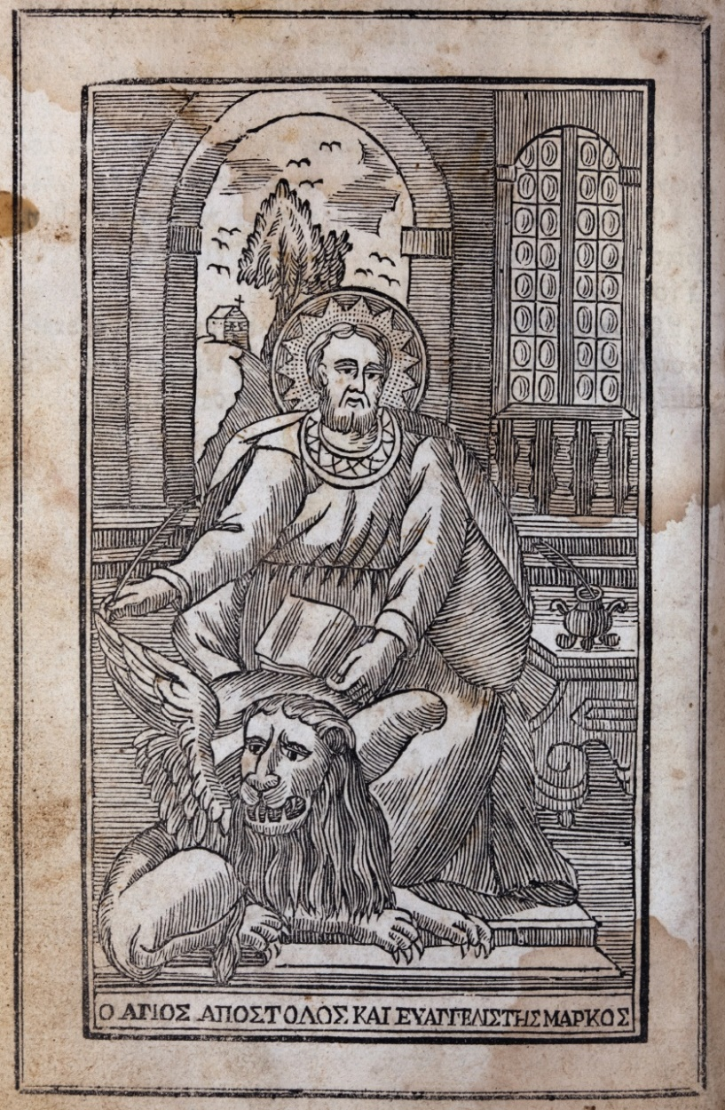
The Gospels
Mark, the shortest and earliest Gospel written, dates from about AD 70.
Each Evangelist chose the teachings and miracles of Jesus that he would include.
Christians have always treated the Gospels with a special reverence.
© bluegame / iStockphoto.com
Notes:
Explain that the Evangelists wrote for certain communities; each chose the content that would be most useful for nurturing the faith of that specific community. To illustrate, discuss how a pastoral minister would quote different passages depending on whether she was visiting the sick, or giving a youth retreat.
This slide corresponds to content in article 17, “God’s Revelation through Sacred Scripture: The New Testament,” in the student book.

Slide 10
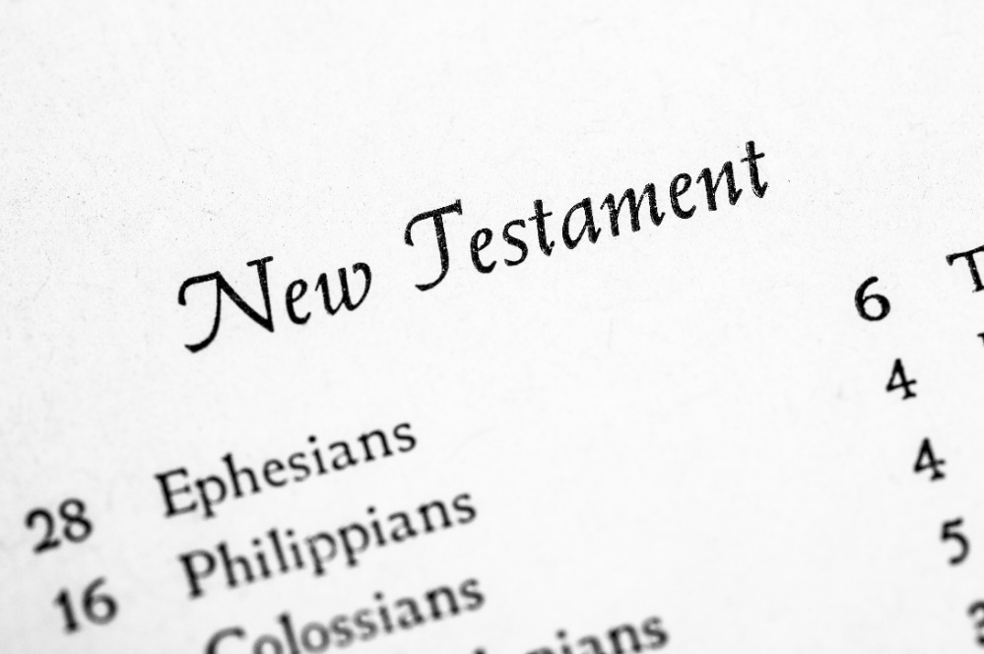
Formation of the Canon
The seventy-three books in the Bible make up the canon of Scripture.
Twenty-seven of the books compose the New Testament.
The early Church Fathers determined which books were divinely inspired and canonical.
© eurobanks / Shutterstock.com
Notes:
Call attention to the definition of canon of Scripture in article 17 in the student book. The four criteria follow on the next slide.
This slide corresponds to content in article 17, “God’s Revelation through Sacred Scripture: The New Testament,” in the student book.

Slide 11
Criteria for the Canon of Scripture
Apostolic origin
community acceptance
use in early Christian worship
consistency
© zentilia / iStockphoto.com
Notes:
Ask volunteers to explain each bullet point, as at the end of article 17 in the student book. Point out that other books could have been included in the canon, but only those found in the New Testament today met all four criteria.
This slide corresponds to content in article 17, “God’s Revelation through Sacred Scripture: The New Testament,” in the student book.

Slide 12
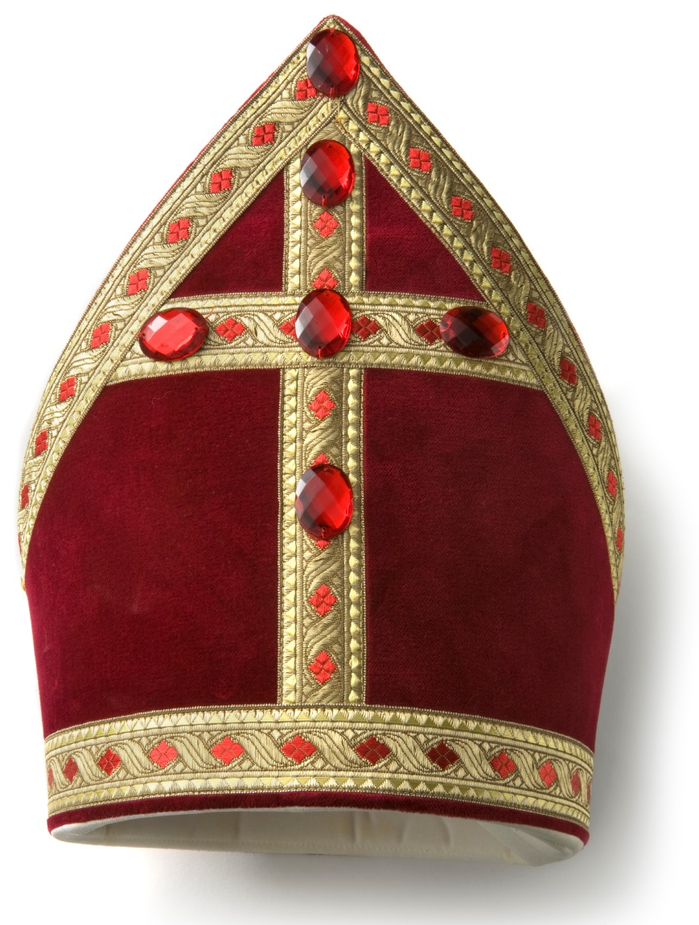
Sacred Tradition
Catholics recognize the authority of both Sacred Scripture and Sacred Tradition.
These are two ways of transmitting Divine Revelation.
© Floortje / iStockphoto.com
Notes:
Explain that the Magisterium of the Church has the responsibility to see that the teaching of the Apostles is handed down to all generations until Christ comes again in glory.
This slide corresponds to content in article 18, “God’s Revelation through Sacred Tradition,” in the student book.

Slide 13
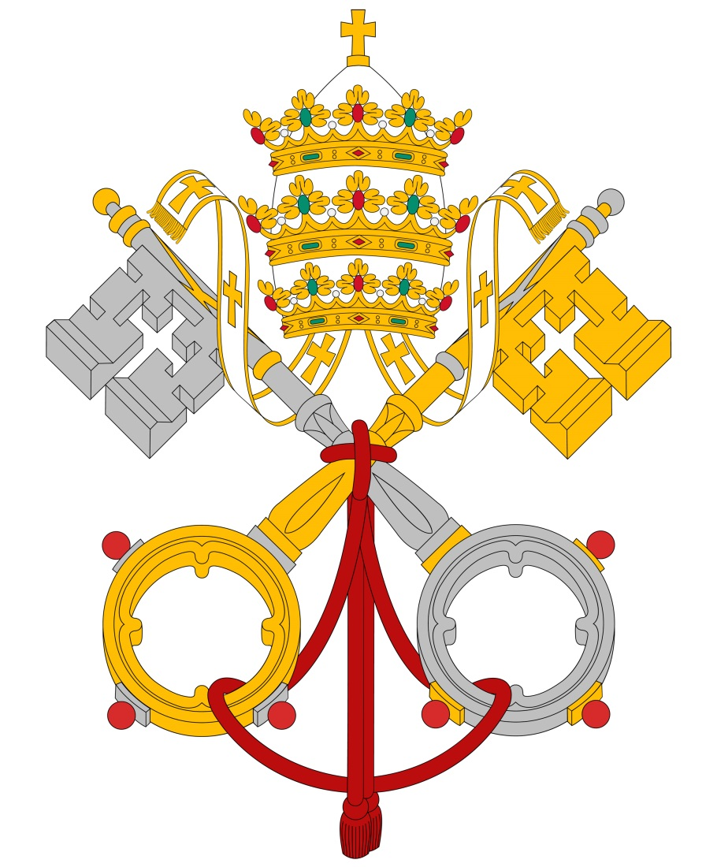
What is Sacred Tradition?
Christ commissioned the Apostles to preach the Gospel everywhere.
Their teaching authority was passed on to the popes and bishops who succeeded them.
This living transmission of the Good News is called Sacred Tradition.
© Cobalt88 / iStockphoto.com
Notes:
Review the steps in the living transmission of the Gospel, always guided by the Holy Spirit, outlined in article 18 in the student book.
This slide corresponds to content in article 18, “God’s Revelation through Sacred Tradition,” in the student book.

Slide 14
The Unity of Scripture and Tradition
Scripture and Tradition work together to achieve the same goal.
They both reveal God to us, so we must respect both.
© Syversen / iStockphoto.com
Notes:
Explain the difference between Tradition (capital T) and tradition (small t), as at the end of article 18 in the student book.
This slide corresponds to content in article 18, “God’s Revelation through Sacred Tradition,” in the student book.

Slide 15
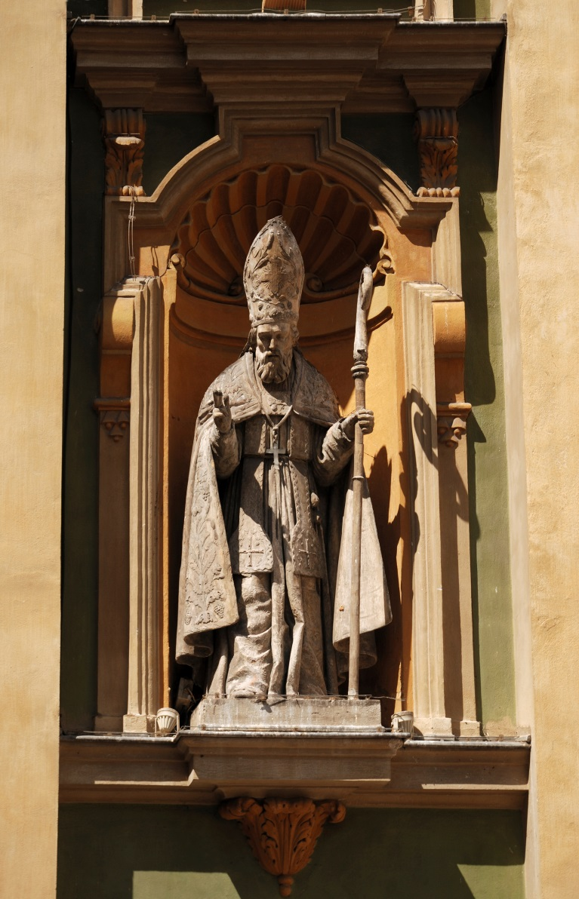
Apostolic Succession: Appointed by Christ
The Church teaches today the same Word of God that Jesus entrusted to his Apostles.
The Pope and all the bishops are the modern-day successors of the Apostles.
© olegmit / iStockphoto.com
Notes:
Share with the students the subject of a recent teaching of their local bishop, or of their national council of bishops. Ask if they know of any recent papal teachings.
This slide corresponds to content in article 19, “Passing On God’s Revelation,” in the student book.

Slide 16
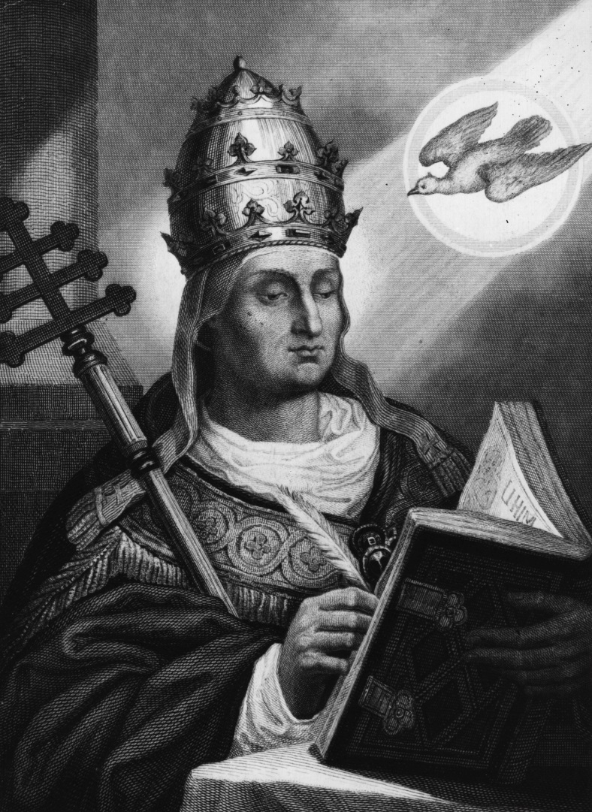
Infallibility
Jesus has guaranteed that we will continue to have access to truths necessary for our salvation.
Papal infallibility means that the Pope’s teachings are without error when he teaches about faith or morals.
© HultonArchive / iStockphoto.com
Notes:
Discuss this teaching, emphasizing that it only applies to certain teachings, not to everything the Pope says.
This slide corresponds to content in article 19, “Passing On God’s Revelation,” in the student book.

Slide 17
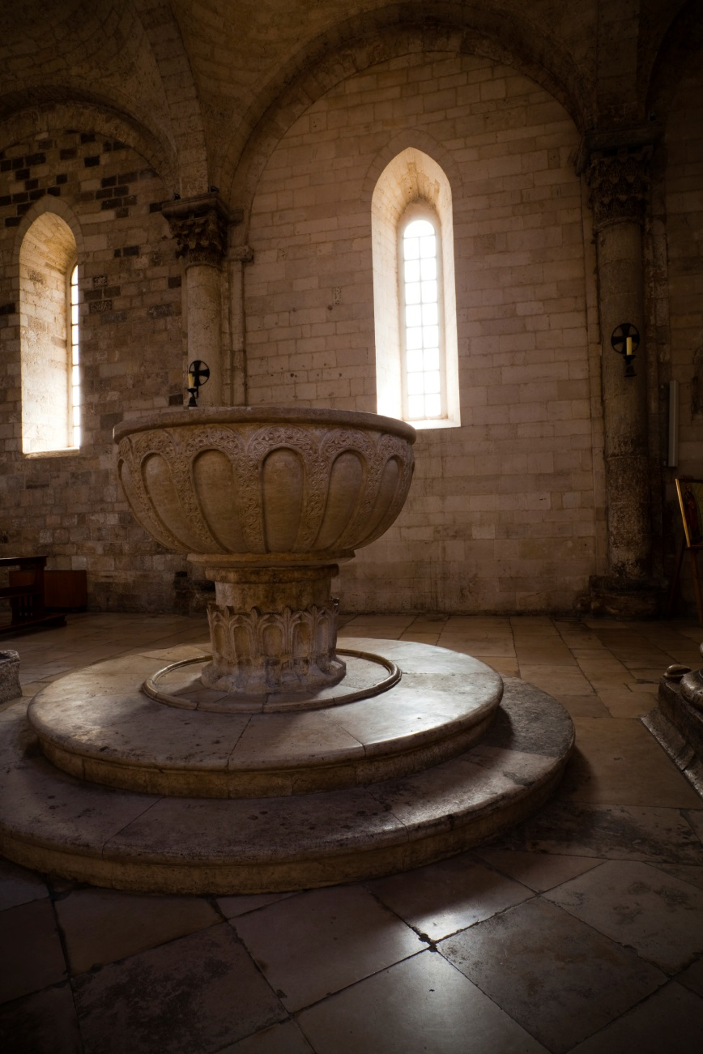
The Catholic Church and Other Christians
The Catholic Church has made huge strides in building bridges with other Christians.
The Church stresses that the Sacrament of Baptism unites all Christians.
© photovideostock / iStockphoto.com
Notes:
Ask a volunteer to define ecumenism, as in article 19 in the student book. Share an example of an ecumenical event in your community, such as an ecumenical Thanksgiving service or Good Friday observance.
This slide corresponds to content in article 19, “Passing On God’s Revelation,” in the student book.

Slide 18
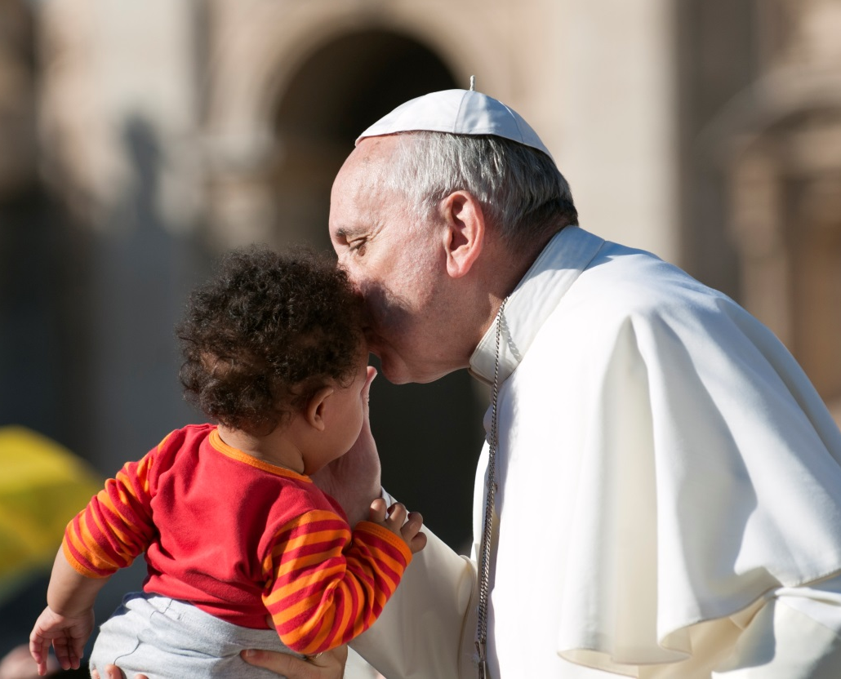
The Catholic Church and Other Religions
The Catholic Church has encouraged interreligious dialogue with people of other faiths.
The Church holds other faiths in “high regard” (Declaration on the Relation of the Church to Non-Christian Religions [Nostra Aetate, 1965]).
© neneos / iStockphoto.com
Notes:
Point out the example of recent popes noted toward the end of article 19 in the student book. Discuss how these kinds of actions help the Church to fulfill its mission.
This slide corresponds to content in article 19, “Passing On God’s Revelation,” in the student book.

