Slide 1
Introduction to Christian Morality
The Catholic Faith Handbook for Youth, Third Edition
Chapter 23
Document #: TX003154
Notes:
Use this presentation to relate key points about morality and human freedom to the students’ own experience.

Slide 2
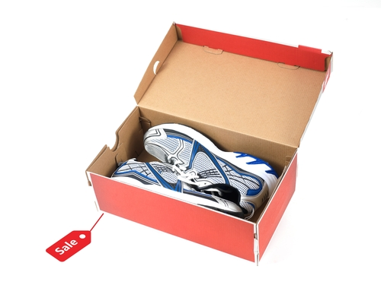
Morality
The goodness or evil of human acts
God’s gift of free will means we have the ability to make choices.
Scripture and Tradition can guide us to live as God wants us to live.
Copyright: Kitch Bain / www.shutterstock.com
Notes:
Point out that we make choices all day long, and that many of those choices have hidden moral implications. Use the image on the slide to discuss the implications of buying athletic shoes. (The Live It! sidebar “Do the Right Thing,” on page 253 of the student handbook, is about buying shoes made by underpaid workers.)

Slide 3
The Foundation of Morality
We are made in the image of God.
When we choose the good, we act in accordance with our nature.
True happiness comes from being in harmony with God and others.
Copyright: Poznyakov / www.shutterstock.com
Notes:
Invite the students to read through the Beatitudes and their meanings on pages 254–255 of the student handbook. Remind the students that many things compete for our attention and try to inform us of what will make us happy. True happiness comes only from following God’s will.

Slide 4
Original Sin
We have free will to make our own choices.
Copyright: Simone van den Berg / www.shutterstock.com
Adam and Eve misused that gift and went against God’s plan.
Their decision left us with a tendency to choose evil.
Notes:
The image on the slide is an example of a situation in which teens are strongly tempted to choose evil. Ask about other such situations that teens might face.

Slide 5
Conscience
We use reason to distinguish right from wrong.
Our interior voice helps us to know right from wrong and then act on that knowledge.
Moral development never stops.
Copyright: mangostock / www.shutterstock.com
Notes:
Invite the students to read about the examination of conscience presented in the Pray It! sidebar on page 256 of the student handbook.

Slide 6
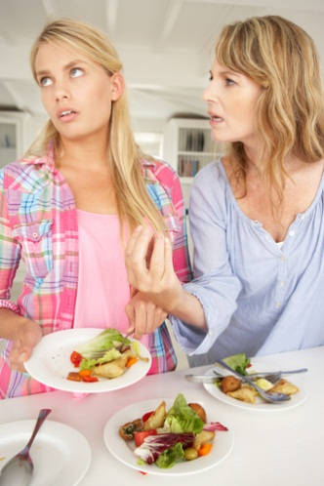
Sin
The choice to do wrong instead of good
Sin hurts our relationship with ourselves, with others, and with God.
Mortal sin and venial sin
Copyright: Monkey Business Images / www.shutterstock.com
Notes:
Ask the students how the teen in the image is damaging the three relationships mentioned on the slide.

Slide 7
Copyright: mangostock / www.shutterstock.com
Who or what helps you in making good moral choices?
Notes:
http://www.oxygenmag.com/Nutrition/Articles/Black-Bean-Burger.aspx

