Slide 1
Jesus and the Church
Jesus Christ: God’s Love Made Visible, Second Edition Unit 3, Chapter 8
Document#: TX004813

Slide 2
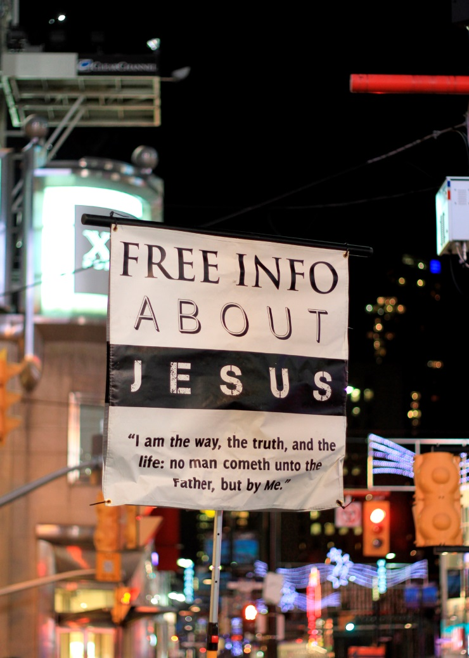
The “New Age” of the Church
After his Resurrection, Jesus promised the Holy Spirit would come to his Apostles.
His promise was fulfilled at Pentecost.
The Spirit enabled the Apostles to proclaim the Gospel in many languages.
© ValeStock / iStockphoto.com
Notes:
Recount the events of Pentecost, as in Acts 2:2–13.
This slide corresponds to content in article 34, “Pentecost and the ‘New Age’ of the Church,” in the student book.

Slide 3
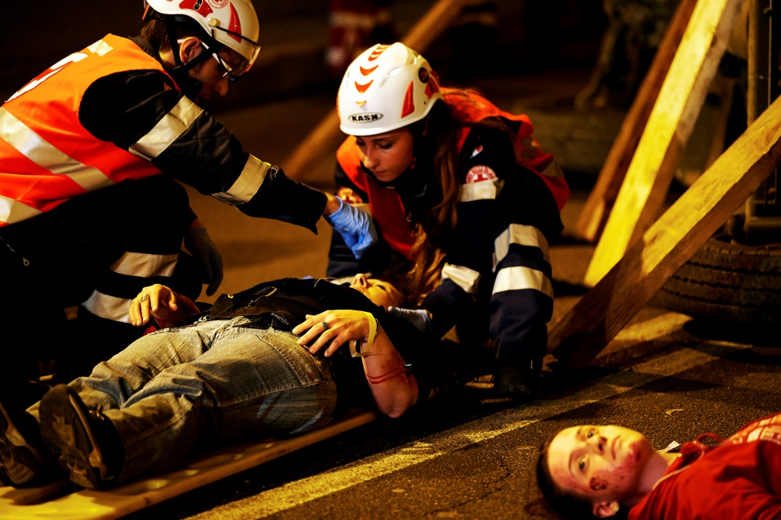
The Church: Christ’s Presence in the World
At Pentecost, the Spirit that had anointed Jesus was poured out on the entire Church.
The Church became Christ’s presence in the world.
Today, Christ lives and acts within his Church.
© claudio.arnese / iStockphoto.com
Notes:
Brainstorm answers to the question that concludes article 34 in the student book, “When have you felt the presence of the Holy Spirit?”
This slide corresponds to content in article 34, “Pentecost and the ‘New Age’ of the Church,” in the student book.

Slide 4
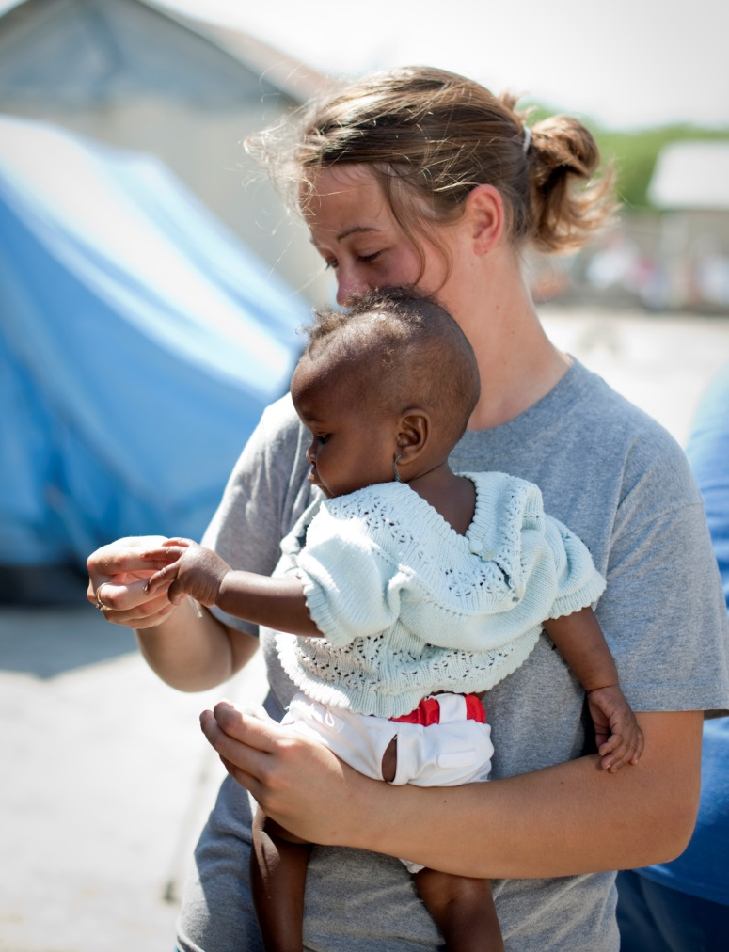
Jesus in the Church
Jesus is no longer physically present to his followers.
However, he gave us the gift of his ongoing presence in the Church.
His presence is not physical, but it is nonetheless real.
© Claudiad / iStockphoto.com
Notes:
Explain the image of the Church as the Body of Christ, with Christ himself as the head.
This slide corresponds to content in article 35, “Jesus Fulfills His Mission in the Church,” in the student book.

Slide 5
The Means and Goal of God’s Plan
God has a plan for the world, and the goal of the plan is the Church.
The Church’s journey toward perfection is not yet completed.
It is through the Church that God accomplishes his goal for us: unity with him.
© Kobby Dagan / Shutterstock.com
Notes:
Explain that the Church offers salvation, or unity with God; it will reach perfection when that unity is achieved. Emphasize that the salvation of our souls is the ultimate end and goal of God’s great plan.
This slide corresponds to content in article 35, “Jesus Fulfills His Mission in the Church,” in the student book.

Slide 6
Four Marks of the Catholic Church
The Church is One in the Lord, in faith, and in Baptism.
It is holy, sharing in the holiness of Christ.
It is Catholic, or universal, in its mission to all.
It is Apostolic, built on the teachings of the Apostles.
© Kali Nine LLC / iStockphoto.com
Notes:
Explain that the Church does not yet perfectly embody these characteristics, but has received the grace to attain them. Draw on the explanation offered in article 36 in the student book.
This slide corresponds to content in article 36, “Four Marks of the Catholic Church,” in the student book.

Slide 7
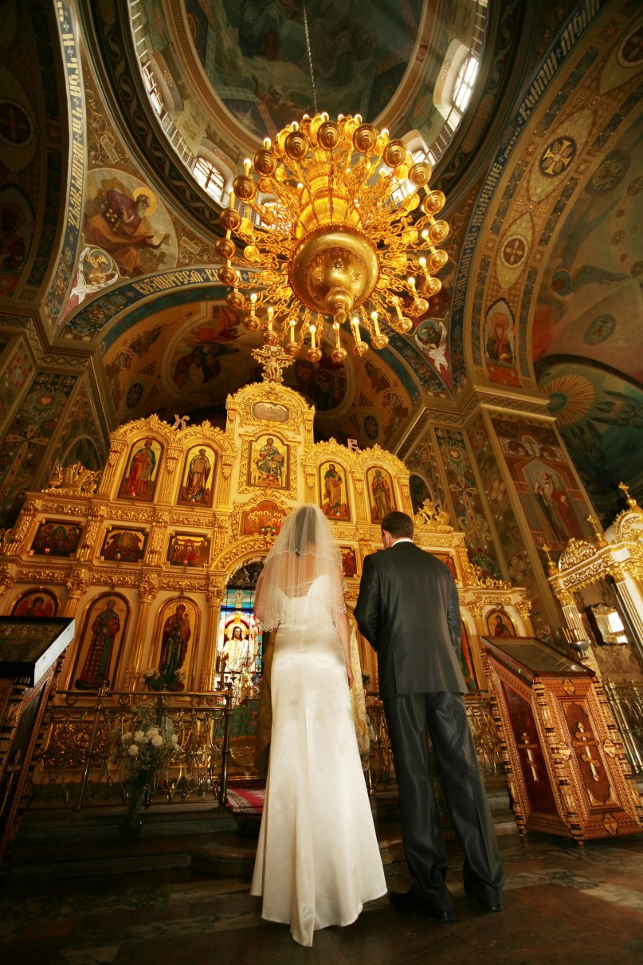
The Sacraments: Encounters with Christ
Jesus established the Sacraments in order to freely give us his grace.
In the Sacraments, the Holy Spirit makes Christ present to us.
We experience the invisible presence of God in visible ways.
© sansara / iStockphoto.com
Notes:
With the students’ help, list the Seven Sacraments on the board, placing them in three categories, as shown in article 37 in the student book. Invite the students to share their experience of the Sacraments, pointing out the sacramental symbols for each.
This slide corresponds to content in article 37, “The Seven Sacraments: Encounters with Christ,” in the student book.

Slide 8
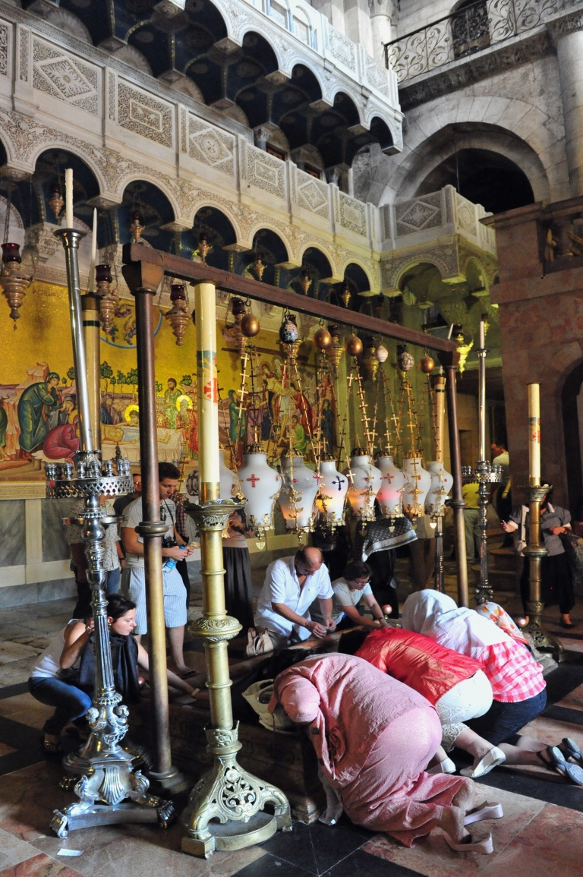
The Ministry of Jesus Christ
Catholic sacramental celebrations are always led by a priest, deacon, or bishop.
But in all of the Sacraments, it is really Jesus Christ who sanctifies us.
© ChameleonsEye / Shutterstock.com
Notes:
Recalling the students’ comments about the Sacraments they have experienced, solicit reactions to the second bullet point.
This slide corresponds to content in article 37, “The Seven Sacraments: Encounters with Christ,” in the student book.

Slide 9
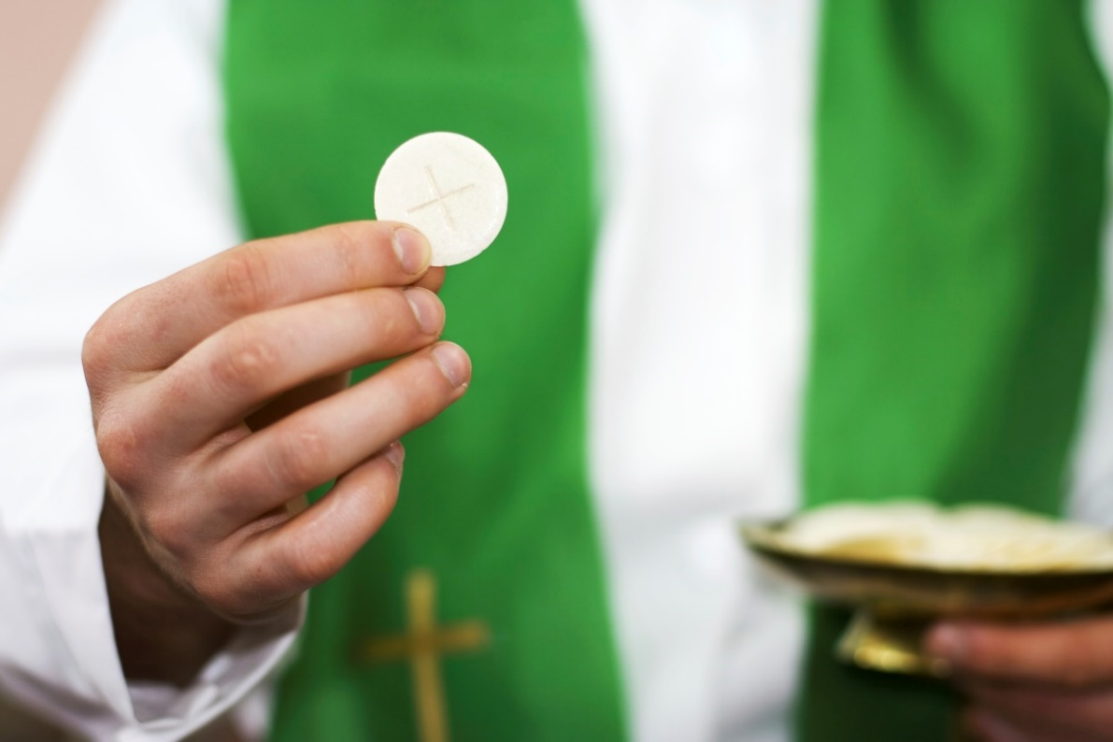
The Eucharist
The Eucharistic liturgy, or Mass, is the central liturgy of the Church.
Eucharist is a Greek word that means “thanksgiving.”
Christ is present to us in four ways at a Eucharistic liturgy.
© small_frog / iStockphoto.com
Notes:
Ask what we are thanking God for in the Eucharist (for all that God has done for us, especially for the Paschal Mystery). The next slides state the four ways Christ
is present.
This slide corresponds to content in article 38, “Jesus’ Presence in the Sacrament of the Eucharist,” in the student book.

Slide 10
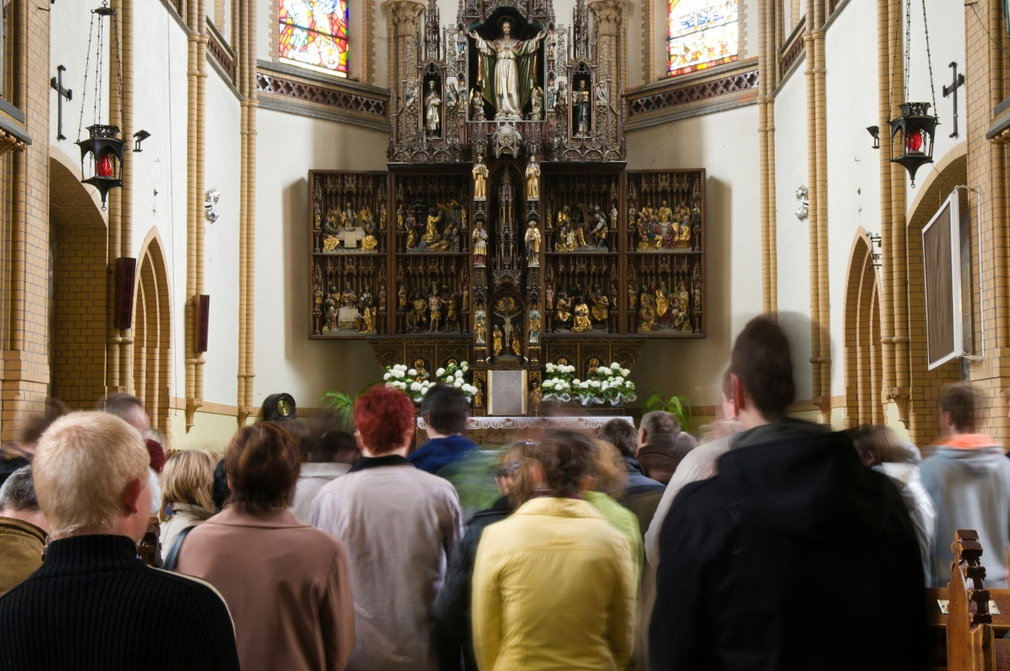
Jesus’ Presence in the Eucharist
Christ is present in the assembly: all members of his Body.
He is present in the priest, who makes the sacrifice of Christ’s Death present again.
Christ is present in his word, speaking to us through the sacred texts.
© kulicki / iStockphoto.com
Notes:
Tell the students that the next slide addresses Jesus’ presence in the Body and Blood at Mass. Ask them for examples of times when they were especially aware of Jesus’ presence in one of the ways noted on this slide.
This slide corresponds to content in article 38, “Jesus’ Presence in the Sacrament of the Eucharist,” in the student book.

Slide 11
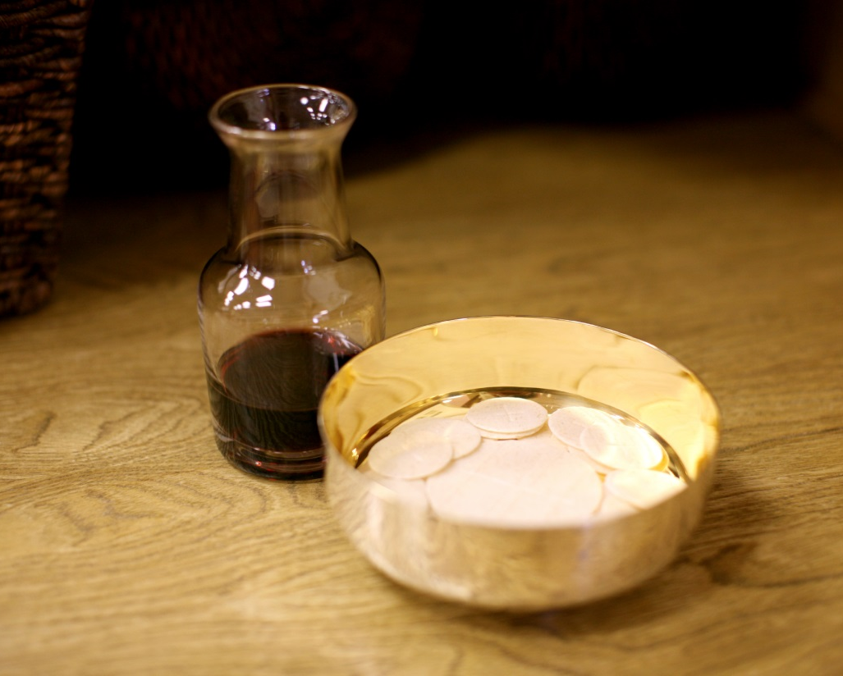
The Body and Blood
Jesus is present in a unique way once the bread and wine have been consecrated.
The consecrated elements taste and look like bread and wine.
But they are truly the Body and Blood of Jesus.
© GemaBlanton / iStockphoto.com
Notes:
Direct some students to silently read the Pray It! sidebar in article 38, while others read the Live It! sidebar in article 39. Ask them to outline the main points of the sidebar they read and to share their experience of, or reaction to, the topic.
This slide corresponds to content in article 38, “Jesus’ Presence in the Sacrament of the Eucharist,” in the student book.

Slide 12
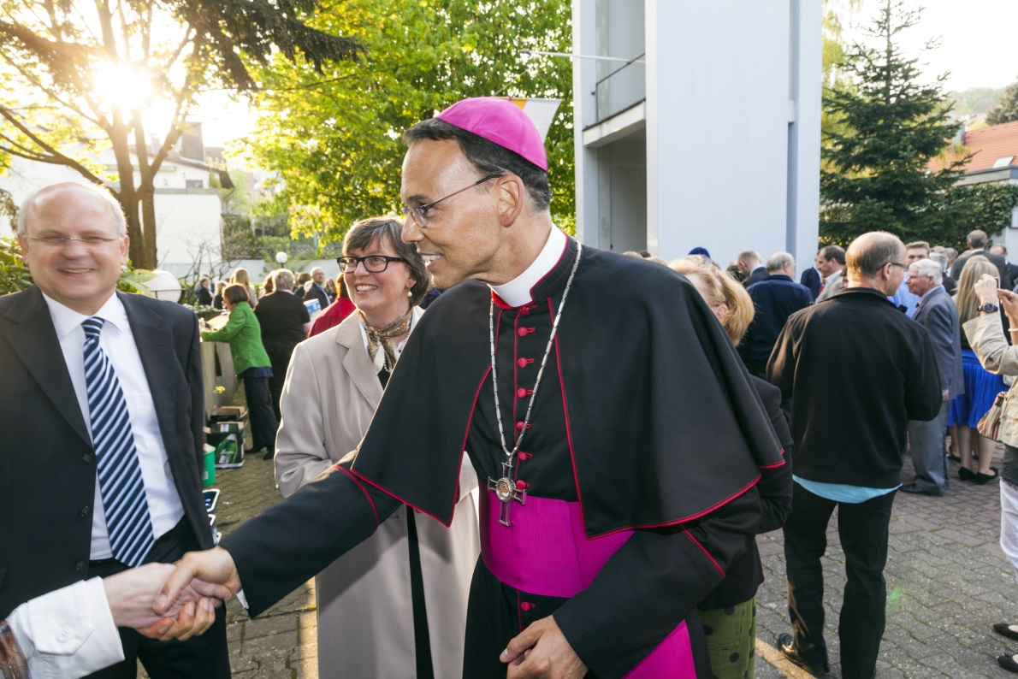
Jesus Teaches through the Church
In the four Gospels, Jesus is called “Teacher,” or rabbi, many times.
Church leaders speak with authority, as Jesus did, because the Church is Christ’s Body.
The bishops teach the faith to the people.
© Jorg Hackemann / Shutterstock.com
Notes:
Explain that the bishops do not create their own teachings: they pass down and interpret the truth revealed by God through Sacred Scripture and Sacred Tradition. Review the concept of infallibility as shown in article 39 in the student book.
This slide corresponds to content in article 39, “Jesus Teaches through the Church,” in the student book.

Slide 13
Jesus Ministers through Us
As members of Christ’s Body, we share in Christ’s mission.
We participate in his ministry to the world, through our particular vocation.
All Christian vocations are oriented to service.
© bobbieo / iStockphoto.com
Notes:
Review the concept of vocation, emphasizing that all members of the Christian community are called to a particular vocation. Identify your own vocation, as well as that of others in the school community. The following slides will explain those vocations.
This slide corresponds to content in article 40, “Jesus’ Ministry through the Community of Faith,” in the student book.

Slide 14
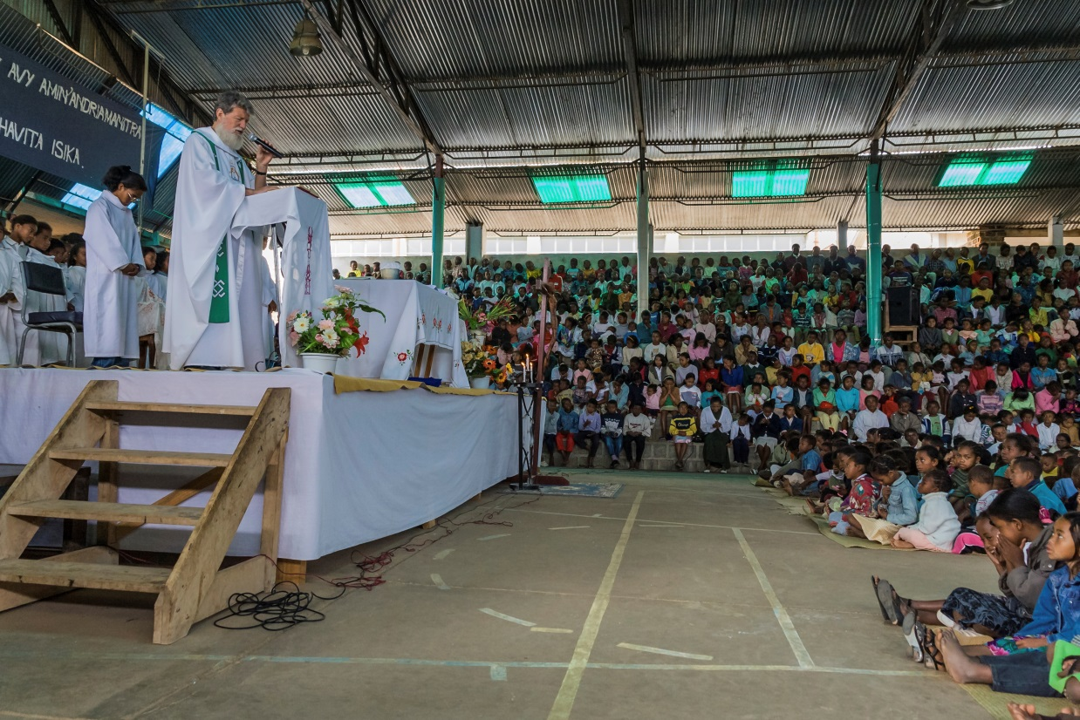
Ordained Ministry
A bishop ministers to a diocese or archdiocese, a geographical region.
Deacons and priests assist the bishop in caring for the needs of the Church within that region.
Through them, Christ continues his work of salvation.
© pierivb / iStockphoto.com
Notes:
Ask which sacrament confers ordained ministry as a bishop, priest, or deacon (the Sacrament of Holy Orders). Explain the difference between diocesan and order priests, as in article 40 in the student book.
This slide corresponds to content in article 40, “Jesus’ Ministry through the Community of Faith,” in the student book.

Slide 15
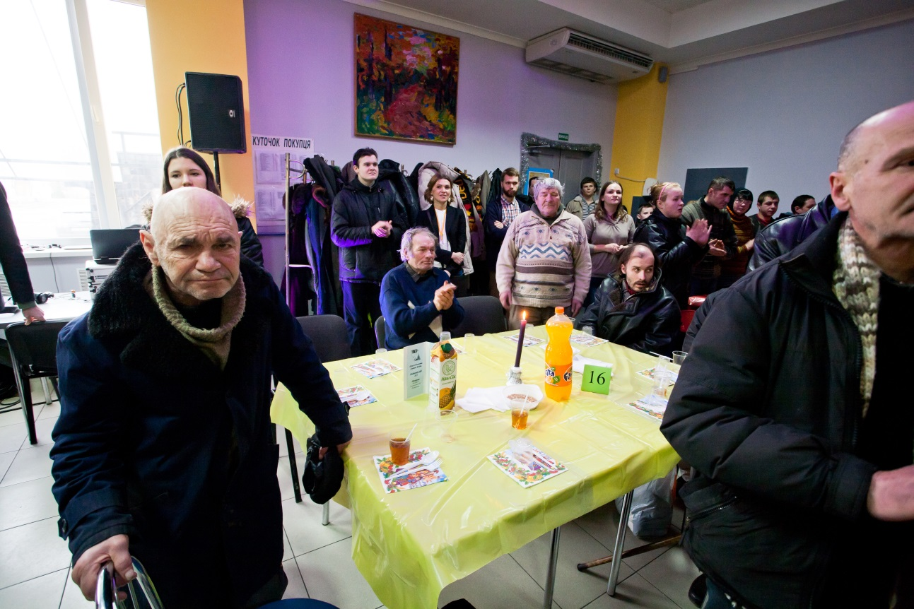
The Laity
The majority of Christians live out their baptismal call to service as a member of the laity.
Many laypeople are called to marriage; they may also become parents.
Other laypeople are called to a dedicated (or committed) single life.
© Radiokafka / Shutterstock.com
Notes:
Discuss the specific types of service to which married and single Catholics are called, as shown in article 40 in the student book.
This slide corresponds to content in article 40, “Jesus’ Ministry through the Community of Faith,” in the student book.

Slide 16
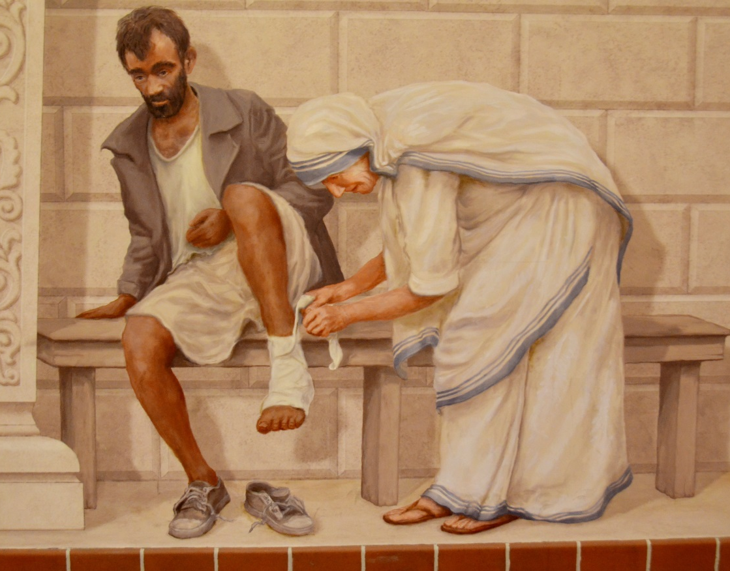
Consecrated Life
Some Christians are called to live the consecrated life.
They make a lifelong commitment to poverty, chastity, and obedience.
Most serve as members of a religious order and are called Sister or Brother.
© meunierd / Shutterstock.com
Notes:
Discuss the type of service on which the religious congregations in your diocese focus, pointing out how Christ continues his work through the efforts of these vowed religious.
This slide corresponds to content in article 40, “Jesus’ Ministry through the Community of Faith,” in the student book.

