Slide 1
The Structure of the Liturgy
The Sacraments
Document #: TX002067
Notes:
Notes: This slideshow is an introduction to the basic structure of liturgy. After viewing this slideshow, the students should be able to discuss the major elements of Catholic liturgy and have a better understanding of the significance of each element of the liturgy.

Slide 2
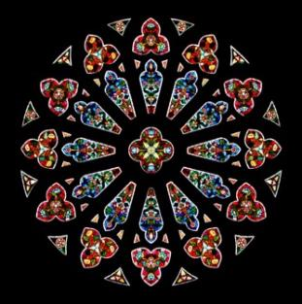
Liturgy Is Ritual
© oriontrail/shutterstock.com
The liturgy is a ritual in which we participate in God’s work.
The Mass is only one form of liturgy. There are many liturgies. The primary liturgies celebrate the Seven Sacraments.
Notes:
Note:
Alternate Image Option: a bird’s-eye view of a full church

Slide 3
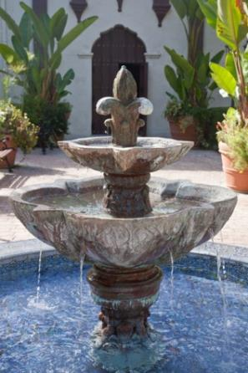
The Same, the World Over
No matter where you attend liturgy in the world, the same ritual, the same pattern of actions, is observed.
© Mariusz S. Jurgielewicz /shutterstock.com
Notes:
Notes: No matter what the language or culture, the Catholic Mass, as well as most of the other rites and liturgies, follows the same rituals around the world. Explain to the students that they can attend liturgies anywhere in the world and feel at home because they will know the basic sequence of the liturgy.
Alternate Image Option: a liturgy in a mission country

Slide 4
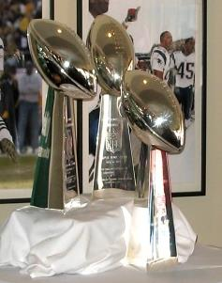
Ritual Is Vital
What would happen if someone forgot to bring the Vince Lombardi trophy to the Super Bowl?
Image in Public Domain
Notes:
Notes: At the beginning of this unit, we describe the liturgy as a ritual through which we participate in God’s work. The basic pattern of this ritual gives those who participate in it a sense of continuity from one liturgical celebration to another. Think about how important continuity and consistency are to us. What would happen if someone forgot to bring the Vince Lombardi trophy to the Super Bowl? Emphasize that those “in the know” understand the sequence of events and the importance, and are reassured when the ritual is followed. And so it is with the Catholic liturgy.

Slide 5
Liminal, or Threshold, Experiences
All liturgies bridge who we are with who we are to be as members of the Body of Christ through our fully conscious and active participation.
© Andrew Jalbert/shutterstock.com
Notes:
Notes: Liturgies are liminal, or threshold, experiences. Every liturgy opens a door to who we are and who we will be in Christ.

Slide 6
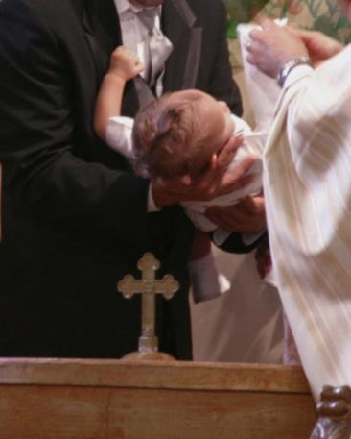
Different Liturgies
One for each of the Seven Sacraments
© J. McPhail /shutterstock.com

Slide 7
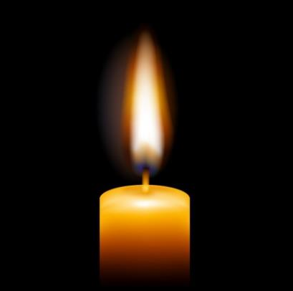
Other Occasional Liturgies
For these liturgies we often use the term rite, which is another word for ritual.
Examples: The Rite of Blessing of the Fire and the Lighting of Candles at the Easter Vigil on Holy Saturday
© iadams/shutterstock.com
Notes:
Notes: Here you can mention other special liturgies: Rite of Christian Initiation of Adults (including rites within it, such as Rite of Acceptance of Catechumens and Rite of Election), wedding anniversaries celebrated with a Mass and a special blessing, beginning of the school year, Red Mass (for lawyers and judges), Blue Mass (for police officers and other public safety entities), White or Rose Masses (for health care professionals), Chrism Mass, and so on. Each liturgy has a basic similar format, which we will examine next. Even though each rite for the Sacraments or blessings for special occasions adds words and actions, we will focus on the basic structure that is essentially the same for all liturgies.
Alternate Image Option: image of people gathered around the New Fire at Easter

Slide 8
Every Liturgy Follows a Pattern
What do all liturgies have in common? A basic pattern.
The basic pattern gives those who participate a sense of continuity from the beginning of the liturgy to the end, and from one liturgical celebration to another.

Slide 9
Basic Format, Added Words and Actions
For each rite for the Sacraments and for special occasions, we add words and actions to the basic format.
The basic structure remains essentially the same for all liturgies.
Notes:
Alternate Image Option: an adult being baptized

Slide 10
Basic Structure of All Liturgy
Introductory Rites
Liturgy of the Word
Liturgy of the Sacrament or Particular Rite or Blessing
Dismissal

Slide 11
Introductory Rites
Every liturgy begins with Introductory Rites, which usually include a greeting or a call to worship.
In the Catholic Church, it is traditional to begin with the Sign of the Cross.
Notes:
Notes: Making the Sign of the Cross reminds us of our Baptism and also recalls the Trinitarian nature of God and the sacrifice of Jesus on the cross. We are united in this Paschal Mystery of Christ as we begin every act of worship as a community.
Alternate Image Option: priest making Sign of the Cross at beginning of Mass or reading the Collect (Opening Prayer)

Slide 12
Liturgy of the Word
The next liturgical action is the proclamation of the Word of God, the Liturgy of the Word.
A homily often follows, which helps us to make connections between the Scriptures and our own lives.
© qingwa/iStock.com.com
Notes:
Notes: We gather around the Word as one Body in Christ. As we listen to Sacred Scripture, the Word of God becomes our guiding word. In the homily we are helped to make the connection between God’s story and our story.

Slide 13
In Some Liturgies, Scripture Optional
In the Sacraments of Penance and Reconciliation, and Anointing of the Sick, a reading from Scripture is encouraged but optional.
Most often, though, the priest will recite a Scripture verse or include a short reading.
Notes:
Alternate Image Option: priest reading from Scripture at Sacrament of Penance and Reconciliation

Slide 14
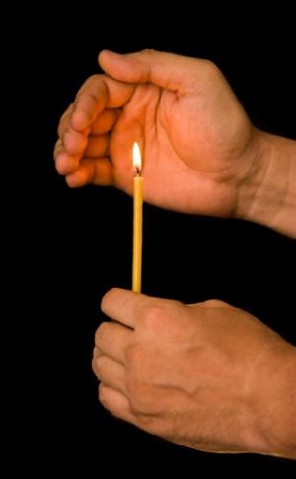
Profession of the Faith
“I believe . . .”
A Profession of Faith in the Nicene Creed often concludes the Liturgy of the Word as a way of affirming our belief in the Triune God, in our salvation through Jesus Christ, and in our hope for eternal happiness with God forever.
The Profession of Faith proclaims that God’s story and our story have become one.
The assembly professes faith by renewing baptismal promises at Easter.
© PRIMA/shutterstock.com
Notes:
Notes: Inform the students that the Nicene Creed is recited only at the Sunday Eucharist and on solemnities (solemn feasts), but not on weekdays. It is also optional in some ritual celebrations.
Alternate Image Option: assembly renewing baptismal promises at Easter

Slide 15
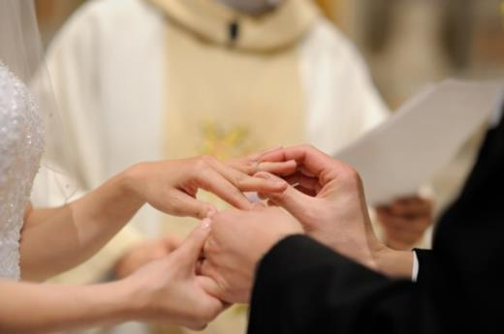
Sacraments after the Liturgy of the Word
The other six Sacraments (other than the Eucharist) can also be celebrated during a Mass.
When celebrated as part of the Eucharist, these Sacraments are celebrated after the Liturgy of the Word.
© MNStudio/shutterstock.com
Notes:
Alternate Image Option: the Consecration of the Mass, and a priest presiding at a wedding

Slide 16
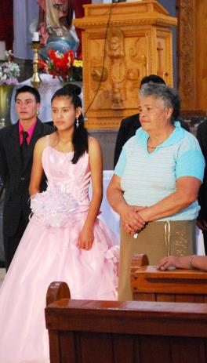
Special Blessing Rites
Blessings for occasions unique to a certain culture, such as a quinceañera, may also be celebrated.
Image in Public Domain
Notes:
Notes: A quinceañera is celebrated by those of Hispanic background when their fifteen-year-old daughters make a commitment to Jesus, Mary, and the Church. Other rites or blessings include the renewal of wedding vows, or, during Lent, the ceremonies of the Rite of Christian Initiation of Adults (RCIA).
Alternate Image Option: a quinceañera blessing in a parish church

Slide 17
General Blessing and Dismissal
• The sacramental or blessing rite concludes with a general blessing and dismissal.
• The dismissal is more than just being sent home: it means being sent out as a disciple and as a Christian witness.
© Christopher Jones/shutterstock.com
Notes:
Notes: At the dismissal, we are to go forth as disciples, to “do this in memory of me” (Luke 22:19), to tell the world our story through our words and service to others.
Alternate Image Option: a final blessing given by a priest at the end of Mass

