Slide 1
Introduction to the Liturgy
The Catholic Faith Handbook for Youth, Third Edition
Chapter 16
Document #: TX003147
Notes:
Use this presentation to introduce or review the meaning of the term liturgy and the events of the Liturgical Year.

Slide 2
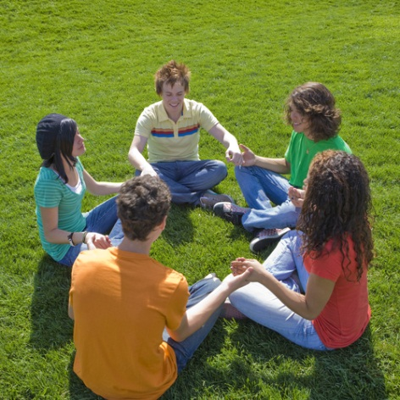
Liturgy
The public, communal, official worship of the Church
Our participation in God’s work
God at work to bring us to salvation
Copyright: Rick Becker-Leckrone / www.shutterstock.com
Notes:
Ask the students about the liturgical ministries that are open to youth in their parishes. If they have participated in any of these ministries, encourage them to talk about their experiences.

Slide 3
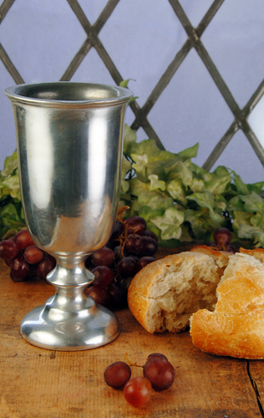
Liturgy and the Holy Trinity
The Church’s liturgy is completely Trinitarian.
Each person of the Trinity is involved in the liturgy.
Christ’s presence: assembly, Scripture, the Eucharist
Copyright: Jill Battaglia / www.shutterstock.com
Notes:
Ask the students how the Father and the Holy Spirit are involved in the liturgy. Refer them to pages 173–174 of the student handbook if they need help with the answer.

Slide 4
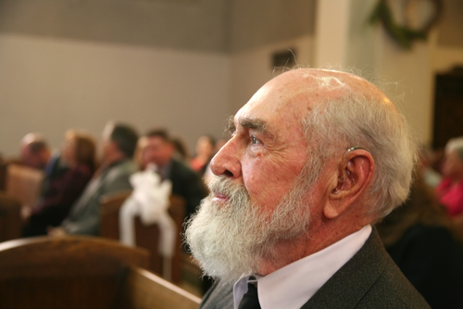
Imagine yourself at Mass . . .
Copyright: Stacy Barnett / www.shutterstock.com
Notes:
Call the students’ attention to the Pray It! sidebar “The Cross,” on page 174 of the student handbook. Allow time for them to read and reflect in silence. Ask the students whether noticing and praying for others at Mass would enrich their experience of the liturgy.

Slide 5
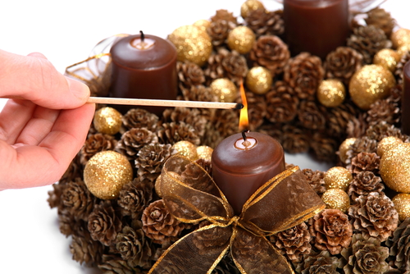
The Liturgical Year
Advent
Christmas
Ordinary Time
Copyright: Bine / www.shutterstock.com
Notes:
Ask the students to identify each of these seasons in the Liturgical Year. A full description of them is found on pages 174–177 of the student handbook. As you discuss each season, ask the students to recall the season’s liturgical color. (Advent: purple and rose; Christmas: white; Ordinary Time: green)

Slide 6
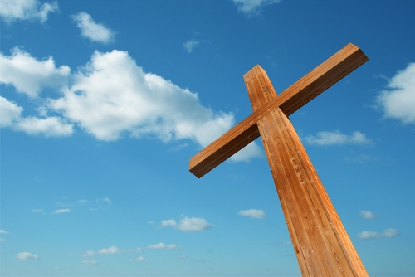
Lent and Holy Week
Lent
Holy Thursday
Good Friday
Holy Saturday
Copyright: design36 / www.shutterstock.com
Notes:
Ask the students to continue identifying the seasons (described on pages 177–178 of the student handbook). Ask the students to identify the liturgical color for Lent. (violet) They may recall that the presider wears red on Passion Sunday and Good Friday; white can be worn on Holy Thursday.

Slide 7
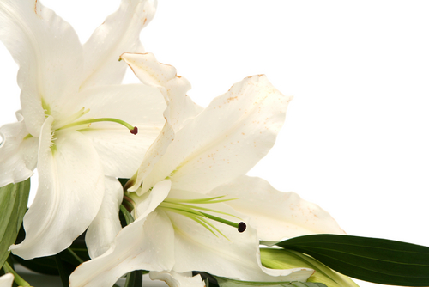
Easter Season
Christ’s Resurrection
Christ’s Ascension
Pentecost
Copyright: Hallgerd / www.shutterstock.com
Notes:
Ask the students to identify the feasts of the Easter season and the liturgical colors seen during this season. (Easter: white; Pentecost: red)

Slide 8
Throughout the Liturgical Year
We remember the past
We celebrate the present
We look toward the future
Copyright: Darren Whitt / www.shutterstock.com
Notes:
Using the example of Christmas, explain that we remember that God came into the world by becoming man, we celebrate the reality that God is truly present in our daily lives, and we hope that God will reign as king in every corner of our lives and our world. Ask volunteers to apply the statements on the slide to Easter.

Slide 9
Celebrating Liturgy
Liturgy is something joyful.
There is an underlying current of hope and joy because of our belief in the Resurrection.
Liturgies are done in remembrance of something.
Copyright: William Attard McCarthy / www.shutterstock.com
Notes:
Help the students understand why the Catholic Church places such strong emphasis on the obligation to attend Sunday Mass and other liturgical celebrations.

