Slide 1



Slide 2

The Old Testament
and the Trinity
Chapter A
The Bible:
The
Patriarchs
© milanklusacek/www.istockphoto.com

Slide 3
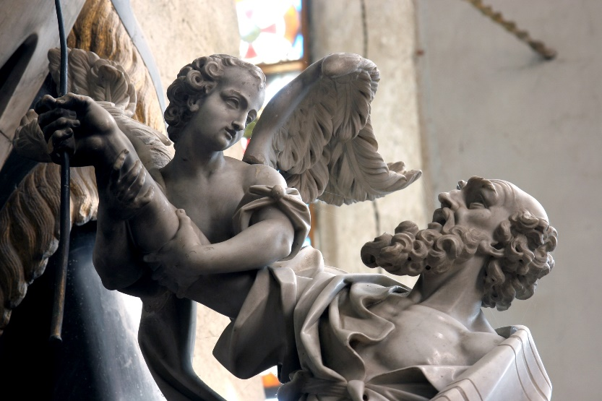
Chapter Summary
The Bible: The Patriarchs
The role of the patriarchs of God’s Chosen People, the Israelites, is important. The patriarchs’ story begins with God’s call to Abraham and Abraham’s trust in God, and continues with God’s blessing extended to Isaac, and then to Jacob, and finally to Joseph. Through the joys and challenges of life—sibling rivalry, love and marriage, and dreams—God continues to act on behalf of his Chosen People to bring about the unfolding of salvation history.
© ZvonimirAtletic/www.shutterstock.com

Slide 4
Introductory Activity
Imagine . . .
you had to leave everything behind you. Your family. Your friends. Your school. Your sports teams. Your town.
And for what . . . ?

Slide 5
Because God had a different plan for your life than you had for your own . . .
. . . a life where you were called to be the first leader of a completely new community of people.
And not just any community . . . a community that God cared for with his entire heart.

Slide 6
Consider your talents.
Consider your weaknesses.
Would you be up for this challenge?
How would you feel if you were given this incredible responsibility?
What would your answer be?

Slide 7
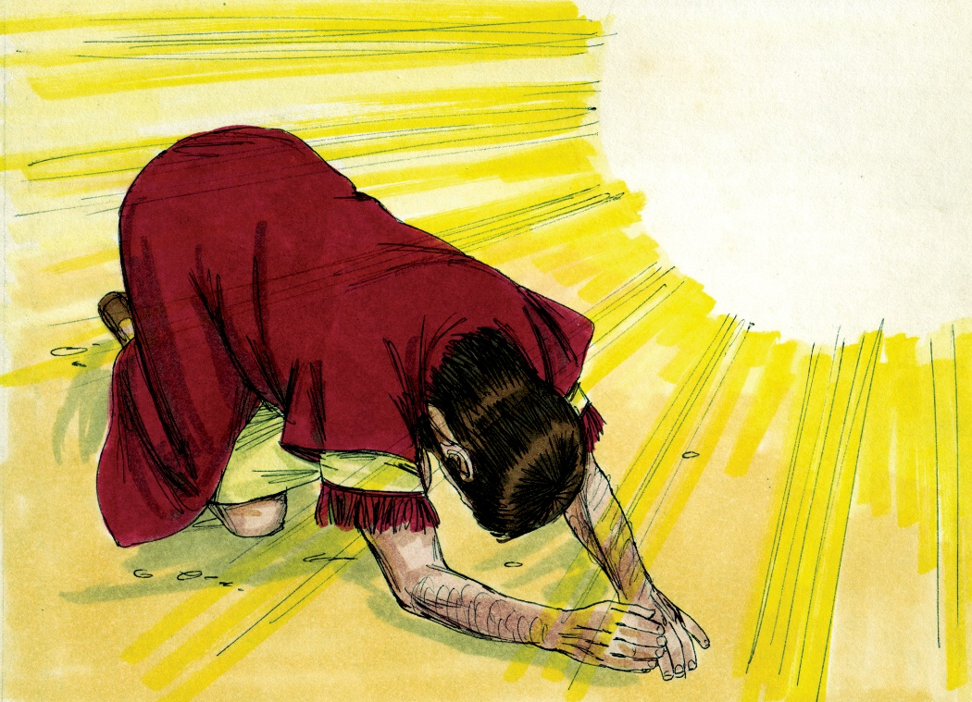
“God Calls, Abraham Listens and Places Complete Trust in God”
(Genesis 12:1–9 and Chapter 22)
God called Abraham, and Abraham placed his complete trust in God.
© BibleArtLibrary/www.istockphotos.com

Slide 8
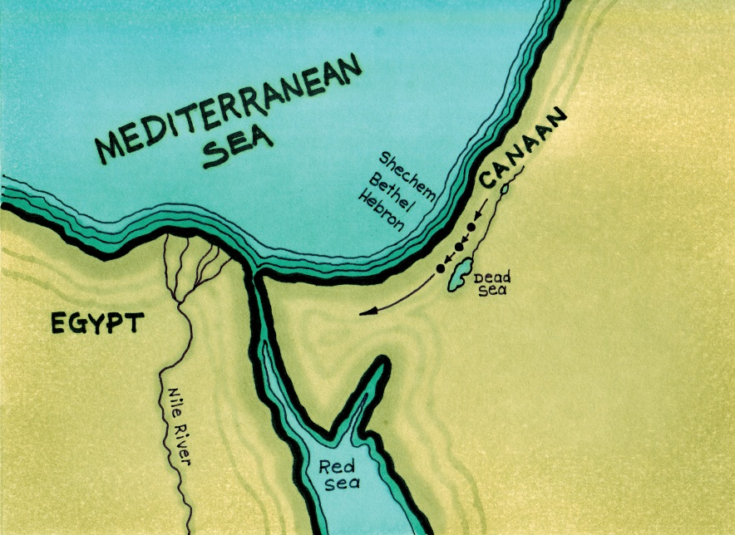
“God Calls, Abraham Listens and Places Complete Trust in God”
(Genesis 12:1–9 and Chapter 22)
The Lord asked Abraham to leave his country, relatives, and father’s home.
God promised Abraham blessings, many descendants, and the land of Canaan.
© BibleArtLibrary/www.istockphotos.com

Slide 9
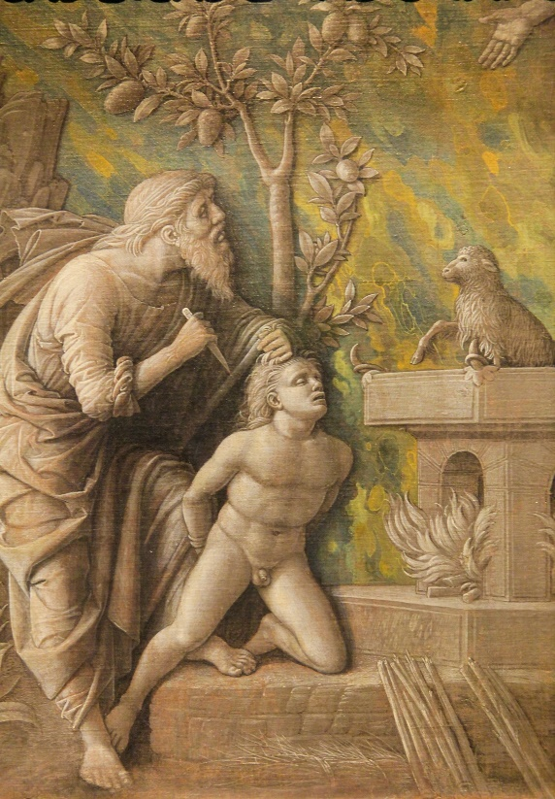
“God Calls, Abraham Listens and Places Complete Trust in God”
(Genesis 12:1–9 and Chapter 22)
Abraham trusted God so much that he was willing to offer his only son, Isaac, as a sacrifice to God.
© jorisvo/www.shutterstock.com

Slide 10
“Treachery and Trickery:
Twin Steals Inheritance!”
(Genesis, Chapter 27)
God’s blessing extended through Isaac to Jacob and was not stopped because of Jacob’s deception.
God’s blessing
Abraham
Isaac
Jacob

Slide 11
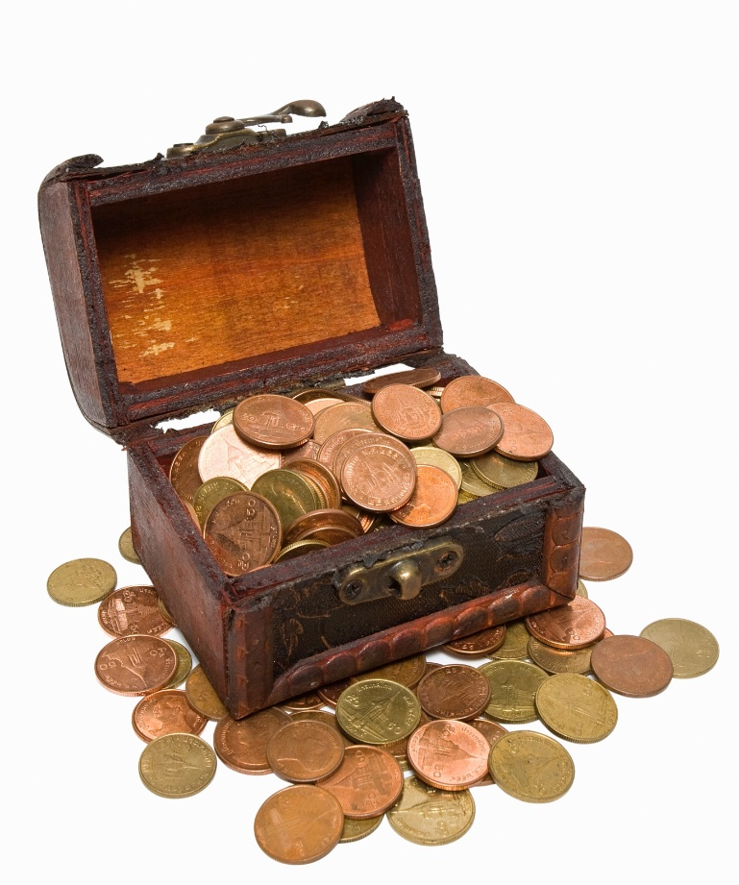
“Treachery and Trickery:
Twin Steals Inheritance!”
(Genesis, Chapter 27)
In the time of the patriarchs, the son who received the father’s blessing would take over leadership of the family and inherit all the family’s belongings after the father’s death.
Esau was Isaac’s firstborn son and the rightful recipient of Isaac’s inheritance and his blessing.
© Techin24/www.istockphoto.com

Slide 12
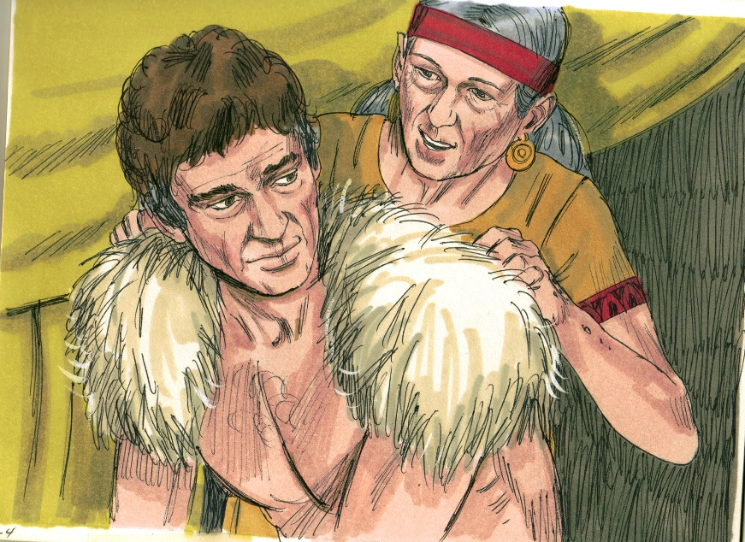
“Treachery and Trickery:
Twin Steals Inheritance!”
(Genesis, Chapter 27)
Rebecca, Jacob and Esau’s mother, favored Jacob and helped Jacob trick her husband into giving his blessing to Jacob instead of Esau.
Jacob received Isaac’s blessing and Esau was left with nothing.
© BibleArtLibrary/www.istockphotos.com

Slide 13

“Jacob Tricked, Marries Wrong Sister!
(Genesis 28:1–5, 29:1–30)
Jacob, the deceiver, was himself deceived, but he persevered to marry both Leah and Rachel.
Jacob and Leah
Jacob and Rachel
© PhotonStock/www.istockphoto.com

Slide 14

“Jacob Tricked, Marries Wrong Sister!
(Genesis 28:1–5, 29:1–30)
Jacob traveled back
to the home of his grandfather in order
to find a wife. Jacob immediately fell in love with Rachel.
Jacob worked for seven years to marry his Uncle Laban’s daughter, Rachel.
© alexeyrumyantsev/www.istockphoto.com

Slide 15

“Jacob Tricked, Marries Wrong Sister!
(Genesis 28:1–5, 29:1–30)
Laban tricked Jacob into marrying Leah.
Jacob worked seven more years to marry Rachel as well.
Rachel?
Leah?
© InaPandora/www.shutterstock.com

Slide 16
“Joseph Sold into Slavery and Then Appointed Governor of Egypt!”
(Genesis 37:12–36 and Chapter 41)
Joseph was made governor over all of Egypt because God gave him the gift of interpreting dreams.
© PeterHermesFurian/www.shutterstock.com

Slide 17
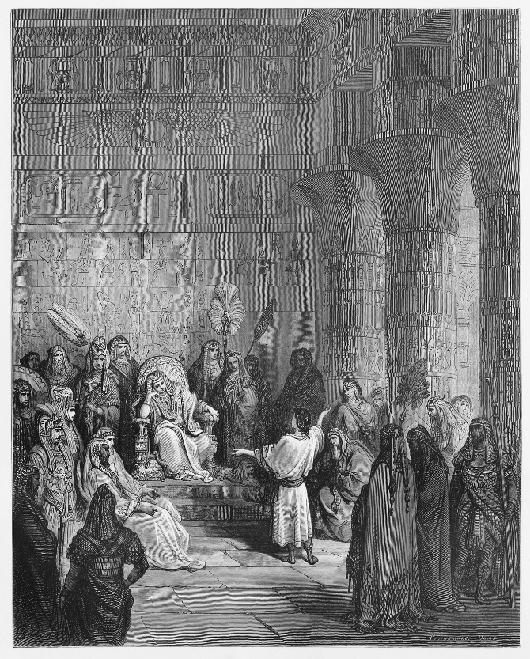
“Joseph Sold into Slavery and Then Appointed Governor of Egypt!”
(Genesis 37:12–36 and Chapter 41)
Out of jealousy Joseph’s brothers sold him into slavery and he ended up in jail in Egypt.
Joseph was taken to Pharaoh and was able to accurately interpret Pharaoh’s dreams.
Joseph was made governor of Egypt to rule over Egypt during seven years of abundance and seven years of famine.
© Nicku/www.shutterstock.com

