Slide 1
The Historical Context of Jesus
Document #: TX004703
Notes:
Notes: This PowerPoint is designed for teachers who would like to provide a more in-depth look at the historical context in which Jesus lived.

Slide 2
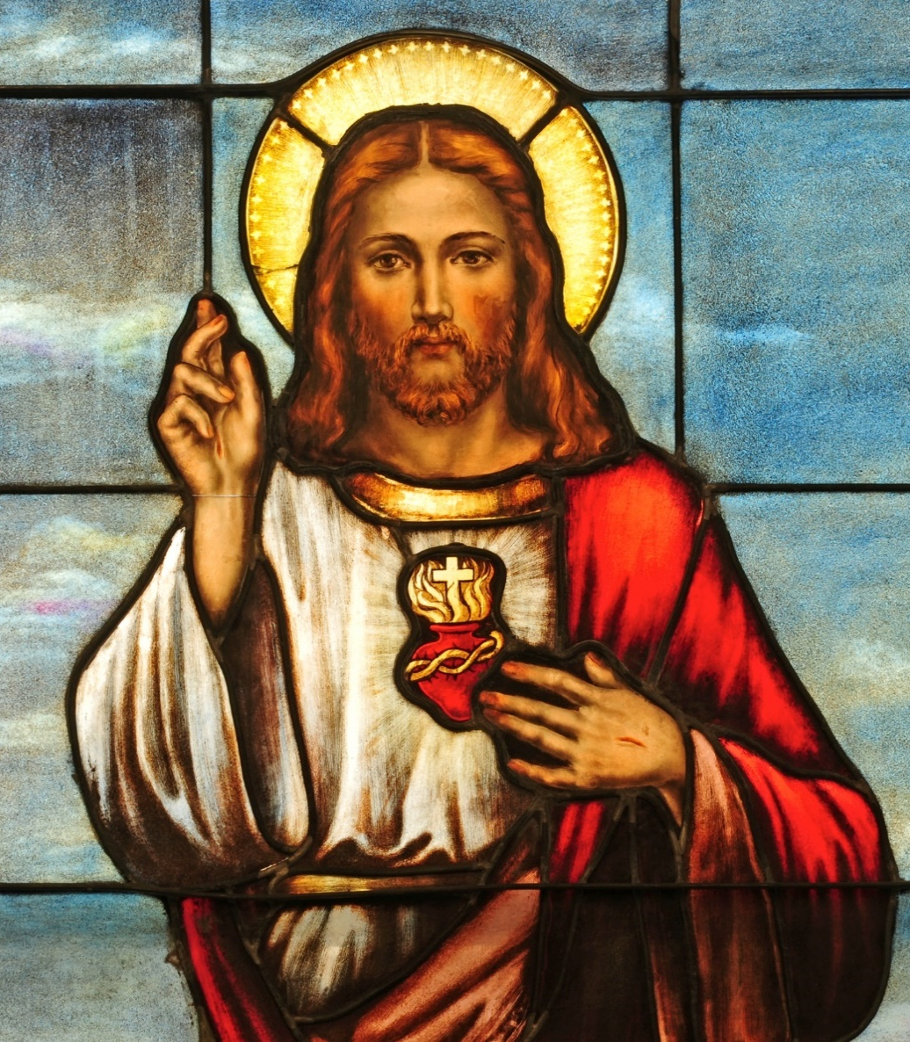
The World of Jesus
The ancient Mediterranean world in which Jesus lived and in which the Gospel authors wrote looks very different from the world in which we live today.
© Nancy Bauer / Shutterstock.com
Notes:
Notes: Explain that it is important for us to step out of our world and enter the historical context of Jesus in order to truly understand the significance of his teachings for us today.

Slide 3
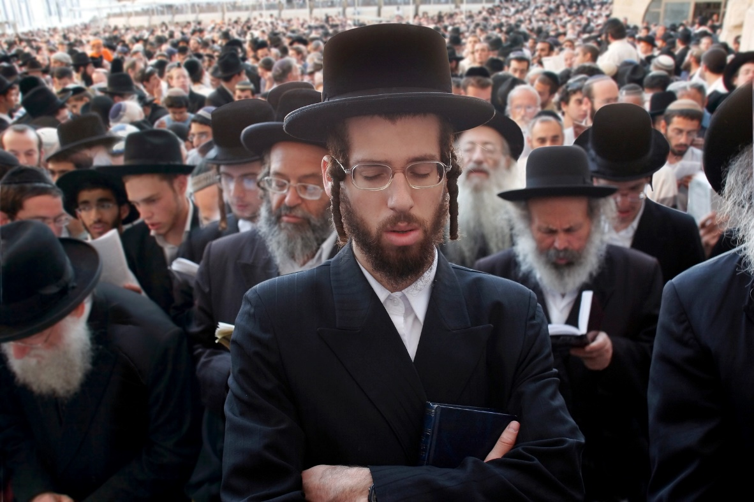
What’s in a Name?
The people of Jesus’ time would have understood and/or used three names as legitimate references to themselves:
Hebrews
Israelites
Jews
© mikhail / Shutterstock.com
Notes:
Notes: The Hebrews were a tribal people who eventually became founders and citizens of a nation called Israel (the people were Israelites). After a series of conflicts and conquests, the Israelites experienced a period of exile in Babylon and became known as the Jews.

Slide 4
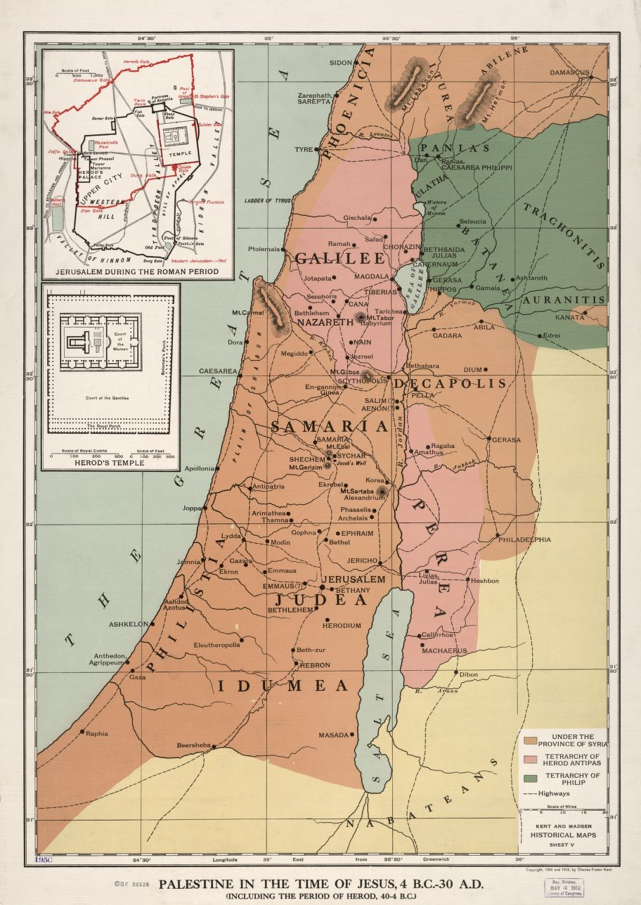
Jesus of Palestine
Palestine has special significance in Jewish history and religion because it was Israel’s Promised Land and was the land that was ruled by King David.
In the time of Jesus, Palestine was occupied and controlled by the Roman Empire.
Library of Congress, Geography and Map Division

Slide 5
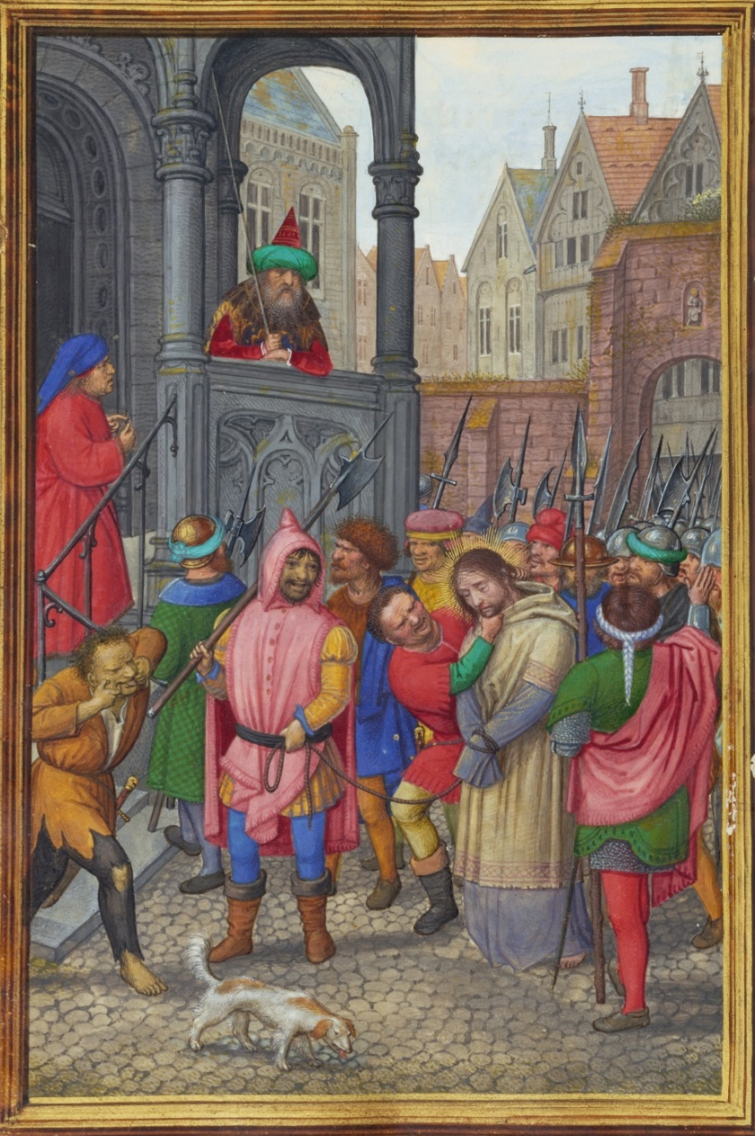
Roman Rule
During Jesus’ life, two different Roman emperors reigned:
Augustus Caesar (27 BC – 14 AD)
Tiberius Caesar (14 – 37 AD)
© Simon Bening, illuminator
Notes:
Notes: Explain to the students that when Augustus came into power, Herod the Great was the King of Judea and had been since 40 BC. Tiberius appointed Pontius Pilate to govern Judea in 26 AD.

Slide 6
Purity Laws
Jewish purity laws were about separating the clean from the unclean, the sacred from the profane.
Jewish purity laws were deeply rooted in the psyche of the people.
There was debate as to how to interpret and practice these laws.
© MeePoohyaPhoto / Shutterstock.com
Notes:
Notes: Examples of purity laws that appear in the Gospels include coming in contact with blood (women who are menstruating) and people who have been struck by leprosy. Women who were menstruating were to avoid all contact with their husbands and other men; lepers were to be separated from the community and had to wear a bell to announce their approach lest they come in contact with another and make him or her unclean, as well.

Slide 7
Palestinian Jewish Groups in the Gospels
There were many groups in the time of Jesus who played a significant role in the social, political, and religious landscape.
© somchai rakin / Shutterstock.com
Notes:
Notes: For the remaining slides, ask students to consider when they may have heard of the following groups in Scripture. Do they remember the particular Gospel story? What do they know about how these groups of people are portrayed in the Gospels?

Slide 8
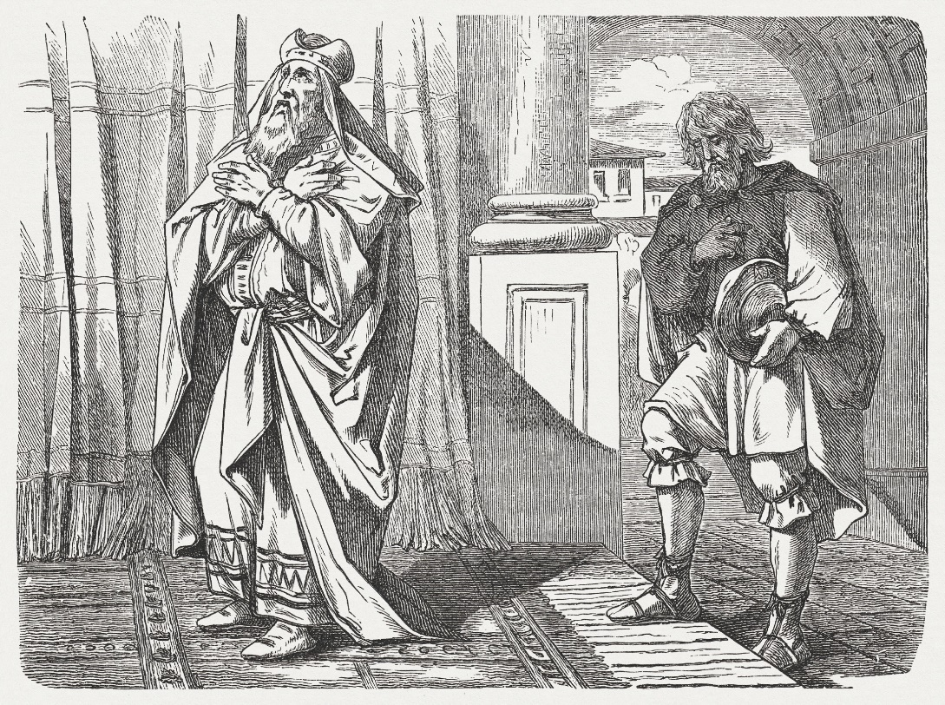
Pharisees
In the Gospels, they are often in opposition to Jesus
Interpreters of the written and oral Mosaic Law
They were focused on social reform through fairly strict observance and enforcement of Mosaic Law
© ZU_09 / iStockphoto.com

Slide 9
Scribes
Trained scholars in reading and writing
Scholars of the Law
Served as professional copyists and secretaries for the Pharisees and other civil and religious groups
Also portrayed as in opposition to Jesus
© cosma / Shutterstock.com

Slide 10
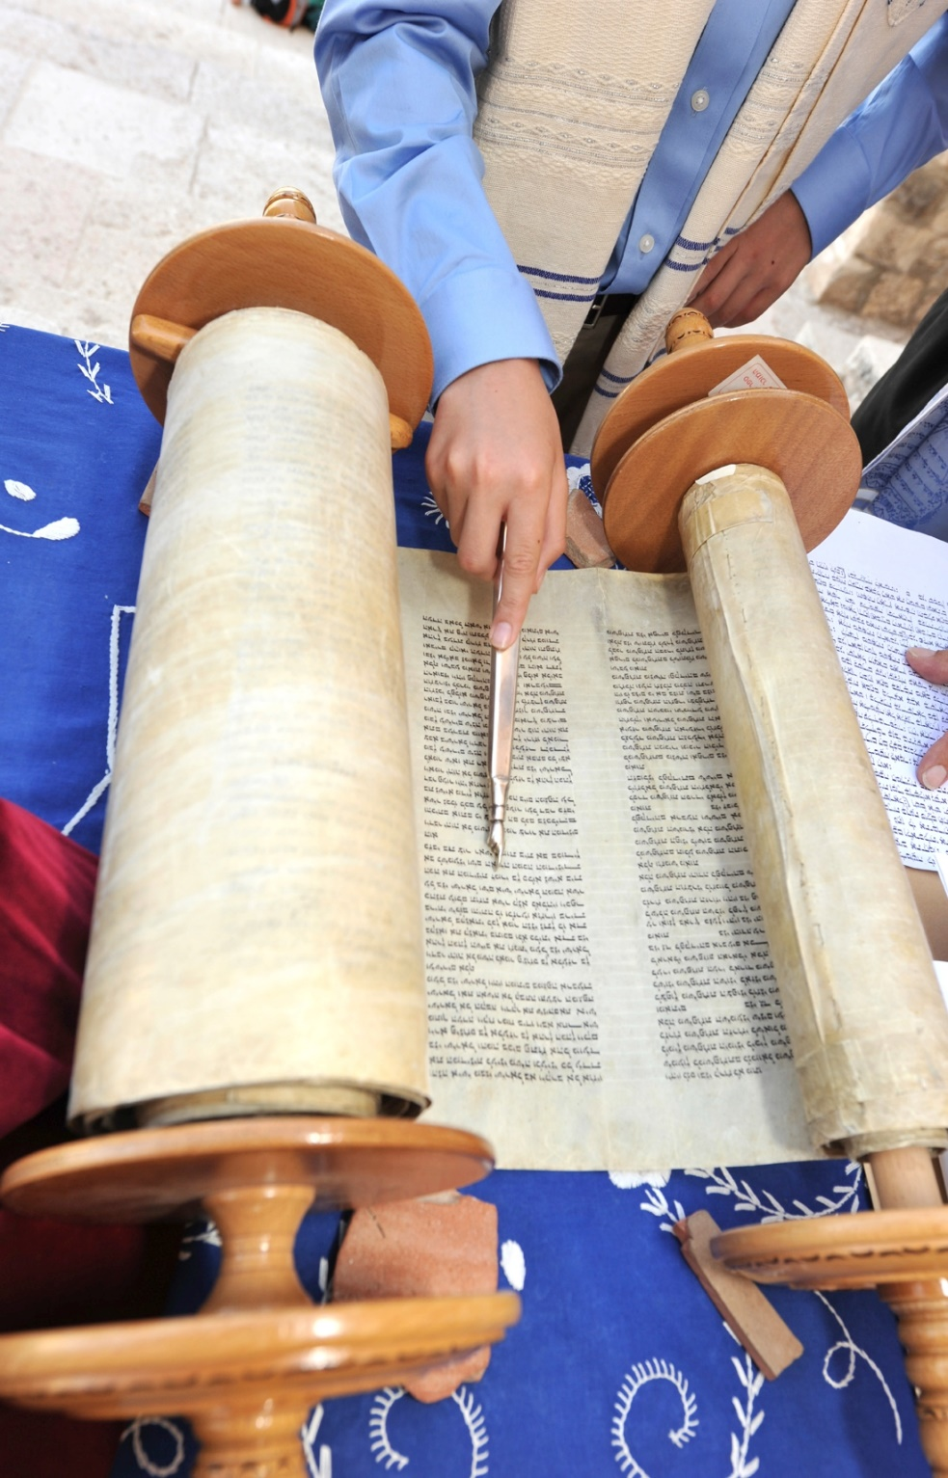
Sadducees
A religious sect within Judaism
They followed only the written Torah – they rejected the Pharisees’ oral law
Consisted of mainly wealthy aristocrats who worked in cooperation with the Roman rule
Exercised control over the priesthood and the Temple
© stevenallan / iStockphoto.com

Slide 11
Essenes
Consisted of celibate males who lived in community
Engaged in fasting and meditation
© 4Max / Shutterstock.com

Slide 12
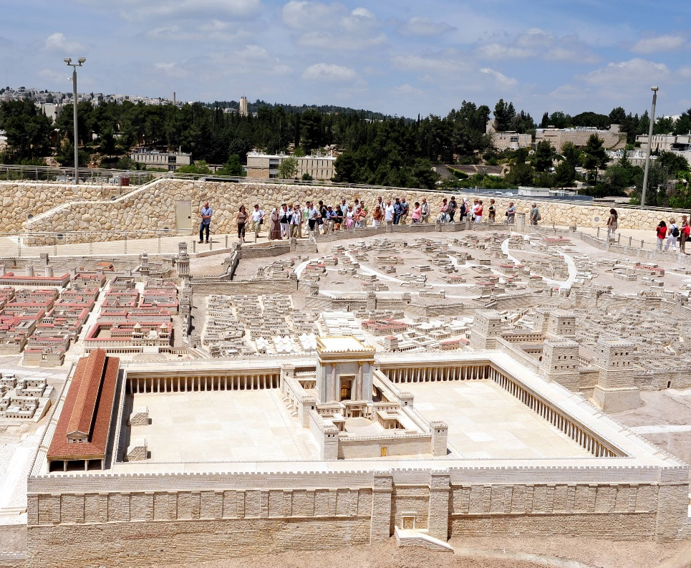
Levite
A Levite is someone from the tribe of Levi.
The Levites were given the responsibility of oversight of the tabernacle and the Temple.
The tribe of Levi, then, is the priestly class.
© ChameleonsEye / Shutterstock.com

Slide 13
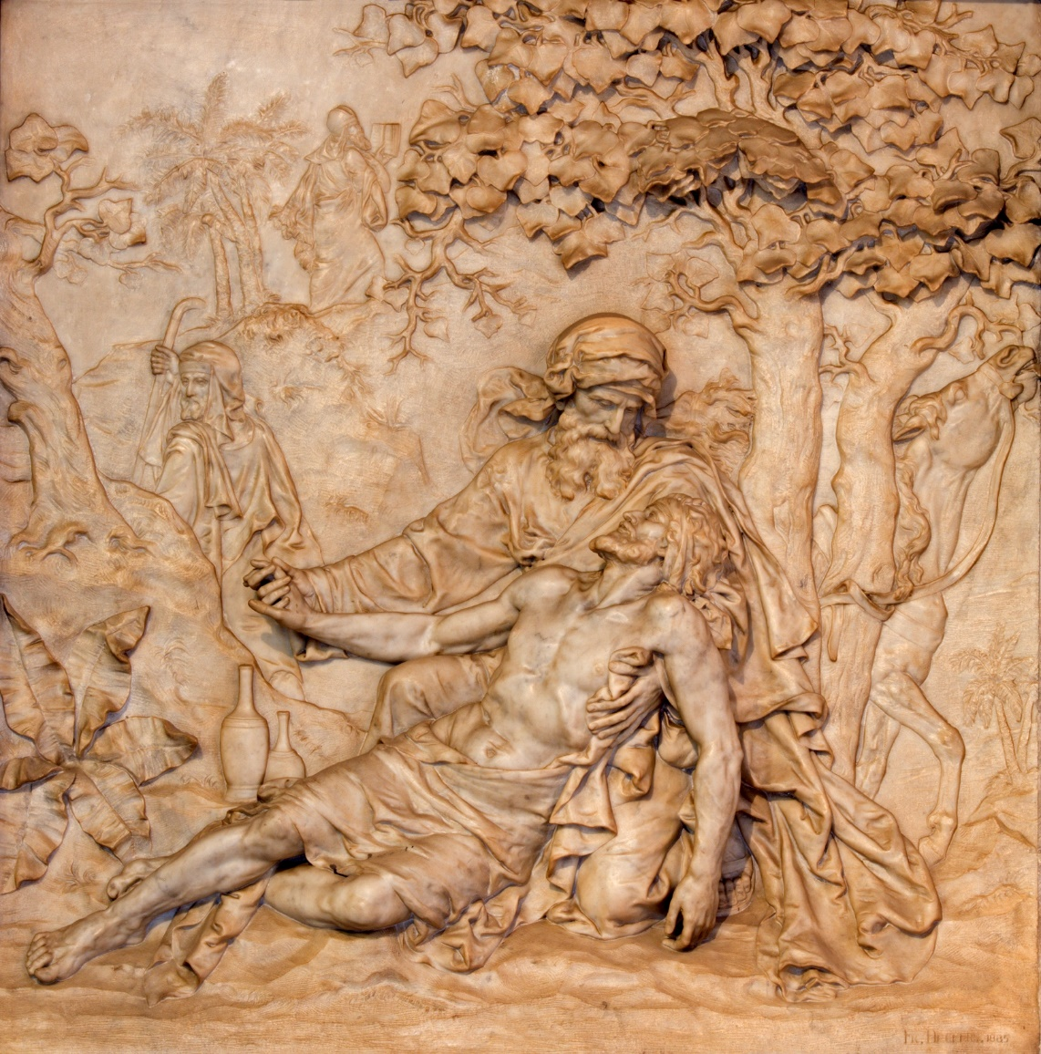
Samaritan
A Samaritan is a person from the territory of Samaria, which is located between Judea and Galilee.
The Jews and Samaritans were deeply divided over religious and ethnic differences.
© Renata Sedmakova / Shutterstock.com

