Slide 1
Divine Revelation
The Living Word: The Revelation of God’s Love, Second Edition
Unit 1, Chapter 3
Document#: TX004681

Slide 2
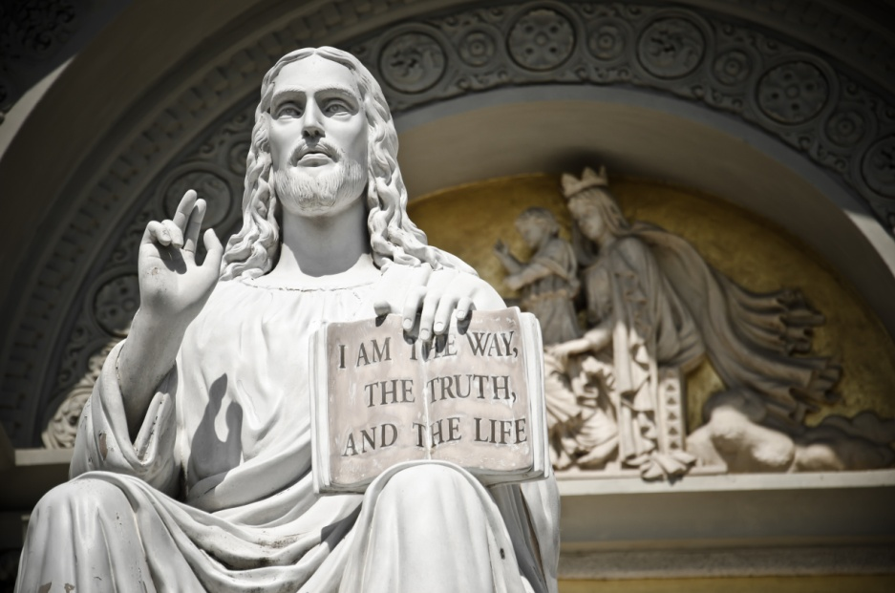
Divine Revelation
God has chosen to reveal himself and his plan for humanity.
Jesus is the fullness of Divine Revelation.
Scripture and Tradition transmit Divine Revelation to us.
© LimitedFont / Shutterstock.com
Notes:
Notes: Direct the students to reflect on the experience of getting to know a new friend. Discuss how we need to reveal ourselves to one another in order to form deep friendships. Compare this experience to God’s self-revelation.
This slide corresponds to content in the chapter 3 introduction in the student book.

Slide 3
Salvation History
Salvation history tells us how God’s saving hand has been at work in human history.
It is the pattern of events in which God revealed his plan to save the human race from bondage to sin and death.
© Mr Twister / Shutterstock.com
Notes:
Notes: Explain to the students that the salvation accomplished through Jesus Christ is foreshadowed and revealed throughout the Old Testament.
This slide corresponds to content in article 9, “Salvation History: God’s Revelation,” in the student book.

Slide 4
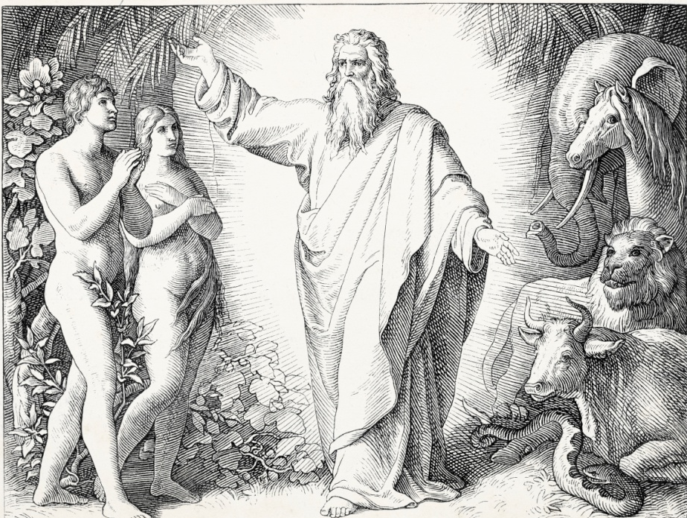
Salvation History Begins
God invited Adam and Eve to intimate communion with him.
They turned away from God, making sin universally present in the world.
Their sin is called Original Sin.
© Grafissimo /iStockphoto.com
Notes:
Notes: Explain to the students how salvation history continues with the accounts of Noah, Abraham, and Moses, found in article 10 in the student book. Draw the students’ attention to what each event reveals about God’s plan to save humanity.
This slide corresponds to content in article 10, “Salvation History in the Old Testament,” in the student book.

Slide 5
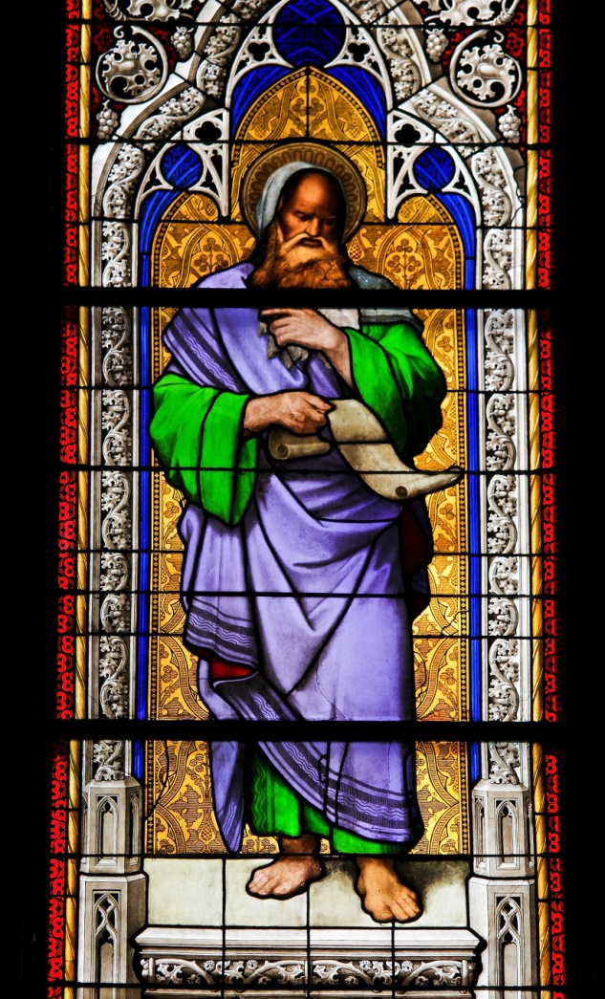
Salvation History Continues
God revealed his will and plan to Adam, Eve, Abraham, and Moses.
The tendency to sin, a result of Original Sin, always stood in the way.
God called the prophets to speak his Word and to announce salvation.
© jorisvo / Shutterstock.com
Notes:
Notes: Point out to the students that the Old Testament books of wisdom and poetry also offer hints of salvation. In addition to offering advice, these books speak of a God who intervenes and discloses himself in the events of people’s lives.
This slide corresponds to content in article 10, “Salvation History in the Old Testament,” in the student book.

Slide 6
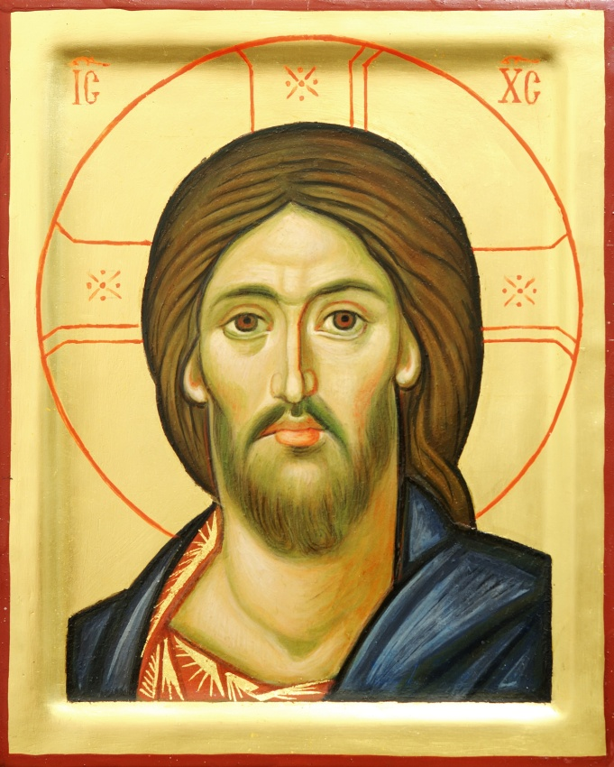
Christ: The Fullness of Revelation
Scripture reveals that Jesus is the Son of God.
He is the transforming Word who created the universe.
He revealed himself in Scripture.
He humbled himself to take on our humanity.
© Dmitry Kalinovsky / Shutterstock.com
Notes:
Notes: Ask the students this question: Why do we say that Christ “humbled himself” in taking on our humanity?
This slide corresponds to content in article 11, “Jesus Christ: The Fullness of All Revelation,” in the student book.

Slide 7
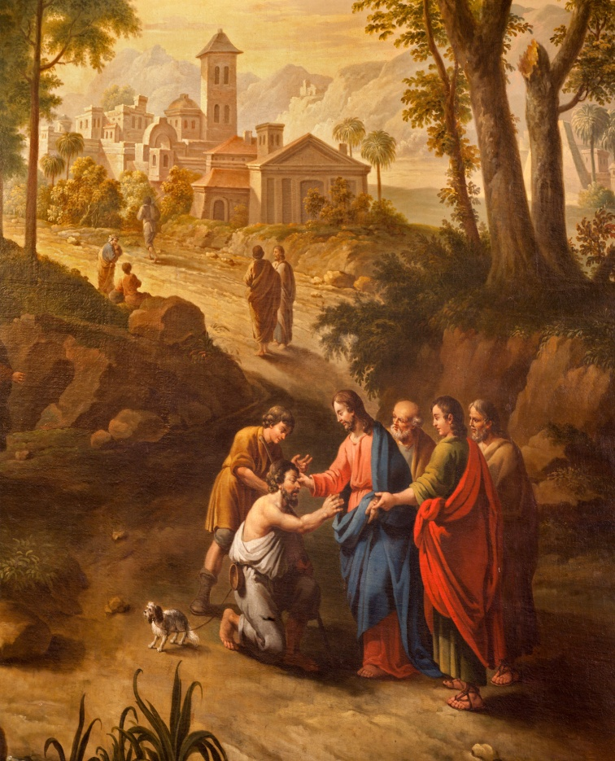
Full of Grace and Truth
When we study the life of Jesus, we come to know the fullness of salvation.
By developing a relationship with Jesus, we come to know his offer of free grace.
© Renata Sedmakova / Shutterstock.com
Notes:
Notes: Direct the students to consider the images of Jesus listed at the end of article 11 in the student book: Shepherd, Friend, Savior, Doctor, Bread, Vine, Gate, and Light. Ask the students to select one of these images of the Divine Word and explain what it reveals about God and God’s plan.
This slide corresponds to content in article 11, “Jesus Christ: The Fullness of All Revelation,” in the student book.

Slide 8
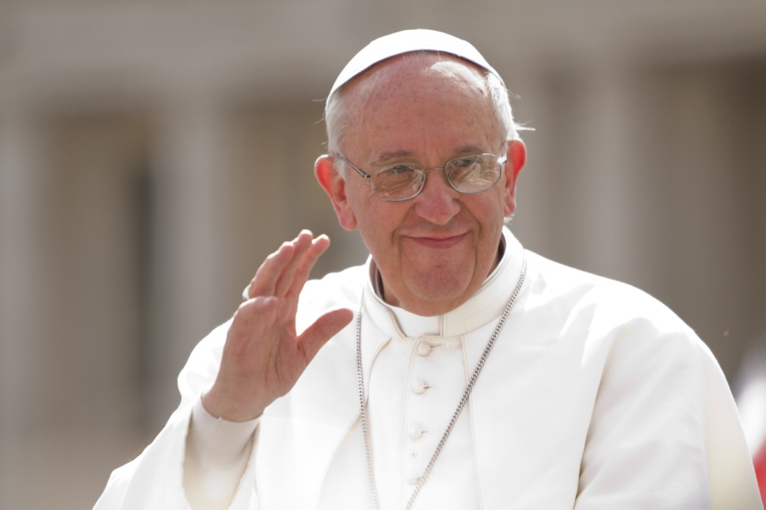
The Church
Jesus commanded the Apostles to tell all nations about the salvation of God.
Sacred Tradition is the process of handing on the truths Jesus taught.
The Apostles passed on their authority to their successors, the bishops.
© Philip Chidell / Shutterstock.com
Notes:
Notes: Call the students’ attention to the second bullet point. Ask them what we call this process of handing on the truths Jesus taught (Sacred Tradition). Do the same for the third bullet point (Apostolic Succession).
This slide corresponds to content in article 12, “The Church and the Transmission of Divine Revelation,” in the student book.

Slide 9
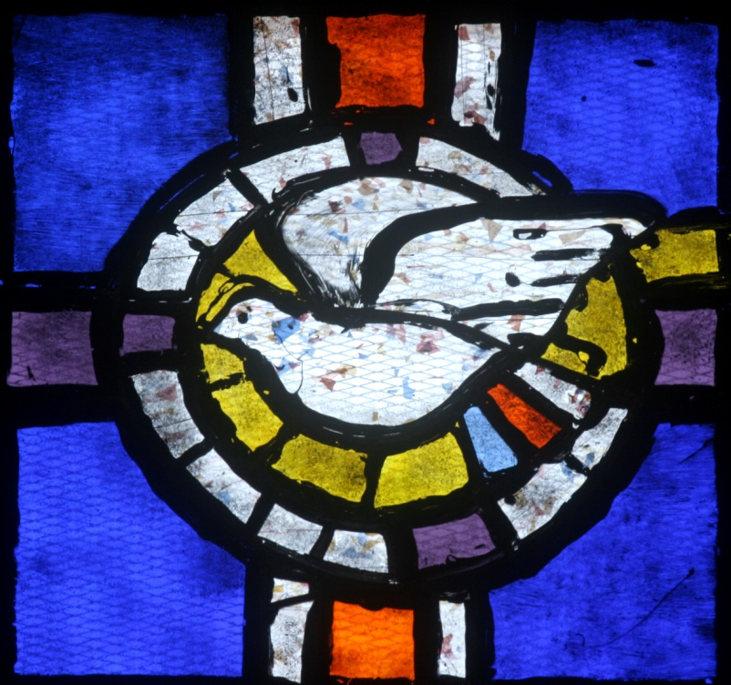
Sacred Tradition
Tradition helps us to understand the Revelation found in Scripture.
Through Tradition the Church proclaims redemption.
In this work, the Church is guided by the Holy Spirit.
© Zvonimir Atletic / Shutterstock.com
Notes:
Notes: Ask the students for a definition of Magisterium (“the teaching office of the Church made up of the Pope and all the bishops”). Point out that the Holy Spirit guides the Magisterium when it defines the dogma, or doctrine of the faith.
This slide corresponds to content in article 12, “The Church and the Transmission of Divine Revelation,” in the student book.

Slide 10
Scripture and Tradition: Two Pillars
God discloses the truths of Revelation through both Scripture and Tradition.
Scripture is the written, inspired Word of God.
Tradition is the living transmission of the Word of God.
© ETIENjones / Shutterstock.com
Notes:
Notes: Explain to the students that both Scripture and Tradition communicate God’s redemptive love; together they make up a single heritage of faith, called the Deposit of Faith.
This slide corresponds to content in article 13, “Scripture and Tradition: The Two Pillars of God’s Revelation,” in the student book.

Slide 11
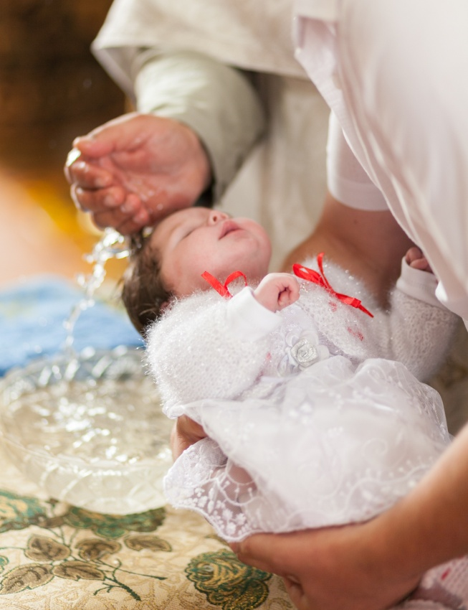
Sacred Tradition
It began with the preaching of the Apostles.
It was written down in Sacred Scripture.
It continues to be handed down and lived out in the Church.
© mylu / Shutterstock.com
Notes:
Notes: Ask the students the following questions:
• How does the Church continue to hand down Tradition? (through teachings of the Magisterium, Sacraments, and so on)
• How does the Church continue to live out Tradition? (through the life of the Church, including worship, service, and community)
This slide corresponds to content in article 13, “Scripture and Tradition: The Two Pillars of God’s Revelation,” in the student book.

Slide 12
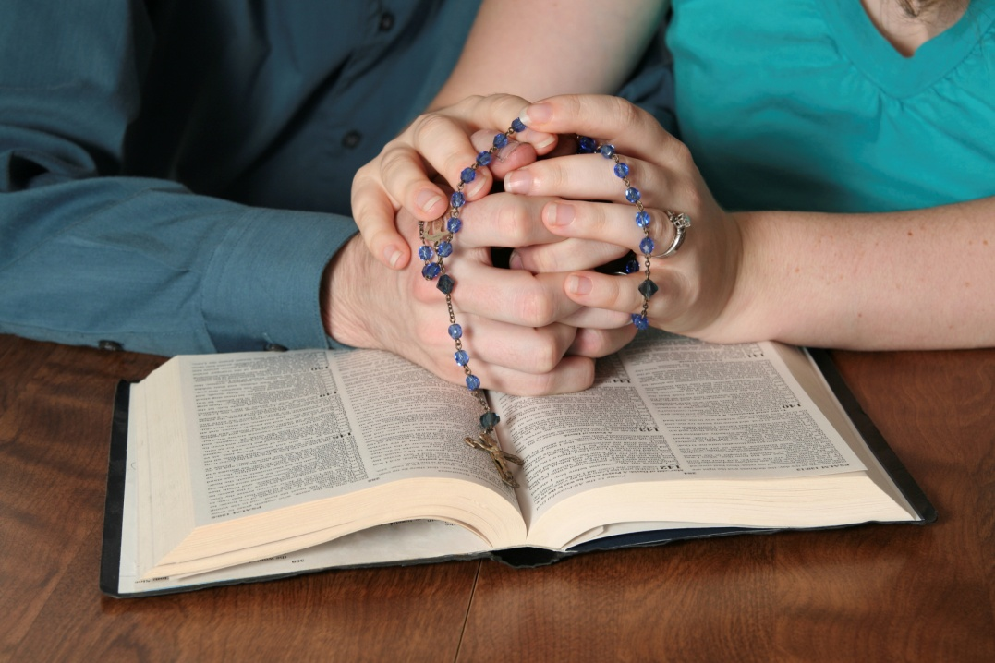
The Vocation of All
By virtue of our Baptism, we are all called to treasure our faith.
We are also called to share the treasure of our faith.
The Church must proclaim the Good News she has heard.
© princessdlaf / iStockphoto.com
Notes:
Notes: Ask the students for examples of how others have shared their faith with them. Ask the students how they are sharing their own faith with others.
This slide corresponds to content in article 14, “The Vocation of All,” in the student book.

