Slide 1
Chapter 6: Sikhism
World Religions: A Voyage of Discovery
DOC ID #: TX003943

Slide 2
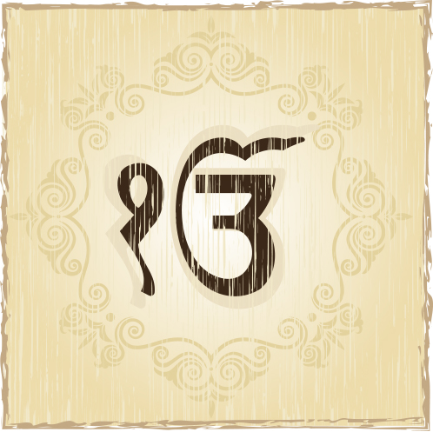
Ik Onkar
Ik Onkar means “one God.”
The symbol represents monotheism.
Sikh daily prayers feature the phrase Ik Onkar.
Ajay Shrivastava / www.shutterstock.com
Notes:
Notes: One of the primary symbols of Sikhism, Ik Onkar (sometimes transliterated as Ek Onkar) is featured in the morning prayer known as the japji, and also in the Mul Mantra and the Adi Granth generally. Other translations include “eternal one,” “one supreme being,” and “one universal God.”

Slide 3
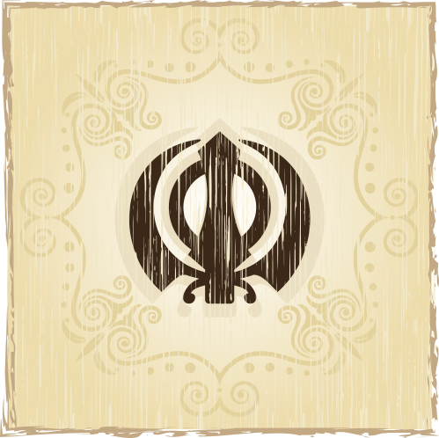
Khanda
The khanda is a prominent symbol.
It is made of three swords encompassed by a circle.
It symbolizes balance between spiritual and worldly aspects.
© Ajay Shrivastava / www.shutterstock.com
Notes:
Notes: The khanda symbol is composed of two kirpans, or short swords, with a double-edged sword encompassed by a circle. The Sikh term for the integration of the spiritual and worldly is miri-piri, “temporal-spiritual.” It relates to the role of the historical Gurus, who were both spiritual and worldly leaders of the Panth, or Sikh community.

Slide 4
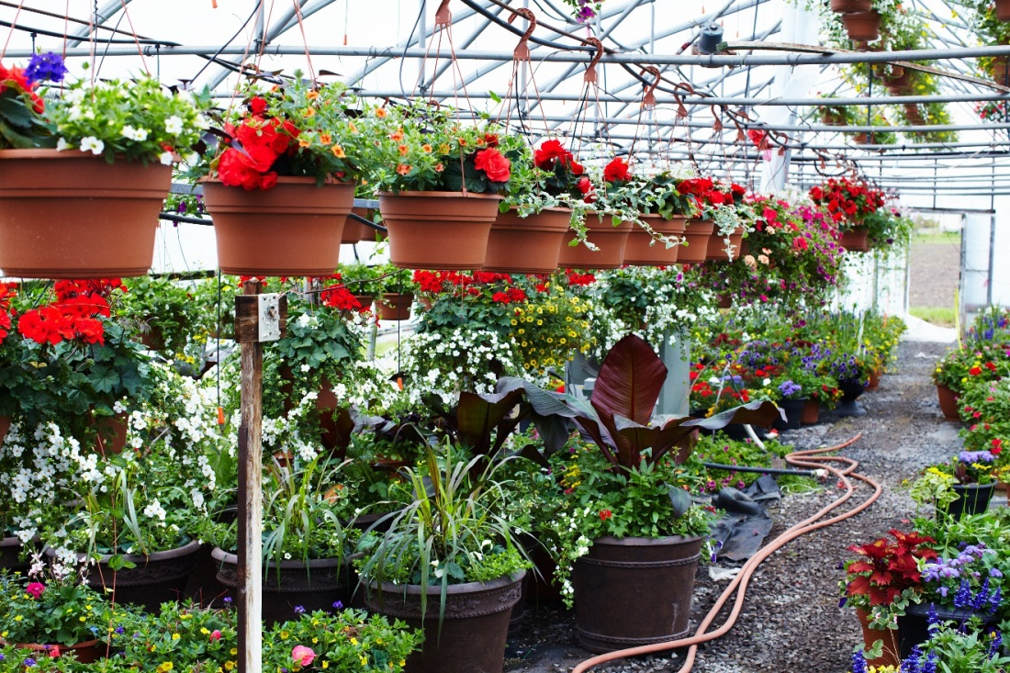
Adi Granth
The Adi Granth, or Sri Guru Granth Sahib, is Sikhism’s most important text.
The Adi Granth is Sikhism’s living Guru since 1708 and Guru Gobind Singh.
Every gurdwara contains a copy of the Adi Granth.
© kurhan / www.shutterstock.com
Notes:
Notes: The title Sri Guru Granth Sahib, or simply Guru Granth, is honorific and commonly used within the tradition. A full English translation is available at http://www.sikhs.org/english/frame.html.

Slide 5
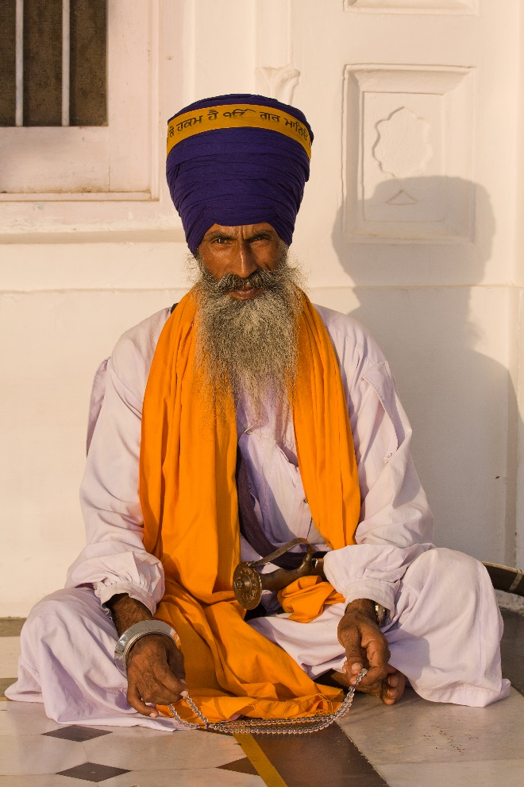
Five Ks
Which of the Five Ks of Sikhism are indicated in this photo?
Kes
Kara
Kirpan
kangha
kachh
© OlegD / www.shutterstock.com
Notes:
Notes: The students might be able to describe the Five Ks:
Kes, uncut hair, indicated by the turban and the thick beard
Kara, the steel wristlet
Kirpan, the small sword
kangha, a small comb that signifies cleanliness
kachh, a pair of shorts that signifies chastity
It is hard to find a photo that shows all Five Ks being worn by a person, but many helpful charts and “staged” photos of the five items are accessible online.

Slide 6
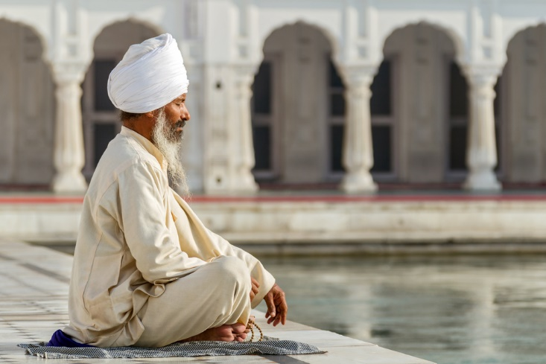
Sikh Meditative Prayer
Prayer and meditation are central ritual activities for Sikhs.
Daily prayers are to be recited early in the morning and in the evening.
Contemplation of the divine Name of God is an important form of meditation.
© Dima Fadeev / www.shutterstock.com
Notes:
Notes: The prevalence of both prayer and meditation are in keeping with Sikhism’s amalgamation of theism and a mystical emphasis. Meditation on the Name is believed to be able to bring the person into perfect harmony with God. The Sikhs.org website provides audio versions in Punjabi of all of the required daily prayers: http://www.sikhs.org/audio.htm.

Slide 7
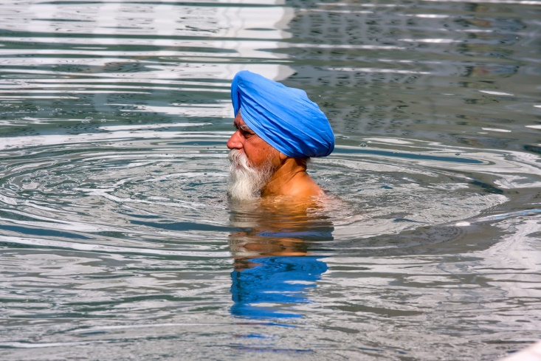
Sikh Man Bathing at the Golden Temple
This is a common sight at the Golden Temple in Amritsar.
The Temple features a large bathing tank known as Amritsar, the “Pool of the Nectar of Immortality.”
Sikhs are to bathe daily, prior to commencing the morning prayers.
© OlegD / www.shutterstock.com
Notes:
Notes: Sikhs regard ablution, or ritual bathing of the body, as a means of worshipping God through maintaining bodily purification. The technical name for a bathing tank is sarovar; other large gurdwaras also are equipped with them. Sikhs are to remove their shoes and bathe their feet before entering the Golden Temple and other sacred places.

Slide 8
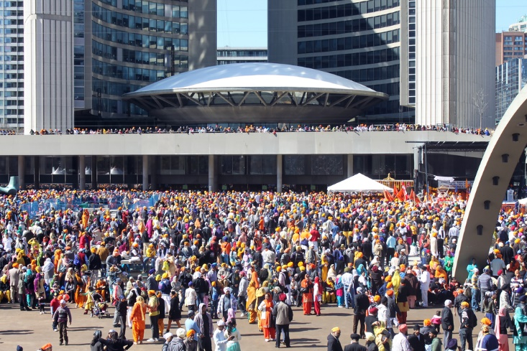
Khalsa Day Parade, Toronto
There are about 450,000 Sikhs in Canada.
Khalsa Day, or Vaisakhi, commemorates the origin of the Khalsa in 1699.
Khalsa Day parades are held in cities across North America.
© Niloo / www.shutterstock.com
Notes:
Notes: In 1699 Guru Gobind Singh baptized the first five initiates, the “beloved five” who were willing to die rather than be disloyal to their Guru. Vaisakhi is also celebrated by Hindus and Buddhists, in part because it is considered New Year’s Day. For Sikhs in the agriculturally oriented Punjab, Vaisakhi is important too, as the celebration of the beginning of harvest season.

Slide 9
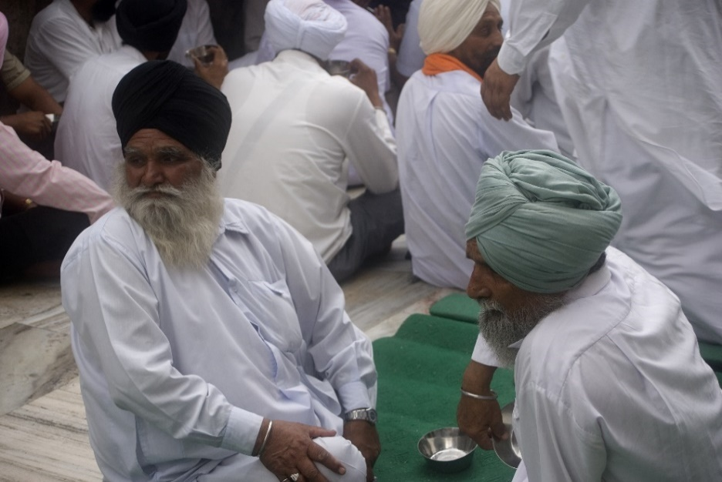
Sikhs Share Langar
Langar is the community meal that is a daily occurrence at Sikh gurdwaras.
The communal ideals of equality are as follows:
gender
age
caste
religion
© Attila JANDI / www.shutterstock.com
Notes:
Notes: The image shown on this slide is of the Golden Temple in Amritsar. Langar is a seemingly ubiquitous feature of Sikhism, provided at gurdwaras throughout the world, and at other settings. At the Golden Temple, up to 100,000 people can be served, requiring some twelve tons of whole wheat flour and similarly large quantities of lentils and other foods. All are welcomed as equality is a key feature of the langar. (More on the Golden Temple langar appears on the next slide.)

Slide 10
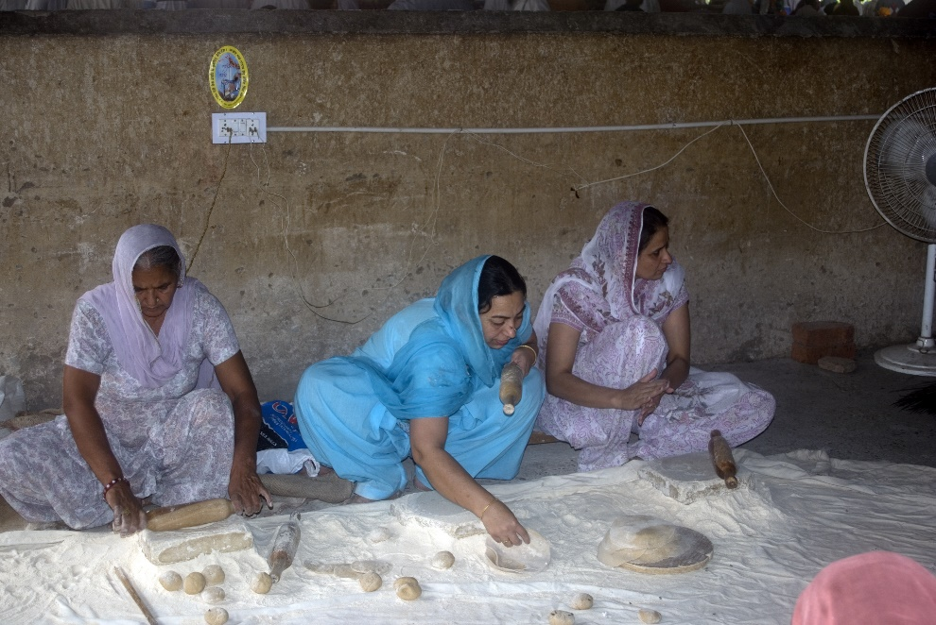
Sikh Women Preparing Food for Langar
Langar depends on volunteers like these women.
They prepare bread known as roti or chapatti.
Vegetables and lentils also are served; meat, poultry, and fish are never served.
© Attila JANDI / www.shutterstock.com
Notes:
Notes: The slide depicts the langar kitchen at the Golden Temple. Though Sikh doctrine does not insist on vegetarianism, many Sikhs prefer not to eat meat. Perspectives on vegetarianism vary among Sikhs. Namdhari Sikhs, for example, are strictly vegetarian. Traditionally, most Sikhs avoided eating beef, probably out of respect for Hindus.

Slide 11
Sikh Turban
Sikh men wear colorful turbans.
Because of the requirement not to cut one’s hair, wearing turbans is customary.
Upon turning ten or eleven, Sikh boys often ceremonially tie their first turban.
© Dmitry Kalinovsky / www.shutterstock.com
Notes:
Notes: The wearing of the turban is perhaps the most widely recognized image of the Sikh tradition. Technically the turban is not required, but rather is a natural corollary to kes, one of the Five Ks. The SikhNet website offers details on the turban, including video instructions about how to tie it: http://www.sikhnet.com/pages/tyingturbans. Other websites provide colorful collections of the variety of turbans.

