Slide 1
The Desire to Know God
The Living Word: The Revelation of God’s Love, Second Edition
Unit 1, Chapter 1
Document#: TX004679

Slide 2
We Are Created to Long for God
God has written an inner longing into our hearts.
We yearn to fill an emptiness or void in our lives.
In our life’s journey, our one true direction and destination is God alone.
© Monkey Business Images / Shutterstock.com
Notes:
Slide 2
Notes: Ask the students for an example of a situation where a young person might experience an empty or restless feeling. Ask how faith in God can satisfy such a feeling. Consider additional examples, such as experiences of grief, failure, or rejection by others.
This slide corresponds to content in article 1, “We Are Created to Long for God,” in the student book.

Slide 3
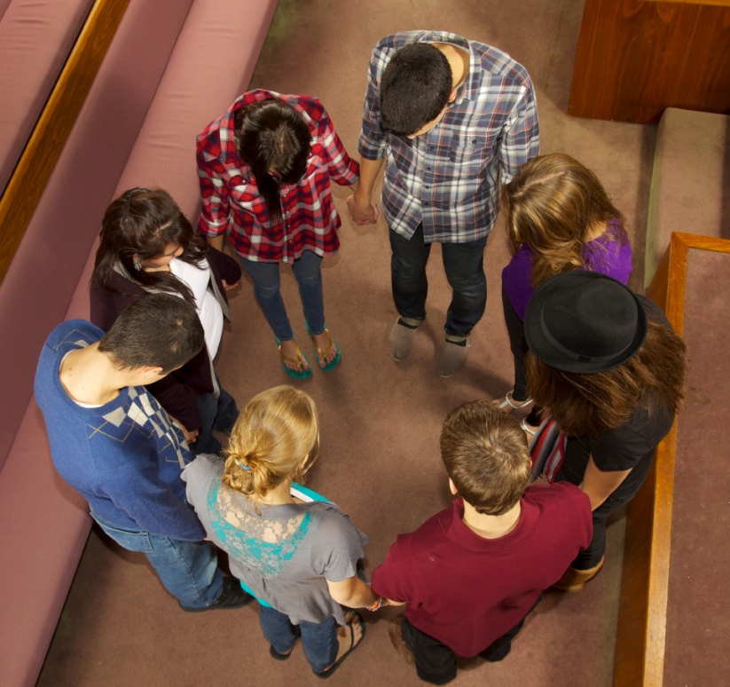
We Are Religious Beings
Our vocation is to know, love, and freely choose God.
We are religious beings, made by God to live in communion with him.
To live in communion with God is to live a fully human life.
© pastorscott / iStockphoto.com
Notes:
Slide 3
Notes: Ask the students for a definition of vocation (“a call from God”). Explain that God calls all members of the Church to embrace a life of holiness, whether as an ordained minister, a vowed religious, or a married or single person.
This slide corresponds to content in article 1, “We Are Created to Long for God,” in the student book.

Slide 4
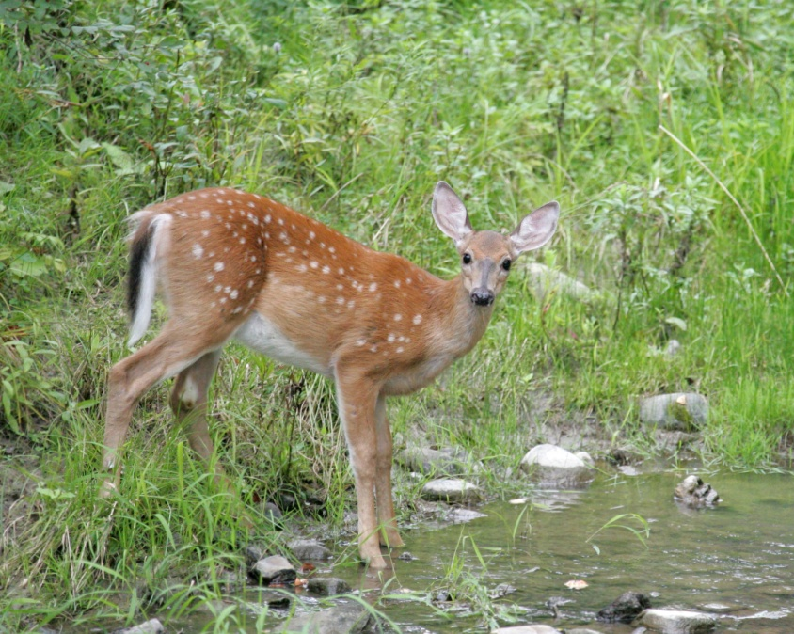
The Psalms Shed Light on Our Longings
Psalm 42 compares the soul’s thirst for God to the longing of a deer for streams of water.
In Psalm 23, we find longing for a shepherd who gives strength, provides protection, and sets a banquet of love.
© Sean Donohue Photo / Shutterstock.com
Notes:
Slide 4
Notes: Encourage the students to explore these images. What is the significance of water for the deer? What is the role of a shepherd?
This slide corresponds to content in article 1, “We Are Created to Long for God,” in the student book.

Slide 5
The Saints and Our Search for God
Saint Teresa of Ávila wrote about how God reaches out to us every day.
Saint John of the Cross described the soul’s desire to be united with God.
Saint Augustine taught that our whole life is the desire to see God.
© Garsya / Shutterstock.com
Notes:
Slide 5
Notes: Ask the students to identify some aspects of modern life that can dull our inborn yearning for God. Ask how we can turn our attention back to God and strengthen our longing for him (prayer, Sacraments, faith community).
This slide corresponds to content in article 1, “We Are Created to Long for God,” in the student book.

Slide 6
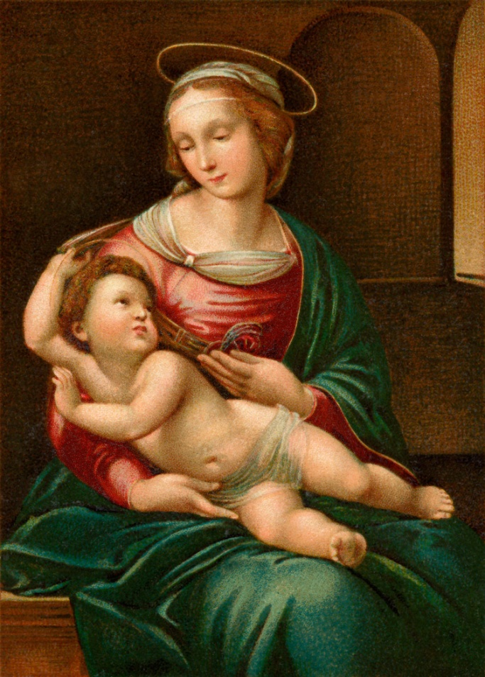
The Incarnation
God so longs for a relationship with us that he has reached out in a radical way.
In the Incarnation, Jesus Christ became truly man while remaining truly God.
© Victorian Traditions / Shutterstock.com
Notes:
Slide 6
Notes: Ask the students how the Incarnation helps us to hear and understand God’s message of salvation.
This slide corresponds to content in article 2, “God’s Invitation,” in the student book.

Slide 7
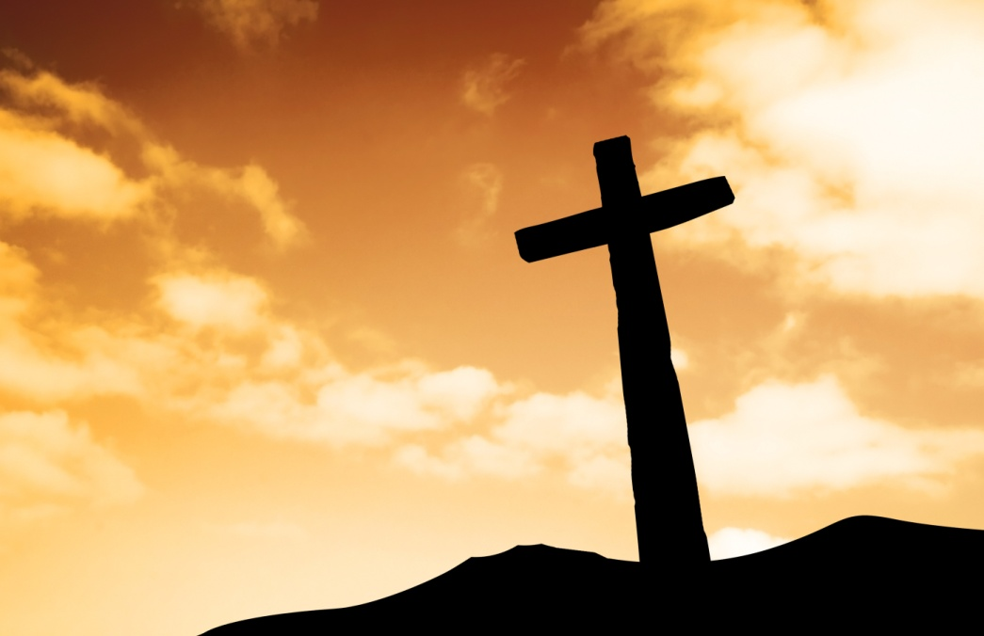
Jesus Christ: God’s Greatest Invitation
Because of his love for us, God sent his only Son to invite us into a life-giving relationship with him.
The name Jesus means “God saves.”
© Skylines / Shutterstock.com
Notes:
Slide 7
Notes: Explain to the students that salvation refers to the forgiveness of sins and assurance of permanent union with God. Explain that God saves us through the Passion, death, Resurrection, and Ascension of Jesus. Ask the question at the end of article 1 in the student book, “What can you do in your everyday life to respond to God’s invitation to live in communion with him?”
This slide corresponds to content in article 2, “God’s Invitation,” in the student book.

Slide 8
Happiness According to the Media
The media convinces people that material goods relieve our dissatisfactions with life.
In reality, material goods leave us still looking for true happiness.
© Alastair Wallace / Shutterstock.com
Notes:
Slide 8
Notes: Ask the students for examples from movies that illustrate the concept that those seeking happiness through material goods do not get the happiness they expect.
This slide corresponds to content in article 3, “Happiness in God Alone,” in the student book.

Slide 9
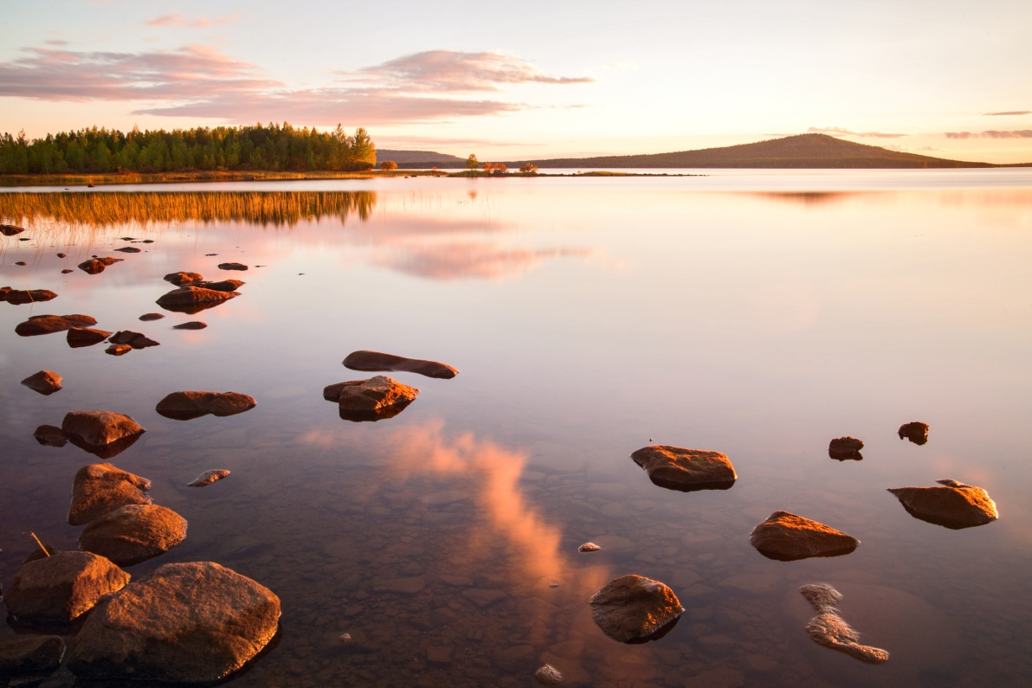
Happiness in God Alone
Our hearts are restless until they find rest in God.
We can find happiness and truth only when we live in right relationship with God.
© Alexander Erdbeer / Shutterstock.com
Notes:
Slide 9
Notes: The student book states that when we respond to God’s call we “remove the promises and distractions of this world.” Ask the students what this might mean for a young person today.
This slide corresponds to content in article 3, “Happiness in God Alone,” in the student book.

Slide 10
The Beatitudes as a Key
The Holy Spirit prepares us to receive God’s gift of faith.
This gift of faith leads us to choose God with our whole heart and mind.
We will then want to live a life based on the Beatitudes.
© Ki Zel / Shutterstock.com
Notes:
Slide 10
Notes: Explain to the students that Jesus gave us the Beatitudes (Mt 5:3–12), found at the end of article 3 in the student book, as a key for living in true happiness. Ask the students to identify some components of true happiness, according to the Beatitudes.
This slide corresponds to content in article 3, “Happiness in God Alone,” in the student book.

Slide 11
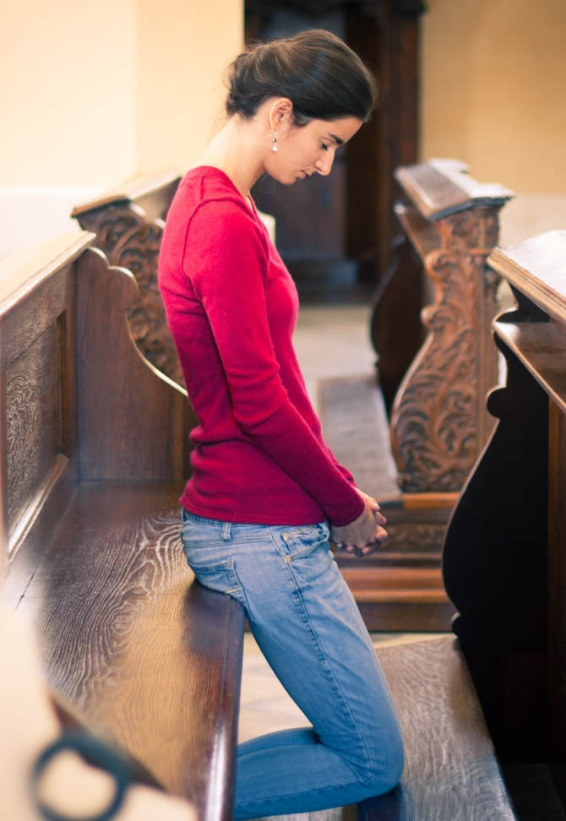
Saint Augustine and the Four Objects of Love
We are able to love God because God loved us first.
We must revere and respect our neighbors.
Loving ourselves should empower us to move beyond ourselves.
We must hold our bodies in high esteem.
© Aubord Dulac / Shutterstock.com
Notes:
Slide 11
Notes: Explain to the students that we should love God, our neighbor, ourselves, and our bodies, because God created us in his own image.
This slide corresponds to content in article 4, “Saint Augustine and the Four Objects of Love,” in the student book.

