Slide 2
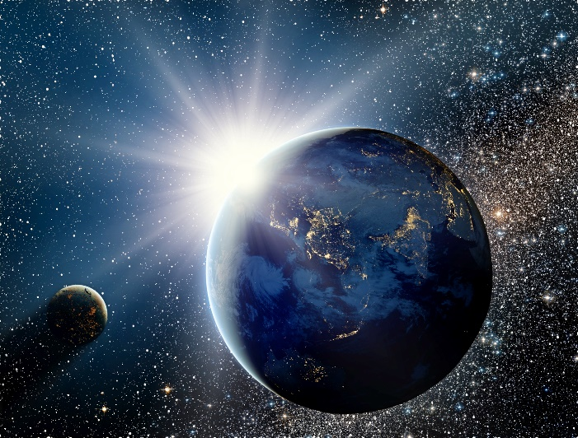
The Old Testament
and the Trinity
Chapter 6
Creation
© Alexandr79 /www.shutterstock.com

Slide 3
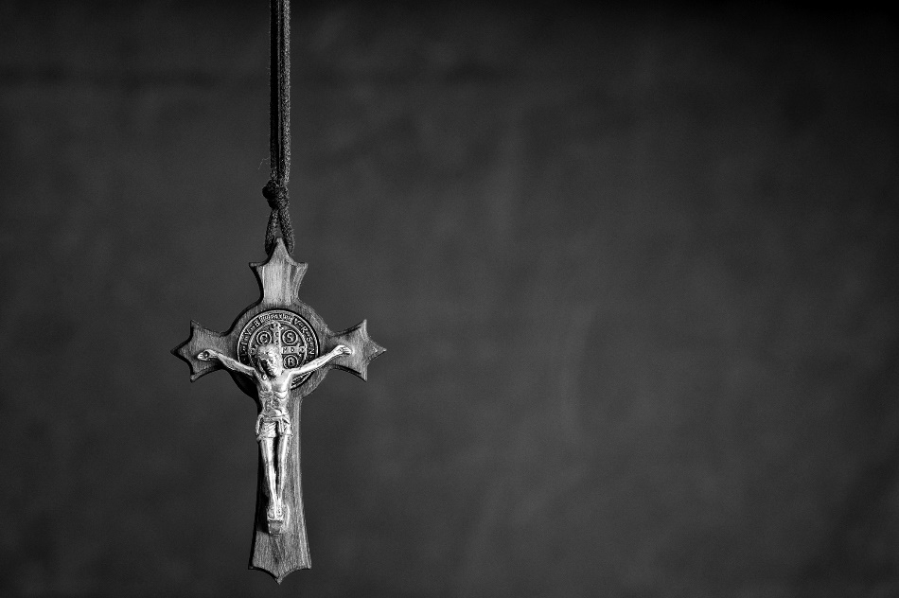
Chapter Summary Creation
God—Father, Son, and Holy Spirit—is the creator of all things—visible and invisible, as we say in the Creed. Although God created the world to be good, evil exists. Evil is not of God, nor is evil desired by God. His saving power is revealed as he brings about good from evil in his ongoing work of creation. God will bring all creation to perfection through his Son, Jesus Christ.
© serav/www.shutterstock.com

Slide 4
Introduction and “Why Does Evil Exist” (Handbook, pages 68–71)
God created all that exists that we might share in his love and glory. While God allows evil to exist, he never ceases to bring good out of evil.
© iurii/www.shutterstock.com

Slide 5
Introduction and “Why Does Evil Exist” (Handbook, pages 68–71)
God is good and created everything that exists to be good.
God allows evil to exist. This is a great mystery we will never fully understand in this life.
© AlinaMD/www.istockphoto.com

Slide 6
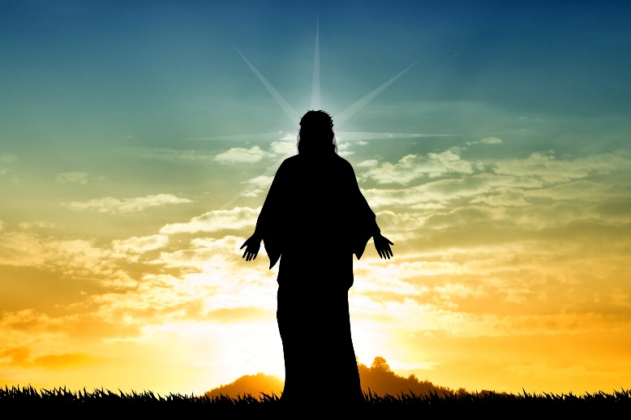
Introduction and “Why Does Evil Exist” (Handbook, pages 68–71)
God has the power to bring good out of that evil.
We trust and hope in God’s power to bring about good. This trust is rooted in the life of Jesus Christ, who was raised to eternal life after suffering evil.
© Sogno Lucido / www.shutterstock.com

Slide 7
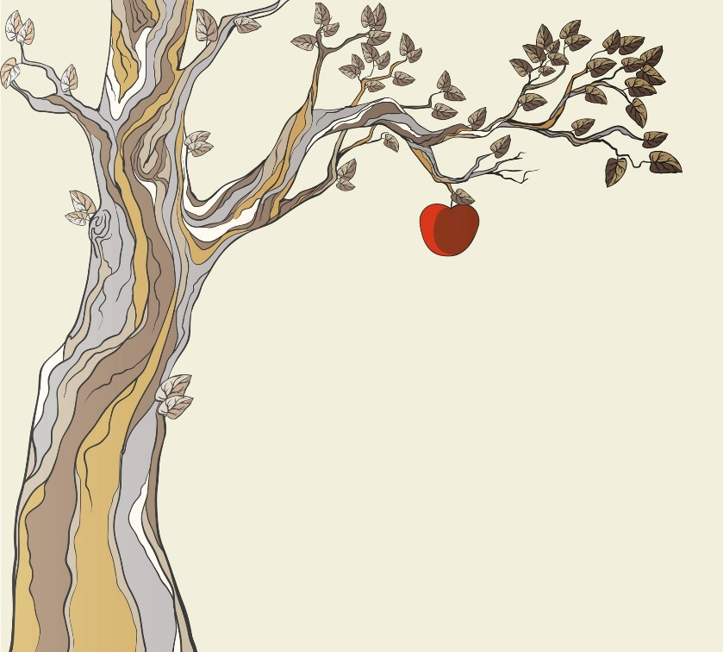
“Sin” (Handbook, pages 71–72)
Human sin, which separates us from God and one another, is one reason that evil exists.
© Blackspring/www.shutterstock.com

Slide 8
“Sin” (Handbook, pages 71–72)
Human sin damages the good and loving relationships God created us to be in. It is the reason behind much of the evil in the world.
For love to be genuine, it must be freely chosen.
© oliveromg/www.shutterstock.com

Slide 9
“Sin” (Handbook, pages 71–72)
Every person has been affected—some say wounded—by Original Sin. This means we have a tendency to sin. Jesus came to heal us from Original Sin and to restore and deepen our union with God so that we might prefer God to sin.
© PeteWill/www.istockphoto.com

Slide 10
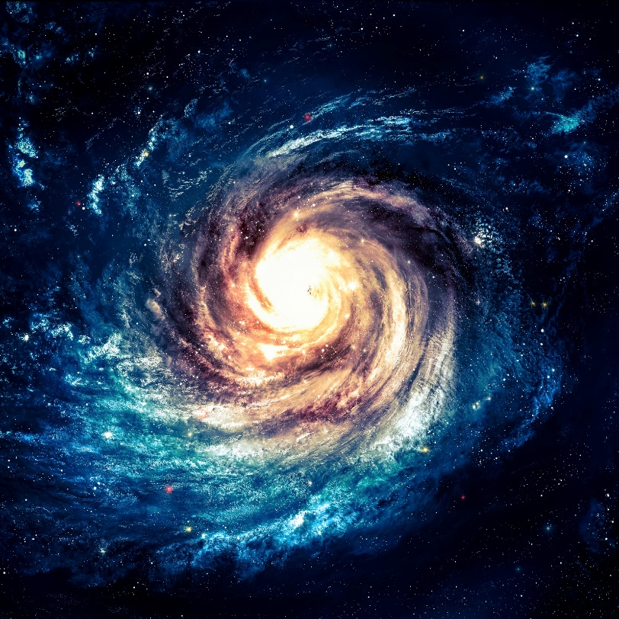
“The Journey of Creation” (Handbook, pages 73–74)
Creation is not simply one event that happened a long time ago but is the ongoing work of God.
© VadimSadovski/www.shutterstock.com

Slide 11
“The Journey of Creation” (Handbook, pages 73–74)
Creation is not simply one event but an ongoing work of creation guided by God’s love and presence.
We have a part to play in God’s plan. We are his co-workers, called to help the world around us be what God created it to be.
We must make choices about our relationships and our care of the earth that are in line with God’s will.
© londoneye/www.istockphoto.com

Slide 12
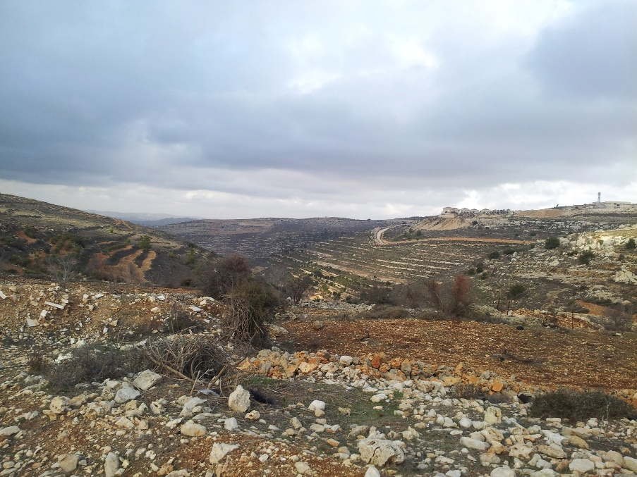
“The Role of the Trinity in Creation” and “The Visible and the Invisible” (Handbook, pages 74–76)
Creation is the work of the whole Trinity—Father, Son, and Holy Spirit.
© janiemaki/SaintMary’sPress

Slide 13
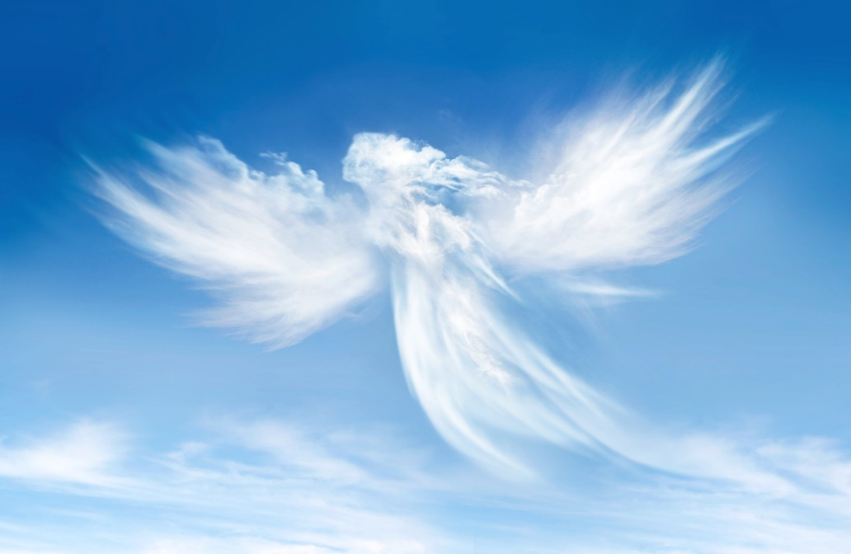
“The Role of the Trinity in Creation” and “The Visible and the Invisible” (Handbook, pages 74–76)
Creation is the work of the whole Trinity.
There is more to creation than what we can see or touch.
Angels are real, but they are beings of spirit, not matter.
© Cranach/www.shutterstock.com

Slide 14
Let’s Reflect!
God brings good out of the evil in our lives. Take a minute to reflect on this.
Think of a time when you experienced sadness, disappointment, or injustice. What was that like? How did you feel?
Even though that experience may not be something you like to remember, did anything good or positive come from the experience? Explain.

