Slide 1
Sacred Scripture and the Life of the Individual
The Living Word: The Revelation of God’s Love, Second Edition
Unit 5, Chapter 17
Document#: TX004695

Slide 2
Our Life with Scripture
The Church earnestly calls Christians to reflect on and pray with Scripture.
Reading, studying, and praying Sacred Scripture can make the most ordinary moments of life extraordinary.
© Christopher Futcher / iStockphoto.com
Notes:
Notes: Ask the students these questions about their reaction to the first bullet point: Have they learned this? Are they surprised by it? Do they think most Catholics do this?
This slide corresponds to content in the chapter 17 introduction in the student book.

Slide 3
Sacred Scripture and Morality
Morality refers to the goodness or evil of human acts, attitudes, and values.
Through free will, we can choose what is truly good.
Reflection and prayer with Sacred Scripture direct us to true good.
© karen roach / Shutterstock.com
Notes:
Notes: Ask the students this question: Who or what are the sources of conflicting voices about right and wrong in your life?
This slide corresponds to content in article 81, “Sacred Scripture and Morality,” in the student book.

Slide 4
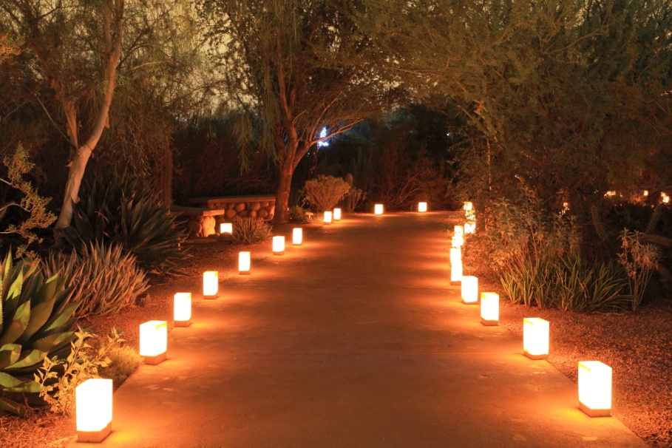
God’s Word Lights Our Path
Scripture directs us toward true happiness and teaches that the path of righteousness is not always easy.
Praying with the Word of God helps us to recognize the morality of an act and to choose what is good.
© Bill Florence / Shutterstock.com
Notes:
Notes: Explain to the students how the Ten Commandments, Beatitudes, teachings of Jesus, and Paschal Mystery each teach about morality.
This slide corresponds to content in article 81, “Sacred Scripture and Morality,” in the student book.

Slide 5
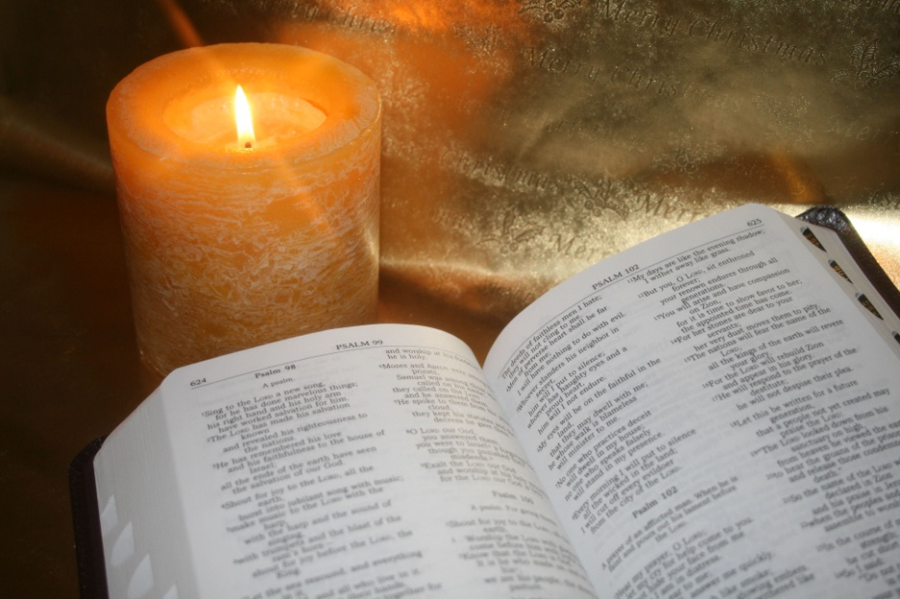
Lectio Divina: Praying with Sacred Scripture
Lectio divina means “divine reading.”
It is a slow, contemplative praying of Sacred Scripture.
It allows the Word of God to penetrate our hearts.
© Allyson Kitts / Shutterstock.com
Notes:
Notes: Ask the students this question: How is the practice of lectio divina similar to, or different from, your idea of prayer?
This slide corresponds to content in article 82, “Lectio Divina: Praying with Sacred Scripture,” in the student book.

Slide 6
The Four Rungs of Lectio Divina
lectio: attentive reading of a passage
meditatio: reflecting on what God is trying to communicate to us
oratio: letting our hearts speak to God in prayer
contemplatio: resting in the presence of God
© kao / Shutterstock.com
Notes:
Notes: Point out to the students that the journey through these stages results in actio, or action. Ask the students how this kind of prayer could actually change a person.
This slide corresponds to content in article 82, “Lectio Divina: Praying with Sacred Scripture,” in the student book.

Slide 7
Lectio Divina Made Easy
The best way to get comfortable with lectio divina is to practice.
Keep a journal handy to write down something that touches your heart.
© Sorin Popa / Shutterstock.com
Notes:
Notes: Direct the students to review the stages of lectio divina, as described in article 82 in the student book.
This slide corresponds to content in article 82, “Lectio Divina: Praying with Sacred Scripture,” in the student book.

Slide 8
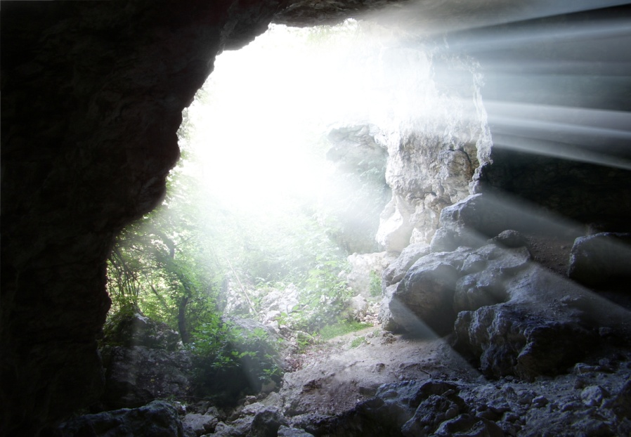
A Way to Learn about God and Self
At the heart of lectio divina is God, our Teacher.
We are called to allow his Word to inform even the darkest corners of our lives.
© Kozoriz Yuri / Shutterstock.com
Notes:
Notes: Discuss how lectio divina allows God to teach us.
This slide corresponds to content in article 82, “Lectio Divina: Praying with Sacred Scripture,” in the student book.

Slide 9
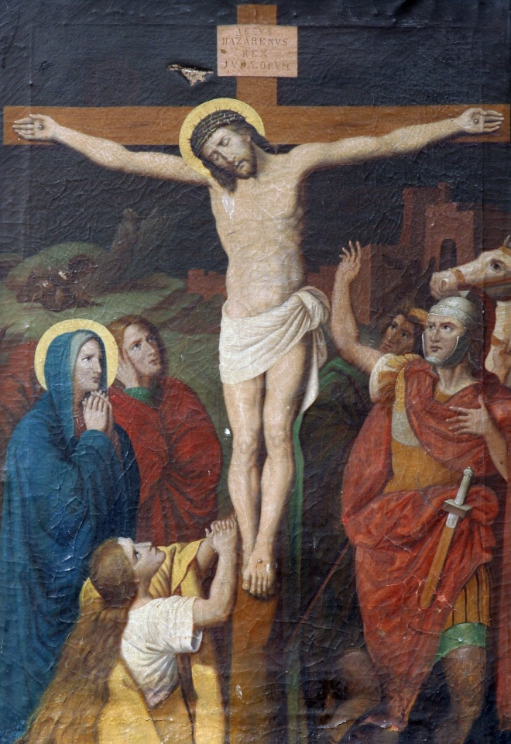
The Stations of the Cross
This devotion is rooted in the Scripture accounts of the Passion.
When we meditate on Christ’s Passion and Death, we commemorate his sacrifice.
© Zvonimir Atletic / Shutterstock.com
Notes:
Notes: Review the traditional Stations or the scriptural version in article 83 in the student book. Ask the students how meditation on Christ’s Passion helps us to better experience God’s redemptive love.
This slide corresponds to content in article 83, “Two Devotional Prayers Based in Sacred Scripture,” in the student book.

Slide 10
Praying the Rosary
We recite five sets of ten Hail Marys.
Each set is called a decade.
Each new decade begins with one Lord’s Prayer and concludes with a Glory Be.
We trace these prayers along a small chain of beads with a crucifix.
© Duncan Andison / Shutterstock.com
Notes:
Notes: Ask the students about their experience of praying the Rosary. Consider sharing your own experience.
This slide corresponds to content in article 83, “Two Devotional Prayers Based in Sacred Scripture,” in the student book.

Slide 11
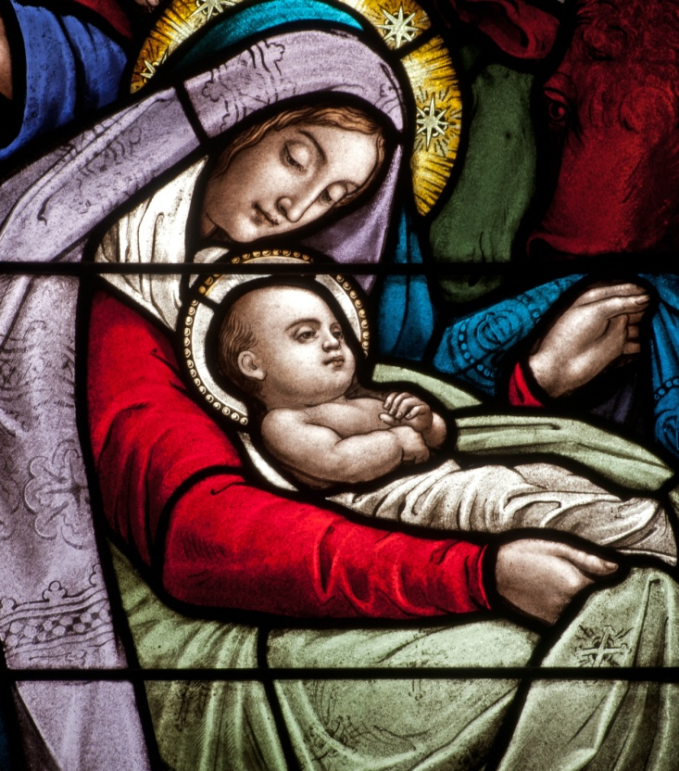
The Mysteries of Christ’s life
While praying the Rosary, we meditate on the mysteries of the life of Jesus.
Each time we pray the Rosary, we dedicate it to a set of five mysteries.
There are five Joyful, five Sorrowful, five Glorious, and five Luminous Mysteries.
© Nancy Bauer / Shutterstock.com
Notes:
Notes: Review the lists of Mysteries in article 83 in the student book. Read the introductory paragraph of the Pray It! sidebar in this article. Invite the class to pray this prayer together.
This slide corresponds to content in article 83, “Two Devotional Prayers Based in Sacred Scripture,” in the student book.

Slide 12
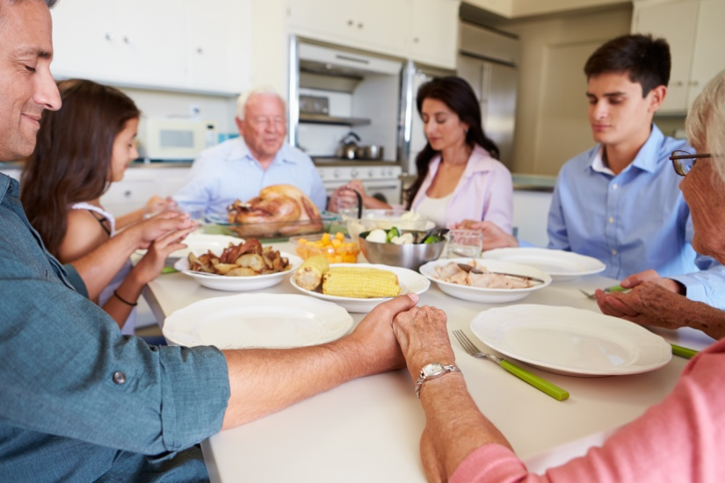
Individual and Communal Prayer with Sacred Scripture
We can pray on our own and also with others.
When we gather as Christians, we are called to make Sacred Scripture the basis for our prayer.
© Monkey Business Images / Shutterstock.com
Notes:
Notes: Brainstorm with the students group settings in which they have prayed (family, hockey team, on retreat, scouts, drama club, and so on). Ask the students how Scripture has been a part of those experiences.
This slide corresponds to content in article 84, “Individual and Communal Prayer with Sacred Scripture,” in the student book.

