Slide 1
Chapter 12: Judaism
World Religions: A Voyage of Discovery
DOC ID #: TX003949

Slide 2
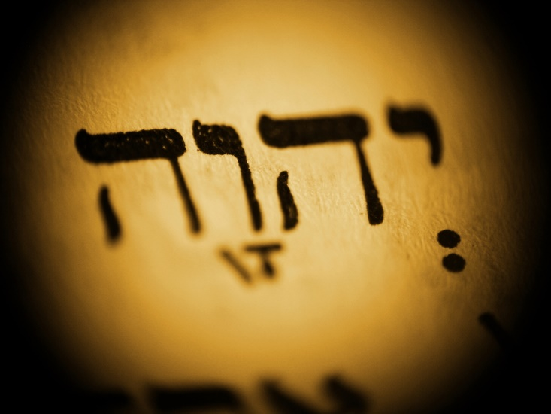
Yahweh
The name of God is identified in the Hebrew Bible with four consonants.
It is commonly transliterated in English as “Yahweh.”
Rather than pronouncing the name, observant Jews have traditionally stated “Adonai,” which means “Lord.”
© Anastazzo / www.shutterstock.com
Notes:
Notes: The Hebrew spelling of the name of God consists of the so-called divine tetragrammaton; reading from right to left: yod, he (pronounced hã), vav, he. The rendition shown on this slide includes vowel markers, but traditionally the name is considered too holy to pronounce. Jehovah is an earlier common transliteration of the divine name that for the most part has been replaced by Yahweh. Study of the various names of God in the Hebrew Bible is an engaging way to learn about biblical theology. The God of the Israelites is also referred to as El, Elohim, El Shaddai, and various other names. Students typically are intrigued by the fact that Elohim is a plural form. Scholars offer a variety of explanations, probably the most common being the idea of the “royal we,” such that the plural form is an attempt to express God’s majesty.

Slide 3
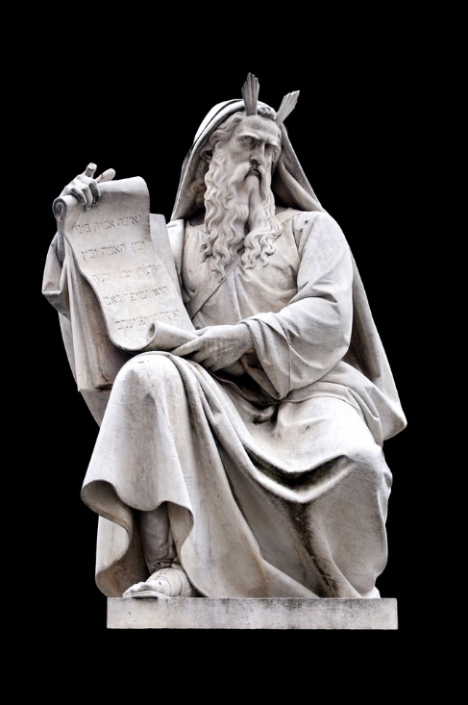
Moses
Moses is the most important prophet of the Jewish tradition.
Here he holds the scroll of the Torah.
According to the Bible, the Torah was pronounced to Moses by God on Mount Sinai.
© Only Fabrizio / www.shutterstock.com
Notes:
Notes: The Torah, which consists of the first five books of the Bible, includes the most significant foundational ideas of Judaism, including the mitzvot (“commandments”), the notion of a covenant relationship between God and the people, and the demand that the Israelites are to worship one God only. This sculpture by Ignazio Jacometti is located at the base of the Column of the Immaculate Conception (Colonna dell’Immacolata) in Rome. The Column was completed in 1856.

Slide 4
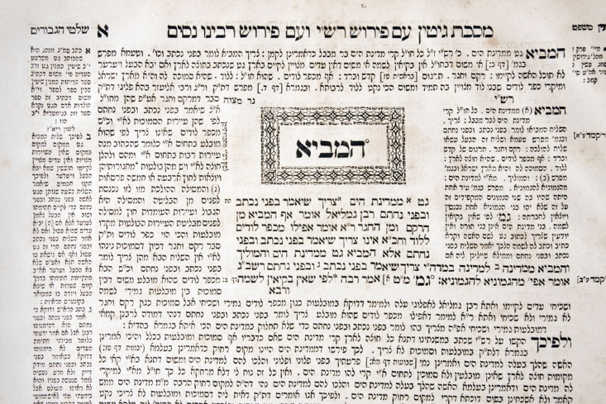
A Page of the Talmud
The Talmud contains teachings of the rabbis through the first six centuries of the Common Era.
Passages from the Mishnah are in the center.
These passages are surrounded by the later commentary known as Gemara.
© vadim kozlovsky / www.shutterstock.com
Notes:
Notes: The Talmud includes sixty-three separate books and in standard print form is over six thousand pages long. There are two versions of the Talmud, the Palestinian (completed by AD 450) and the Babylonian (completed by AD 600).

Slide 5
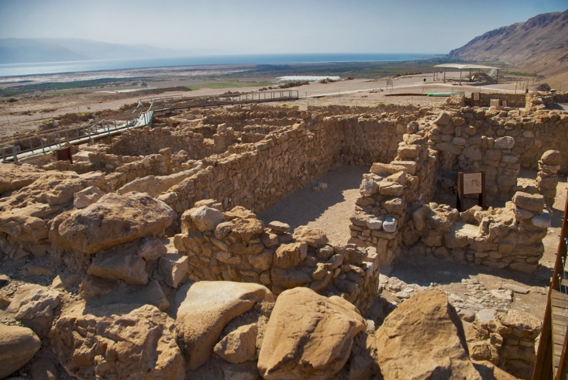
The Dead Sea Scrolls
Discovered in 1947, the Dead Sea Scrolls are one of the most important archaeological finds of the twentieth century.
The scrolls were discovered in caves at Khirbet Qumran on the northwestern shore of the Dead Sea.
© Aprilphoto / www.shutterstock.com
Notes:
Notes: Most scholars believe that the community at Khirbet Qumran, established during the second century BC, was the group known as the Essenes, who opted to live separated from the rest of Jewish society. Other Jewish groups from this time period include the Sadducees, who were closely associated with the Jerusalem Temple and were conservative toward change, and the Pharisees, who believed in the “Oral Torah” as a legitimate continuation of the written Torah. The source for these categories of Jews during the time of Roman occupation of Palestine is the Jewish historian Josephus (AD 37 to c. AD 100). The term Essene does not occur in the Dead Sea Scrolls, and so some scholars are hesitant to identify the members of the Qumran community as Essenes.

Slide 6
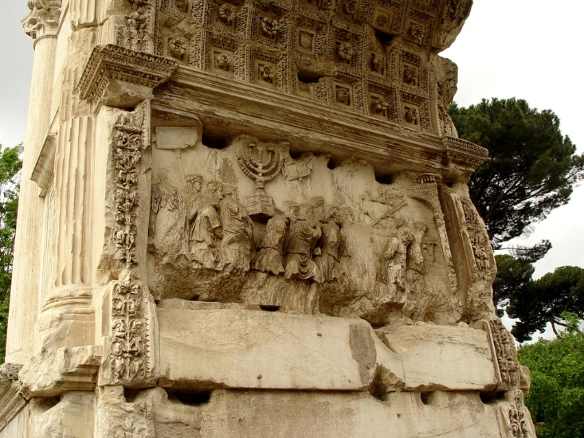
Arch of Titus, Rome
The Arch of Titus commemorates the general’s victory over the Jews in AD 70.
The Romans destroyed the Jerusalem Temple.
The inner frieze depicts a menorah and other Jewish items being taken.
© Joseph Calev / www.shutterstock.com
Notes:
Notes: The Arch of Titus, located at one entrance of the Roman Forum, commemorates Titus’s victory while a general during his father Vespasian’s reign as emperor. Among the changes brought about by the destruction of the Temple, which theretofore had been the spatial and spiritual center of Judaism, was the rapid ascendance of the rabbis to prominence, teaching the Torah—including the developing Oral Torah—in synagogues. Whereas before the Temple with its animal sacrifices had been the religious center, the synagogue and study of Torah took its place. The second great conflict with the Romans occurred from AD 132 to 135, when Bar Kochba, “Son of the Star(s),” led an unsuccessful revolt. The Romans, per the command of the emperor Hadrian, destroyed Jerusalem and permanently forbade Jews from entering the area.

Slide 7
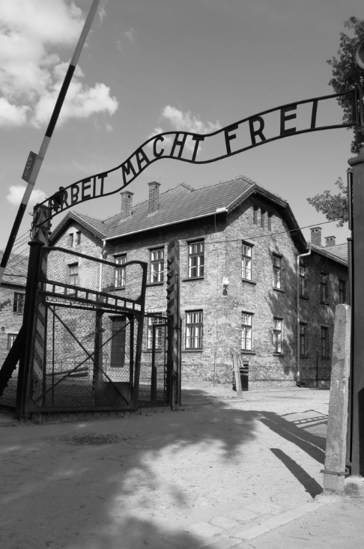
Holocaust, or Shoah
The entrance gate to the Auschwitz concentration camp reads “Labor makes (you) free.”
Six million Jews were killed in the Holocaust, or Shoah.
The Holocaust significantly impacted Judaism as a religion, forcing theological challenges.
© alessandro0770 / www.shutterstock.com
Notes:
Notes: The Hebrew term Shoah, which literally means “whirlwind” and therefore “mass destruction,” is a more precise label than Holocaust, a Greek term that refers to a burnt sacrificial offering. The theological challenges revolve mainly around how a loving God could have allowed for such a tragedy to befall the Jewish people. Though the Holocaust is its most extreme event, anti-Semitism has a long and complex history. With regard to Nazi Germany, even by the time of publication of his biography, Mein Kampf (1925), Adolf Hitler condemned the Jews as a menace to society that needed to be vanquished. Hitler and the Nazis based their anti-Semitism on a kind of racist conception of Jews and Judaism. Other forms of anti-Semitism as manifest within Christianity and Islam have been based on more explicitly religious issues.

Slide 8
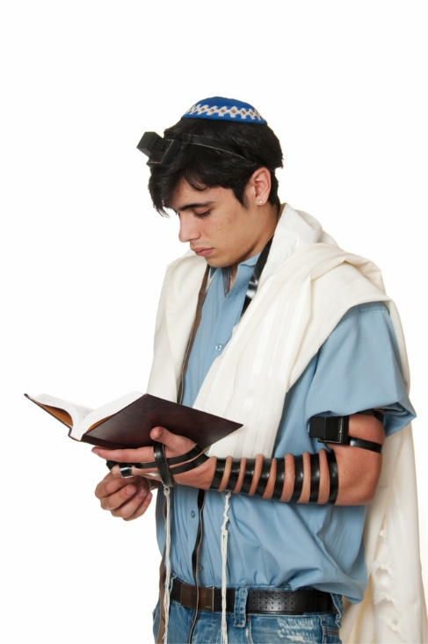
Morning Prayers
Observant Jews pray three times daily, with an additional prayer service on the Sabbath.
During morning prayer, Jewish men wear a tallit, or prayer shawl, and tefillin, or prayer amulets.
The prayers come from the Bible or from the writings of the rabbis.
© Howard Sandler / www.shutterstock.com
Notes:
Notes: The tefillin, sometimes called phylacteries, are two small boxes that contain papers with biblical verses. The traditional collection of prayers is the Siddur. It contains, for example, the Shema (Deuteronomy 6:4–9), which begins: “Hear, O Israel! The Lord is our God, the Lord alone.” The thrice-daily routine was established even by the end of the biblical period; Daniel 6:11 portrays Daniel praying in this manner.

Slide 9
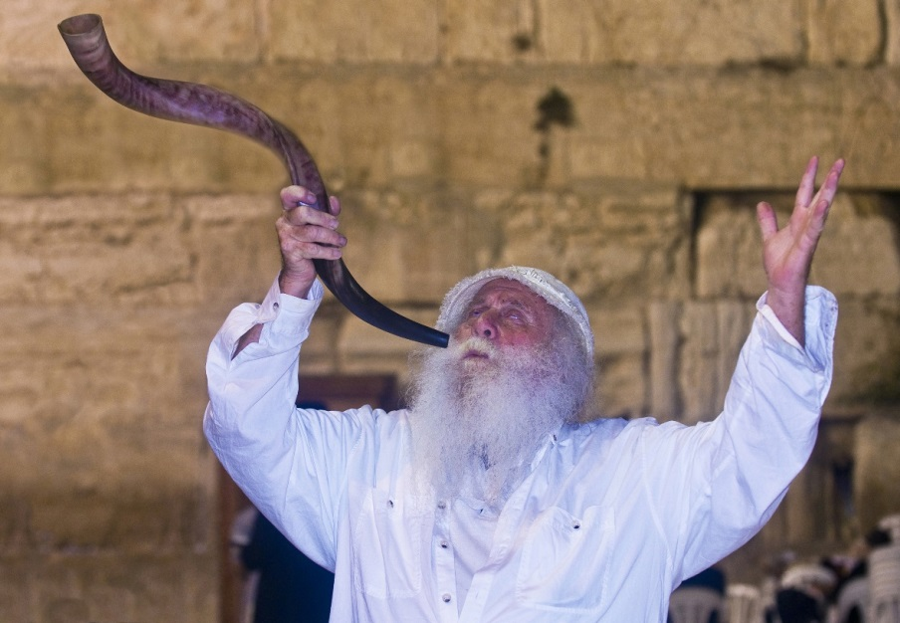
Shofar
A shofar is a ram’s horn used to mark the beginning of the seasonal religious observances.
The first observance is Rosh Hashanah, the Jewish New Year.
During the Rosh Hashanah service, the shofar is blown one hundred times.
© Kobby Dagan / www.shutterstock.com
Notes:
Notes: The man shown on this slide is blowing the shofar at the Wailing Wall in Jerusalem. The blowing of the shofar serves to remind worshippers of the need for self-reflection and repentance, but the mood at the beginning of the cycle of major festivals tends to be celebratory. There are five festivals: Rosh Hashanah, Yom Kippur, Sukkot, Passover (Pesach), and Shavuot.

Slide 10
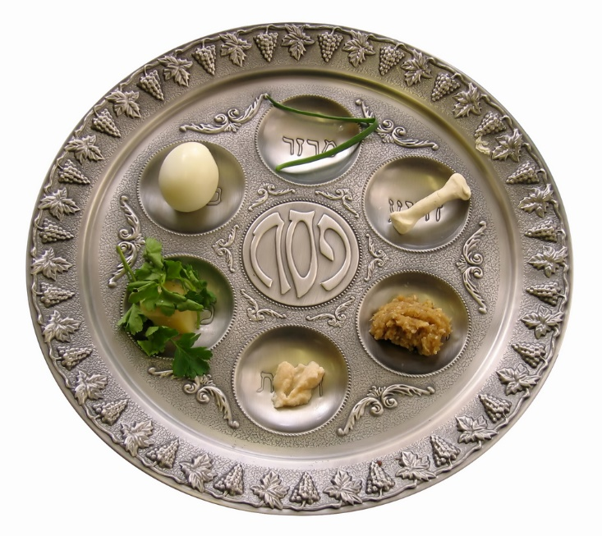
Passover: The Seder Plate
The eight-day festival of Passover commemorates the Exodus from Egypt and occurs in the spring.
The Seder meal is the central event of Passover.
The meal consists of highly symbolic menu items.
© diligent / www.shutterstock.com
Notes:
Notes: The Hebrew term for Passover is Pesach. The foods on the Seder plate are unleavened bread, known as matzo (or matzah, it recalls the haste with which the Israelites left Egypt); bitter herbs; a mixture of wine, nuts, and apples (reminiscent of the mortar used to make bricks); a lamb shank bone; a roasted egg; parsley; and an additional herb or vegetable.

Slide 11
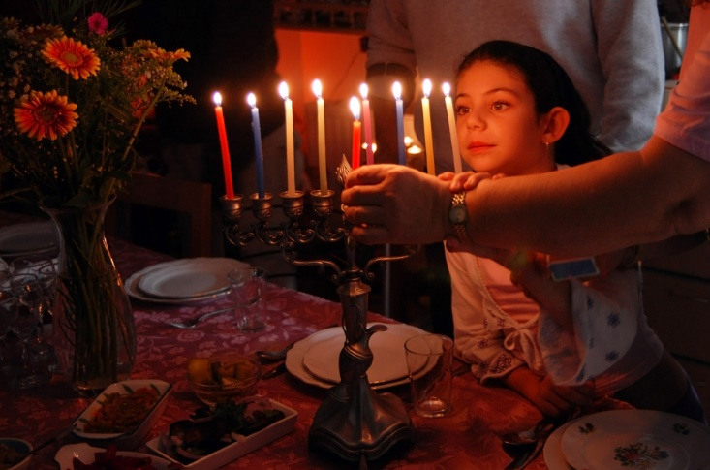
Hanukkah: Menorah
The menorah, featured during Hanukkah, is one of the most recognizable symbols of Judaism.
It holds eight candles plus one.
Hanukkah commemorates a Jewish victory in 164 BC.
© ChameleonsEye / www.shutterstock.com
Notes:
Notes: Although officially a minor festival, Hanukkah is popularly celebrated and is well known, in large part because it coincides with the Christmas season. The menorah represents with its eight candles plus one the miraculous miracle of the lights at the time of the Maccabean Revolt that commenced in 167 BC. Once the Jerusalem Temple had been recaptured by the Jews, it needed to be cleansed and sanctified; one day’s worth of oil for the lamps miraculously burned for eight days. The first and second of the four Books of the Maccabees are included in the Apocrypha (but not in most Bibles traditionally used in Protestant churches). The account features Judas the Maccabee, who led a two-year armed revolt against the Greek-Syrian king Antiochus IV Epiphanes. The celebration of Hanukkah includes the lighting of one of eight candles on the menorah on each night of the festival.

Slide 12
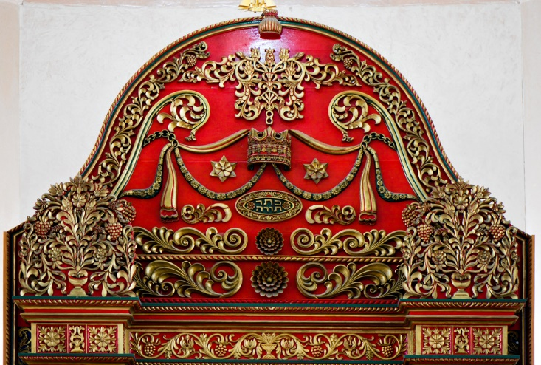
Ark with Torah
Every synagogue contains an ark in which are placed scrolls (parchment copies) of the Torah, the first five books of the Bible.
The Torah contains the foundational sacred legislation of Judaism.
The term Torah, which literally means “teaching,” is sometimes translated “Law.”
© Aron Brand / www.shutterstock.com
Notes:
Notes: The ark shown on this slide is in the Nechalim synagogue in Israel. The books of the Torah are Genesis, Exodus, Leviticus, Numbers, and Deuteronomy. Traditionally the number of mitzvot, or commandments, contained in the Torah is 613, including the famous Ten Commandments, which are presented in two slightly different versions (see Exodus, chapter 20, and Deuteronomy, chapter 5).

Slide 13
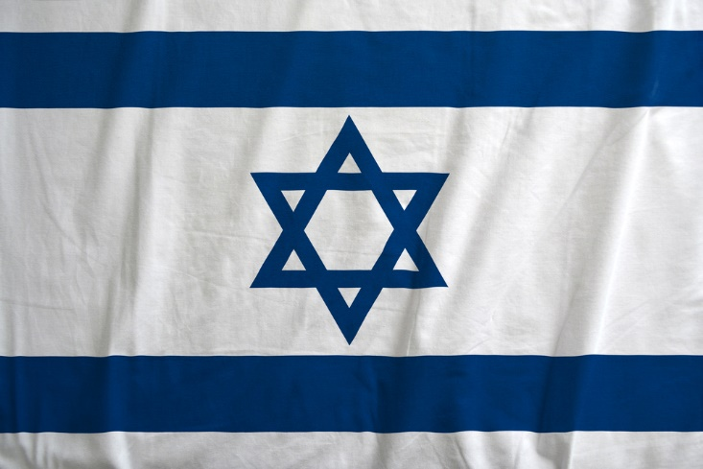
State of Israel
The Israeli flag features the Star of David.
The flag symbolizes the long struggle to maintain a secure homeland.
Since 1948, the homeland has been the nation of Israel.
© Stefano Ginella / www.shutterstock.com
Notes:
Notes: The Star of David is a medieval symbol, but it hearkens back to the Israelite kingdom united by David in about 1000 BC. The modern state of Israel came about largely as the result of Zionism, a movement that arose in the late nineteenth century. The first significant event in the development of Zionism was the publication in 1862 of Moses Hess’s Rome and Jerusalem, in which Hess asserted that the only solution to the problem of anti-Semitism was the creation of a sovereign state. Perhaps the most influential Zionist of all was Theodor Herzl (1860 to 1904), who set forth in The Jewish State (1896) and The Old-New Land (1902), a utopian novel, his vision of “political” Zionism. Of course, World War II and the Holocaust were crucial events leading to the establishment of the state of Israel. Especially because of issues involving a Palestinian homeland, this was and continues to be a very complex, and in some ways controversial, issue.

