Slide 1
The Moral Life
The Catholic Faith Handbook for Youth, Third Edition
Chapter 32
Document #: TX003163
Notes:
Use this presentation to introduce and review the key points in chapter 32 of the student handbook.

Slide 2
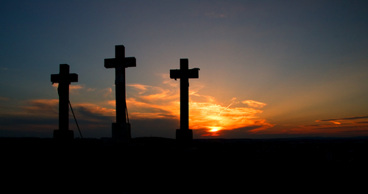
Habits
What habits help you to do well in school, sports, or the arts?
What habits help you to stay healthy?
What habits help you to be a good friend?
Copyright: muzsy / www.shutterstock.com
Notes:
Invite the students to reflect on these questions, and ask about the role that habits have played in their successes.

Slide 3
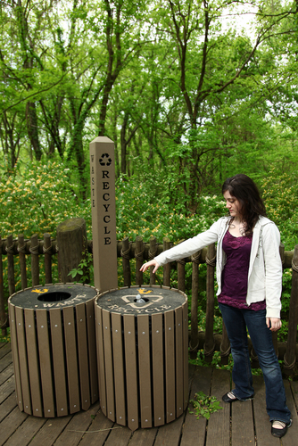
Good Habits
Develop over time
Help us make good decisions
Become second nature
Virtues are habits.
Copyright: Jaimie Duplass / www.shutterstock.com
Notes:
After showing the last statement, tell the students to think of one virtue they possess. Explain that they can regard any of their good qualities, such as generosity or perseverance, as a virtue. Ask if the statements on the slide apply.

Slide 4
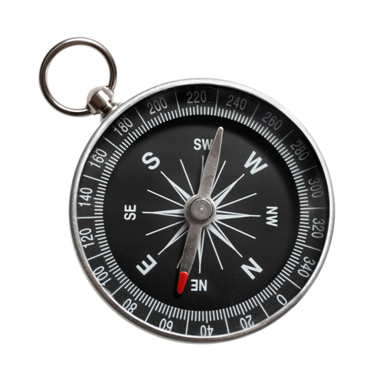
Two Kinds of Virtues
Cardinal virtues build moral character.
Theological virtues build our relationship with God.
Copyright: Kokhanchikov / www.shutterstock.com
Notes:
These types of virtues are discussed in the next slides.

Slide 5
Cardinal Virtues
Prudence
Justice
Temperance
Fortitude
Copyright: Monkey Business Images / www.shutterstock.com
Notes:
Ask volunteers to read the description of each virtue on pages 353–354. After each description, ask for examples of how that virtue could help a teen make a good decision.

Slide 6
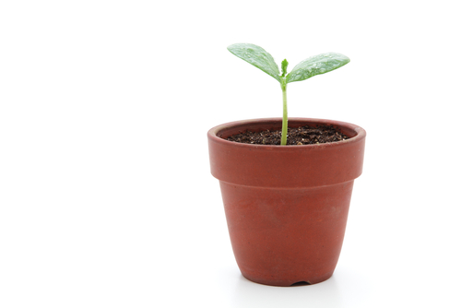
Pick one of the cardinal virtues you would like to grow in, and make a plan for practicing this virtue intentionally for one week.
Copyright: haru / www.shutterstock.com
Notes:
Invite the students to write some ideas for practicing this virtue in their notebooks, along with a “check progress” date, one week from today.

Slide 7
Theological Virtues
Faith
Hope
Love
Copyright: Tomas Sereda / www.shutterstock.com
Notes:
Invite the students to silently read the descriptions of these virtues on pages 354–355 of the student handbook. Ask for volunteers to summarize the meaning of each virtue.

Slide 8
God’s Grace
Copyright: Tischenko Irina / www.shutterstock.com
No sin can ever separate us from God’s love and forgiveness.
The Holy Spirit communicates God’s grace to us.
Grace is the help God gives us to respond to our vocation to be his adopted sons and daughters.
Notes:
Explain that we receive grace through our Baptism, and in all of the other Sacraments.

Slide 9
Experiencing God’s Grace
Stop to give praise for all creation.
Be more aware of God’s presence in your daily life.
Pray, worship, and participate in the Sacraments.
Conversion: our lifelong journey with and to God
Copyright: PHOTOCREO Michal Bednarek / www.shutterstock.com

