Slide 1
Paul’s Journeys
The Church Course
Document # TX001506

Slide 2
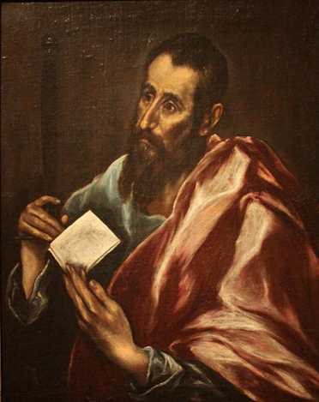
Spreading the Word
Over a period of ten years in the middle of the first century, Saint Paul made three major missionary journeys, traveling throughout the Mediterranean region, spreading the Gospel.
Image in public domain
Notes:
(Notes: Acts of the Apostles 13:1)

Slide 3
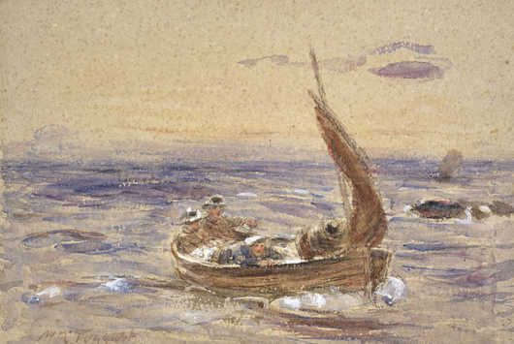
Travel Wasn’t Easy
The majority of his journeying was made on foot or by small coastal boat.
Travel was very dangerous in Paul’s day.
Image in public domain

Slide 4
Set Apart by God
“While they were worshiping the Lord and fasting, the Holy Spirit said, ‘Set apart for me Barnabas and Saul for the work to which I have called them.’ Then, completing their fasting and prayer, they laid hands on them and sent them off.” (Acts of the Apostles 13:2–3)

Slide 5
Map of the First Journey
© Saint Mary’s Press

Slide 6
Paul’s First Journey
Paul, Barnabas, and John Mark begin their first journey from Antioch in Syria.
They travel to Cyprus (Barnabas’s home), where Saul begins to use his new name, Paul. In Cyprus, Paul rebukes and blinds Elymas the magician.

Slide 7
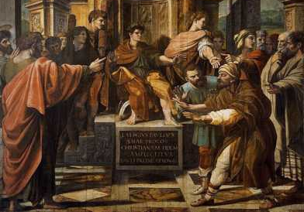
Blinding Elymas
“You son of the devil, you enemy of all that is right, full of every sort of deceit and fraud. Will you not stop twisting the straight paths of [the] Lord? Even now the hand of the Lord is upon you. You will be blind, and unable to see the sun for a time.” (Acts of the Apostles 13:10–11)
Image in public domain

Slide 8
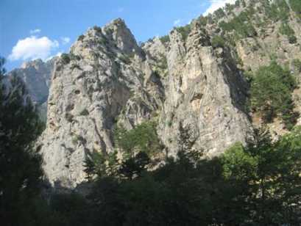
Pisidian Antioch
They then travel to Perga (where John Mark leaves them), and Paul and Barnabas cross the rugged Taurus Mountains into Pisidian Antioch.
Here their preaching is opposed by the Jews and the city’s leading citizens. This soon becomes a familiar pattern in Paul’s travels.
© taheny.com

Slide 9
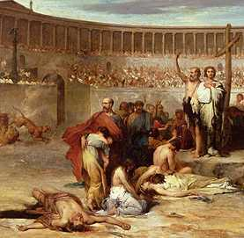
Tribulations in Lystra
They then move on to the city of Iconium, where they find many believers but face opposition. Hearing of a plot to stone them, they flee to Lystra.
In Lystra, Paul heals a crippled man.
Jews from Antioch and Iconium stone Paul and drag him outside the city, leaving him for dead.
He recovers, miraculously, and he and Barnabas go on to Derbe.
Image in public domain
Notes:
(Notes: Acts of the Apostles 14:8–12)

Slide 10
Derbe
In Derbe they find many who believe, and win large numbers of disciples.
They retrace their steps and sail back to Antioch.
The four churches in the southern portion of the Roman province of Galatia—Pisidian Antioch, Iconium, Lystra, and Derbe—become the core of Saint Paul’s churches in Anatolia.
Notes:
(Notes: Acts of the Apostles 14:21–28)

Slide 11
Map of the Second Journey
© Saint Mary’s Press

Slide 12
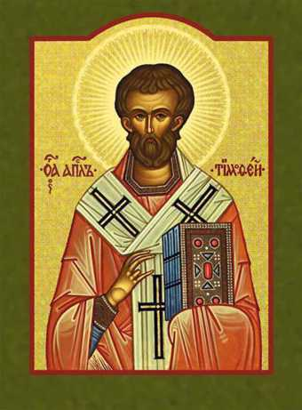
Paul’s Second Journey
In late AD 49, Paul, determined to strengthen the churches in Galatia, sets out with Silas for Tarsus.
From Tarsus they travel to Derbe and Lystra.
In Lystra, Paul meets a young believer named Timothy, who becomes a frequent traveling companion, a fellow missionary, and his closest friend.
Image in public domain
Notes:
(Notes: Acts of the Apostles 16:1–5; 1 Timothy 1:2, 4:14)

Slide 13
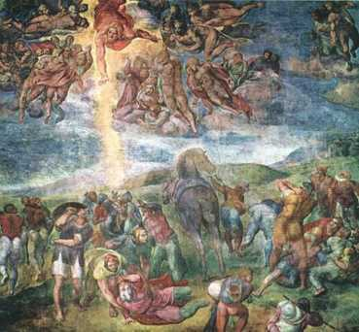
Paul’s Vision
Paul, Silas, and Timothy travel to Iconium and Pisidian Antioch.
The Holy Spirit forbids them to enter Ephesus and Bithynia, so they travel to the Asia Minor port city of Troas.
In Troas, Paul has a vision of a man in Macedonia asking him to come preach. Paul takes the vision as a sign from God and the three men set sail for Neapolis.
© asksistermarymartha.blogspot
Notes:
(Notes: Acts of the Apostles 16:6–11)

Slide 14
Lydia Baptized
From there, they travel to Philippi, where a woman named Lydia hears Paul’s preaching and is baptized, along with her entire household.
Notes:
(Notes: Acts of the Apostles 16:12–15)

Slide 15
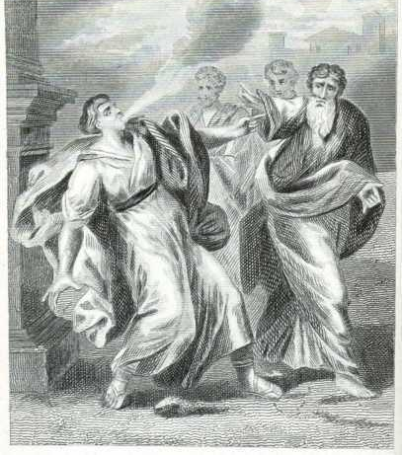
Beaten and Imprisoned
In Philippi, Paul casts out a demon from a female slave. Her masters, angry that they have lost the ability to make more money from the slave’s demonic divination, stir up the city against Paul and Silas.
The two evangelists are arrested, beaten, and put in prison.
Image in public domain
Notes:
(Notes: Acts of the Apostles 16:16–24)

Slide 16
Prison Conversion
About midnight, while Paul and Silas are praying, an earthquake hits, miraculously loosening their bonds and opening all prison doors, freeing Paul and Silas.
A guard, seeing the broken chains, tries to kill himself, thinking his prisoners have escaped.
Paul cries out, telling him not to harm himself. The guard hears the Word of the Lord and, with his family, is baptized that night.
Notes:
(Notes: Acts of the Apostles 16:25–40)

Slide 17
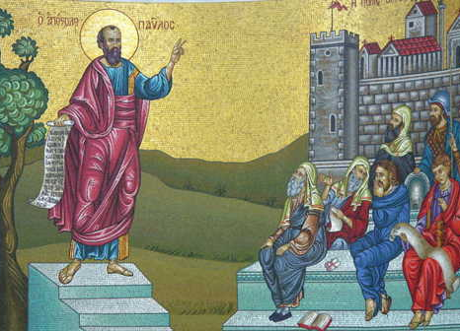
Synagogue Speeches
Paul, Silas, and Timothy travel to Thessalonica, where there is a synagogue. Paul visits and preaches there for three consecutive Sabbaths, preaching that Jesus is the Savior of Mankind spoken of in the Old Testament.
Image in public domain
Notes:
(Notes: Acts of the Apostles 17:1–5)

Slide 18
Synagogue Speeches
Although many believe what Paul says, certain Jews who are envious of the Gospel’s success form a mob and seek the three, who leave for Berea.
Image in public domain
Notes:
(Notes: Acts of the Apostles 17:1–5)

Slide 19
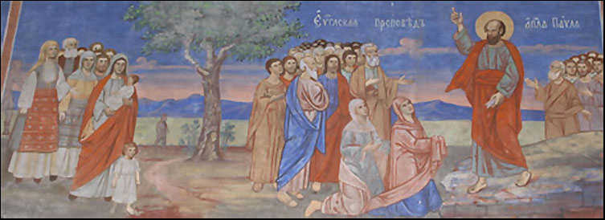
Bereans Believe
Paul and Silas visit and preach in a synagogue in Berea. The Bereans, of more noble character than the Thessalonicans, are willing to listen to what Paul has to say, and they verify what he preaches.
Image in public domain
Notes:
(Notes: Acts of the Apostles 17:11–14)

Slide 20
Bereans Believe
Many Bereans come to believe the Gospel.
But Jews from Thessalonica arrive, seeking to cause more trouble for Paul. He immediately leaves for the coast and sails for Athens. Timothy and Silas remain in Berea.
Image in public domain
Notes:
(Notes: Acts of the Apostles 17:11–14)

Slide 21
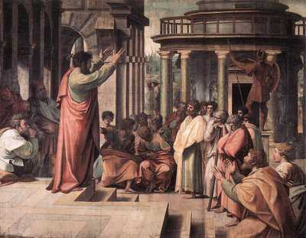
In Athens
In Athens, Paul writes to Silas and Timothy, asking them to come to Athens, where the city is full of idols.
Paul’s preaching leads to an invitation by the Athenians to elaborate on the Gospel.
Image in public domain
Notes:
(Notes: Acts of the Apostles 17:16, 22–34)

Slide 22
In Athens
Paul speaks to a meeting of the Areopagus, where he uses the existence of an altar dedicated TO THE UNKNOWN GOD to reveal the existence of a Creator God, who alone is worthy of worship.
Image in public domain
Notes:
(Notes: Acts of the Apostles 17:16, 22–34)

Slide 23
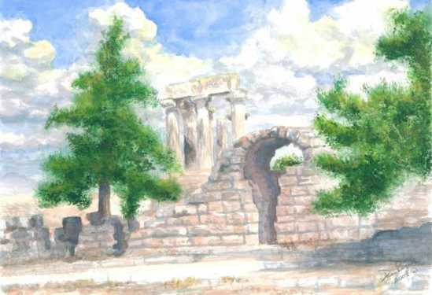
Among the Corinthians
In AD 50 Paul leaves Athens and travels south to Corinth, where he works as a tentmaker with Aquila and Priscilla.
Silas and Timothy join him in Corinth.
fineartamerica.com
Notes:
(Notes: Acts of the Apostles 18:1–10)

Slide 24
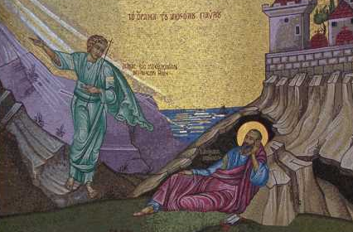
Paul’s Vision of Safety
After Corinthian Jews reject his message, Paul receives a vision from God, telling him he will be protected from harm and that the Gospel message he carries will bear much fruit.
Paul stays and teaches in Corinth for a year and a half.
© webshots.com
Notes:
(Notes: Acts of the Apostles 18:5–11)

Slide 25
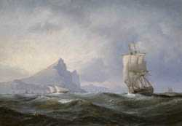
Ephesus to Caesarea
The Jews eventually raise another riot against Paul and bring him before the Roman governor. Paul is set free when the governor refuses to hear the Jews’ accusations.
Paul sails with Priscilla and Aquila to Ephesus.
Paul then sails to Caesarea and on to Antioch.
Image in public domain
Notes:
(Notes: Acts of the Apostles 18:12–16,18–22)

Slide 26
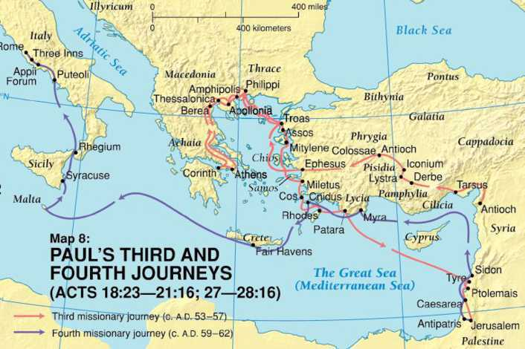
Map of the Third Journey
© Saint Mary’s Press

Slide 27
Paul’s Third Journey
God’s will was that Paul visit Ephesus, so he and Timothy journeyed through Asia to the fourth largest city in the Empire.
At Ephesus the Lord worked many miracles through Paul, so that “when face cloths or aprons that touched his skin were applied to the sick, their diseases left them and the evil spirits came out of them” (Acts of the Apostles 19:12).
Notes:
(Notes: Acts of the Apostles 18:23)

Slide 28
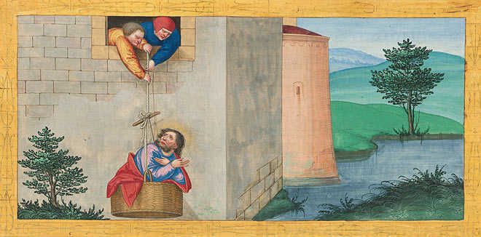
Macedonia
Paul escapes from a riot by Ephesian merchants and journeys to Macedonia.
Image in public domain
Notes:
(Notes: Acts of the Apostles 20:1–3)

Slide 29
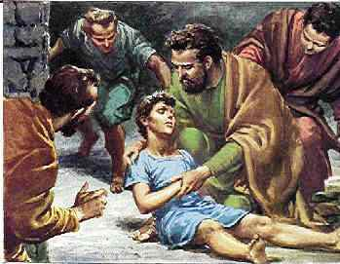
Raising Eutychus
Paul travels through Macedonia to Troas, where he raises from the dead Eutychus, a young boy who fell from the upper story of a building.
Image in public domain
Notes:
(Notes: Acts of the Apostles 20:6–10)

Slide 30
A Warning
Paul travels on to Mitylene.
While sailing to Miletus, Paul requests elders from the Ephesian church to visit him.
When they arrive, he warns them about the coming challenges in the Church.
Notes:
(Notes: Acts of the Apostles 20:11–16,17–38)

Slide 31
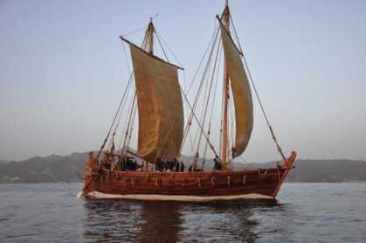
Island Travels and Caesarea
Paul leaves Miletus by boat and visits islands such as Cos, Rhodes, and Patara before arriving in Caesarea.
Patara is the birthplace of Saint Nicholas, patron saint of Christmas.
bayourenaissanceman.blogspot.com
Notes:
(Notes: Acts of the Apostles 21:1–8,10–15)

Slide 32
Island Travels and Caesarea
Paul stays at the house of Philip the evangelist for several days.
He then sets off for Jerusalem, even though he is warned twice about entering the city.
bayourenaissanceman.blogspot.com
Notes:
(Notes: Acts of the Apostles 21:1–8,10–15)

Slide 33
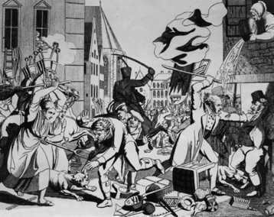
Jerusalem
In Jerusalem, Paul visits James and goes to the Temple with four Jewish converts.
Jews from Asia who hate Paul, believing he has brought Gentiles into the Temple area, cause a riot.
Roman troops hear of the riot and race to the scene, saving Paul from certain death.
Image in public domain
Notes:
(Notes: Acts of the Apostles 21:18,23–32)

Slide 34
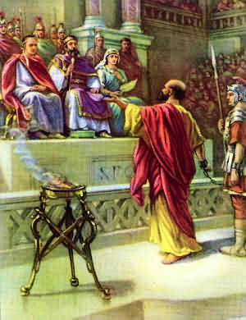
Before the Sanhedrin
The Romans take Paul away and decide to scourge him to find out what crimes he has committed.
Paul is saved from being scourged when he declares that he is a Roman citizen.
Paul defends himself the next day before the Sanhedrin, but accomplishes little.
© holtzendorff.com
Notes:
(Notes: Acts of the Apostles 22:25–29, 23:1–10)

Slide 35
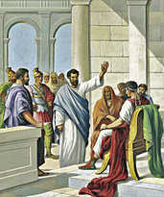
Caesarea
The Lord appears to Paul and tells him that he must testify about him in Rome.
Paul is escorted out of the city at night by Roman soldiers so that he won’t be killed.
The soldiers take Paul to Caesarea, to the Roman governor of Judea, so that he can decide Paul’s fate.
© godrules.com
Notes:
(Notes: Acts of the Apostles 23:11–35)

Slide 36
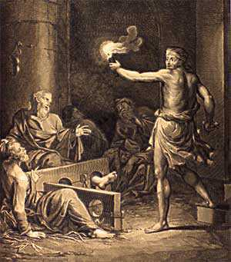
Prisoner in Caesarea
Paul is a Roman prisoner for two years, during which time he defends himself three times.
Paul requests to be tried by Rome, rather than risk returning to Jerusalem.
© finaltrump.com
Notes:
(Notes: Acts of the Apostles 24:26)

Slide 37
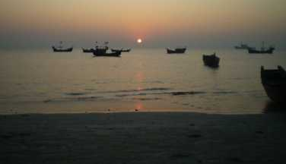
On the Seas
In late AD 60, Paul and other prisoners board a ship for Rome, escorted by a Roman centurion named Julius.
The group makes its way to the Isle of Crete.
Although Paul warns Julius not to sail the Mediterranean during a dangerous time of year, the centurion disregards his advice and they set sail from Crete.
Image in public domain
Notes:
(Notes: Acts of the Apostles 27:1–2,7,9–12)

Slide 38
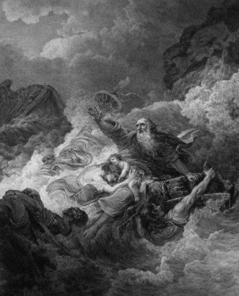
Shipwrecked
The ship encounters a fierce storm and is shipwrecked near the island of Malta.
All those on the ship either swim or grab boards from the wreck and make their way to the island.
Image in public domain
Notes:
(Notes: Acts of the Apostles 27:14, 28:1)

Slide 39
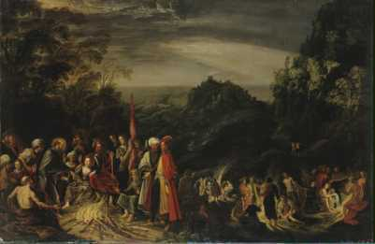
On to Rome
The group stays on Malta for three months, during which time Paul works miracles with the sick.
They leave for Rome, stopping in the Italian port city of Puteoli, where Paul stays for one week with Christians in the area before traveling on to Rome.
© oceanbridge.com
Notes:
(Notes: Acts of the Apostles 28:2–13)

Slide 40
Prisoner in Rome
The centurion Julius delivers Paul to the captain of the guard in Rome.
Paul is allowed to live by himself, guarded only by a soldier.
For two years Paul is able to receive visitors and continue his preaching of the Gospel.
Notes:
(Notes: Acts of the Apostles 28:16,23–31)

Slide 41
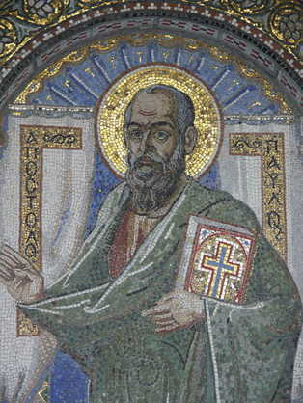
Crete, Macedonia, and Spain
Paul is released from prison in AD 63 and travels to the Isle of Crete.
From there he goes to Nicopolis in Macedonia.
It is likely that he also fulfilled his goal of visiting Spain.
Image in public domain
Notes:
(Notes: Titus 1:5, 3:12; Romans 15:28)

Slide 42
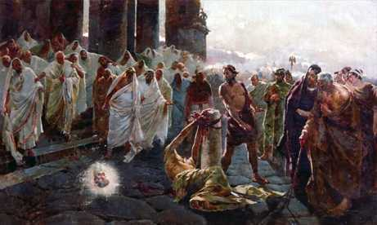
A Martyr’s Death in Rome
Paul, once again a prisoner in Rome, writes a letter to his friend Timothy. It is Paul’s last writing before he dies a martyr’s death around the middle of AD 68.
According to Christian tradition, Paul was beheaded in Rome.
Image in public domain
Notes:
(Notes: 2 Timothy)

