Slide 1
Introducing the Trinity: Central Mystery of Faith
Jesus Christ Course
Document # TX001185

Slide 2
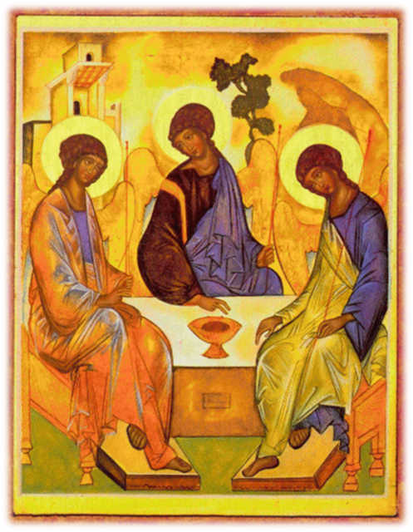
Image in public domain
Notes:
(Notes: Ask the students to reflect on Rublev’s Trinity Icon. Encourage discussion by asking the students some or all of the following questions:
• What do you see?
• What’s going on in this picture?
• What do you see that makes you say that?
• How would you feel if you were in this work of art?
• What is the symbolism?
Make a final comment that the icon is full of symbolism to draw the viewer deeper into the mystery of the Trinity.
This discussion is possibly an opportunity for YawnBuster Point of View.
For more information on Rublev’s Trinity Icon, go to www.wellsprings.org.uk/rublevs_icon/rublev.htm.)

Slide 3
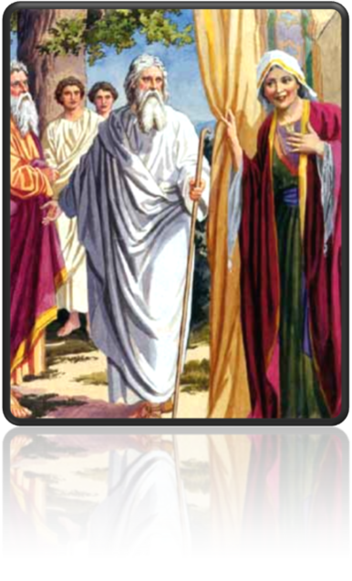
Introduction to the Trinity
What is monotheism?
the belief in and worship of only one God
began with the Covenant between God and Abraham
grew through Abraham, Sarah, and their descendants
Image in public domain

Slide 4
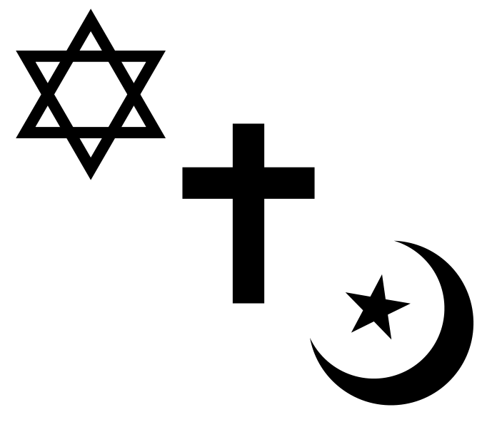
Introduction to the Trinity
We share our belief in this one God—and our commitment to monotheism—with Judaism and Islam.
Image in public domain

Slide 5
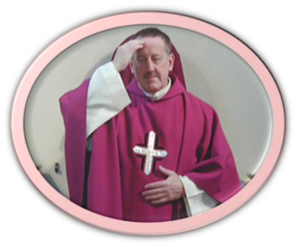
Introduction to the Trinity
Catholic Christians pray “in the name of the Father, and of the Son, and of the Holy Spirit.” This may lead some to think that Catholics worship three gods, not one.
Catholics have always affirmed the truth that God is one.
“I believe in one God” (Nicene Creed).
Notes:
(Notes: Ask the students the following questions:
• Where do you hear the Nicene Creed?
• How often is it recited?
• Why is it recited at every Sunday Mass?
Point out that the Creed summarizes the importance of the Trinitarian mystery of faith.)

Slide 6
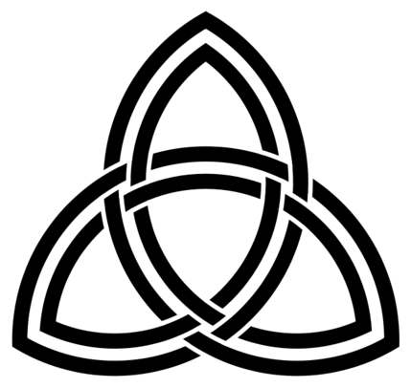
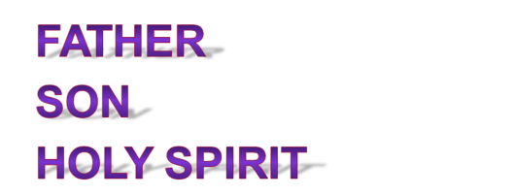
Introduction to the Trinity
What is the Trinity?
comes from the Latin trinus, meaning “threefold”
refers to the central mystery of the Christian faith
mystery—God exists as a communion of three distinct and interrelated Divine Persons:

Slide 7
Introduction to the Trinity
The Holy Trinity is a unique and defining trait of Christian faith.
The Catechism of the Catholic Church states that the Trinity is the Church’s “most fundamental and essential teaching” (234) and the central mystery of our faith, which only God can fully reveal to us.
Notes:
(Note: Invite the students to explore this concept of mystery. Solicit answers about what a mystery is.)

Slide 8
Introduction to the Trinity
What is a mystery?
A mystery is something that is beyond human understanding.
In theological terms, a mystery is a specific doctrine (teaching) revealed by God that is beyond full human understanding.

Slide 9
Introduction to the Trinity
What do the mysteries of our faith require?
Trust and faith
Trust: confidence in someone or something
Faith: belief in and loyalty to God
Notes:
(Notes: You may want to explore these two concepts, trust and faith, through a brief discussion. Ask the students to explore these questions through class discussion or in their journals:
• How is trust developed?
• In whom or in what do you have trust?
• In whom or in what do you not have trust? Why?)

Slide 10
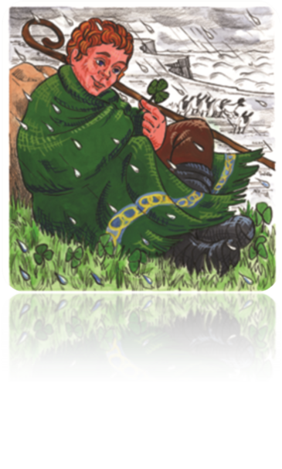
Introduction to the Trinity
Many images and analogies throughout our Church’s history have tried to bring clarity to this mystery of faith.
According to legend, Saint Patrick used the shamrock to explain the Trinity. How does the shamrock represent the Trinity?
© 2009 Saint Mary’s Press/Illustration by Vicki Shuck

Slide 11
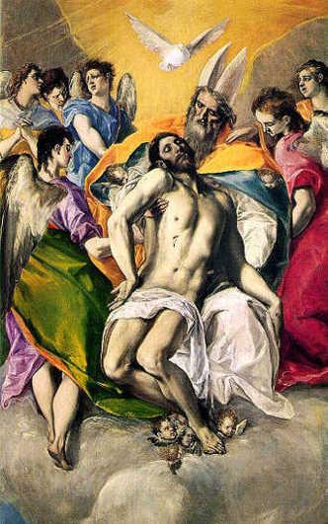
Introduction to the Trinity
Many images and analogies throughout our Church’s history have tried to bring clarity to this mystery of faith.
Artists throughout time have attempted to explain the mystery of the Trinity. How does this painting by the artist El Greco explain the Trinity?
© image in public domain

Slide 12
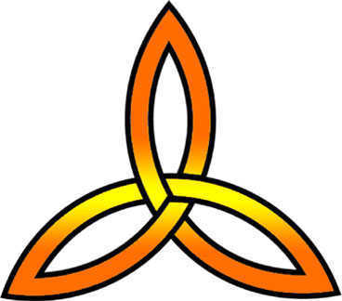
Introduction to the Trinity
Many images and analogies throughout our Church’s history have tried to bring clarity to this mystery of faith.
How can you explain the Trinity with three intersecting circles?

Slide 13
Introduction to the Trinity
The concept of the Holy Trinity is also expressed in the Scriptures.
“Go, therefore, and make disciples of all nations, baptizing them in the name of the Father, and of the Son, and of the Holy Spirit” (Matthew 28:19).
“The grace of the Lord Jesus Christ and the love of God and the fellowship of the holy Spirit be with all of you” (2 Corinthians 13:13).

Slide 14
Introduction to the Trinity
The doctrine of the Trinity is part of Sacred Tradition. The doctrine was clarified and taught by several of the early Church councils.
First Council of Nicaea (AD 325)—adopted the original Nicene Creed to explain that Jesus is truly God
First Council of Constantinople (AD 381)—revised the Nicene Creed to assert the Holy Spirit’s divinity and place in the Trinity. This Creed is the one we know today.
Council of Ephesus (AD 431)—reaffirmed the Nicene Creed’s teaching that Jesus Christ is both human and divine in one nature
Council of Chalcedon (AD 451)—reasserted the full divinity and full humanity of Jesus, the Second Person of the Trinity

Slide 15
Introduction to the Trinity
The doctrine of the Trinity
distinguishes Christianity from other monotheistic religions
unifies mainstream Christians

Slide 16
Introduction to the Trinity
With every prayer we pray and every sacrament we celebrate, we act in the name of this Triune God—Father, Son, and Holy Spirit.

Slide 17
Image in public domain
Notes:
(Notes: Encourage the students to reconsider this image of the Trinity from the beginning of the presentation. How has their understanding of the mystery of the Trinity grown through this presentation? Invite them to reflect on this question in their journals, or conduct a class discussion. Sharing their reflections may be a nice way for them to exit the class, or it may serve as an opportunity for a closing prayer.)

