Slide 1
Commitment to the First Commandment
Christian Morality
Document # TX001835

Slide 2
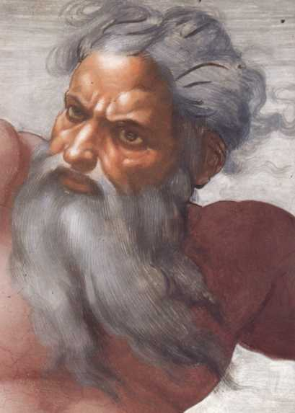
Why do we consider the First Commandment the starting point of our moral life?
The First Commandment calls us to put our faith in God alone. When we do this, we commit to following God’s moral law, our true path to love and happiness.
Image in public domain

Slide 3
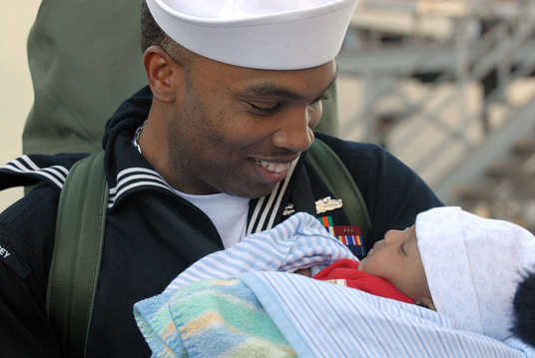
Why do all the other commandments depend on the First Commandment?
The First Commandment calls us to love God with our whole heart, soul, mind, and strength. Because of our love for God, we will reverence and honor him—which are at the heart of the Second and Third Commandments. We will also love and respect those he made in his image—our neighbors and ourselves—which forms the heart of the Fourth through the Tenth Commandments.
Image in public domain

Slide 4
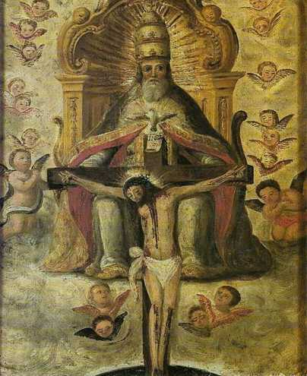
“The theological virtues . . . have God for their origin, their motive, and their object—God known by faith, God hoped in and loved for his own sake.”
—Catechism of the Catholic Church, 1840
Image in public domain

Slide 5
How does commitment to the First Commandment strengthen our practice of the theological virtues?
Commitment to the First Commandment encourages the practice of faith, putting our trust in an unchanging source of life and goodness—in God, who is faithful to his promises.
Commitment to the First Commandment encourages the practice of hope. Hope is expecting God’s blessings in this life and the reward of Heaven in the next.
Commitment to the First Commandment leads to love: of God, others, and self.
Image in public domain

Slide 6
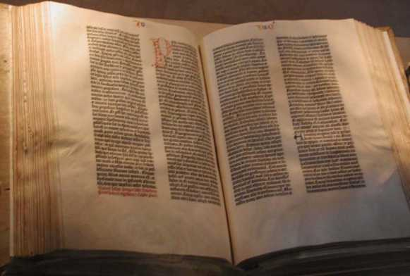
How does failure to keep our commitment to the First Commandment lead to sin?
Image in public domain
Putting our faith in God means accepting the truths of faith revealed through the Scriptures and Tradition and taught through the Church’s Magisterium. Thus, failing to put our faith in God can lead to heresy or apostasy—rejection of Christian faith.

Slide 7
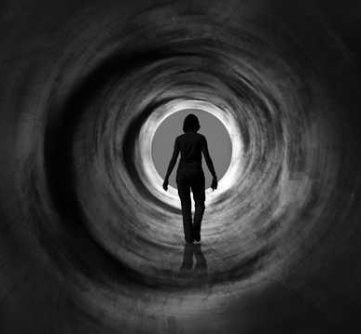
How does failure to keep our commitment to the First Commandment lead to sin?
Failing to trust in God may lead to despair: ceasing to believe that God cares.
Failing to love God may lead to ingratitude, indifference, hatred, or pride.
Shutterstock/mangojuicy

Slide 8
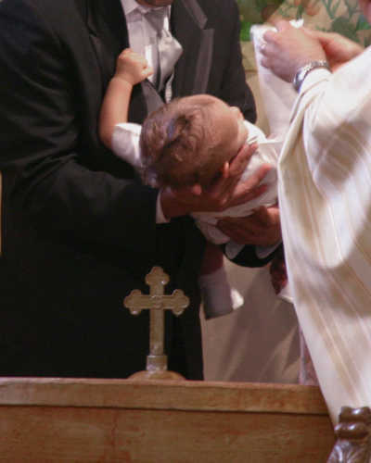
How do we nurture a relationship with God and strengthen faith, hope, and love?
We strengthen our relationship with God primarily through the Sacraments, and also through adoration, prayer, sacrifice, and keeping our promises and vows.
Shutterstock/J. McPhail

Slide 9
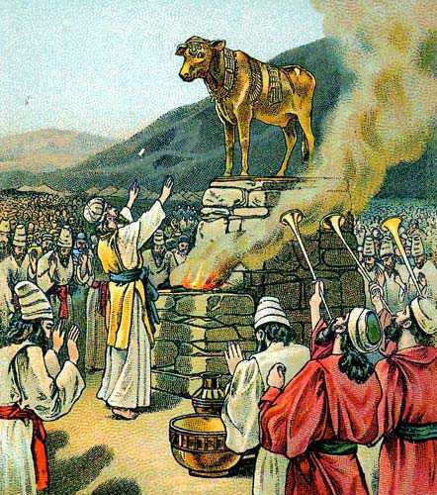
What was the Hebrew understanding of idolatry?
In its original context, the First Commandment was understood to forbid the literal worship of gods and goddesses other than Yahweh.
For the Israelites idolatry was a real and concrete thing. Archaeologists have found many statues of pagan gods and goddesses in the ruins of ancient Israel.
Image in public domain

Slide 10
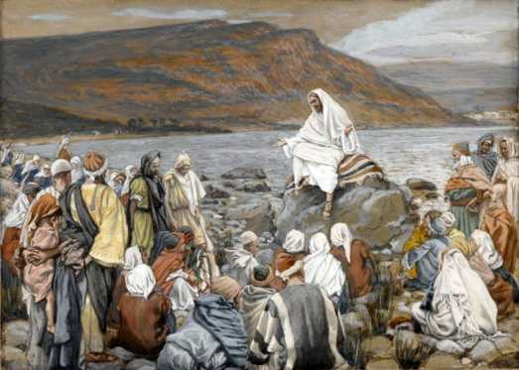
How did Jesus broaden the Hebrew understanding of idolatry?
Jesus expanded the understanding of idolatry with teachings such as “You cannot serve God and mammon” (Matthew 6:24). Mammon means wealth or power.
Today we understand idolatry to mean not allowing anything to take the place of God in our lives.
Image in public domain

Slide 11
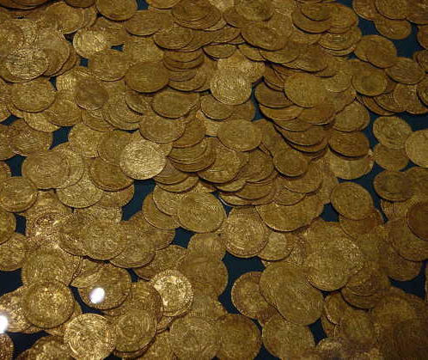
What are modern examples of idolatry?
Idolatry is turning toward something that is not God for our happiness and fulfillment. Modern examples could be the pursuit of money, success, fame, entertainment, or sex.
Image in public domain
Notes:
The quotation on slide 4 is from the English translation of the Catechism of the Catholic Church for use in the United States of America, second edition, number 1840. Copyright © 1994 by the United States Catholic Conference, Inc.—Libreria Editrice Vaticana (LEV). English translation of the Catechism of the Catholic Church: Modifications from the Editio Typica copyright © 1997 by the United States Catholic Conference, Inc.—LEV.
The scriptural quotation on slide 10 is from the New American Bible with Revised New Testament and Revised Psalms. Copyright © 1991, 1986, and 1970 by the Confraternity of Christian Doctrine, Washington, D.C. Used by the permission of the copyright owner. All Rights Reserved. No part of the New American Bible may be reproduced in any form without permission in writing from the copyright owner.

