Slide 1
Water Symbols
The Sacraments
Document #: TX002104
Notes:
Notes: Explain to the class that they will now see numerous images of water, primarily in nature. Have the students take out a piece of paper and a pen. As they look at each image, have them think about the quality of water represented in the image, and write a brief description of what they see. After each slide, have the students share what they wrote. Make a note of some of the more insightful observations, and review several of these with the students.

Slide 2
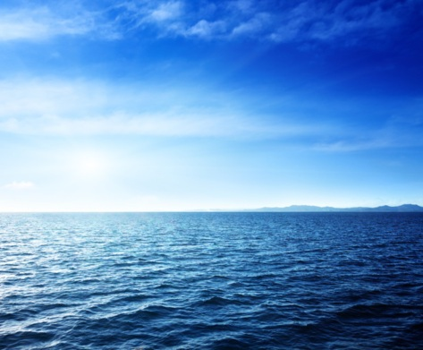
Water as a Source of Life
© Iakov Kalinin/shutterstock.com

Slide 3
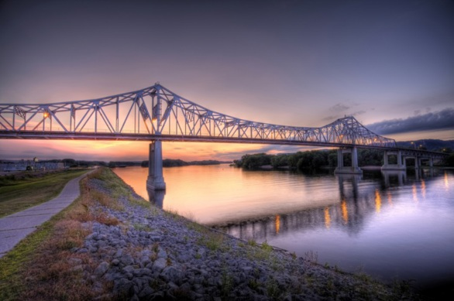
© Andrew Jalbert/shutterstock.com

Slide 4
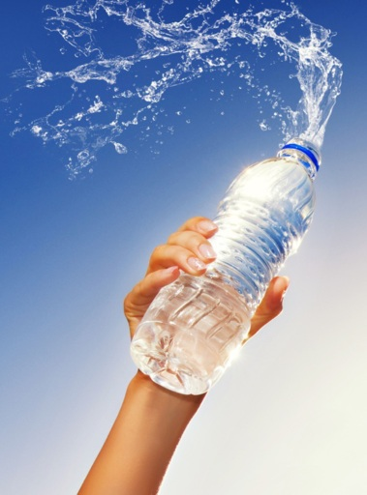
© Nejron Photo/shutterstock.com

Slide 5
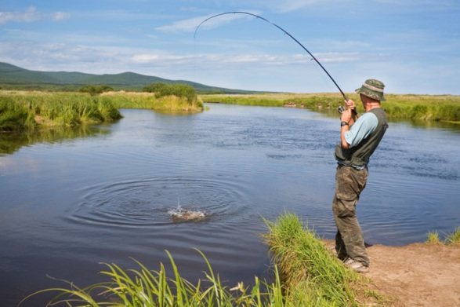
© Stanislav Komogorov/shutterstock.com

Slide 6
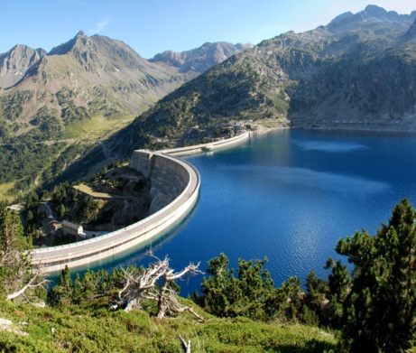
© kor/shutterstock.com

Slide 7
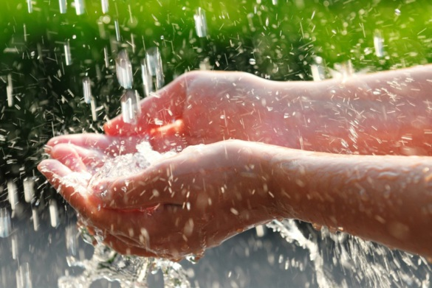
© Elena Elisseeva/shutterstock.com

Slide 8
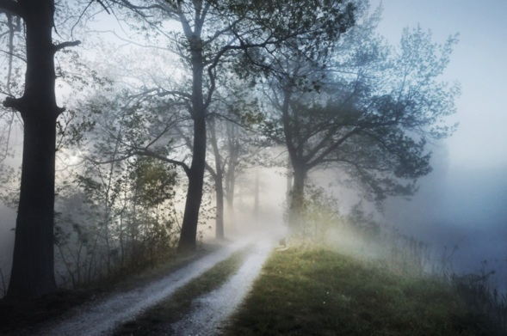
© conrado/shutterstock.com

Slide 9
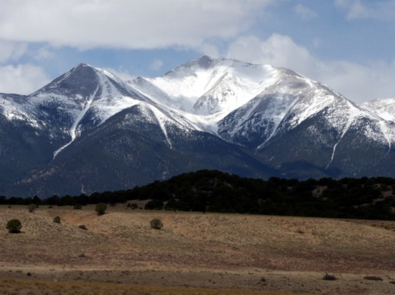
© John S. Sfondilias/shutterstock.com

Slide 10
Water as a Source of Cleansing
© CandyBox Images /shutterstock.com

Slide 11
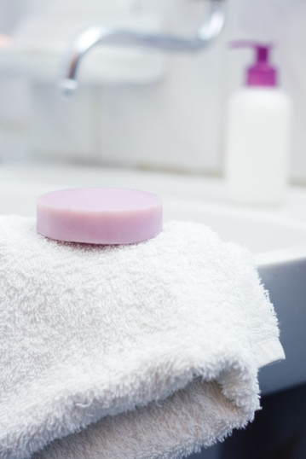
© Ardelean Andreea/shutterstock.com

Slide 12
© Stocksnapper/shutterstock.com

Slide 13
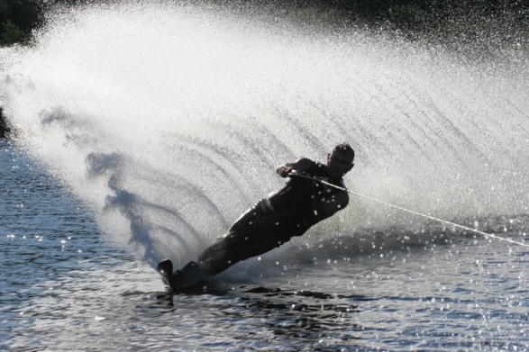
Water as Recreation
© Trevor Allen/shutterstock.com

Slide 14
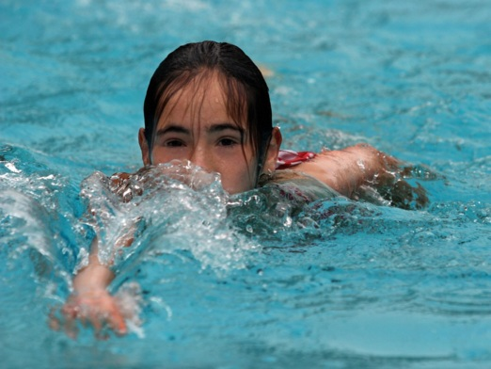
© Galina Barskaya/shutterstock.com

Slide 15
© Maridav/shutterstock.com

Slide 16
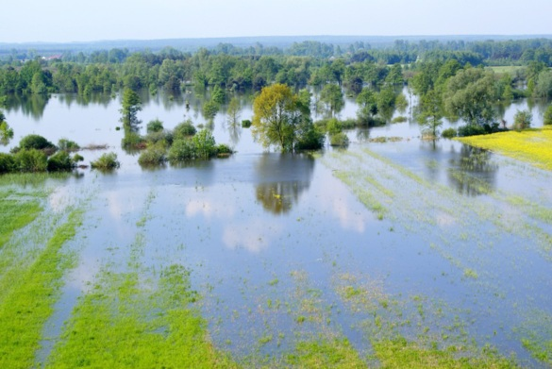
Water as a Source of Death
© Elzbieta Sekowska/shutterstock.com

Slide 17
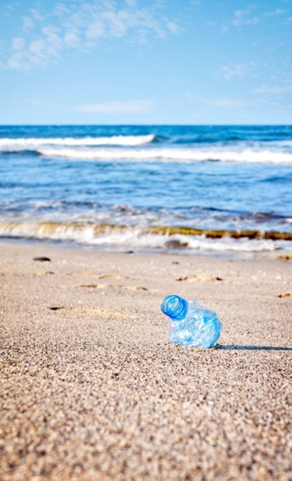
© infografick/shutterstock.com

Slide 18
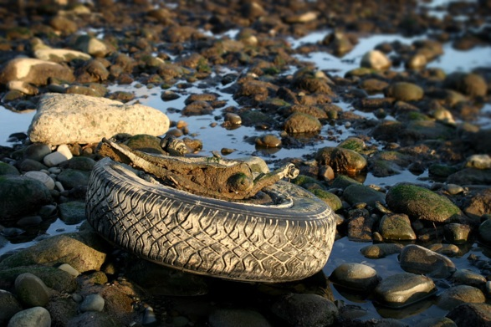
© Henrik Lehnerer/shutterstock.com

Slide 19
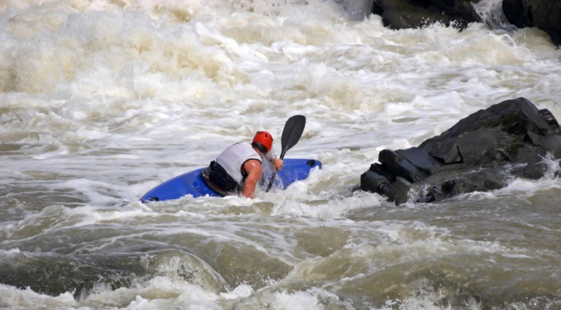
© 2265524729/shutterstock.com

Slide 20
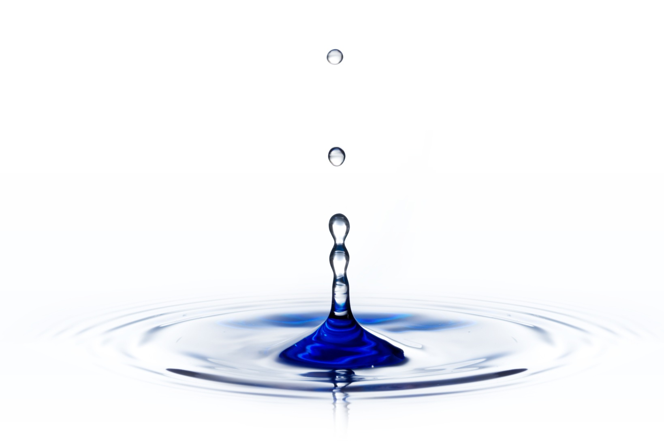
Water Is:
A source of life (life originated in water; 55–60 percent of the human body is water)
A source for cleansing
A source of recreation
A source of death (80 percent of childhood diseases come from contaminated water)
© Filipe B. Varela/shutterstock.com
Notes:
Notes: After this last image, offer the following information, using these or similar words:
@ The images we have observed help us to understand the power of water as a symbol. Water is a source of life—and, in fact, it is an endangered source of life. Today less than half of the world’s population has access to clean and safe drinking water. We use water for drinking, watering crops, cooking, and even for playing. Water is also an important source of cleansing. We bathe in water, wash clothes and dishes with water, even process sewage with water. Water is also destructive and can even cause death. We are aware of dangerous floods, of people drowning in pools and rivers, of tsunamis, of water surges that accompany hurricanes, and even of the danger of polluted water. Eighty percent of all childhood diseases in the world are caused by contaminated water. Water is, indeed, a powerful symbol of both life and death. Water as a source of life and death is a powerful symbol in Sacred Scripture as well, and some of the most important of these accounts are an integral part of the Baptism ritual.
@ We will now listen to four short Scripture passages: two from Genesis, one from Exodus, and one from the Gospel of Mark. These show the importance of water in the history of our salvation.

Slide 21
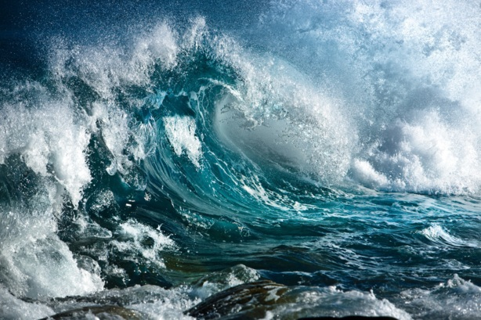
Genesis 1:1–2
The Holy Spirit and the Waters of Creation
© irabel8/shutterstock.com
Notes:
Notes: Ask a student to read the Scripture passage.

Slide 22
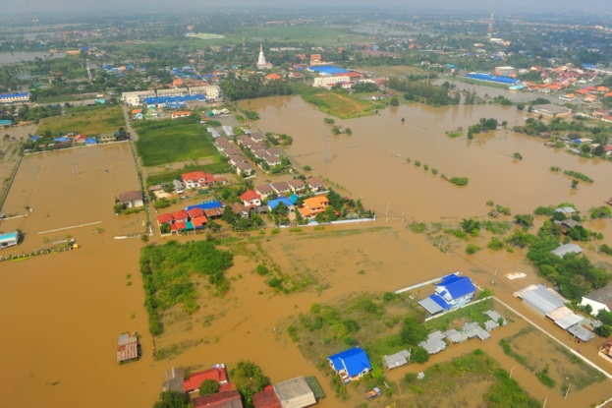
Genesis 7:6
The Great Flood
© think4photop/shutterstock.com
Notes:
Notes: Ask a student to read the Scripture passage. If you wish, you may have her or him read the entire selection, Genesis 7:1–10.

Slide 23
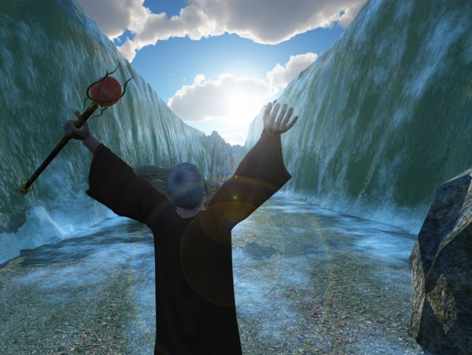
Exodus 14:22
Moses Parts the Red Sea
© Mike Heywood/shutterstock.com
Notes:
Notes: Ask a student to read the Scripture passage. If you wish, you may have him or her read the entire selection, Exodus 14:21–31.

Slide 24
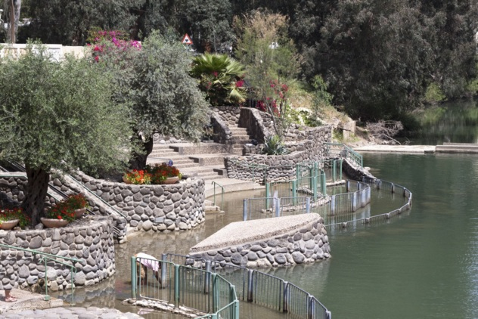
Mark 1:9–10
Jesus Is Baptized
© David Orcea/shutterstock.com
Notes:
Notes: Ask a student to read the Scripture passage.

