Slide 1
The Ministries at Mass
The Sacraments
Document #: TX002150

Slide 2
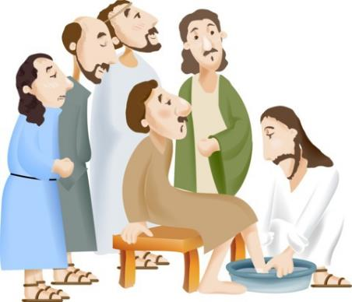
The word ministry means “service.”
Ministries are all of the official roles that people play in the celebration of the Eucharist.
© Vibe Images /shutterstock.com
Notes:
Notes: When we talk about ministries in the Church, we are talking about all of the various vocations through which we may be called to serve God’s people in the Church. There are various roles of service to be carried out by both ordained and lay ministers in the celebration of the Eucharist. HOWEVER, the greatest minister of all, the greatest “servant of all,” as he described himself (see Luke 22:27), is Jesus Christ.

Slide 3
The People of God participate in God’s work through the liturgy.
Notes:
Notes: In every Eucharist, we are united with the entire Church. The liturgy is God’s work, in which the whole People of God participate. Every liturgy affects the entire Church, as well as the individual members of the Church.
Alternate Image Option: assembly at Mass

Slide 4
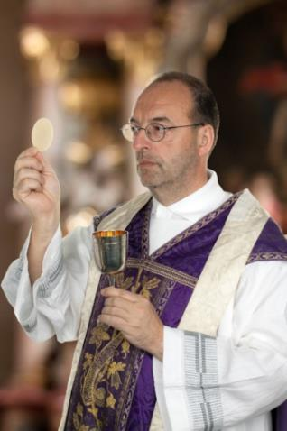
Roles are determined by vocations, offices, ministries, and participation.
© Ferenc Szelepcsenyi /Shutterstock
Notes:
Notes: In the liturgy, every member of the Church has a role, in accordance with that member’s particular vocation, office, ministry, or participation in the Eucharist. Each person is called to carry out his or her role without taking on the role of another person. That is not to say that ministries cannot change over time, but they do not change during one liturgical celebration.

Slide 5
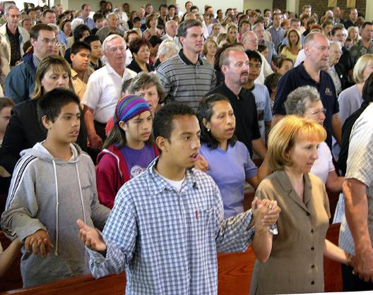
The assembly that gathers for the celebration of the Eucharist assembles the Body of Christ in the world.
© Bill Wittman / www.wpwittman.com
Notes:
Notes: The assembly already symbolizes and makes real the presence of Christ. All who celebrate the Eucharist, including ministers who will preside over the Eucharistic assembly, are first members of this body, called into being by Christ through the Holy Spirit.
Alternate Image Option: people assembled at Mass, around altar, or bird’s-eye view of entire church

Slide 6
Every Eucharist is a celebration of a local church gathered around its bishop.
Notes:
Notes: In every celebration of the Eucharist, we are particularly united with the Pope, who is a sign of unity, and with the bishop of our diocese. We name the bishop because he is responsible for the celebration of the Eucharist in our diocese, and he is present in spirit.
Alternate Image Option: local bishop celebrating the Eucharist

Slide 7
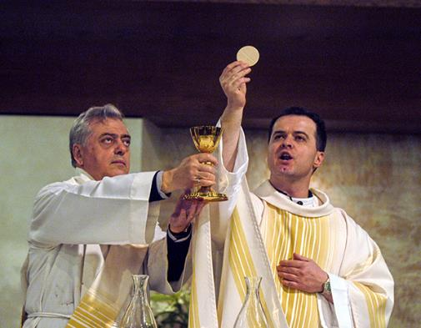
The priest stands in the place of Christ.
© Bill Wittman / www.wpwittman.com
Notes:
Notes: In every Eucharist the priest stands in the place of Christ over the people and presides in their prayer, proclaims the Word of God to them, includes them as he offers gifts of bread and wine in their name to the Father, and gives them the Bread of Life and the Cup of Salvation.

Slide 8
The deacon serves by proclaiming the Gospel, preaching the homily, and distributing Holy Communion.
© Bill Wittman / www.wpwittman.com
Notes:
Notes: In many celebrations of the Eucharist, an ordained deacon will proclaim the Gospel, preach the homily, assist in the distribution of Holy Communion, offer the Sign of Peace, and dismiss the assembly.

Slide 9
The assembly as a whole has a role in the liturgy.
© Bill Wittman / www.wpwittman.com
Notes:
Notes: Together with the priest, we offer Christ to the Father, and through Christ, we offer ourselves. As children of the Father, we are to make every effort to be a sign of unity to one another as brothers and sisters, and should not allow any individual preference, however devout, to detract from this unity. Whatever we do in the liturgy, we do as one body, whether that be listening to the Word of God, joining in the prayers, singing, or receiving Holy Communion. There is a beauty in the unity of liturgical gestures and postures (standing, sitting, or kneeling), which is a sign of the beautiful unity of the Body of Christ.
Alternate Image Option: the assembly, preferably at the Sign of Peace, greeting one another

Slide 10
There are a variety of lay liturgical ministries in the Church.
© antoshkaforever /shutterstock.com
Notes:
Notes: Other important ministries at Mass are a variety of lay liturgical ministries. The need of each of these ministries is determined by the particular celebration.
Alternate Image Option: a group of lay ministers praying before Mass

Slide 11
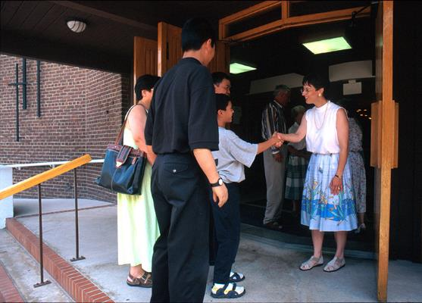
Hospitality Ministers (Greeters)
© Bill Wittman / www.wpwittman.com
Notes:
Notes: There are greeters or hospitality members who welcome the assembly as it gathers.
Alternate Image Option: hospitality ministers greeting people before Mass, handing out songbooks, etc.

Slide 12
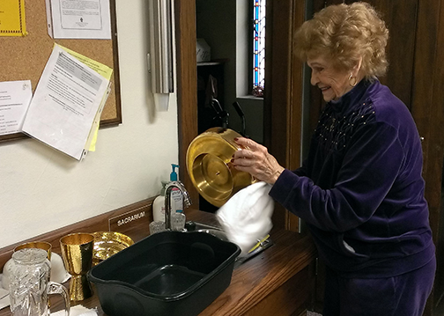
Sacristan
Notes:
Notes: There is a sacristan who arranges all of the liturgical books, vestments, chalices, and other elements for the celebration.
Alternate Image Option: sacristan lighting candles or placing the Roman Missal on the altar

Slide 13
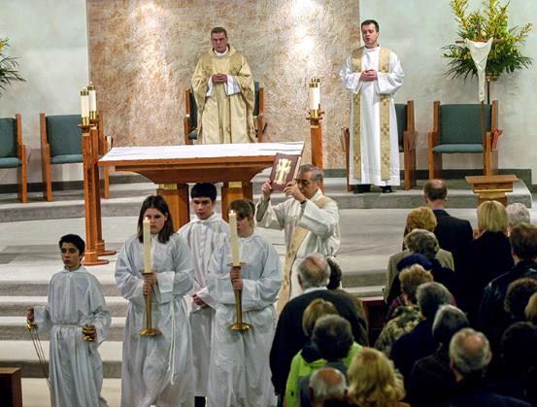
Altar Servers
© Bill Wittman / www.wpwittman.com
Notes:
Notes: There are altar servers who help the priest and deacon during the Mass. Being an altar server is a privilege. Although most altar servers are young, many older people serve in this role as well. Altar servers must always be alert to the needs of the priest and deacon at the altar, and must assist in the liturgy in a dignified way.
Alternate Image Option: altar servers in procession or serving at the altar

Slide 14
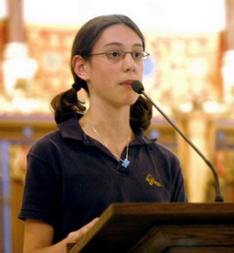
Lector
© Bill Wittman / www.wpwittman.com
Notes:
Notes: There are lectors who train and prepare to read the Word of God. The role of lector, or reader, is another ministry that can be fulfilled by laypeople. Being a lector requires preparation, meaning that the lector must first understand the Scripture passage he or she is assigned. Lectors are encouraged to practice their reading several times aloud at home, and even a few times in church, before reading it to the assembly. In public reading, it is easy to stumble over words we know quite well, much less unfamiliar words that we have never before tried to pronounce. Lectoring requires practice and best efforts before the Mass.

Slide 15
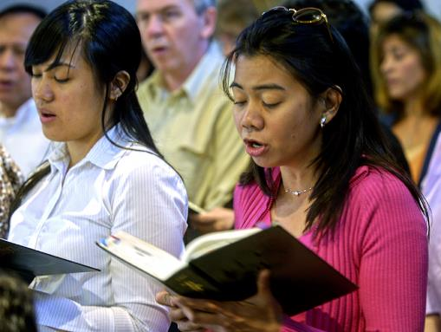
Choir
(Schola Cantorun)
© Bill Wittman / www.wpwittman.com
Notes:
Notes: There are singers or choir (schola cantorum) who augment the Word of God with song. (Quote St. Augustine, who said, “He who sings prays twice.”) Musicians are vital to the celebration.

Slide 16
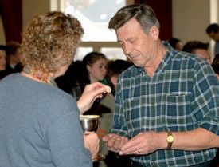
Eucharistic Ministers
© Bill Wittman / www.wpwittman.com
Notes:
Notes: There are Eucharistic Ministers that help the priest and deacon distribute the Body and Blood of Christ during Communion. They are also privileged to take Holy Communion to those who are sick or homebound and unable to participate in the Mass. This ministry is an ancient one in the Church, requiring preparation and prayerful dedication.

Slide 17
Ushers
© lisafx/ iStock.com
Notes:
Notes: There are ushers who seat people in the assembly and who collect the offerings.

Slide 18
All ministers are important to the liturgical celebration.
© Palto /shutterstock.com
Notes:
Notes: Some of these people are more visible than others, but all are important to the liturgical celebration. First, they are members of the assembly, and second, they fulfill a role as ministers.
Alternate Image Option: a bird’s-eye view of sanctuary, with ministers visible

Slide 19
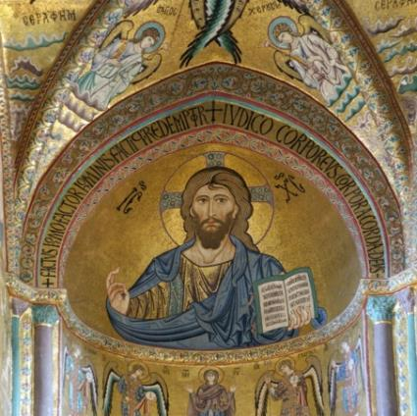
Christ is our High Priest
Image from Shutterstock
© VLADJ55 /shutterstock.com
Notes:
Notes: All celebrate the Eucharist as members of the assembly or as liturgical ministers, but it is essential to remember that Christ is our High Priest who celebrates in and through all of us, offering himself to the Father for our salvation. Because he lived and died among us, as both God and man, he understands our frailties and our gifts. Therefore, he is able to make a perfect and perpetual offering to the Father through the Holy Spirit on our behalf.
Alternate Image Option: icon or fine art of Risen Christ, or Christ at the Last Supper

Slide 20
Have you served as a lay liturgical minister?
Notes:
Notes: Ask whether any of the students have served as a minister, and how. Afterward, briefly discuss the value of an assembly who consciously and intentionally celebrates the Eucharist together. Because they truly experience the Paschal Mystery, the transformation of death to life, they will undoubtedly become agents of transformation in society.
Alternate Image Option: teens, both male and female, serving as liturgical ministers (readers, altar servers, greeters, ushers, singers, or musicians)

