Slide 1
The Lenten Scrutinies
Christian Morality
Document #: TX001822

Slide 2
During Lent all Christians are called to strengthen their resolve to turn away from sin and to embrace God’s grace.
Image in public domain

Slide 3
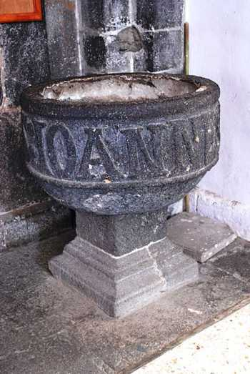
During Lent adults who are seeking to become Catholics enter into a period called “purification and enlightenment.” These adults are called the “elect.”
These elect are preparing to receive the Sacraments of Baptism, the Eucharist, and Confirmation at the Easter Vigil liturgy.
Image in public domain

Slide 4
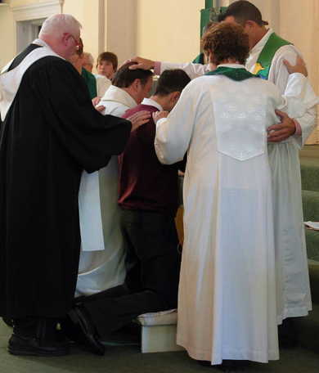
On the third, fourth, and fifth Sundays of Lent, the elect celebrate the scrutinies. These are prayerful rites that occur during Mass in which the elect examine the hold sin has on their lives and seek the healing grace that restores their relationship with God.
Image in public domain

Slide 5
A scrutiny is defined as a searching study, an inquiry, and an examination.
The scrutinies “are meant to uncover, then heal, all that is weak . . . or sinful in the hearts of the elect” (RCIA, 141).
Image in public domain

Slide 6
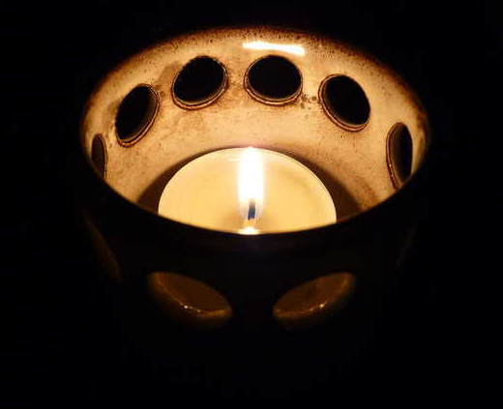
Image in public domain
Lent “is intended as well to enlighten the minds and hearts of the elect with a deeper knowledge of Christ the Savior” (RCIA, 139).

Slide 7
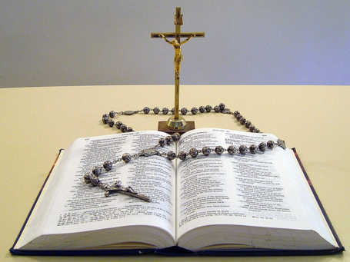
Image in public domain
Carefully chosen passages from the Gospel of John are read on the Lenten Sundays for the rite of scrutiny. These Gospel passages invite us to identify what binds us to sin, blinds us to truth, and takes away our freedom to live in perfect relationship with God.

Slide 8
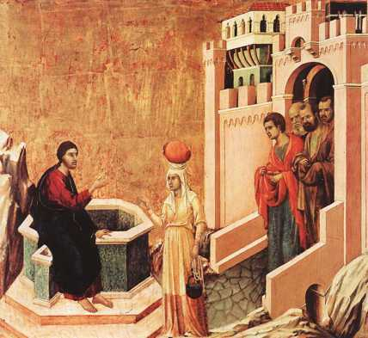
The Gospel for the first scrutiny is John 4:4–42, the Samaritan woman at the well.
Jesus touches the heart of the sinful woman, and she receives his living water. Through her testimony others are drawn to seek out Jesus, the Lord.
Image in public domain

Slide 9
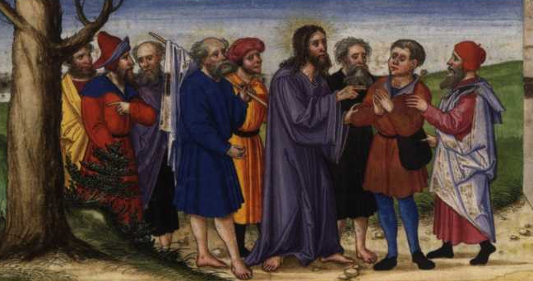
The Gospel for the second scrutiny is John 9:1–41, Jesus and the man born blind.
Jesus leads the man born blind to the Kingdom of light. Others remain blind to the false values surrounding them.
Image in public domain

Slide 10
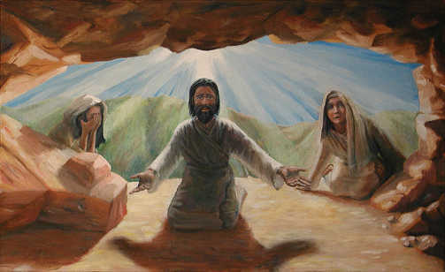
The Gospel for the third scrutiny is John 11:1–44, Jesus raises Lazarus from the dead.
Jesus is sent to save us from death and sin and to lead us to a new life lived in full communion with the Holy Trinity. Freed from the power of evil, we bear witness to new life in the Risen Christ.
Image in public domain
Notes:
The quotations labeled RCIA are from the English translation of the Rite of Christian Initiation of Adults ©1985 International Commission on English in the Liturgy (ICEL), numbers 141 and 139, in The Rites of the Catholic Church, volume one, prepared by the ICEL, a Joint Commission of Catholic Bishops’ Conferences (Collegeville, MN: Liturgical Press, 1990). Copyright © 1990 by the Order of St. Benedict, Collegeville, MN.

