Slide 1
The Last Things
The Catholic Faith Handbook for Youth, Third Edition
Chapter 15
Document #: TX003146
Notes:
Use this presentation to introduce or review the key points in chapter 15 of the student handbook.

Slide 2
Fearful of Death
We spend money to hold off the moment of death.
How do people use consumer goods or medical treatments to maintain the illusion of youth?
What are other signs that people fear death?
Copyright: Elnur / www.shutterstock.com
Notes:
As you discuss this topic, be sensitive to the likelihood that some students have dealt with end-of-life issues in their families.

Slide 3
Fascinated by Death
Many people seem attracted to violent death portrayed in the media.
Why do you think movies, TV shows, and video games have become more violent?
Do you think that violence in the media causes us to be more or less afraid of death?
Copyright: MCarper / www.shutterstock.com

Slide 4
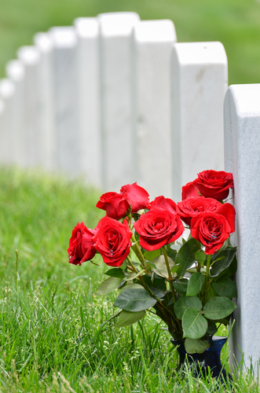
The Reality of Death
Our culture tends to “protect” us from direct contact with death.
What are some examples?
Do you think we would regard death differently if we had grown up with closer contact to those who are dying?
Copyright: Orhan Cam / www.shutterstock.com
Notes:
Point out that in many cultures around the world, family members care for those who are aged or ill at home. They also prepare the body of deceased relatives for burial or cremation at home.

Slide 5
Our faith helps us to understand that death is not a final ending but a new and glorious beginning.
Copyright: idiz / www.shutterstock.com
Notes:
Ask a student to read aloud, or direct the students to read silently, the description of Heaven on pages 162–164 of the student handbook. Point out that Heaven is about restoring our joyful relationship with God; it is about the joy of perfect love.

Slide 6
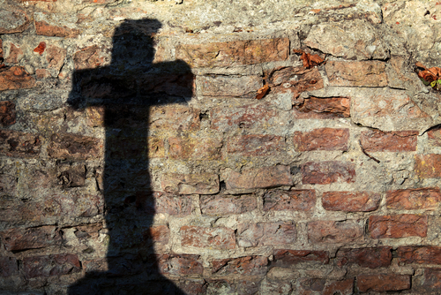
How to Inherit Everlasting Life
Believe in God’s only Son.
Obey Jesus.
Hear Jesus and believe his Father.
Eat Jesus’ Body and drink his Blood.
Do not be attached to things in this life.
Copyright: Vilius / www.shutterstock.com
Notes:
Explain that these statements summarize some of the teachings about eternal life found in the Gospel of John.

Slide 7
Final Judgment
The day that the dead will be raised
Signaled by Christ’s second coming, or Parousia
Our souls will be reunited with new bodies that will never know illness or death.
Copyright: leigh / www.shutterstock.com
Notes:
Explain that Christ will come again, and the Kingdom of God will be fully established for all eternity.

Slide 8
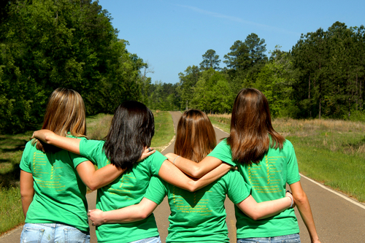
The Communion of Saints
All believers, living and dead, are part of the Church.
Copyright: Bonita R. Cheshier / www.shutterstock.com
We continue to pray for those who have died and are being purified.
We hope and pray that all people will be saved and that we will all be joined together in Heaven.

