Slide 1
Introduction to the Book of Genesis
Document #: TX004704

Slide 2
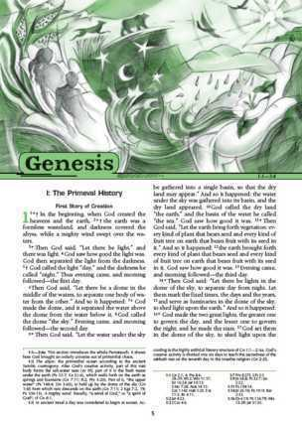
Overview of Genesis
Genesis is not intended to be read as a detailed, chronological account of history.
Genesis is an account steeped in truth and meaning.
© Saint Mary’s Press, artwork by Vicki Shuck
Notes:
Notes: Begin by asking the students what they know about the Book of Genesis. Invite them to also identify stories from Genesis with which they are familiar. You may wish to reiterate the students’ understanding of a contextualist approach to Scripture rather than a fundamentalist approach.

Slide 3
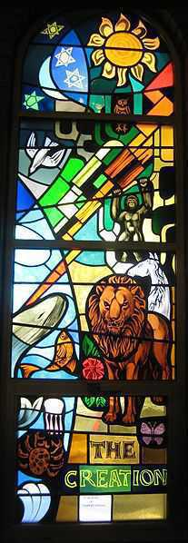
Overview of Genesis
Genesis, along with the other four books of the Pentateuch,
illustrate God as the source of all creation
explain the role of humans in the origin of sin and its many devastating effects
show God’s desire to be in communion with people
emphasizes the lasting effect of the Covenant God formed with Abraham
Public Domain

Slide 4
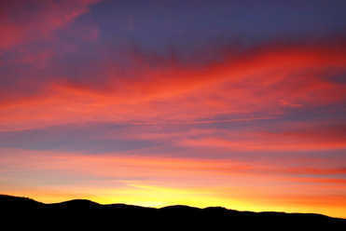
Creation
The glory of God lies within each of his creations.
Sometimes God’s glory is visible and at other times it is invisible.
All creation bears the mark of God.
All creation is the good work of God. When people disrespect God’s creation, they also disrespect God.
Public Domain
Notes:
Notes: Have a student read aloud Genesis 1:1–2:3 before presenting the points on this slide.

Slide 5
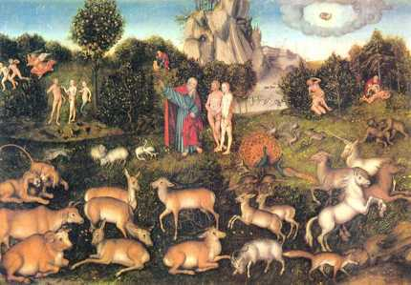
God’s Desire for Humanity
The Creation stories show us that God wanted us to be close to him and live in paradise, but did not want to force our choice.
The Creation stories teach us that free will is essential to being human.
Public Domain

Slide 6
The Fall of Humanity
Adam and Eve’s disobedience to God’s one rule disrespected their Creator and showed a desire to be equal to him.
Sin is any deliberate offense, in thought, word, or deed, against the will of God.
We are created to live according to God’s laws. In other words, we are created to be in right relationship with God and others.
© Teri Virbickis / Shutterstock.com
Notes:
Notes: Have a student(s) read aloud Genesis 3:1–24 before presenting the points on this slide.

Slide 7
The Fall of Humanity
The choice to give in to the devil’s temptation and disobey God marks the first sin in salvation history. Adam and Eve’s sin is called Original Sin and is often referred to as “the Fall.”
The term Original Sin has two meanings:
The sin of the first human beings who disobeyed God’s command by choosing to follow their own will, causing them to lose their original holiness and become subject to death
The fallen state of human nature that affects every person born into the world

Slide 8
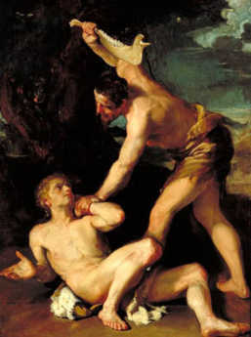
Cain and Abel
What do you know about Cain and Abel?
Public Domain
Notes:
Notes: Ask the students the question, and then have them read Genesis, chapters 4–16. Invite the students to see that the effects of Original Sin continue in the story of Cain and Abel.

Slide 9
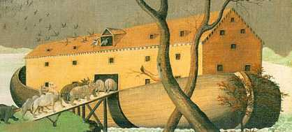
The Flood
What do you know about Noah and the Flood?
Public Domain
Notes:
Ask the students the question, and then make sure to cover the following points:
In the story of Noah and the Flood, human beings fall prey to the sinful and evil ways of the world.
Following the Flood a rainbow appears as a sign of God’s Covenant with Noah and all living beings.
The Covenant with Noah foreshadows God’s Covenant with Abraham.
God chooses Noah to escape the Flood because of his obedience to God’s Law and respect for creation.

Slide 10
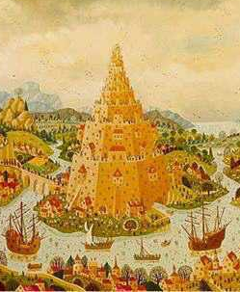
Tower of Babel
What do you know about the Tower of Babel?
Public Domain
Notes:
Notes: Ask the students the question, and then make sure to cover the following points:
In the account of the Tower of Babel, power-hungry people of different nations together attempt to build a tower that will reach the heavens.
Longing to be like God, lured by the hope to be famous, and forgetting about their covenantal relationship with God, the people will not be stopped from building a self-serving tower of greed—except by the hand of God.
God stops the people from building the tower by confusing their speech, making it impossible for them to communicate and effectively carry out their plan.

Slide 11
What do you feel are the most important things to remember from this presentation?
Notes:
Notes: Invite the students to share what they are “taking away” from this presentation. Make a note of the points they share. The next two slides contain key points—make sure they recognize these before moving forward.

Slide 12
Important Teachings
God created the earth and humanity as good.
The history of our interaction with God began with God’s initiative in the Creation.
Disobedience caused Original Sin, leading to humanity’s Fall.
Disrespect for humanity and life is disrespect for God, the Creator, as shown in the story of Cain and Abel.
God respects those who respect his creation and law (rules), as shown in the story of Noah.

Slide 13
Important Teachings (cont’d.)
God desires to be in relationship with humanity, as shown by the stories of Adam and Eve and Noah.
These stories are the opening moments of salvation history and the reason for it.
God did not abandon humanity at the Fall. Instead, salvation history began at this point to help humanity return to a committed relationship with God.
Salvation history records humanity’s relationship with God through a series of promises, or covenants, in which both God and humanity have responsibilities.

