Slide 1
Rain Forest Destruction
Catholic Social Teaching
Document #: TX002032
Notes:
[Music: Introduction music such as “Peace Is Flowing like a River”]

Slide 2
Benefits of Rain Forests
Rain forests are the world’s lungs, removing carbon dioxide and creating oxygen.
Rain forests contain a large percentage of the world’s plant and insect species.
Rain forests can boost pollination.
By Karduelis (tr:Dosya:Çayeli-Sıranlık.jpg (Own work)) [Public domain], via Wikimedia Commons
Rain forests benefit crops.
Preserving rain forests is one of the most effective ways to slow down global climate change.

Slide 3
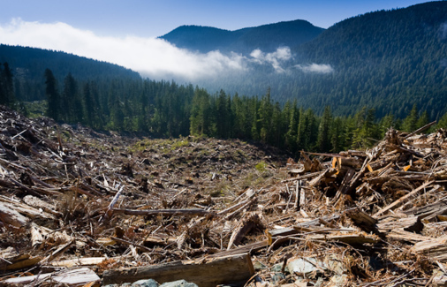
Rain Forest Destruction
Rain forests are cut down by poor farmers looking for tillable land.
Rain forests are cut down to make land for cattle ranches.
Rain forests are destroyed by irresponsible logging.
Rain forests once covered 14 percent of the earth’s land; today they cover 6 percent.
WikiMediaCommons

Slide 4
Rain Forest Preservation
Many groups and organizations are working to preserve the rain forests.
Boycott wood products and beef coming from rain forest destruction.
Encourage development in underdeveloped countries with rain forests.
By Karduelis (tr:Dosya:Çayeli-Sıranlık.jpg (Own work)) [Public domain], via Wikimedia Commons
Support laws protecting rain forests and banning their destruction.
Rain forests must become a global conservation priority.

