Slide 1
Jesus’ Message and Mission
The Catholic Faith Handbook for Youth, Third Edition
Chapter 9
Document #: TX003140
Notes:
Use this presentation to introduce or review the key points in chapter 9 of the student handbook.

Slide 2
Jesus’ Early Life
• Jesus was born without Original Sin, and never sinned during his lifetime.
• The Gospels include little information about Jesus’ childhood and youth.
• Jesus obeyed his parents, studied his religion, and worked at a trade.
• Jesus was born without Original Sin, and never sinned during his lifetime.
Copyright: Anneka / www.shutterstock.com
Notes:
Invite a student to summarize the one existing story about Jesus’ youth, when Mary and Joseph discovered him in the Temple, described on pages 93–94 of the student handbook.

Slide 3
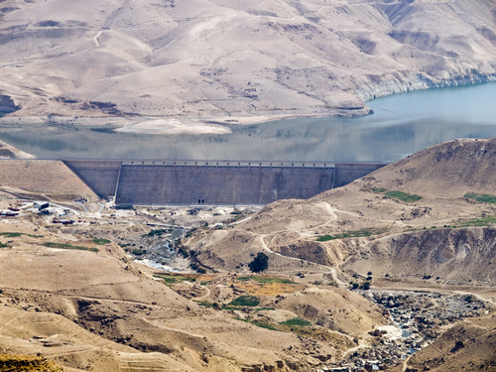
Jesus Begins His Public Ministry
• Jesus’ public life begins with his Baptism by John the Baptist.
• Jesus, who was sinless, identified himself with sinners when he asked John to baptize him.
• He then spent forty days in the desert, preparing for his ministry.
• When Jesus returned from the fasting and praying, he was truly ready to begin his mission.
Copyright: OPIS / www.shutterstock.com
Notes:
Ask if anyone recalls what happened to Jesus in the desert. Help the students to understand that being without sin didn’t mean that Jesus wasn’t tempted to sin.

Slide 4
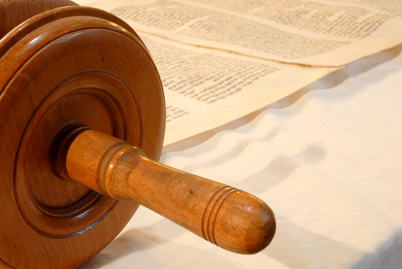
Jesus Teaches about the Kingdom
The term Reign of God reminds us that the Kingdom is not a place.
The Kingdom is real when we try to live out God’s call to love.
It is open to anyone who wants God’s help to be more loving.
Copyright: Carly Rose Hennigan / www.shutterstock.com
Parables are one way Jesus taught about the Kingdom of God.
Notes:
Read aloud the prophecy referred to on page 94 of the student handbook, Luke 4:16–21, when Jesus reads from Isaiah in the synagogue.

Slide 5
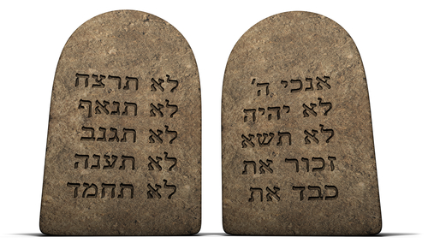
Jesus Affirmed Some Beliefs
Obeying the Law is a way to be part of the Kingdom.
God has called the Jews to life in his Kingdom.
God will send a new king, the Messiah.
Copyright: James Steidl / www.shutterstock.com
Notes:
Explain that these statements reflect the understanding of the Jews at the time of Jesus.

Slide 6
Jesus Challenged Some Beliefs
Jesus taught that God does not reject sinners, if they repent.
He taught that God calls everyone, not only Jews, to his Kingdom.
He taught that the Messiah will rule a Kingdom, but not an earthly one.
Copyright: jocic / www.shutterstock.com
Notes:
Explain that Jesus built on Scripture and religious laws, but makes their true meaning clear to his followers.

Slide 7
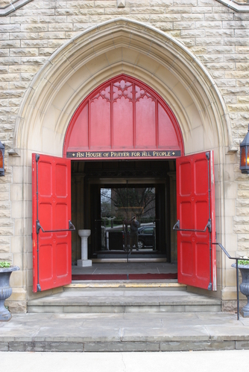
Jesus Lives the Kingdom of God
People who were around Jesus experienced God’s love and power in a profound way.
Jesus welcomed everyone, especially those who were shunned by others.
Jesus forgave sinners.
Copyright: Robert J. Daveant / www.shutterstock.com
Notes:
Point out that Jesus lived out the Kingdom in his actions. Ask the students what it means to say “walk the talk.” Lead a discussion about the students’ experience of people who live this maxim.

Slide 8
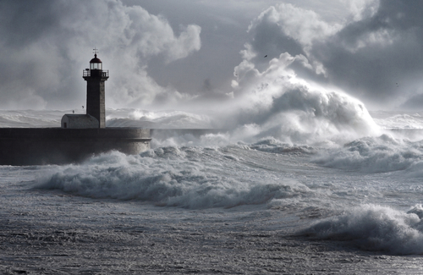
Jesus’ Miracles
Copyright: bruno ismael da silva alves / www.shutterstock.com
Miracles showed Jesus’ power over creation, including demons, and even death.
They showed that Jesus Christ and the Kingdom of God are linked together.
Miracles are signs of God’s power and loving presence.
Notes:
Explain that miracles are also signs of the Kingdom because they show the extent of God’s rule.

Slide 9
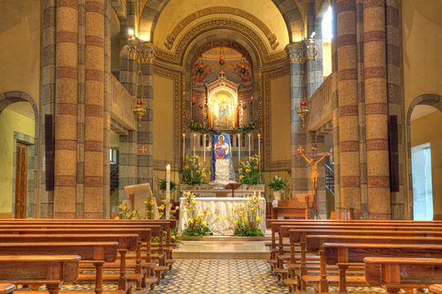
A Community of Faith
Jesus’ disciples worked together to continue his mission.
We need the love and support of other Christians to be true disciples of Jesus Christ.
Copyright: Rostislav Glinsky / www.shutterstock.com
God wants us to take part in proclaiming the Gospel message.
The Church continues to proclaim and make real the Kingdom of God.
The Church strives to be a sign of the Kingdom of God in the world.
Notes:
Call the students’ attention to the statement on page 103 of the student handbook, “The Church can only claim to be made up of sinful but redeemed (saved) people, relying on the power of the Holy Spirit to be a sign of the Reign of God in the world.” Ask the students how they see the Church doing this.

