Slide 1
The French Revolution
Church History, Unit 6

Slide 2
During the Enlightenment, ways of thinking about religion and science evolved. Ideas about government also became revolutionary.
God
Angels
Monarchs
Nobility
Common People
Animals, Minerals, Plants
Long-held beliefs about the “Great Chain of Being” assigned every being and thing to an unchanging rank in a strict religious hierarchy.
These beliefs shifted as philosophers taught about the natural, equal rights of all human beings.
People began to reject the idea that monarchs have a divine right to rule.

Slide 3
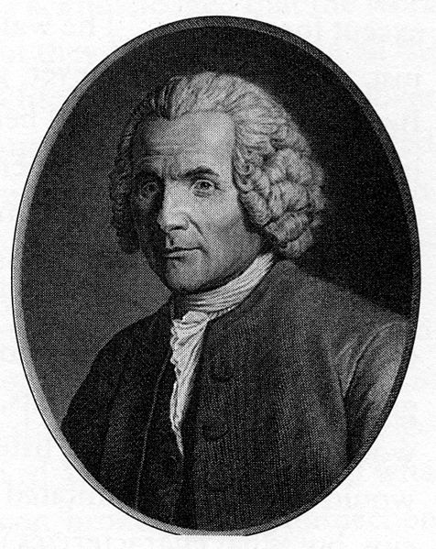
Enlightenment philosophers began to propose new ways of thinking about the role of government.
In the 1660s, the English philosopher John Locke proposed that a legitimate government functions to protect citizens’ individual rights to life, liberty, health, and ownership of property.
Nearly a century after Locke, the French philosopher Jean-Jacques Rousseau wrote that a moral government must be built on the consent of the people governed and should uphold the individual’s political rights.
Image in public domain
Notes:
Image: A portrait engraved for a posthumous edition of Rousseau’s works, after an original by Angelique Briceau.

Slide 4
These new philosophies of government gave rise to the two significant revolutions of the 1700s: the American Revolution and the French Revolution.
In drafting the American Declaration of Independence in 1776, Thomas Jefferson integrated the political philosophies of Locke, Rousseau, and other Enlightenment philosophers to make a legal argument for independence from Great Britain.
In France in 1789, these revolutionary political ideas led to significant changes to the existing order—for all French citizens and for the Church in France.
Image in public domain

Slide 5
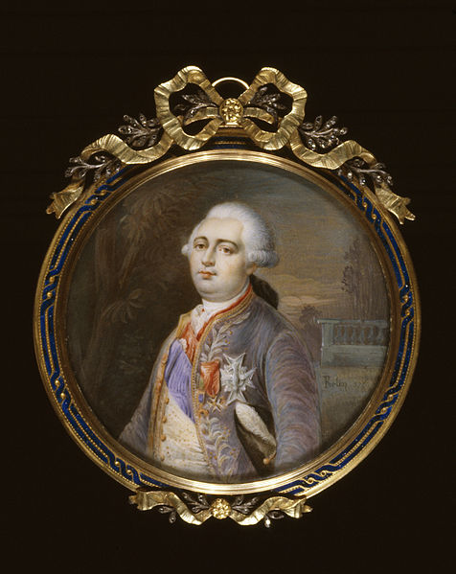
In 1789 King Louis XVI of France convened the Estates General in Versailles to resolve a financial crisis.
The Estates General is an assembly made up of representatives from three main groups, called “estates,” in France:
the clergy (First Estate)
the nobility (Second Estate)
the common people or peasants (Third Estate)
Image in public domain

Slide 6
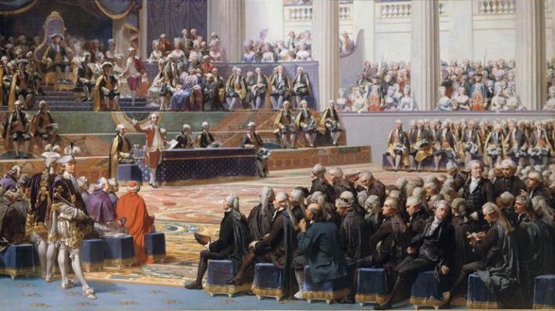
The Estates General of 1789
An archaic rule gave each estate one vote, regardless of the number of representatives in each group.
Because the First and Second Estates (clergy and nobility) enjoyed influence and prestige, they were expected to cast their two votes together to maintain their status.
The Third Estate—the common
people—had minimal power,
even though it had the most
individual representatives
present.
Image in public domain

Slide 7
The Estates General of 1789 (continued)
The common people had already been suffering under an oppressive combination of taxation and famine for several years.
Peasants were obliged to pay various heavy taxes, including tithes to the Church, property taxes, taxes on family size, and fees to use public mills and bakeries.
The clergy and nobility were exempt from taxation.
Consecutive poor harvests during the 1780s created a shortage of food, especially grain, the staple food of the peasant class.
The “bread riots” of the 1780s provided the first hints that the common people of France were angry and ready to unite in revolt.

Slide 8
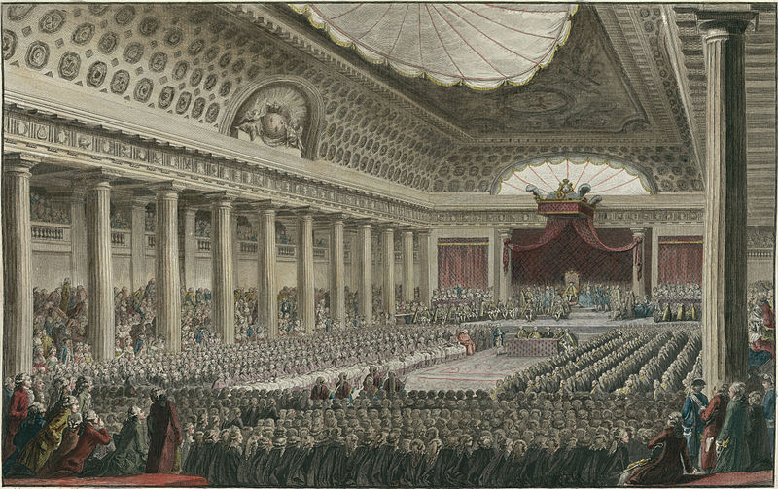
The Estates General of 1789 (continued)
Recognizing the growing power and anger of the people, the First Estate—the clergy—voted to support the cause of the Third Estate. The First Estate voluntarily gave up many economic privileges, including tithing income and tax exemptions.
The Third Estate reconvened as the National Assembly.
The National Assembly called for substantial reforms to the monarchy and to financial policies that favored the nobility and the clergy over the commoners.
Image in public domain

Slide 9
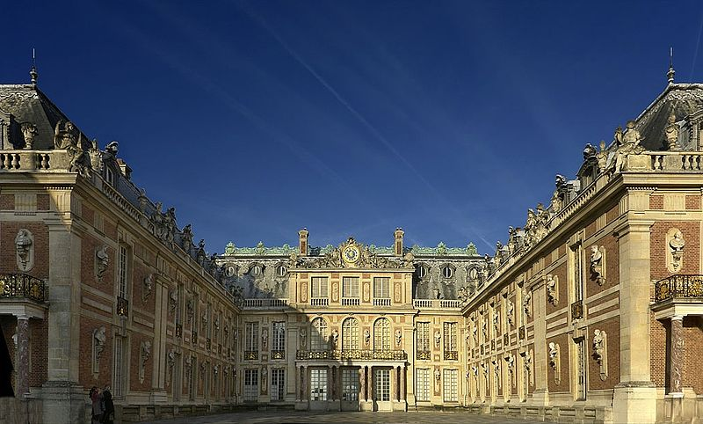
Louis XVI finally proposed some reforms, hoping to appease the Assembly and encourage it to disband, but he was ignored.
Panicking, the King ordered the military to defend his absolute power and control of France. In response, the people revolted.
Image in public domain

Slide 10
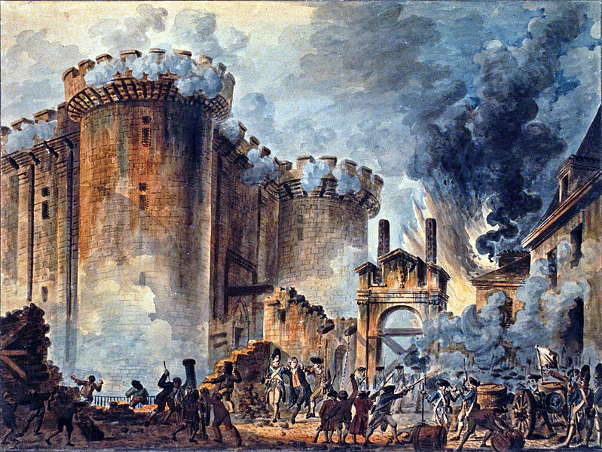
On July 14, 1789, a mob of Parisians stormed the Bastille: a French prison that represented the power of the monarchy. Historians consider this the beginning of the French Revolution.
Nearly one hundred citizens died in the uprising.
Several prison guards were beheaded.
The National Assembly grew more radical.
Image in public domain
Notes:
Image: “The Storming of the Bastille” Visible in the center is the arrest of Bernard René Jourdan, marquis de Launay (1740–1789), Watercolor painting; 37,8 x 50,5 cm

Slide 11
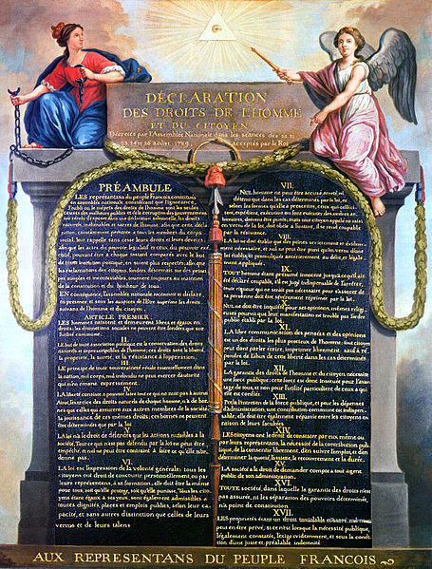
In August 1789 the National Assembly passed the Declaration of the Rights of Man and of the Citizen, which declared the rights of all French citizens to be universal. Among its principles:
All people have natural rights to liberty, life, and property.
The government derives its power from those governed— the citizens of the nation.
The power of the monarchy was curtailed, and all citizens were to have a say in governing the nation.
Image in public domain

Slide 12
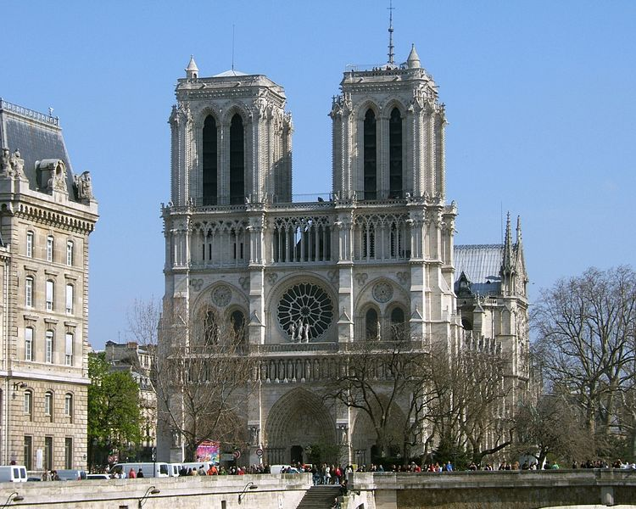
What did the French Revolution mean for the Church in France?
The Church was no longer under the protection of the monarchy.
Even though many individual clergy had joined the Third Estate’s cause, the Church became a target of the revolution.
Image in public domain
Notes:
Image: The Notre Dame de Paris: Western Façade, mid-afternoon, April 2007. Photograph by Tom S., while observing and admiring High Gothic in France.

Slide 13
What did the French Revolution mean for the Church in France? (continued)
Men and women religious were forced out of their monasteries and convents.
Church properties were seized and sold to fund the Revolution.
New laws suppressed religious orders and forbade people from professing religious vows.
Priests who did not pledge their support for the Revolution were exiled or executed.
In short, the French Revolution attempted to wipe out Christianity in France.
Image in public domain
Notes:
Image: Mont St Michel as viewed along the Couesnon River in Brittany, France

Slide 14
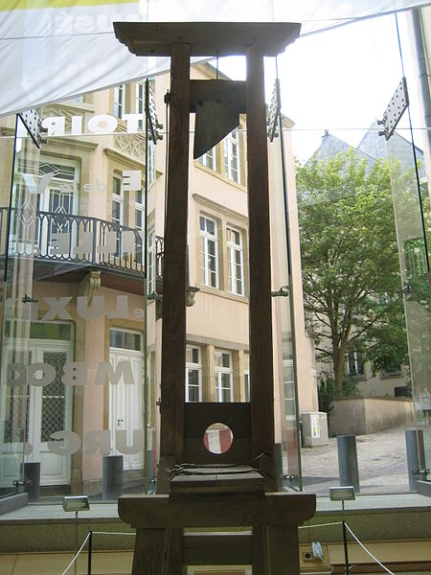
King Louis XVI was beheaded in January 1793. The period known as the Reign of Terror began.
Thousands of nobles, bishops, priests, monks, and nuns were executed.
A new calendar eliminated all Christian holy days and created new celebrations of reason and liberty.
The Revolution declared a new “religion” with a single dogma— immortality of the soul—and a single moral principle—to do your duty.
Image in public domain

