Slide 1
The Prophetic Books
The Living Word: The Revelation of God’s Love, Second Edition
Unit 3, Chapter 10
Document#: TX004688

Slide 2
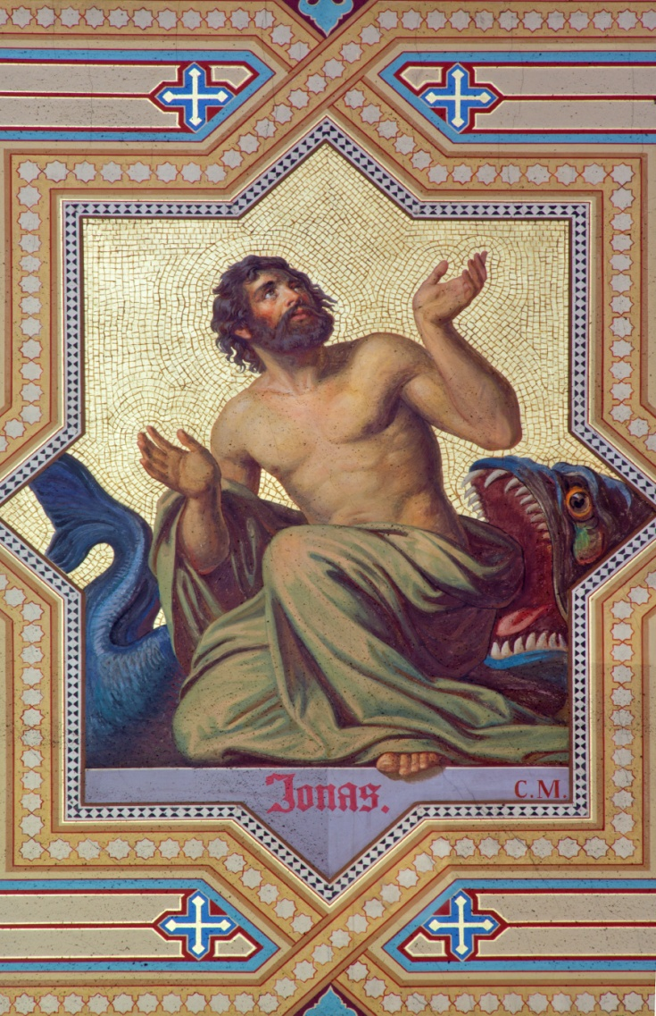
Called to Speak
God called prophets to speak to the people on his behalf.
The prophets reminded them that God would hold them accountable.
The prophets also reminded them of God’s saving love.
© sedmak / iStockphoto.com
Notes:
Notes: Ask the students to brainstorm modern situations in which people need to be reminded of their accountability, of God’s love.
This slide corresponds to content in the chapter 10 introduction in the student book.

Slide 3
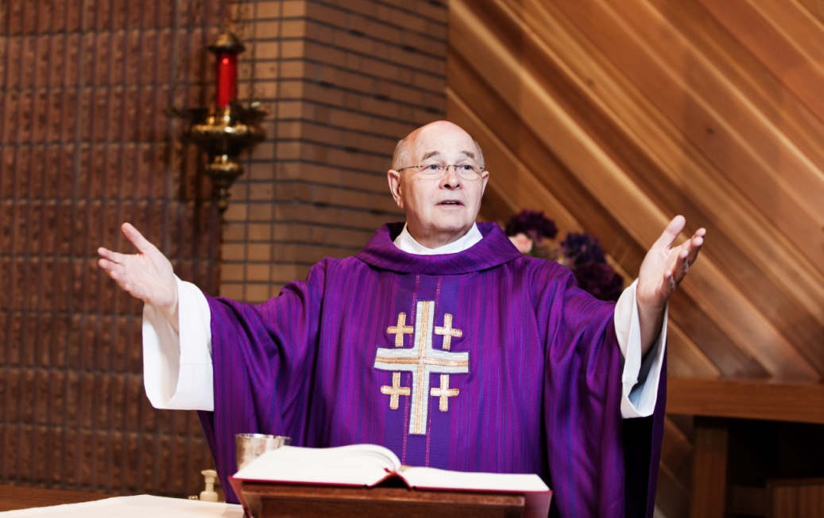
The Prophets: A Radical Redemption
Time and again we see that God’s people lost sight of their covenant relationship with God.
They needed someone to call them back to God.
© Cody Wheeler / Shutterstock.com
Notes:
Notes: Explain to the students that prophets, such as Moses, appear throughout the Old Testament, but the prophetic books focus on the speeches and deeds of specific prophets.
This slide corresponds to content in article 47, “The Prophets: A Radical Redemption,” in the student book.

Slide 4
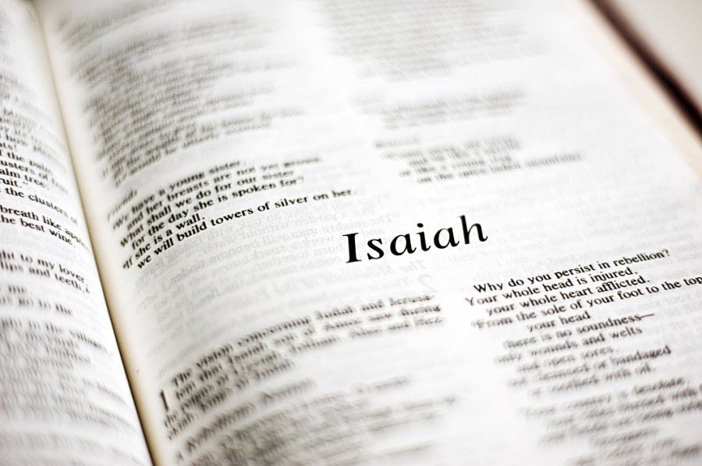
Major and Minor Prophets
Prophets with Old Testament books named for them are called the writing, or canonical, prophets.
These are called major prophets or minor prophets, depending on length of their book.
Prophets are also categorized based on when they lived.
© jodie777 / dollarphotoclub.com
Notes:
Notes: Explain to the students that the Babylonian Exile (defined in article 47 in the student book) is the deciding factor for the last bullet point. Discuss the different messages in relation to the Exile.
This slide corresponds to content in article 47, “The Prophets: A Radical Redemption,” in the student book.

Slide 5
Awake, O Sleeper
Before the Exile, the prophets acted as the conscience of the people.
The prophets challenged people to look at their individual lives.
They also called the entire nation to reflect on the unjust practices of the world.
© blueeyes / Shutterstock.com
Notes:
Notes: Ask the students the questions at the end of article 47 in the student book: What might a prophet say to the world today? How would you respond?
This slide corresponds to content in article 47, “The Prophets: A Radical Redemption,” in the student book.

Slide 6
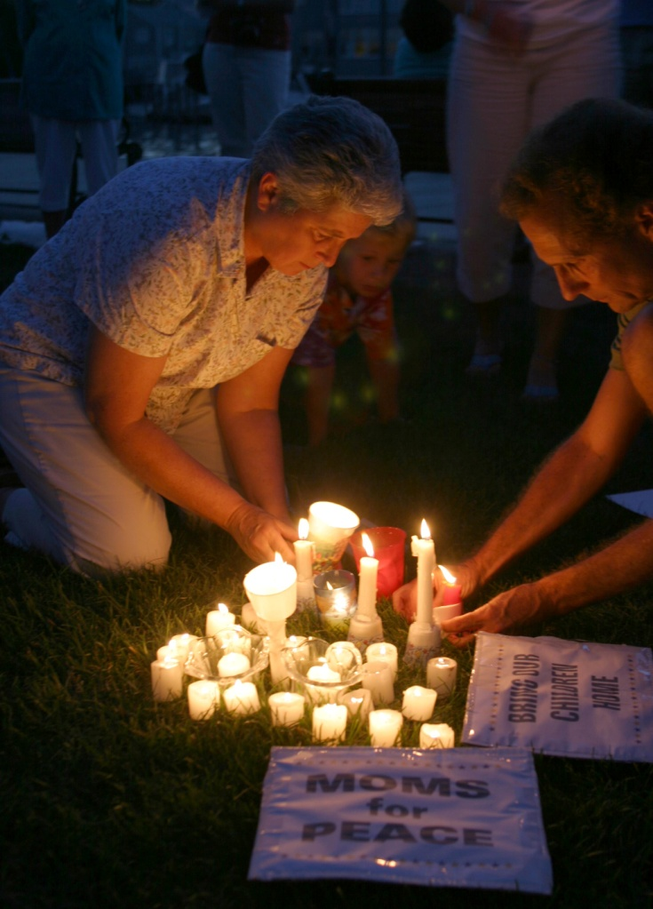
A Universal Call and Message
Every generation needs men and women to challenge it to remain faithful to God.
When we respond to the messages of the prophets, we are no longer enslaved to sin.
We experience the redeeming love of God.
© Larry St. Pierre / Shutterstock.com
Notes:
Notes: Ask the students to name some modern figures who are acting as prophets, challenging us to look at our individual lives and at the unjust practices of the world.
This slide corresponds to content in article 47, “The Prophets: A Radical Redemption,” in the student book.

Slide 7
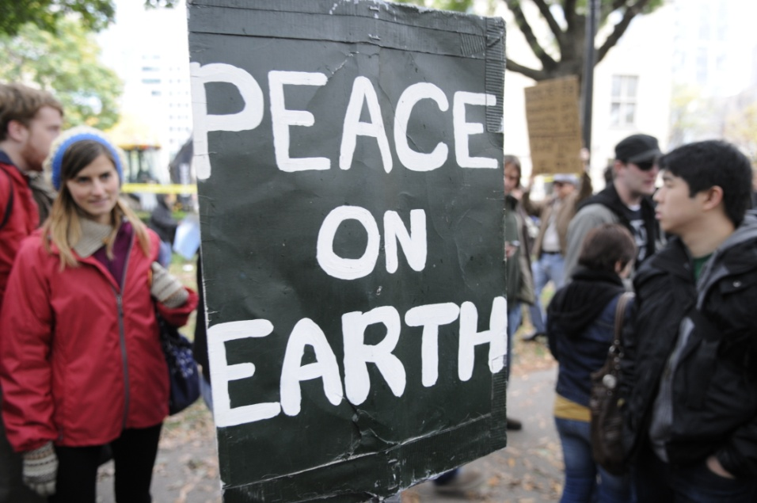
Ezekiel
Ezekiel wrote from Babylon where he was an exile.
He challenged idolatry and injustice toward those who were vulnerable.
He used symbolic actions to enhance his prophetic messages.
© arindambanerjee / Shutterstock.com
Notes:
Notes: Point out to the students that Ezekiel’s prophetic style was similar to that seen in modern street theatre. Discuss why this technique might be effective.
This slide corresponds to content in article 48, “Ezekiel: Challenging Idolatry and Injustice,” in the student book.

Slide 8
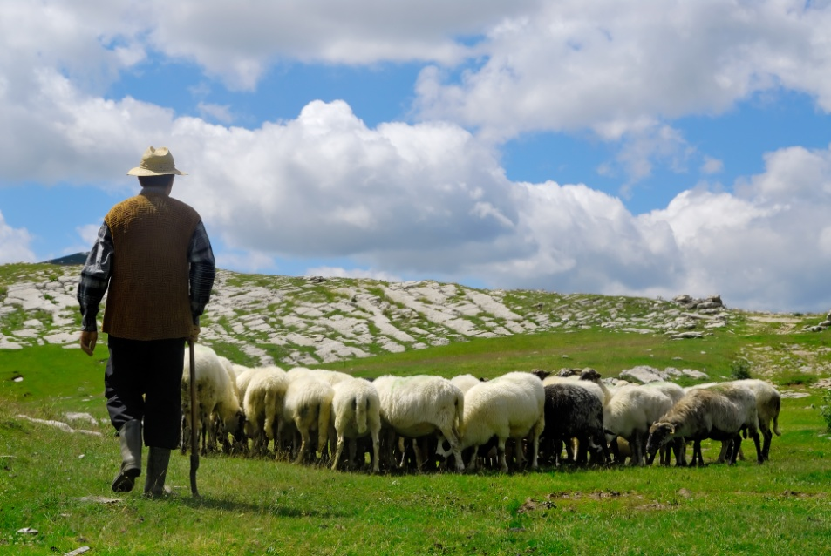
A Call to Those Led Astray
Ezekiel compared the leaders of Israel to shepherds who have not led their sheep on the path of righteousness.
Ezekiel held the leaders responsible for the eventual destruction of the people.
© Dalibor Sevaljevic / Shutterstock.com
Notes:
Notes: Explain to the students that Ezekiel taught that by not caring for the needs of all, and especially of those who were vulnerable, Israel’s leaders disrespected God’s plan of loving goodness. Ask the students to identify the vulnerable in our world, our society, and in your school.
This slide corresponds to content in article 48, “Ezekiel: Challenging Idolatry and Injustice,” in the student book.

Slide 9
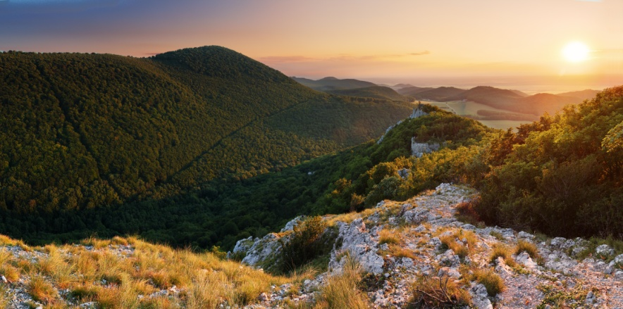
A Vision of Dry Bones
In a vision, God directed Ezekiel to prophesy to the dry bones that filled a valley.
He commanded Ezekiel to herald a time when God would breathe new life into their dead faith.
Nothing would stand in the way of God’s promise of salvation.
© Ttstudio / Shutterstock.com
Notes:
Notes: Discuss with the students how Christ’s work of salvation has fulfilled the prophecy of dry bones coming to life.
This slide corresponds to content in article 48, “Ezekiel: Challenging Idolatry and Injustice,” in the student book.

Slide 10
Jeremiah
Jeremiah’s writings reflect events before and during the Babylonian Exile.
Jeremiah called for the unfaithful Israelites to repent and return to the Lord.
© Anneka / Shutterstock.com
Notes:
Notes: Point out to the students the excerpt from Jeremiah at the beginning of article 49 in the student book. Ask them what this tells us about God’s plan for Jeremiah’s life. Ask whether it says anything about our own lives.
This slide corresponds to content in article 49, “Jeremiah: Success in the Lord,” in the student book.

Slide 11
A Call to Faithfulness
Jeremiah prophesied that if the people did not repent, punishment was inevitable.
Following the destruction of Jerusalem, his prophecies became hopeful.
He promised that God would write his Law on the people’s hearts.
© Africa Studio / Shutterstock.com
Notes:
Notes: Explore with the students what Jeremiah may have meant when he said God’s Law would be written on people’s hearts. Ask how this internalization of the Law relates to Jeremiah’s theme of faithfulness.
This slide corresponds to content in article 49, “Jeremiah: Success in the Lord,” in the student book.

Slide 12
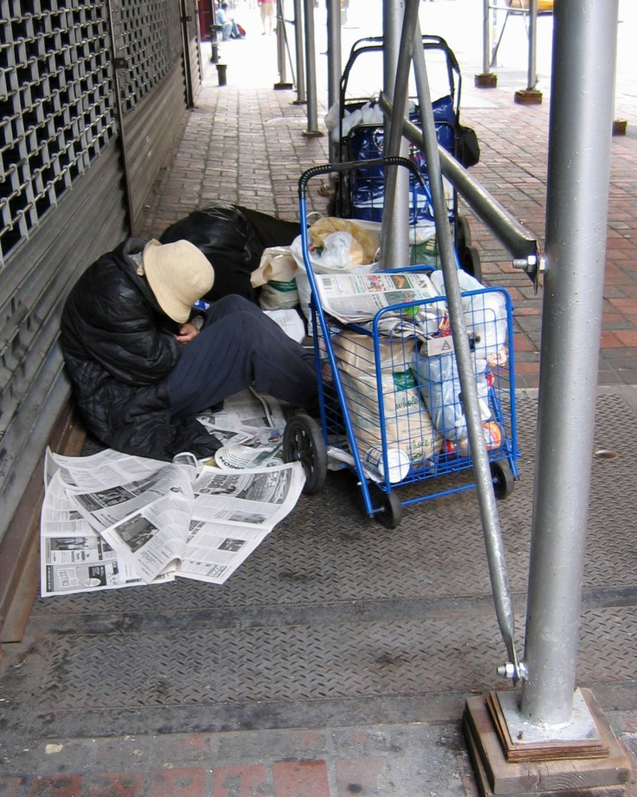
Isaiah
First Isaiah challenged the Israelites to eliminate the unjust treatment of the poor.
Second Isaiah offered words of hope and encouragement during the Exile.
After the Exile, Third Isaiah cried out against the return to unjust and idolatrous practices.
© George P. Choma / Shutterstock.com
Notes:
Notes: Point out to the students that the Book of Isaiah was begun before the Exile by an original Isaiah and completed by two later followers. Ask the students these questions: How do you think the prophets felt when the people continued to ignore their cries for repentance? Why do you think they did not just give up?
This slide corresponds to content in article 50, “Isaiah: Herald of the Messiah,” in the student book.

Slide 13
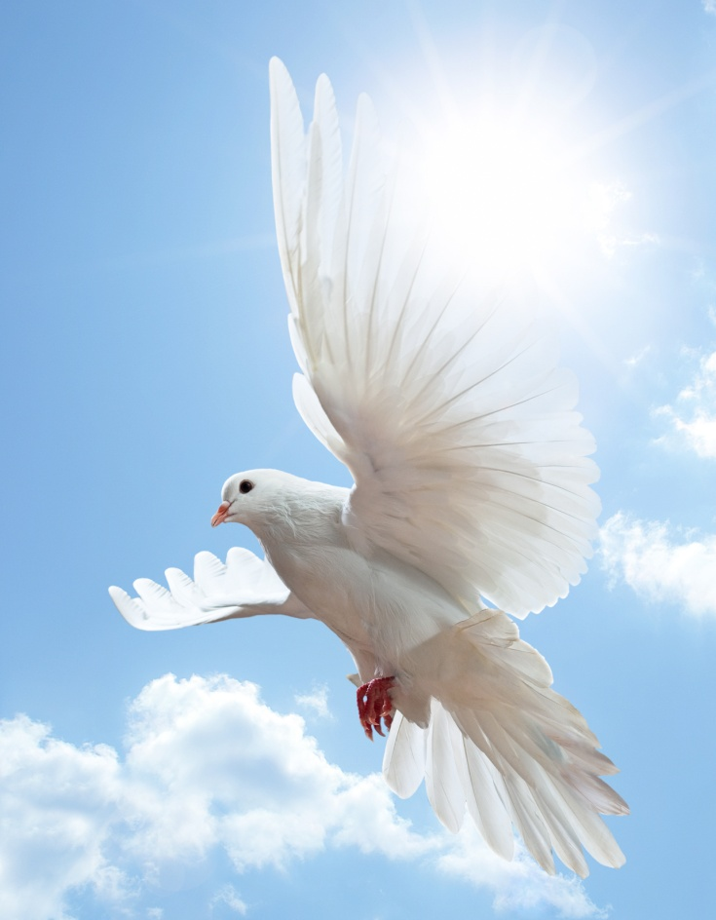
Emmanuel, God with Us
The Book of Isaiah sings of messianic hope.
The promised Messiah would be wisdom incarnate, a defender of his people, a faithful parent, and an agent of peace.
He would inaugurate a peaceful kingdom.
© Tischenko Irina / Shutterstock.com
Notes:
Notes: Ask the students if they have seen Christmas images of a lion and a lamb. Read the description of the peaceable kingdom in Isaiah 11:6–9. Ask the students to name some modern elements of a peaceable kingdom.
This slide corresponds to content in article 50, “Isaiah: Herald of the Messiah,” in the student book.

Slide 14
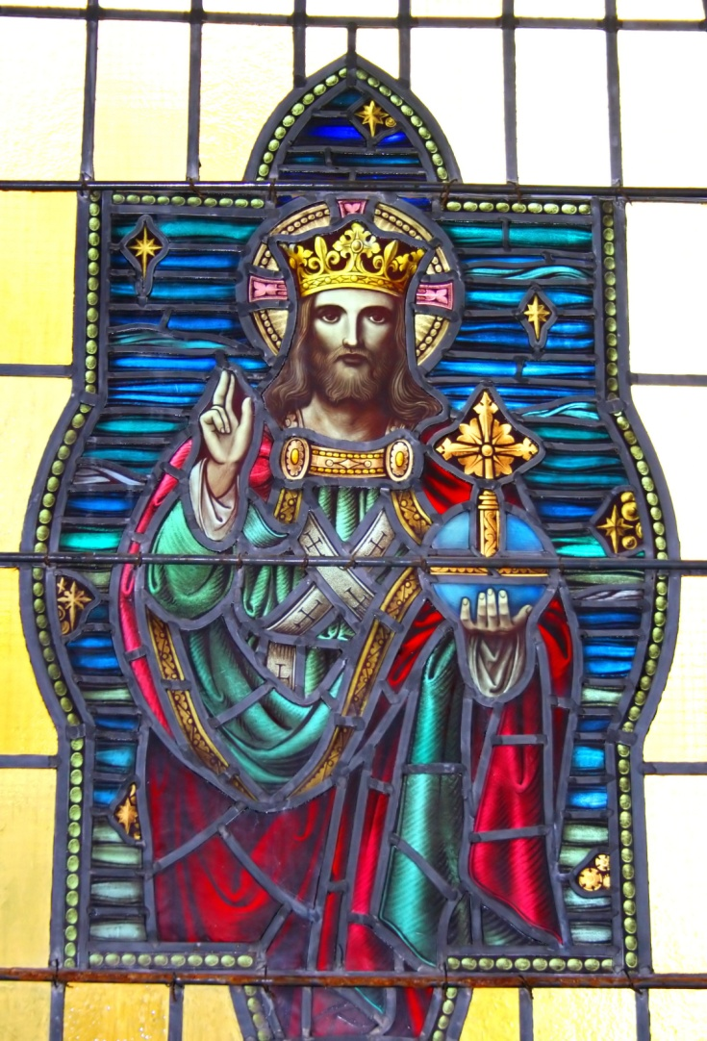
Messiah and King
Isaiah announced that a new king would come from the throne of David.
He would judge with righteousness.
He would inaugurate a peaceful kingdom.
All creation would bow before Emmanuel.
© V. J. Matthew / Shutterstock.com
Notes:
Notes: Explain to the students how the prophecy of Isaiah embodied the hopes of a people longing for a savior who would set them free.
This slide corresponds to content in article 50, “Isaiah: Herald of the Messiah,” in the student book.

