Slide 1
The Cycle of Redemption
The Bible Course
Document # TX001077

Slide 2
Redemption and Repentance
Throughout salvation history, the Judeo-Christian people have been caught in the cycle of redemption.
The word redemption comes from the Latin redemptio—meaning “a buying back.”
In the Old Testament, repentance refers to Yahweh’s deliverance of Israel.
Repentance is vital in the cycle of redemption.
Repentance is from the Latin poenitire—meaning “to make sorry.”
Notes:
Notes: Redemption is one of the most powerful ways God’s loving grace is shown in salvation history. Repentance is the vital act of recognizing when and how we’ve turned from God’s will and of seeking to return to God’s embrace.

Slide 3
The Cycle of Redemption
God creates or enters into a covenant, and it is good.
Humanity falls into idolatry, resulting in disease, war, and grief.
God sends teachers, kings, prophets, and others who lead the people to repentance.
The people return to following the Covenant.
Peace and God’s healing return to the people.
Notes:
Notes: This cycle is one that is repeated throughout the Old Testament. It is seen numerous times as the people turn from God, meet the natural consequences of this selfish action, hear and respond to the prophets and others who call them back, and then experience God’s blessing. It continues today in individual lives as well as in the Church. The key is that God is working through every part of this cycle and is constantly desiring closeness with his creation.

Slide 4
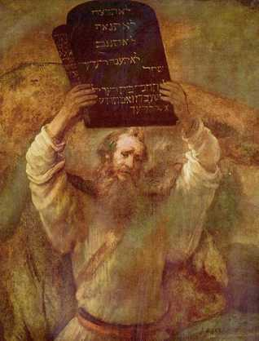
Israelites’ Covenantal Responsibilities
Because of the Ten Commandments, the Israelites are responsible for maintaining the following:
Obedience: An obedient person hears God’s Word and follows it. To be obedient is simply to align oneself with God’s will.
Respect for Divine Justice: Divine justice calls for the fair and equitable distribution of life’s necessities.
Openness to Divine Revelation: Revelation is the act or process by which God reveals himself and the divine plan to humanity.
Image in public domain
Notes:
Notes: When the Israelites enter into the Covenant with God, they become responsible for fostering these five conditions in their community. These are the same conditions for the community today, which is the Church. This slide and the next can be a good opportunity for reviewing the story of the Israelites in Genesis and Exodus to evaluate how they have or have not fostered these conditions. Divine justice is commonly thought of as God’s retribution against injustice in the world. This concept is much broader as it relates to the scriptural idea that justice is based on the truth that all humans have dignity and worth and are children of God. Thus resources should be shared so that all have enough to thrive. God called for this in the Israelite community and continues to call for it in the community of the Church.

Slide 5
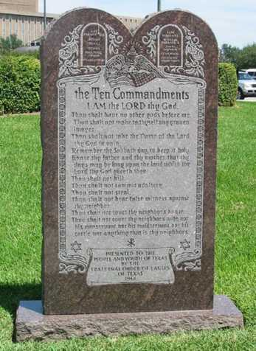
Israelites’ Covenantal Responsibilities
Because of the Ten Commandments, the Israelites are responsible for maintaining the following:
Commitment to Ethical Responsibility: The commandments of God are the fundamental rules of conduct for the Chosen People.
Commitment to the Covenant and Commandments: The covenants between God and Israel are central to the Old Testament, where God promises to be faithful to the Chosen People, who in turn are expected to observe God’s commandments.
Image in public domain

