Slide 1
Baptism
The Catholic Faith Handbook for Youth, Third Edition
Chapter 18
Document #: TX003149
Notes:
Use this presentation to review the effects of Baptism and how we can use our gifts as members of the Church to support and enhance those effects. The slides invite discussion and journaling.

Slide 2
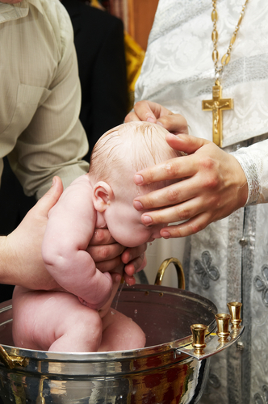
A History of Baptism
Scriptural references to water and God’s saving power
Jesus is baptized and calls his disciples to baptize.
Catechumenate
Infant Baptism
Copyright: Dmitry Kalinovsky / www.shutterstock.com
Notes:
Summarize the points on pages 194–196 of the student handbook to introduce the students to the history of Baptism, or have them read these pages and, using the points above, summarize key information.

Slide 3
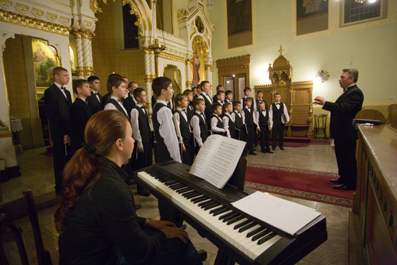
Welcome into a Community
What are some things that parishes could do to help others feel welcome?
What is one thing you could do to make your parish more welcoming to others?
Copyright: Ferenc Szelepcsenyi / www.Shutterstock.com
Notes:
Show the title of this slide and point out that the Sacrament of Baptism welcomes us into a community, but that our own actions as baptized members of the Church can enhance and support that welcome. Show the first question for class discussion. Show the second question, and direct the students to journal their answer.

Slide 4
Forgiveness of Sins
What qualities would you expect to see in those who know they have been forgiven?
What is one thing you could do in response to God’s forgiveness?
Copyright: samotrebizan / www.shutterstock.com
Notes:
Point out that through the grace of Baptism, all our sins are forgiven, and we are given the grace to fight future temptation. After discussing the first question, move on to the second question, and direct the students to journal their answer.

Slide 5
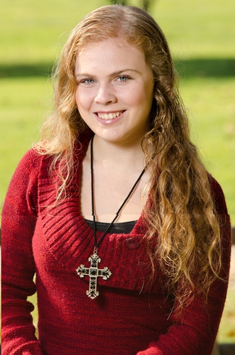
Born into a New Life
What are some ways Christians can remind themselves that they now belong to Christ?
What one thing could you do to remind yourself that you belong to Christ?
Copyright: John Roman Images / www.shutterstock.com
Notes:
Tell the students that through Baptism we die and rise with Christ. We leave a way of life that is headed for death and separation from God and begin a way of life that is destined for eternal life with him. After discussing the first question, move on to the second question, and direct the students to journal their answer.

Slide 6
Receive the Holy Spirit
What are some qualities you would expect to see in someone who has received the Holy Spirit?
What one quality could you ask the Holy Spirit to develop in you?
Copyright: Jaren Jai Wicklund / www.shutterstock.com
Notes:
Tell the students that it is in Baptism, not Confirmation, that we first receive the Holy Spirit into our lives. Discuss the first question; then move on to the second question, and direct the students to journal their answer.

Slide 7
Baptism Is Necessary for Salvation
Salvation: the restoration of our relationship with God as he intended it to be
Our relationship with God was damaged by Original Sin.
Baptism unites us with God and makes us one family again in the Church.
Copyright: Dmitry Kalinovsky / www.shutterstock.com
Notes:
Read aloud or review the paragraph on pages 200–201 of the student handbook, answering the question about whether a person who has not been baptized can still be saved. Be sensitive to the fact that you may have unbaptized students in your class, or the students may have unbaptized loved ones.

Slide 8
Baptism in Your Parish
What is your favorite part of the baptismal ritual?
How do the symbols and words help you to understand the meaning of Baptism?
Copyright: Rachwalski Andrzej / www.shutterstock.com
Notes:
For the first question, you may wish to review the Baptism Rite with the students. You will find a description of it on pages 201–202 of the student handbook. Invite the students to journal their answers, and then ask them to share some of their ideas. Ask them to look over their answers to the previous questions, and ask what they have learned.

